Slide 1
CSE523 Machine Learning Code Crafters
Athlete profiling based on similar characteristics
Aagam Shah AU2140024
Dhairya Shah AU2140133
Aayushi Shah AU2140159
Aanal Dobariya AU2140182
Btech. CSE, School of Engineering and Applied Sciences
Btech. CSE, School of Engineering and Applied Sciences
Btech. CSE, School of Engineering and Applied Sciences
Btech. CSE, School of Engineering and Applied Sciences

Slide 2
Content
Problem Statement
Literature Survey
Methodology
Results
References

Slide 3
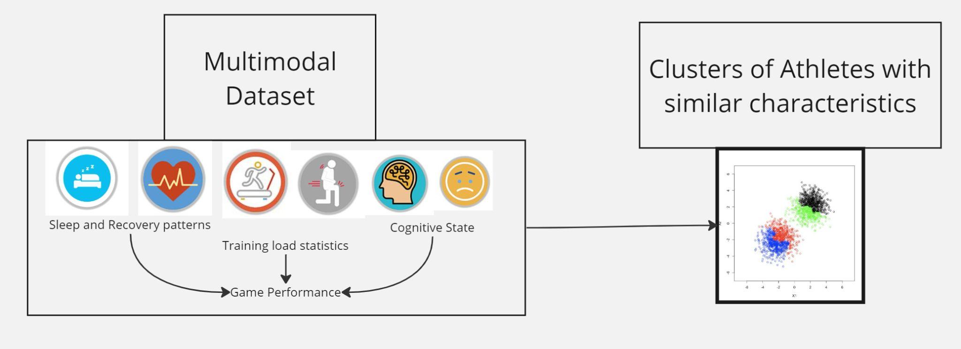
Problem Statement
Athlete Profiling for Division I Basketball Players
Fig. 1 [4]
[4] Sharma, S. U., Divakaran, S., Kaya, T., & Raval, M. (2022, July). A Hybrid Approach for Interpretable Game Performance Prediction in Basketball. In 2022 International Joint Conference on Neural Networks (IJCNN) (pp. 01-08). IEEE.

Slide 4
Literature Survey
Study Title | Authors | Year | Methodology | Main Findings
Impact of Sleep and Training on Game Performance and Injury in Division-1 Women’s Basketball Amidst the Pandemic [1] | S Senbel et al. | 2022 | To collect various physiological and psychological data of Division-1 women's basketball players and using machine learning algorithms to predict injury risk amidst the pandemic season. | Created a platform for predicting game performance and injury risk assessment.
A holistic approach to performance prediction in collegiate athletics: player, team, and conference perspectives [2] | T Kaya et al. | 2024 | Aanalyze data from Division-1 Women's basketball players, predicting performance at player, team, and conference levels based on various metrics and features. | Identification of critical metrics (e.g., RSImod, jump height) to employ predictive models for player efficiency ratings and game scores.
A Framework for Biomechanical Analysis of Jump Landings for Injury Risk Assessment [3] | S Sharma et al. | 2023 | Evaluation and analysis of a framework based on Computer vision techniques. | An extremely robust framework to give the injury-risk score with accurate predictions.
A Hybrid Approach for Interpretable Game Performance Prediction in Basketball [4] | SU Sharma et al. | 2022 | Combines decision tree models with factor analysis to predict game scores. | Hybrid approach has better MSE and R2 values than classical multilinear regression based approaches.

Slide 5
Methodology
Data Processing
Feature Engineering
Clustering
Interpretation

Slide 6
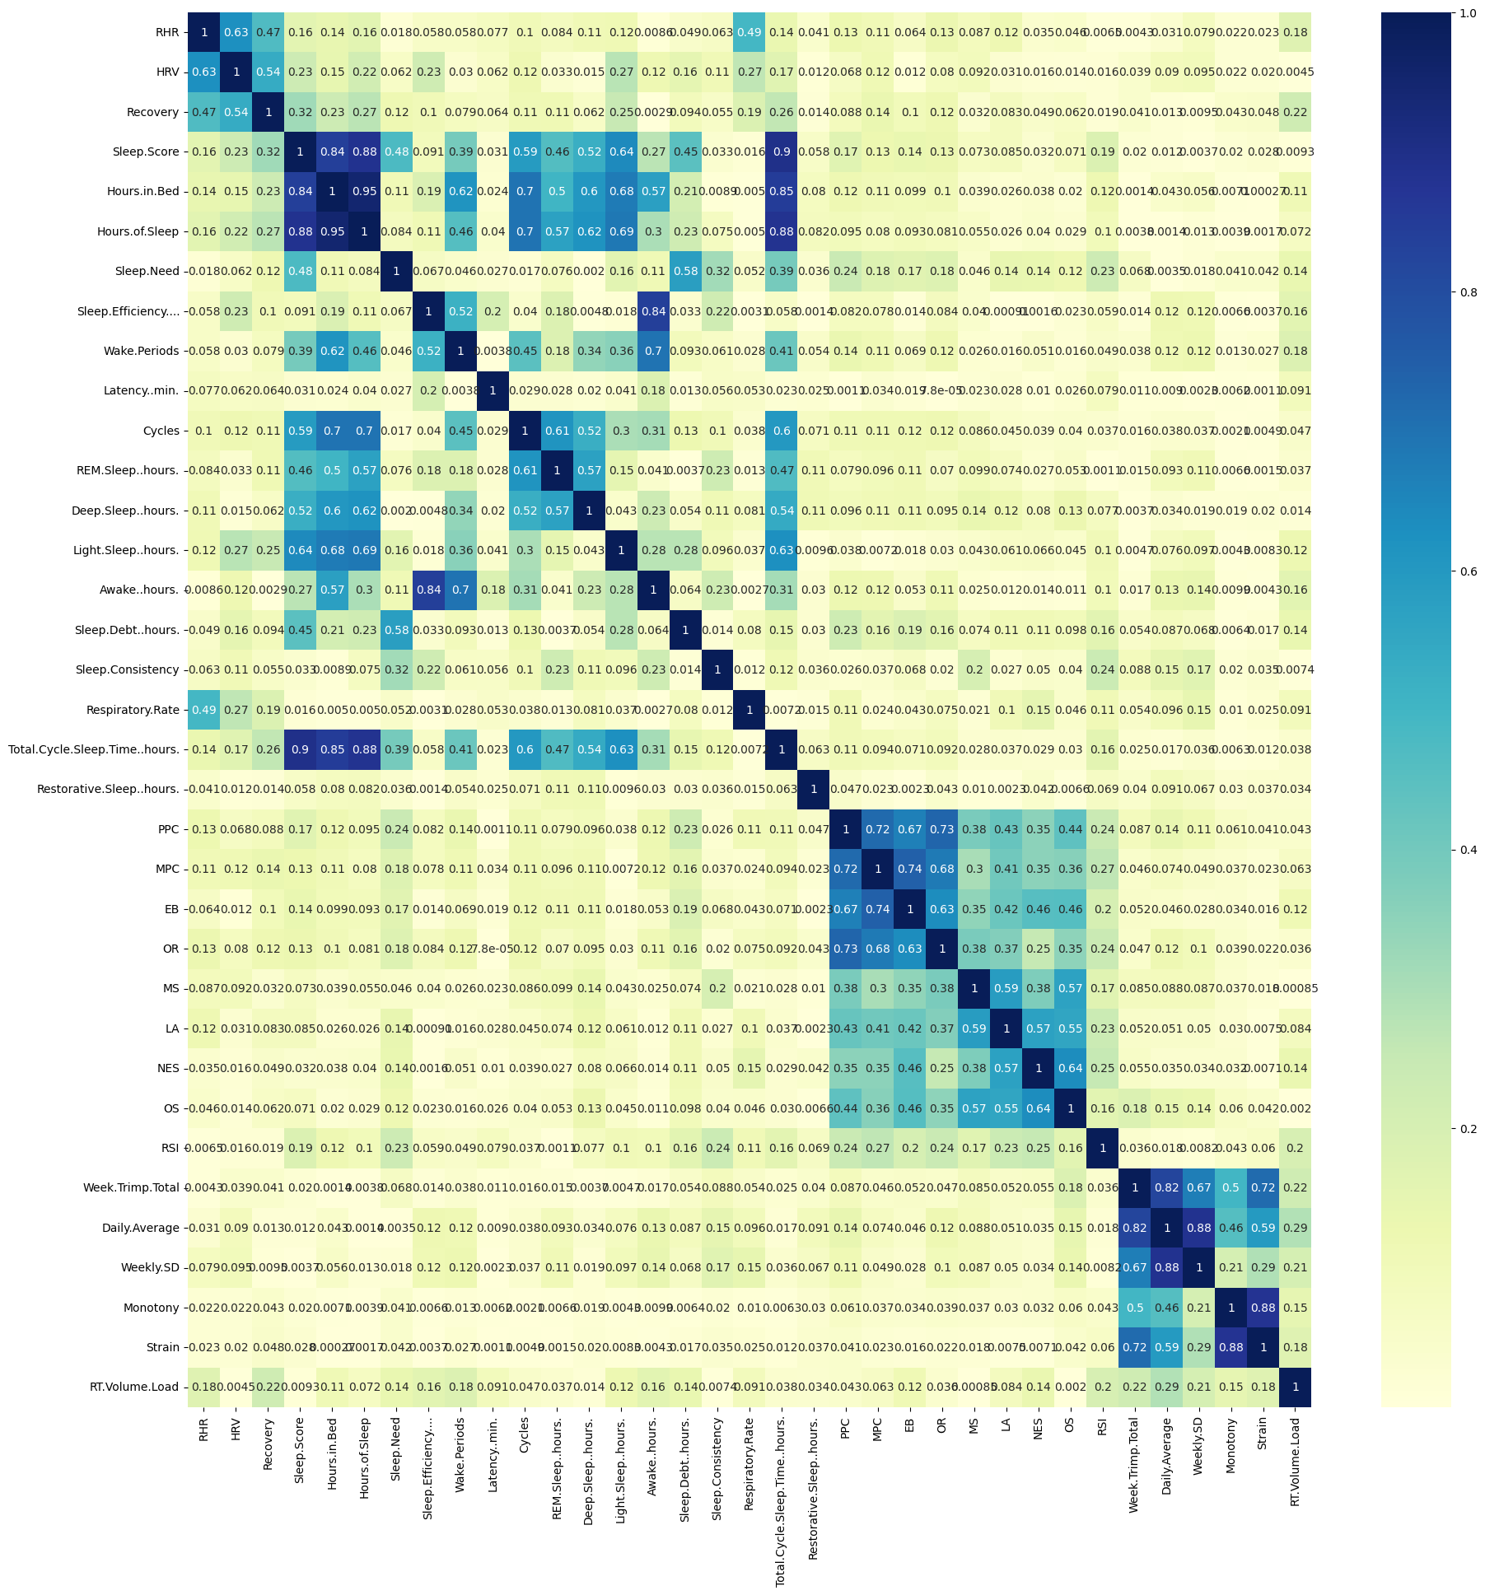
Correlation Heat Map

Slide 7
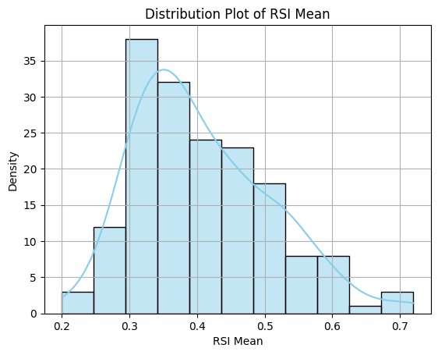
Exploratory Data Analysis
The X-axis represents the intervals of RSI Mean and the Y-axis represents the number of data points (players) which fall within each bin.
The graph follows a normal distribution.
The higher the RSI the better the performance of the player

Slide 8
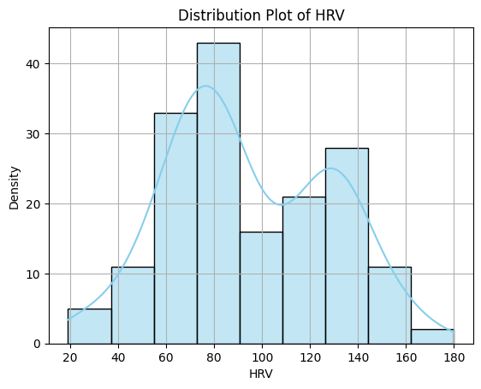
Exploratory Data Analysis
The X-axis represents the intervals of HRV and the Y-axis represents the number of data points (players) which fall within each bin.
Since there are two peaks on the histogram it suggests that HRV follows a bimodal distribution in the data.

Slide 9
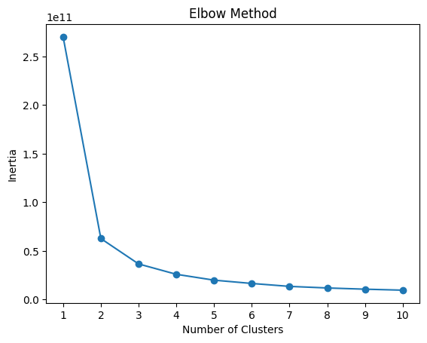
Elbow Method
Inertia: Metric that measure the compactness of the clusters. It quantifies the variance within clusters.
Objective of KMeans clustering is to minimize interia.
Elbow method is a heuristic approach that visually inspects the resulting curve for an "elbow point."

Slide 10
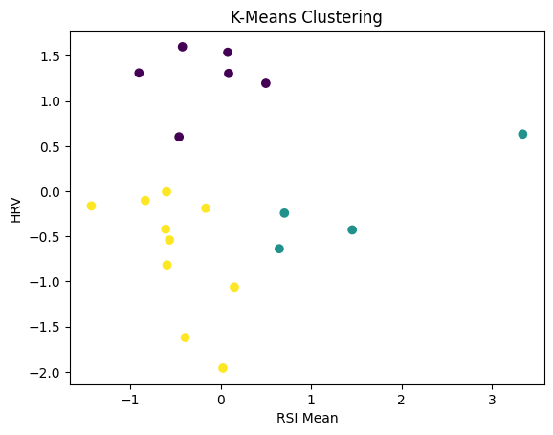
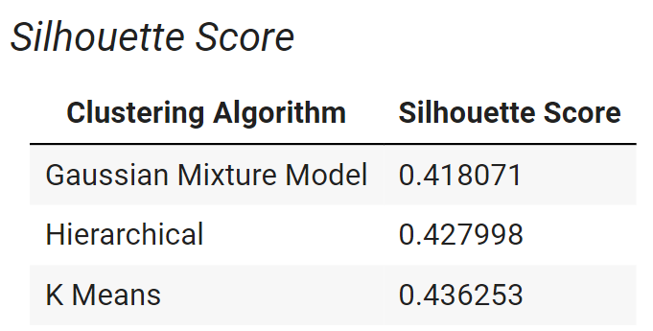
K- Means Clustering
Notes:
Comes from different gaussian distribution, Agglomerative (Bottom up) and Divisive (Top down)

Slide 11
Future Approach
We will try to include more features using feature importance in order to check whether we get better clusters.
We will use explainable AI methods in order to understand why the athletes were clustered in a certain way and to find out which features are given more importance and then subsequently display the results on the dashboard.

Slide 12
References
Senbel, S., Sharma, S., Raval, M. S., Taber, C., Nolan, J., Artan, N. S., ... & Kaya, T. (2022). Impact of sleep and training on game performance and injury in division-1 women’s Basketball Amidst the Pandemic. Ieee Access, 10, 15516-15527. https://ieeexplore.ieee.org/abstract/document/9690164/
Taber, C.B., Sharma, S., Raval, M.S. et al. A holistic approach to performance prediction in collegiate athletics: player, team, and conference perspectives. Sci Rep 14, 1162 (2024). https://doi.org/10.1038/s41598-024-51658-8
Sharma, S., Divakaran, S., Kaya, T., Taber, C., & Raval, M. S. (2023, October). A Framework for Biomechanical Analysis of Jump Landings for Injury Risk Assessment. In 2023 IEEE 28th Pacific Rim International Symposium on Dependable Computing (PRDC) (pp. 327-331). IEEE. https://ieeexplore.ieee.org/abstract/document/10356423/?casa_token=yM-1J2vMKG8AAAAA:QnMMyph1mKa6BfvljAqSSABrReChb5hvsEvxFUEv3z5Fiiv1daHpTdbG2oXllJYQ-WQPUijJ6wZr
Sharma, S. U., Divakaran, S., Kaya, T., & Raval, M. (2022, July). A Hybrid Approach for Interpretable Game Performance Prediction in Basketball. In 2022 International Joint Conference on Neural Networks (IJCNN) (pp. 01-08). IEEE. https://ieeexplore.ieee.org/abstract/document/9892583/?casa_token=Ye3GQJ1JpD0AAAAA:GSlyds24pIa__7Od6UBSNs8nugbEwLvCbI8vG6w-YMYrFX2O-TUlUDo4xej3ulJUAvmO_4ij0J36

