Slide 1
Semister project
Dhairya dosi 16BAS1104

Slide 2
About The Project
My project is to find out deflection angle in shockwave at speeds above mach 1,to do so i`ve taken help of few guys from computer science dept. To be honest, and came up with one HTML UI one javascript code and one python programme for this.

Slide 3
The Principal

Slide 4
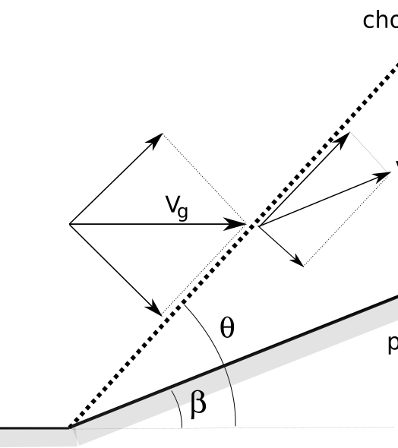

Theta-beta-mach relation

Slide 5
Using this formula you`re gonna get 4results how you `re gonna figure out which is correct ?.

Slide 6
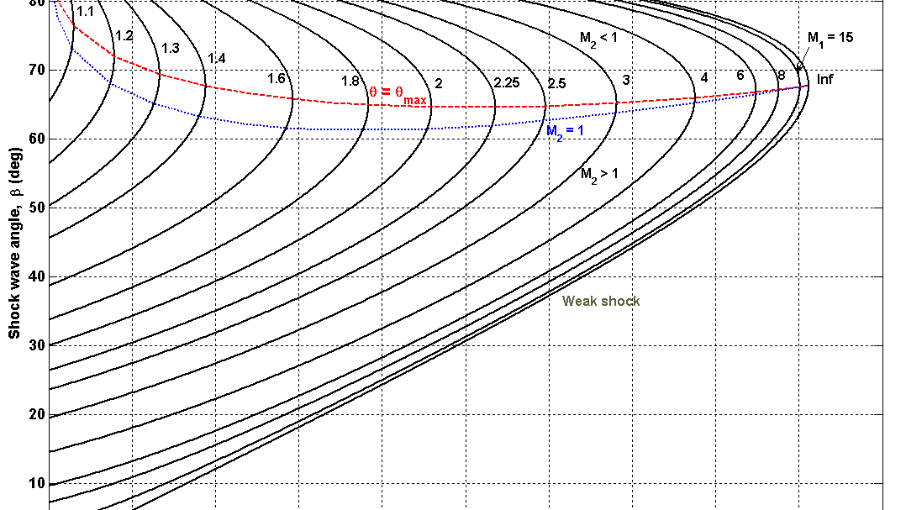
We `re gonna ignore -ve results becsuae 1/m = sin theta
And we re doing this analysis in first quadrent
Strong // weak shock solutions

Slide 7
The code

Slide 8

Programmes/files
HTML CODE
HTML FILE
JAVASCRIPT FILE
JAVA CODE
PYTHON CODE
PY Charm
.exe FILE
.EXE file

Slide 9
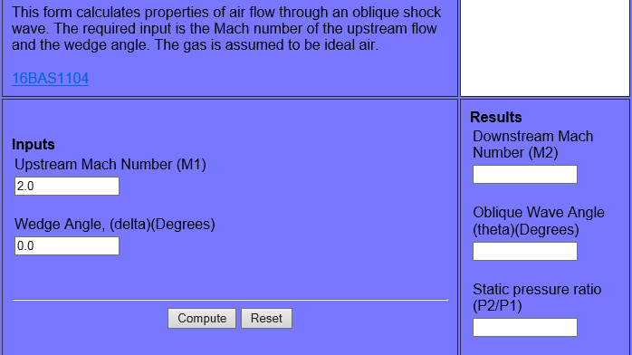
Check out HTML for frontend and python code for backend part
Screenshot of the actual UI on python

