Slide 1


Slide 2

Mini Project (01CE0609)
Weather Forecast App
Team ID: 6CE_135
Team Member 1: Kashyap Vekariya(92200103103) (6TC1)
Team Member 2: Dhairya Aundhia (92200103268) (6TC1)
Team Member 3: Yash Dhedhi (92200103292) (6TC1)
Guided By
Internal Guide Name: Prof. Parth Shah
Date: 12-04-2025
Department of Computer Engineering, Faculty of Technology

Slide 3
Outline
Introduction
Abstract
System Analysis
ER Diagrams
Flow Chart
Use case diagram
Tools & Technology to be used
Gantt Chart
UI screens
Expected Outcomes
References

Slide 4
Introduction
Introducing the Weather Forecast App, a comprehensive weather forecasting website designed to provide users with precise and up-to-date weather conditions based on their location and time.
The site delivers accurate weather information, including local time, date, temperature, and weather conditions.
It also provides details like wind speed, humidity, wind degree, and feels-like temperature.
Additionally, the site offers hourly weather forecasts and details about sunrise and sunset times, ensuring that users have all the necessary information to plan their day effectively.

Slide 5
Abstract
A weather forecast app or website helps users check the weather based on their location and time. This project aims to create a user-friendly platform with various useful features. Key functions include real-time weather updates, wind speed, and temperature readings. Users can search for weather by precise local information. The app also provides forecasts for the next 5-7 days, helping users plan ahead. The design will be simple and attractive, using weather icons and charts to show information clearly. By using modern web technologies and APIs, this project will offer accurate and reliable weather details, keeping users informed and ready for any weather conditions. Also user can save locations to directly access the saved locations weather.

Slide 6

System Analysis
Accuweather
Features:
Real-time weather information
Wind speed, and air quality
Hourly forecasts
Radar map
Limitation:
Offers extensive data
Multiple ads
https://www.accuweather.com/

Slide 7

System Analysis
Weather
Features:
Day and night temperature predictions
Wind speed and humidity levels
UV index
Limitation:
Overwhelming for users looking for quick
https://weather.com/

Slide 8

System Analysis
Weather-forecast
Features:
Users can view detailed weather maps
Wind and pressure
Live weather observations
Limitation:
Bad user interface
https://www.weather-forecast.com/

Slide 9
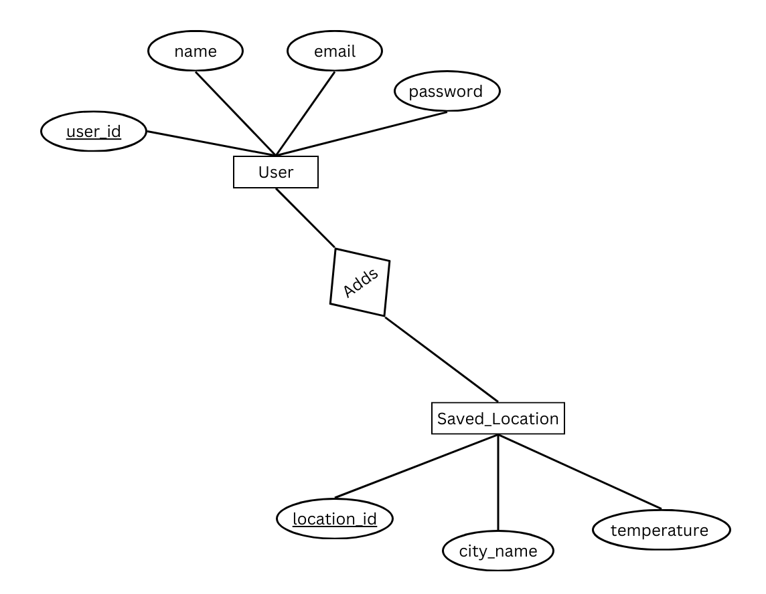
ER Diagrams

Slide 10
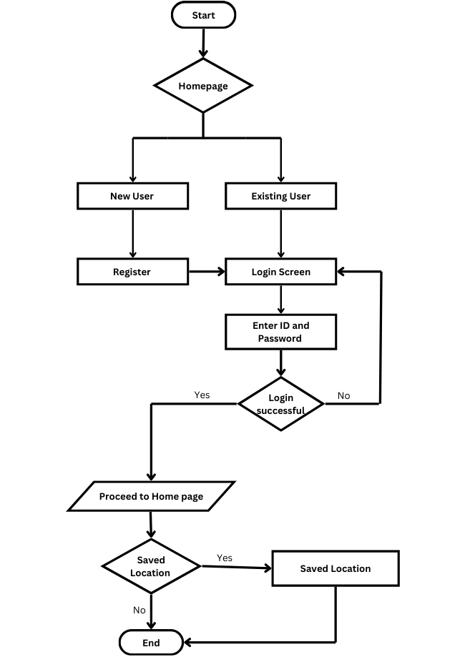
Flow Chart

Slide 11
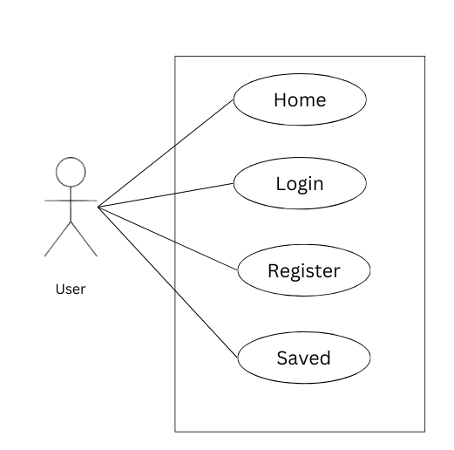
Use case diagram

Slide 12
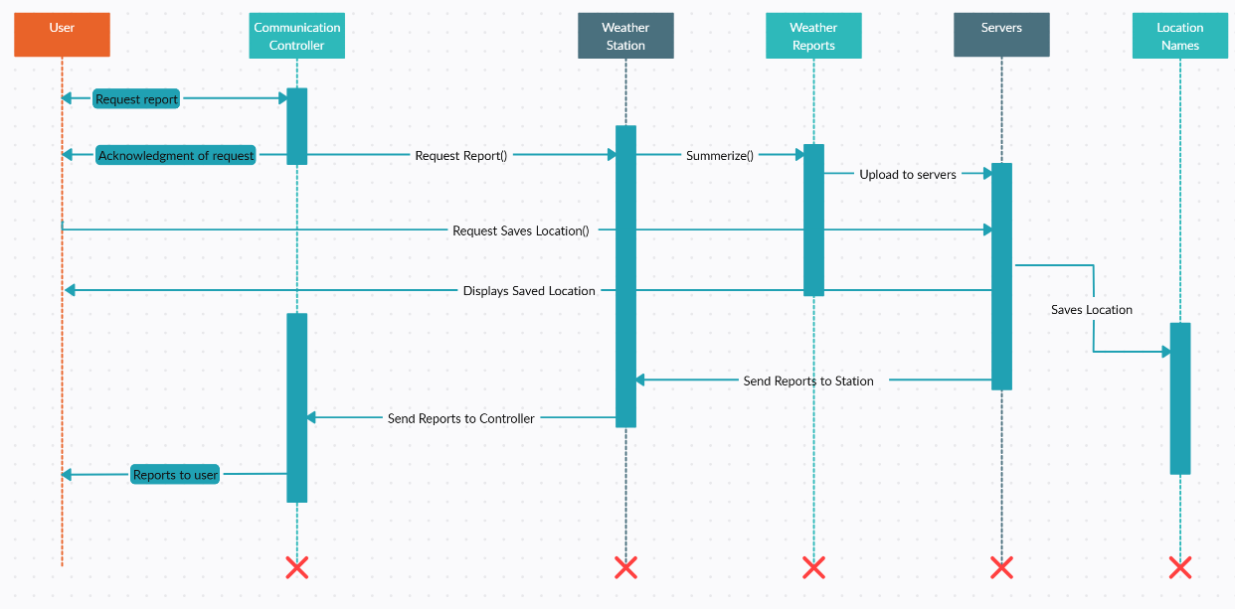
Sequence diagram

Slide 13
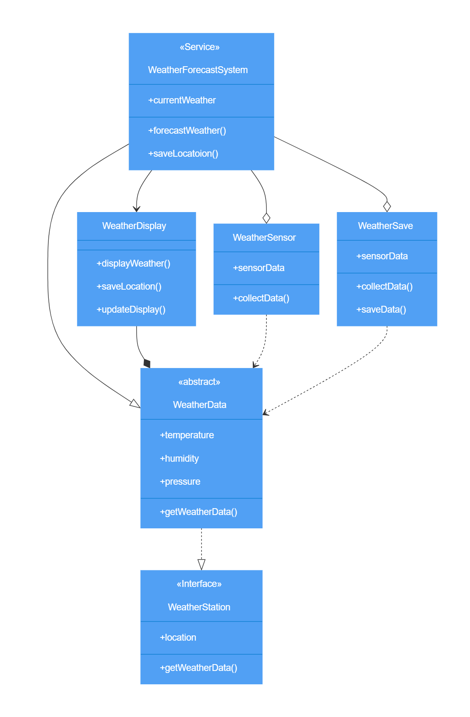
Class diagram

Slide 14




Tools & Technology to be used
Tool
Visual Studio Code
Technology
Frontend : React
Backend : Node.js , Express.js
Database
MongoDB

Slide 15
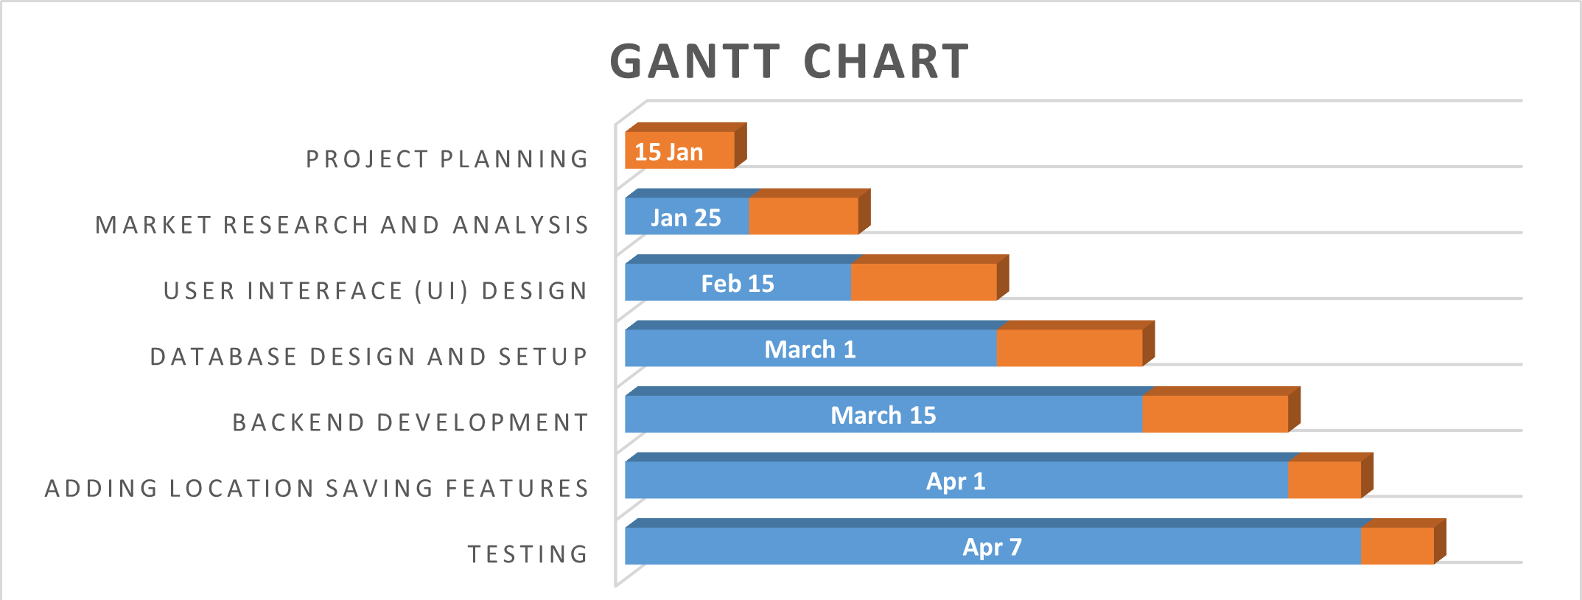
Gantt Chart

Slide 16
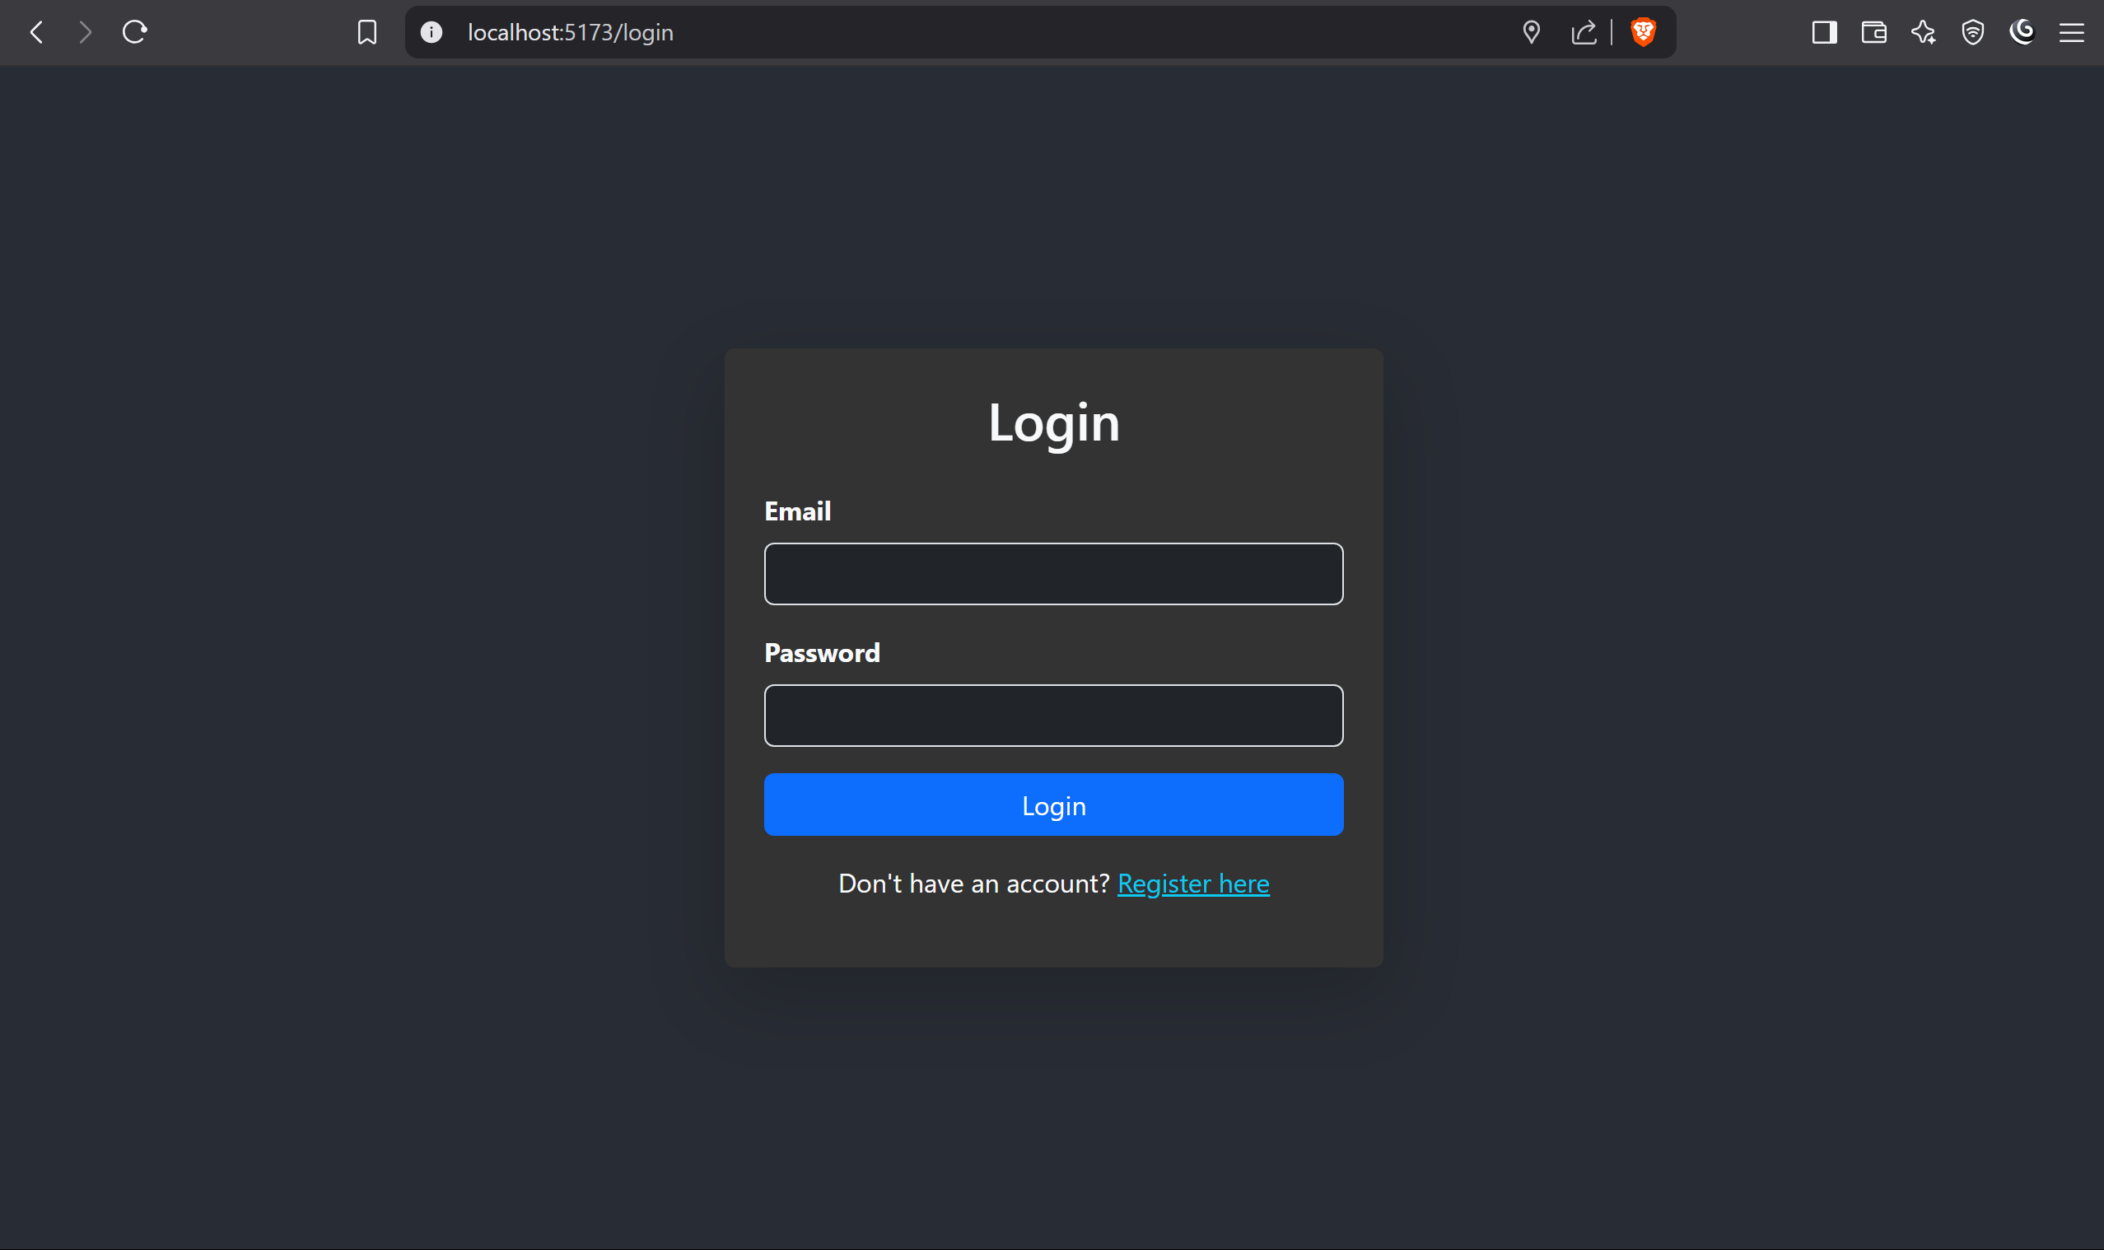
UI Screen

Slide 17
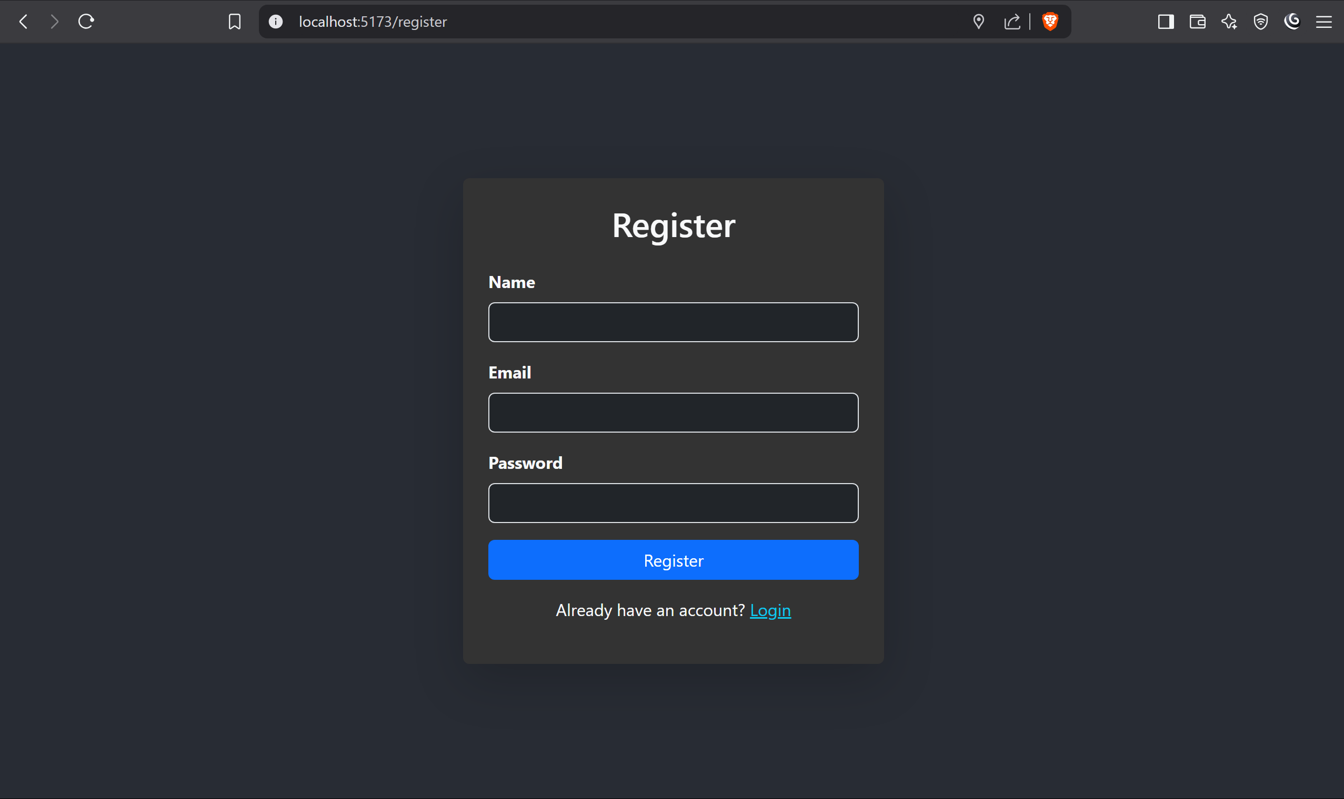
UI Screen

Slide 18
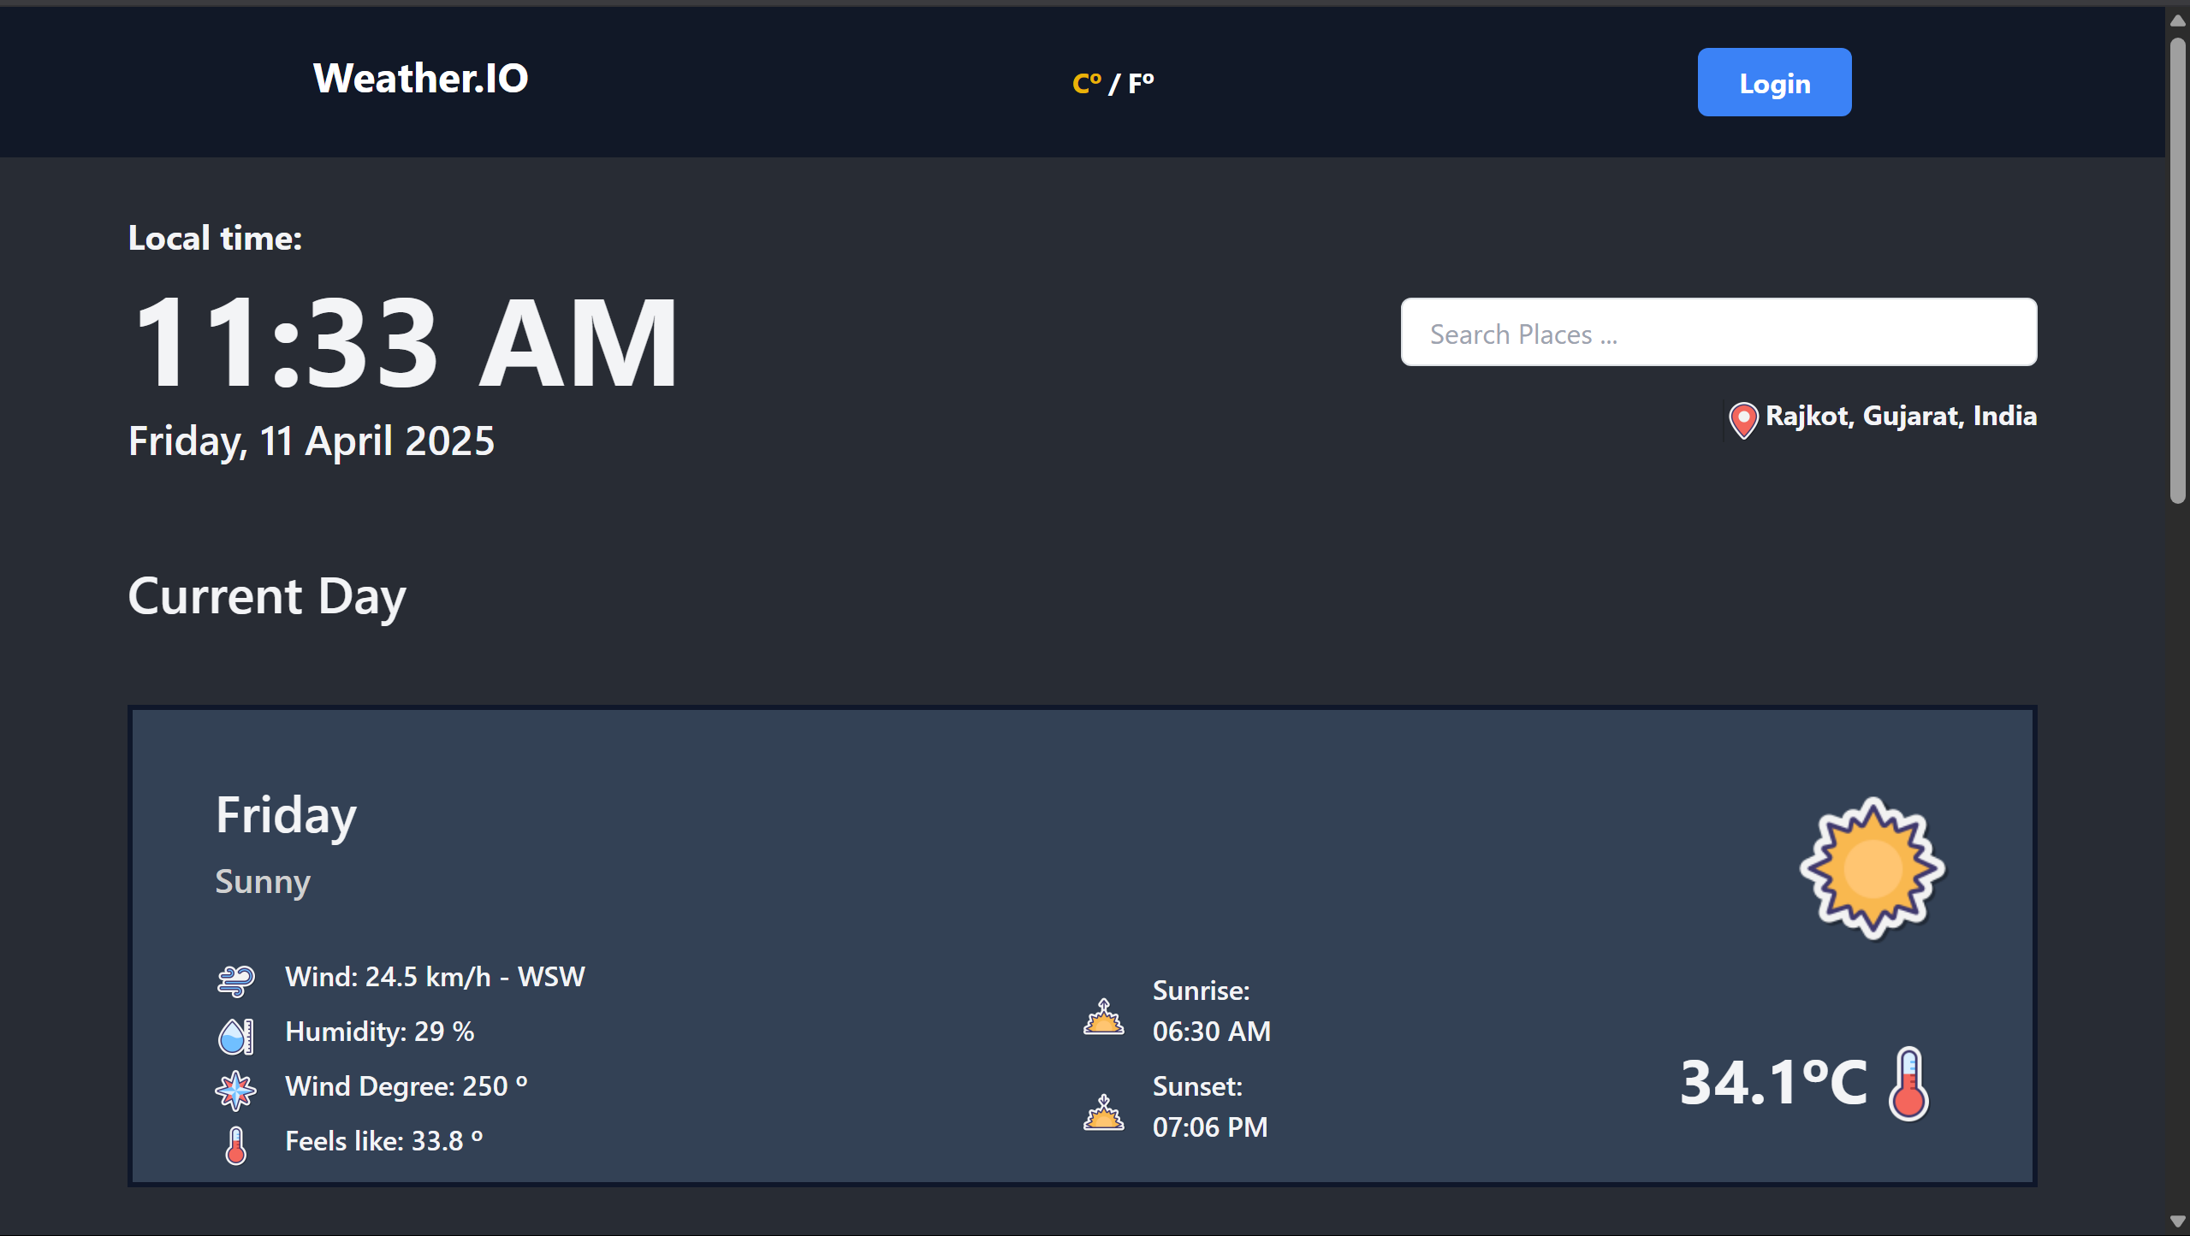
UI Screen

Slide 19
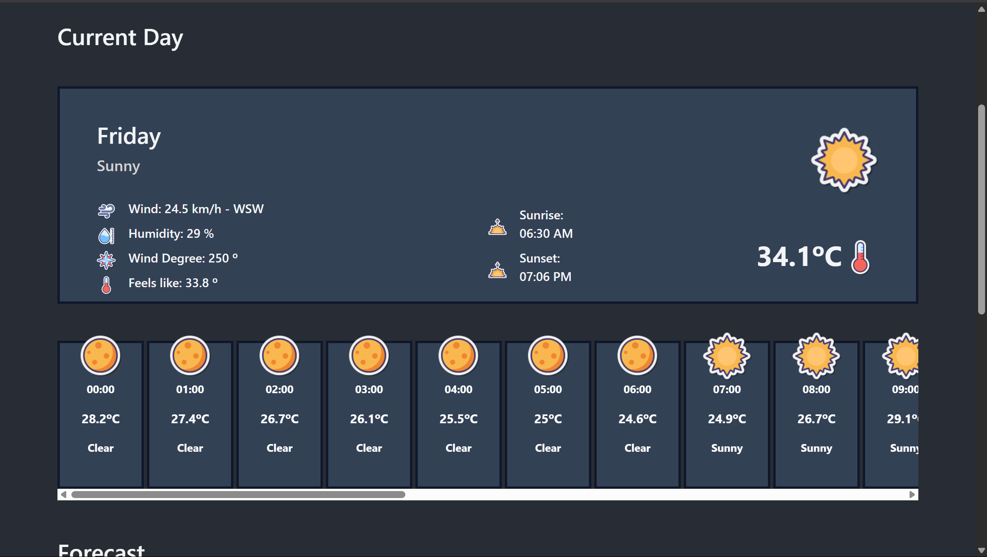
UI Screen

Slide 20
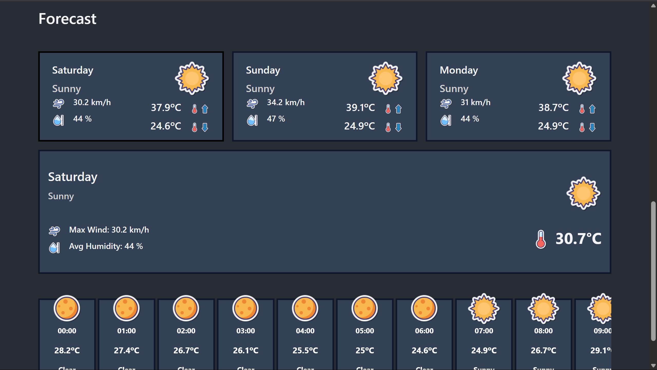
UI Screen

Slide 21
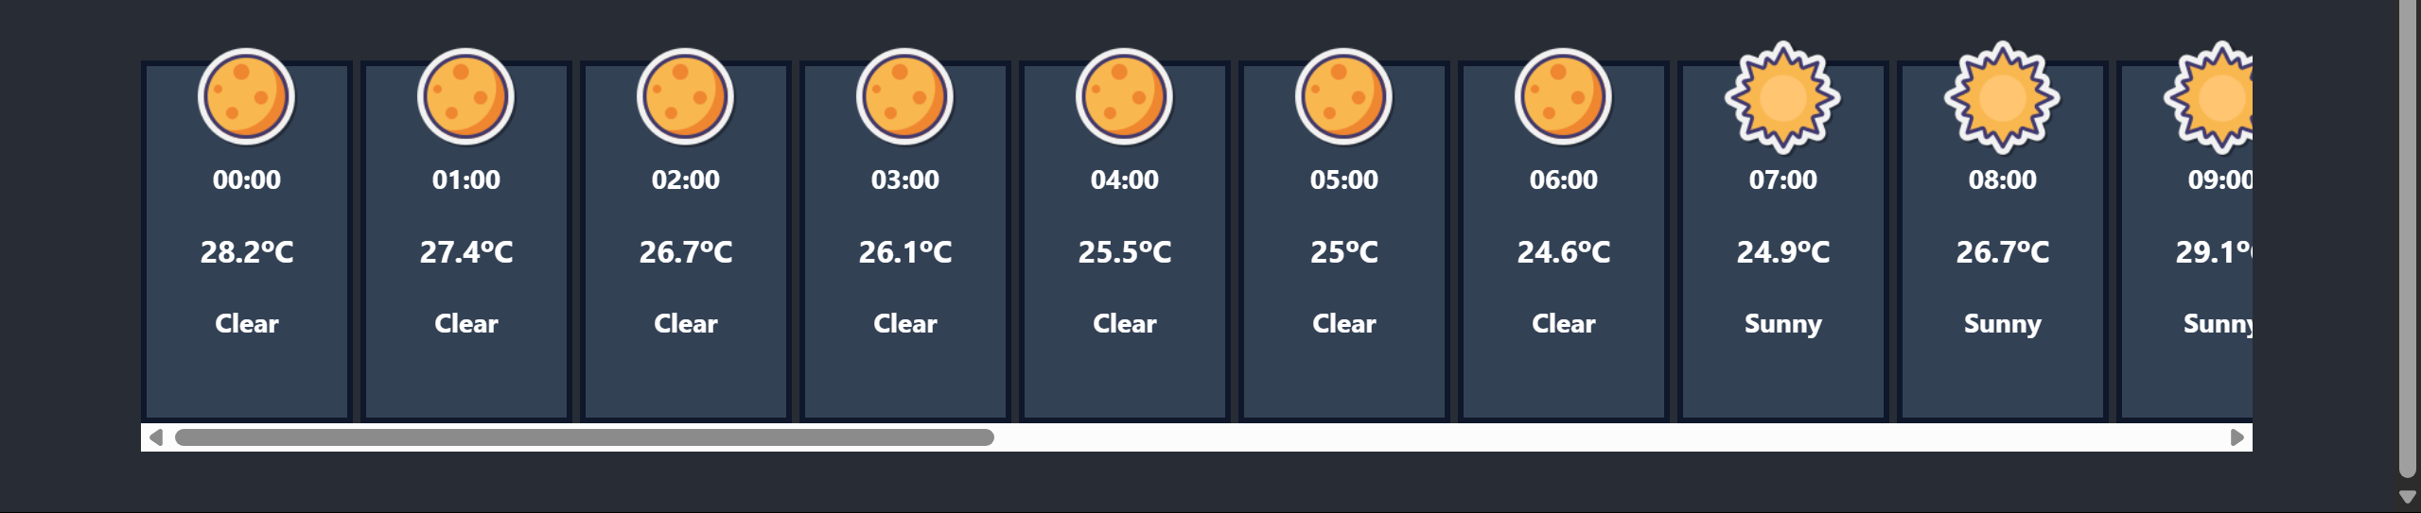
UI Screen

Slide 22
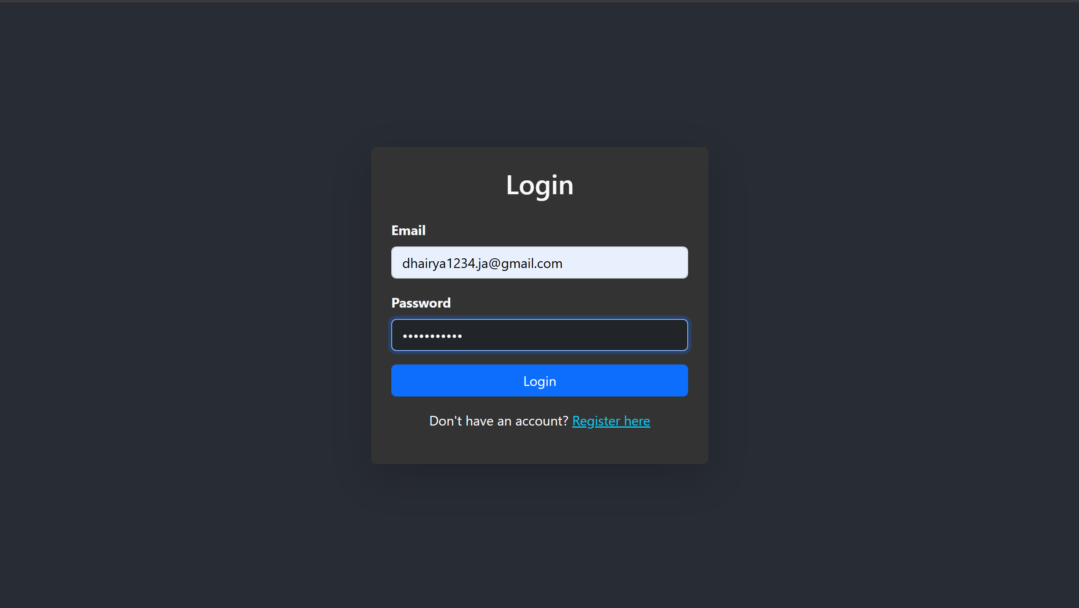
UI Screen

Slide 23
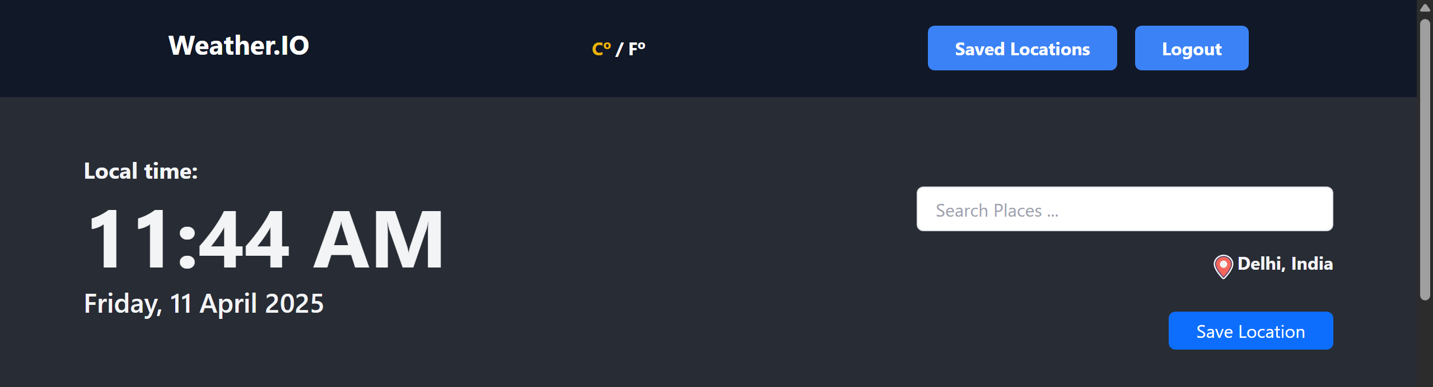
UI Screen

Slide 24
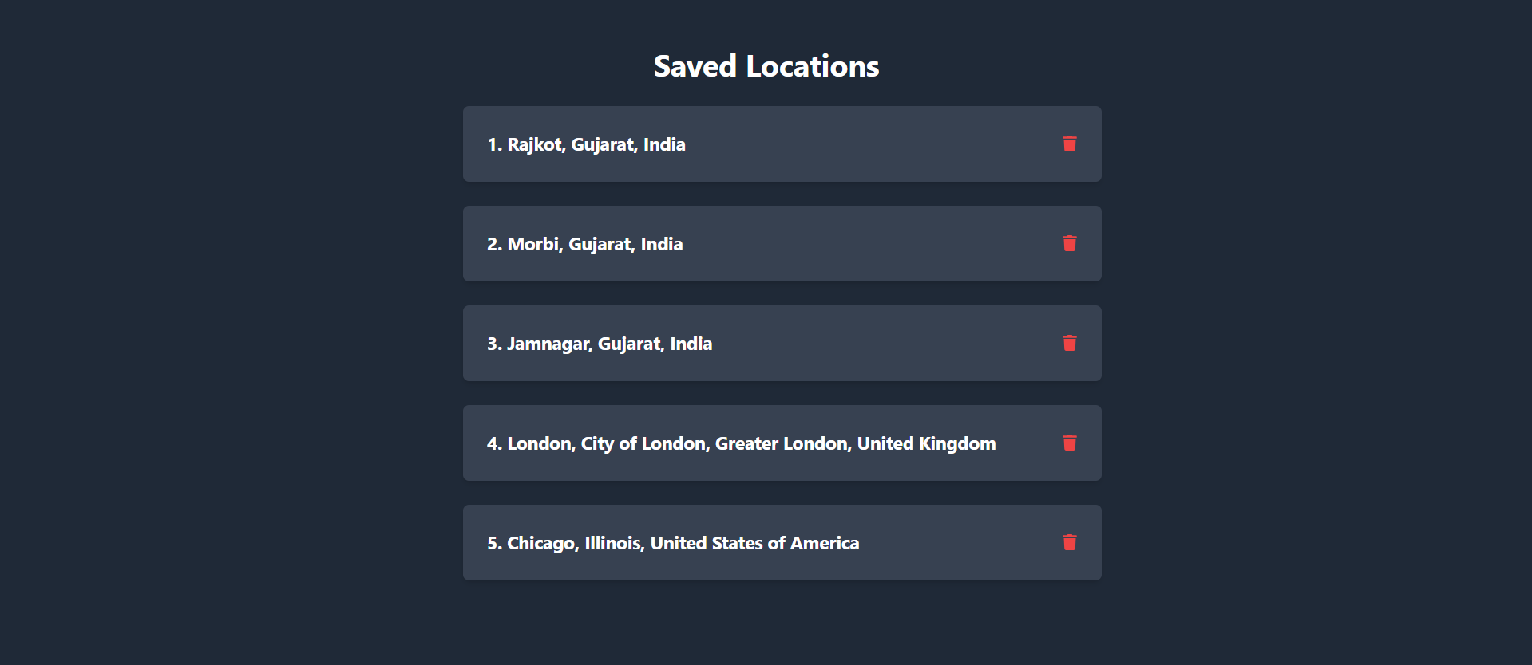
UI Screen

Slide 25
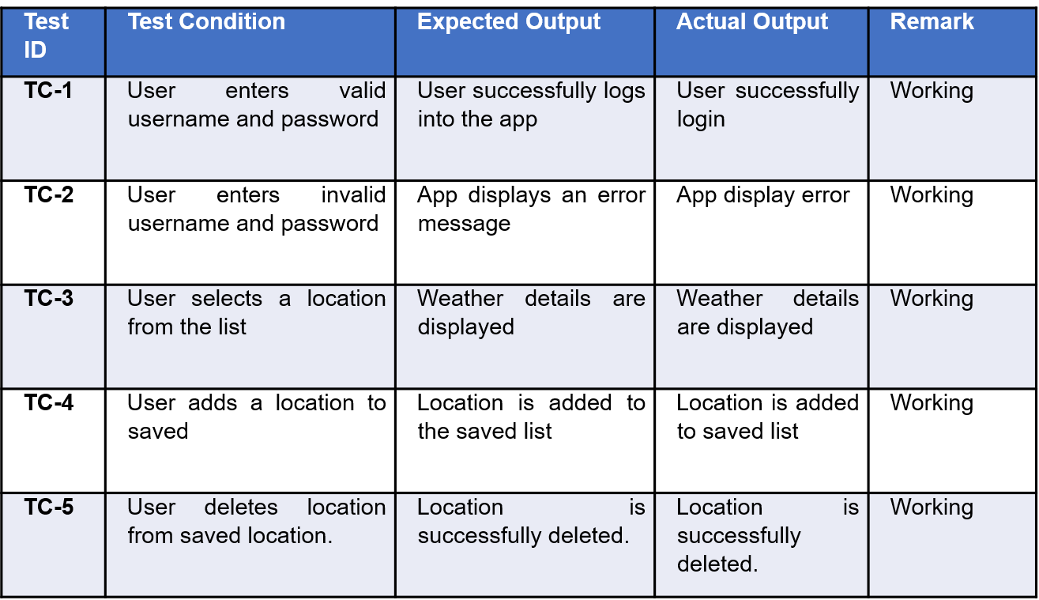
Testing

Slide 26
Expected Outcomes
Fully functional weather forecasting website that provides accurate and timely weather information.
Users will be able to easily access real-time weather updates, view detailed forecasts, and save weather information for multiple locations.
The site will ensuring users are well-informed and can plan their activities effectively based on reliable weather data.

Slide 27
References
WeatherAPI. (n.d.). Official WeatherAPI Documentation. Retrieved from https://www.weatherapi.com/docs/ - Used to understand weather API endpoints, request parameters, and response formats.
Stack Overflow. (n.d.). Programming Q&A Community. Retrieved from https://stackoverflow.com/ - Referenced for resolving errors and troubleshooting issues during development.
Nominatim API used for search bar - https://nominatim.org/release-docs/latest/api/Search/
RapidAPI. (n.d.). API Hub for Testing and Integration. Retrieved from https://rapidapi.com/ - Utilized for API testing and managing weather data integrations.

Slide 28
References
https://openweathermap.org/
https://www.youtube.com/
https://nominatim.org/release-docs/latest/api/Search/
https://weatherapi-com.p.rapidapi.com/forecast.json

Slide 29


