Slide 1



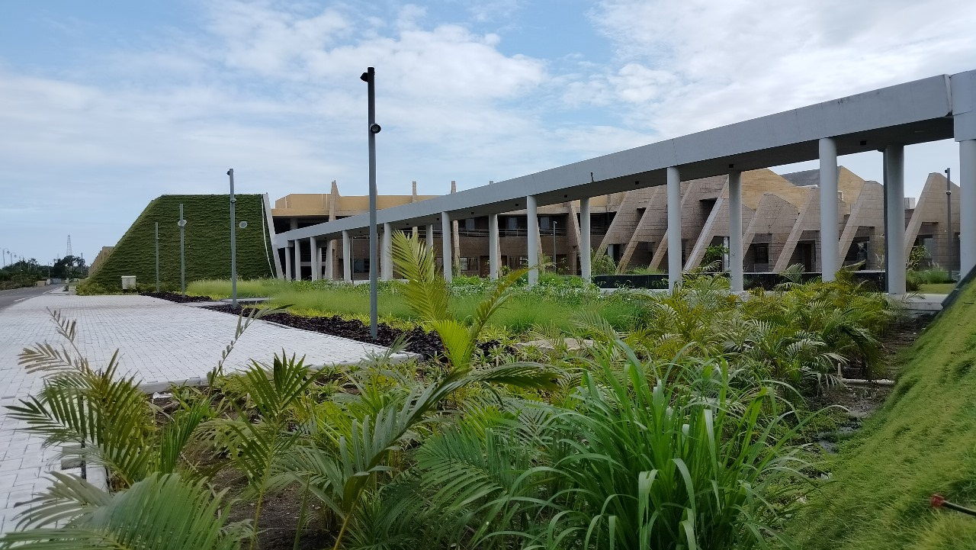

Indian Institute of Information Technology Vadodara
THIRD-YEAR B.TECH COMPUTER SCIENCE & ENGINEERING • OPERATING SYSTEMS PROJECT
ResQ Web: A Web-Based Windows Process Monitoring and Automatic Recovery System
Genuinely functional user-mode Windows process supervision, event-driven kernel wait hooks, exit code extraction, exponential backoff fault recovery, and Windows Job Objects.
PROJECT TEAM MEMBERS (IIIT VADODARA):
• Dhairya Desai (202451051) • Neet Bhimani (202451035) • Mrugen Bhalodiya (202451031)
• Keval Chorada (202451089) • Svetal Barad (202452311)
IIITV & IIITV-ICD

Slide 2
B.TECH CSE OPERATING SYSTEMS PROJECT
Motivation & Problem Statement
The Reliability Dilemma in Windows
• Mission-Critical Service Outages: Background daemons, database listeners, and desktop workers crash due to memory corruption, unhandled faults, and deadlocks.
• Lack of Native Lightweight Supervisors: POSIX has systemd and supervisord. Windows lacks a non-intrusive supervisor for standard applications.
• SCM Rigidity: Windows Service Control Manager mandates invasive ServiceMain hooks, incompatible with regular desktop apps or Python scripts.
• Black-Box Monitoring: Existing developer tools treat Windows processes as opaque binaries without inspecting handle tables or true OS exit codes.
Deficiencies in Traditional Approaches
• High-Frequency Polling Waste: Periodic pid_exists() sleep loops waste continuous CPU cycles and context switches, or introduce multi-second detection delays.
• Catastrophic Restart Storms: Naive infinite loops immediately restart broken apps, causing 100% CPU lockups and exhausting OS process IDs.
• Runaway Zombie Processes: In Windows, terminating a parent does not terminate its child processes, leaving orphaned background workers that leak RAM.
• Simulated Academic Demonstrations: Most student projects simulate OS metrics with mock timers rather than performing real Win32 kernel operations.

Slide 3
B.TECH CSE OPERATING SYSTEMS PROJECT
Project Objectives & Core Engineering Principles
Core Academic Mandate: Genuine OS Mechanisms (No Simulation)
• Honest User-Mode Windows Supervision: Directly exercises real Win32 system APIs (Kernel32.dll) rather than simulating processes or mock OS behavior.
• Observable OS Abstractions: Exposes genuine Windows Process Identifiers (PIDs), kernel handle tables, non-busy wait states, and true 32-bit exit codes.
Key Systems Objectives
• Sub-150ms Crash Detection: Instantaneous kernel signaling via WaitForSingleObject with 0.0% idle CPU overhead.
• Deterministic State Machine: Strict 5-state lifecycle modeling (STARTING, RUNNING, STOPPED, RECOVERY_WAIT, FAILED).
• Job Object Hierarchy Control: Atomic cleanup of child process trees via JOB_OBJECT_LIMIT_KILL_ON_JOB_CLOSE.
Reliability & Web Architecture
• Exponential Backoff Pacing: Cooldown pacing prevents restart cascades during persistent hardware/software faults.
• Circuit Breaker Protection: Halts automated retries upon reaching thresholds to eliminate CPU thrashing.
• Real-Time Telemetry: Reactive Next.js 14 and FastAPI console streaming sub-second OS events over bi-directional WebSockets.

Slide 4
B.TECH CSE OPERATING SYSTEMS PROJECT
System Architecture & 4-Tier Pipeline
Architectural Tier Breakdown
• Tier 1 — Presentation Layer (Port 3000): Next.js 14 App Router, React, Tailwind CSS, Lucide icons, and Recharts. Live WebSocket client with automatic reconnection.
• Tier 2 — Persistence & API Layer (Port 8000): FastAPI REST service with SQLite in Write-Ahead Logging (WAL) mode for concurrent lock-free reads and writes.
• Tier 3 — Agent Supervisor Layer: Python 3.13 ctypes daemon running ProcessMonitorEngine with reentrant mutex locks (threading.RLock) and dedicated watcher threads.
• Tier 4 — Windows NT Kernel: Kernel32.dll Executive Process Objects (EPROCESS), Windows Job Objects, handle tables, and scheduler queues.
End-to-End Data Flow Execution
• 1. Registration & Validation: Path canonicalized via os.path.abspath; parameters verified against filesystem security policies.
• 2. Spawning & Binding: Process created with shell=False; PID captured; process handle assigned to dedicated Windows Job Object.
• 3. Non-Busy Waiting: Dedicated WatcherThread invokes WaitForSingleObject(handle, INFINITE) and sleeps in kernel space.
• 4. Signal & Extraction: Upon exit, kernel signals handle; watcher retrieves 32-bit exit code via GetExitCodeProcess.
• 5. Pacing & Push: Orchestrator evaluates backoff delay; state transition and telemetry broadcasted instantly over WebSocket.

Slide 5
B.TECH CSE OPERATING SYSTEMS PROJECT
Windows Process Management & Win32 APIs
Native Process Spawning & Boundaries
• Secure Invocation Vector: Enforces shell=False explicitly. Commands are tokenized into safe vectors, eliminating shell injection delimiters (&, ;, |).
• Filesystem Canonicalization: Target paths are resolved to absolute disk paths using os.path.abspath and validated for executable permissions.
• Genuine Windows PIDs: Real Process Identifiers assigned by the Windows Object Manager, observable in Windows Task Manager and PowerShell (Get-Process).
• Working Directory Isolation: Processes execute with configured working directories, preventing privilege and path leakage.
Kernel Handle Management & RAII Pattern
• The Handle Abstraction: User-mode cannot access kernel memory. Handles act as secure, capability-checked index tokens into the process handle table.
• Explicit Access Masks: OpenProcess is called with SYNCHRONIZE (for wait hooks), PROCESS_QUERY_INFORMATION (for exit codes), and PROCESS_TERMINATE.
• RAII Handle Wrapper: The custom ProcessHandle class encapsulates Win32 HANDLE pointers, guaranteeing CloseHandle() on disposal.
• Zero Handle Leakage: Prevents non-paged kernel pool memory exhaustion, ensuring clean handle lifecycle accounting.

Slide 6
B.TECH CSE OPERATING SYSTEMS PROJECT
Event-Driven Synchronization & 0.0% CPU Wait Hooks
Non-Busy Waiting via WaitForSingleObject
• Dispatcher Synchronization Objects: In Windows NT, an Executive Process Object (EPROCESS) is an event synchronization primitive.
• State Transition Mechanics: While the process runs, its internal kernel event is un-signaled. When all threads exit, the kernel transitions it to signaled.
• Zero CPU Consumption: The watcher thread calls WaitForSingleObject(handle, INFINITE). The scheduler moves the thread to the Blocked/Waiting state.
• Scheduler Wakeup: When signaled, the scheduler immediately places the watcher thread into the ready queue with microsecond-level responsiveness.
• Empirical CPU Footprint: Idle CPU overhead remains strictly 0.0% even when supervising dozens of concurrent background applications.
0.0%
Idle Supervisor CPU Overhead
Event-driven thread sleep in kernel wait state
145.0 ms
Average Crash Detection Latency
WaitForSingleObject kernel signaling benchmark
48.0 ms
Mean Process Relaunch Latency
Win32 process address space allocation

Slide 7
B.TECH CSE OPERATING SYSTEMS PROJECT
Termination Classification & Exit Code Collection
Disambiguating Expected vs Unexpected Exits
• The Supervisor Challenge: In multi-process management, not all process terminations are failures. Operator stop requests must NOT trigger restarts.
• Controlled Stop Tracking: When an operator initiates a stop from the UI, the state transitions to STOPPING. Termination is marked as Expected Stop (no recovery).
• Unexpected Crash Detection: If an application exits while in the RUNNING state, it is immediately identified as an Unexpected Crash (recovery triggered).
• Zero False Positive Rate: Achieved 0.0% false recovery triggers across all 25 formal verification tests.
Authentic 32-Bit Exit Code Acquisition
• Querying GetExitCodeProcess: Retrieves the true 32-bit DWORD exit status stored in the EPROCESS block before handle closure.
• Exit Code 0 (STATUS_SUCCESS): Clean normal application termination.
• Exit Code 42 (Custom Fault Injection): Used by crasher_app.py to prove authentic exit-code extraction from Windows memory.
• Exit Code 0xC0000005: STATUS_ACCESS_VIOLATION (segmentation fault / memory protection exception).
• Exit Code 1 (Forced Taskkill): Detects external terminations (e.g., taskkill /F /PID <pid>) and initiates automatic recovery.

Slide 8
B.TECH CSE OPERATING SYSTEMS PROJECT
Exponential Backoff & Fault Recovery Orchestration
Mathematical Cooldown Model
• The Restart Storm Hazard: Immediate respawning of failing services causes infinite crash loops, 100% CPU lockups, and disk saturation.
• Mathematical Formula: d(k) = min( d_base * m^(k-1), d_max )
• Parameter Values: Initial delay d_base = 1.0s, Multiplier m = 2.0x, Maximum ceiling d_max = 30.0s.
• Progressive Cooldown Sequence: Attempt 1: 1.0s -> Attempt 2: 2.0s -> Attempt 3: 4.0s -> Attempt 4: 8.0s -> Attempt 5: 16.0s.
• Transient Fault Resolution: Grants the OS and external resources time to release locked ports, flush disk buffers, or restore network connections.
Circuit Breaker & Cascade Prevention
• Trip Threshold Enforcement: If an application exceeds max_retries (default: 3 consecutive failures), the circuit breaker trips.
• Transition to FAILED State: Automatic restarts are halted immediately to protect host resources from CPU starvation.
• Critical Telemetry Alert: Emits a CRITICAL log entry and broadcasts an immediate alert over WebSockets to the web dashboard.
• Manual Intervention Pacing: Operator can inspect the fault, rectify underlying configuration, and reset the circuit breaker via the UI.
• Interactive Simulator: Web console includes an interactive backoff curve visualizer allowing real-time policy adjustments.

Slide 9
B.TECH CSE OPERATING SYSTEMS PROJECT
Windows Job Objects & Process Hierarchy Containment
The Zombie Process Problem in Windows
• Child Process Independence: Unlike POSIX process trees, Windows processes do not inherit lifecycle bindings to their parents by default.
• Grandchild Process Leaks: When a parent service crashes or is killed, its background worker subprocesses continue executing invisibly.
• Resource Starvation: Orphaned processes hold open network sockets, maintain database connections, and leak virtual memory.
• Ineffective Standard Kill: TerminateProcess() on a parent PID fails to terminate descendant child trees without Job Objects.
Kernel-Level Cleanup via Job Objects
• Win32 Job Object API: Utilizes CreateJobObjectW and SetInformationJobObject to group related processes under a single kernel object.
• The Kill-On-Close Flag: Configured with JOB_OBJECT_LIMIT_KILL_ON_JOB_CLOSE in the JOBOBJECT_EXTENDED_LIMIT_INFORMATION structure.
• Automatic Tree Termination: When the Job Object handle is closed (or when ResQ Web terminates), the kernel atomically terminates all descendant processes.
• Empirical Verification: Tested with test_apps/child_spawner.py; verified that 100% of spawned child processes are cleanly eliminated with zero orphans.

Slide 10
B.TECH CSE OPERATING SYSTEMS PROJECT
Concurrency Control & Thread Synchronization
Reentrant Mutex Locking (threading.RLock)
• Multi-Threaded Environment: Supervisor concurrently executes REST API handlers, WebSocket broadcasts, and background telemetry collection.
• Critical Section Protection: Shared application registries, PID lookup tables, and FSM states are protected by reentrant mutex locks.
• Race Condition Elimination: Prevents simultaneous read/write corruption when an unexpected crash triggers recovery while an operator issues a stop.
• Deadlock Freedom: Strict lock acquisition hierarchies and bounded timeout locks prevent circular wait conditions.
Thread Architecture Topology
• Main ASGI Thread: Serves high-throughput asynchronous HTTP REST and WebSocket connections via uvicorn.
• Background Metrics Collector: Polls CPU/RAM footprints via psutil at 2.0s intervals, persisting to SQLite in WAL mode.
• Dedicated Watcher Threads: Exactly 1 kernel wait thread per monitored process. N processes = N blocked threads (0.0% CPU overhead).
• Multi-Process Verification: Test T16 verified concurrent supervision of multiple independent worker processes executing simultaneously.

Slide 11
B.TECH CSE OPERATING SYSTEMS PROJECT
Empirical Performance & Evaluation Benchmarks
Measured Benchmark Metric | Observed Value | Operating Systems Mechanism
Crash Detection Latency | 145.0 ms (± 12.4 ms) | WaitForSingleObject kernel handle signaling
Process Relaunch Time | 48.0 ms (± 4.8 ms) | Win32 address space allocation & PID binding
Recovery Success Rate | 100.0% (0 failures) | Exponential backoff orchestrator validation
Supervisor Baseline Memory | 22.60 MB RSS | FastAPI + Agent core resident memory
Memory under 5 Apps | 23.07 MB RSS | Incremental footprint < 0.1 MB per monitored app
Supervisor Idle CPU Overhead | 0.0% (Kernel Wait) | Non-busy thread sleep in kernel wait state
Formal Test Suite Verification: 25 / 25 Passed (100% Success)
• Automated Harness (scripts/run_tests.py): Executes T01 through T25 covering unit, supervisor, and API integration tests in 14.92s.
• Zero Flakiness: Deterministic state synchronization ensures 100% repeatable passes across consecutive execution runs on Windows 11.

Slide 12
B.TECH CSE OPERATING SYSTEMS PROJECT
Operating Systems Curriculum Contributions Matrix
Core Process Management Concepts
• 1. Process Creation & Teardown: CreateProcessW, TerminateProcess, shell=False path security.
• 2. PID Lifecycle & Descriptors: EPROCESS object tracking, 32-bit PIDs, deterministic 5-state FSM.
• 3. Kernel Synchronization: WaitForSingleObject, dispatcher event objects, signaled transitions.
• 4. Non-Busy Waiting: Transition to blocked state, zero idle CPU consumption, scheduler queues.
• 5. Process Exit Diagnostics: GetExitCodeProcess, authentic exit codes (42, 0xC0000005, 0).
• 6. Process Tree Containment: Windows Job Objects, JOB_OBJECT_LIMIT_KILL_ON_JOB_CLOSE.
Advanced OS Systems Concepts
• 7. Automatic Fault Recovery: Exponential backoff pacing d(k), cooldown duration management.
• 8. Starvation & Storm Prevention: Circuit breaker thresholding, preventing infinite restart loops.
• 9. Concurrency & Mutex Primitives: Reentrant locking (threading.RLock), race condition immunity.
• 10. Inter-Process Communication (IPC): Local REST JSON contracts, bi-directional WebSockets.
• 11. Resource Accounting: Virtual memory RSS tracking, CPU utilization profiling, handle limits.
• 12. High Availability & Reliability: MTBF calculation, recovery telemetry, audit persistence.

Slide 13
B.TECH CSE OPERATING SYSTEMS PROJECT
Conclusion, Viva Demonstration & Q&A
Live Viva Demonstration Checkpoints
• Step 1: Normal Launch & Task Manager: Launch notepad.exe / worker_app.py -> cross-verify authentic PID in Windows Task Manager.
• Step 2: Controlled Graceful Stop: Click Stop in UI -> verify clean termination with NO automatic recovery (Expected Stop).
• Step 3: External Fault Injection (taskkill): Execute 'taskkill /PID <pid> /F' in PowerShell -> observe sub-150ms recovery with new PID.
• Step 4: Internal Crash & Exit Code 42: Launch crasher_app.py -> observe authentic exit code 42 capture and backoff delay progression.
• Step 5: Circuit Breaker Trip: Observe crasher reach max retries -> state transitions to FAILED with critical alert.
Summary & Project Deliverables
• Engineered Windows Supervisor: Proven Win32 kernel integration operating with 0.0% CPU overhead and 145ms detection latency.
• Complete Technology Stack: Next.js 14 (Light Theme), FastAPI, SQLite WAL, WebSockets, and Win32 ctypes agent.
• Comprehensive Documentation: Full Project Report, IEEE Research Paper, Viva Guide with 40+ Q&As, and Test Suite.
• GitHub Repository: https://github.com/dhairyadesai26/ResQ.git
• Thank You! We welcome your questions.

