Slide 1
YEL BUILD $ BANK 2026 • TRACK 2 • PROBLEM 5
SENTINEL
Financial crime doesn't hide in transactions. It hides in patterns.
Sentinel connects transactions, accounts, beneficiaries, and time-based behaviour to expose coordinated financial crime that isolated transaction-level detection misses.
PROBLEM STATEMENT:
“Find a way to catch financial crime that only becomes visible across many transactions or accounts over time.”

Slide 2
01 / THE CORE CHALLENGE
Financial crime is bigger than a single transaction.
Why isolated, point-in-time fraud detection fails against modern distributed financial crime networks.
TRADITIONAL TRANSACTION INSPECTION
• Evaluates in isolation
Analyses individual payments at time of authorization. Looks only at immediate amount, velocity, and device footprint.
• Blind to coordinated distribution
Criminal operations deliberately break illicit activity across multiple disparate accounts, micro-amounts, and staggered time intervals.
• High False Positive tax
Tightening single-transaction rules flags legitimate customers while letting structured, slow-moving coordinated rings slip past undetected.
• Misses network evolution
Attackers iteratively mutate account hops and timing patterns faster than static rule engines can be updated.
THE PATTERN REALITY: HOW CRIME ACTUALLY MOVES
Txn A | Account #1042 → Beneficiary X • ₹4,950
Status: Looks normal (Below KYC check)
Txn B | Account #2891 → Beneficiary X • ₹4,800
Status: Looks normal (New device)
Txn C | Account #8410 → Beneficiary Y • ₹4,900
Status: Looks normal (Regular UPI flow)
Txn D | Account #9123 → Beneficiary X • ₹4,990
Status: Looks normal (Low velocity)
⚡ CONNECTED THROUGH COMMON DESTINATION & TIMING:
Coordinated Mule Smurfing Ring Funneling ₹19,640 into shared off-ramp entity within a 45-minute window. Single-txn engines approve all 4.

Slide 3
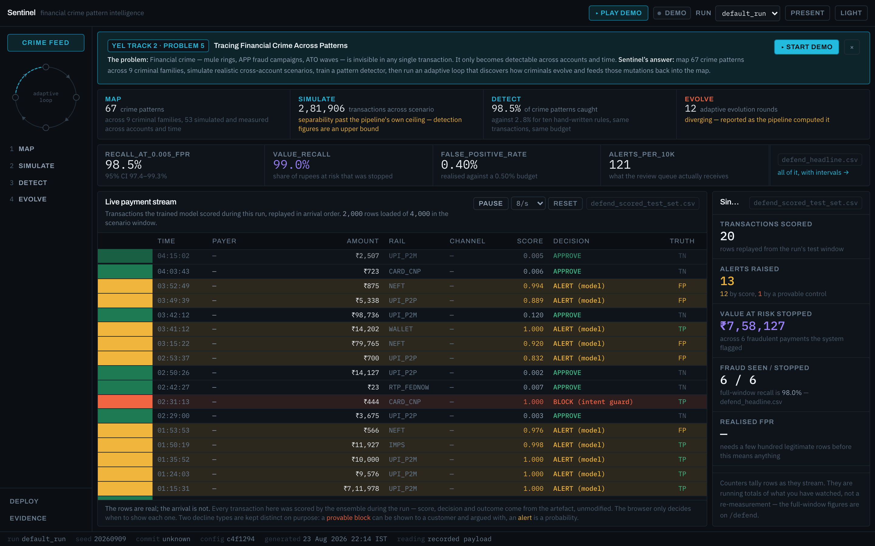
02 / PROPOSED SOLUTION
Sentinel: Pattern Intelligence for Financial Crime
A multi-scale intelligence engine that connects entities, tracks temporal behaviour, and explains coordinated risks.
END-TO-END PATTERN INTELLIGENCE PIPELINE
1. Streaming Transaction Ingestion
Captures raw payments with strict temporal causality.
2. Multi-Window Spatio-Temporal Extraction
Calculates 67 rolling features across 1h, 24h, 7d intervals.
3. Entity & Relationship Graph Linking
Connects accounts, beneficiaries, devices, and shared IP hops.
4. ML Ensemble & Threat Pattern Classification
Scores risk probability & assigns specific crime taxonomy.
5. Explainable Inspector & Reason Codes
Provides SHAP-style local feature contributions & counterfactuals.
6. Adaptive Mutation & Feedback Loop
Stress-tests defense against synthetic pattern evasions.
REAL APPLICATION INTERFACE: Live streaming transaction monitor with instant risk stratification (Actionable Flag vs Low Risk), real-time pattern taxonomy tagging, and batch inspector routing.

Slide 4
03 / TECHNICAL WORKFLOW
From isolated payments to connected patterns
The four-stage operational framework powering Sentinel's pattern intelligence engine.
01 / MAP
Pattern Taxonomy
————————————————
• Formalizes 9 distinct financial crime families across 67 mathematical features.
• Captures temporal bursts, structuring, mule fan-ins, and cycling.
• Eliminates reliance on arbitrary single-rule heuristics.
02 / SIMULATE
Scenario Stress-Testing
————————————————
• Generates realistic multi-account attack vectors at varying scales.
• Tests detector boundaries against coordinated smurfing & velocity jumps.
• Evaluates detector without risking live payment operations.
03 / DETECT
Stacked ML Ensemble
————————————————
• Combines gradient boosted trees & temporal network feature aggregations.
• Calculates Wilson 95% confidence intervals on pattern recalls.
• Delivers calibrated risk probabilities and immediate reason codes.
04 / EVOLVE
Adaptive Arms Race
————————————————
• Applies programmatic mutations (staggered timing, amount jitter).
• Monitors detection degradation under adversary evasion tactics.
• Quantifies defensive robustness across mutation iterations.

Slide 5
04 / PRODUCT & ENGINEERING
Built for investigation, not just scoring
Deep operational toolset paired with a production-ready, strictly verifiable technology stack.
OPERATIONAL INVESTIGATION CAPABILITIES
• 1. Transaction Inspector
Deep forensic view explaining exactly why an event was flagged with risk factor attribution.
• 2. Related Transaction Analysis
Instant discovery of connected transfers across shared origin accounts and common targets.
• 3. Mule-Ring Detection
Identifies fan-in convergence patterns where multiple feeder accounts channel funds to common off-ramps.
• 4. Campaign Clustering
Detects coordinated multi-account bursts operating synchronously across narrow time windows.
• 5. Threat Pattern Catalog
Comprehensive taxonomy indexing 9 verified financial crime patterns with baseline metrics.
• 6. Adaptive Mutation Lab
Stress-tests detection models against iterative attack permutations and evasive timing shifts.
VERIFIED REPOSITORY STACK
FRONTEND ARCHITECTURE
React 18 + TypeScript + Vite
UI & COMPONENT STYLING
Tailwind CSS + Lucide Icons
DATA VISUALIZATION
Recharts (ROC, PR, Metric Trends)
BACKEND SERVICES
Python 3.11 + FastAPI (REST)
MACHINE LEARNING
scikit-learn ensemble + NumPy
DATA PERSISTENCE
SQLite (Causal timeline storage)
CLOUD DEPLOYMENT
Vercel Edge Infrastructure

Slide 6
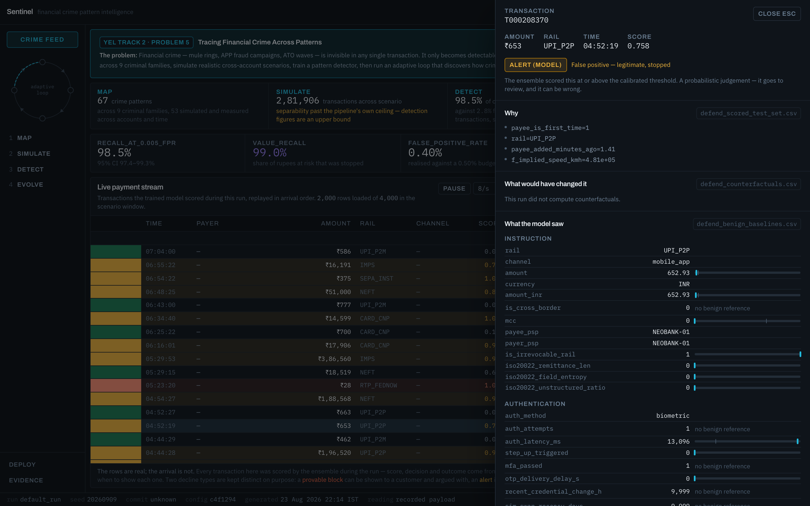
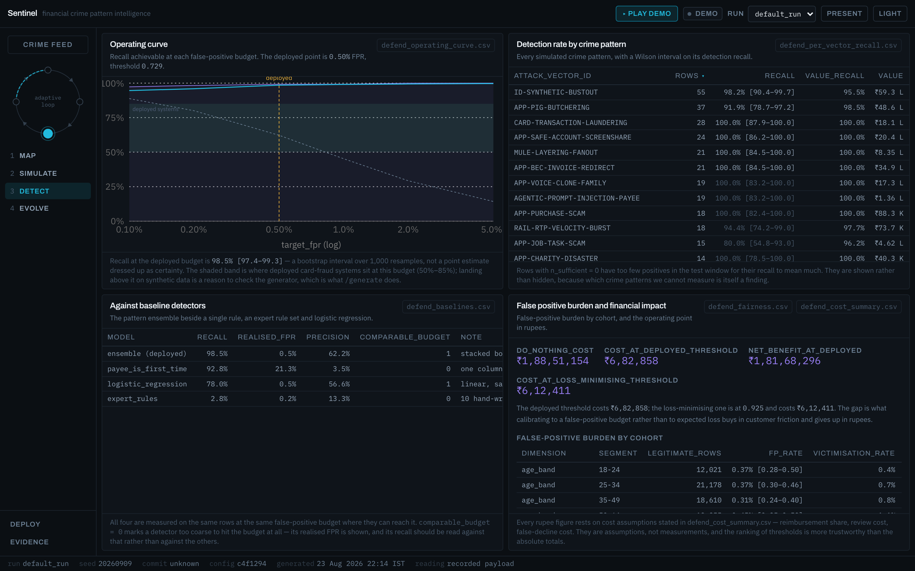
05 / TECHNICAL DEPTH & FORENSICS
Explainable, adaptive, and measurable
Moving beyond black-box classification: answering the 5 critical investigative questions.
NOT JUST 'FRAUD: YES' — ACTIONABLE ANSWERS
WHY WAS IT FLAGGED?
Reason codes ranking top contributing spatio-temporal features and threshold boundaries.
WHAT IS IT CONNECTED TO?
Entity resolution linking past counterparties, shared beneficiary IDs, and IP clusters.
WHAT PATTERN DOES IT REPRESENT?
Classification into 9 financial crime taxonomies (Mule smurfing, Layering, Velocity jump).
HOW WELL DOES THE MODEL PERFORM?
Per-pattern recall evaluation with rigorous 95% Wilson confidence intervals.
HOW DOES IT HANDLE EVASION?
Adversarial mutation testing measuring detector degradation across synthetic evasion rounds.

Slide 7
06 / ROADMAP & REALISTIC SCOPE
From prototype to financial-crime infrastructure
Honest evaluation of current engineering boundaries and the roadmap to enterprise deployment.
CURRENT TECHNICAL CHALLENGES
• Distributed Entity Resolution
Mapping mule rings when fraudsters use synthetic or compromised accounts across disjoint banking rails.
• Temporal Concept Drift
Criminal syndicates continually alter transaction cadences, velocity bursts, and threshold-avoidance amounts.
• Investigation Queue Fatigue
Balancing high pattern recall with strict false-positive budgets to prevent analyst operational overload.
• Synthetic vs Production Gap
Calibrating models on synthetic pattern datasets before exposing to massive production transaction noise.
• Label Latency in Crime Data
Real financial crime confirmations often arrive weeks after execution via chargeback/SAR filings.
FUTURE PRODUCTION ROADMAP (LABELED SCOPE)
• Graph-Native Detection Engines
Integrating Graph Neural Networks (GNNs) for sub-millisecond dynamic subgraph clustering.
• Streaming Kafka / Flink Pipeline
Real-time stateful stream processing capable of handling 50,000+ UPI TPS.
• Analyst Active Learning Loop
Incorporating human investigator resolution outcomes directly into incremental model updates.
• Privacy-Preserving Federated Intelligence
Cross-institutional fraud signal sharing via secure multi-party computation without sharing PII.
• Enterprise Feature Store Integration
Low-latency point-in-time feature computation via Redis / Feast infrastructure.

Slide 8
SENTINEL
Financial crime doesn't hide in transactions. It hides in patterns.
YEL Build $ Bank 2026 • Track 2 — Fraud Detection & Financial Crime Prevention • Problem 5
Live Web Application: https://sentinel-sand-two.vercel.app
GitHub Repository: https://github.com/dhairyahuh/Sentinel
Thank you to the Youth Economy Lab & IGDTUW Review Committee.

