Slide 1

TECHNEX 26’
Hack It Out
THE POINTLESS POINTERS
I refactored my logic to make you the lead,
The only dependency I’m banking on,
I thought it’s where we meet,
But sorrow it’s a hackathon…

Slide 2
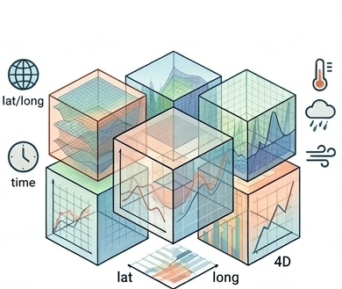
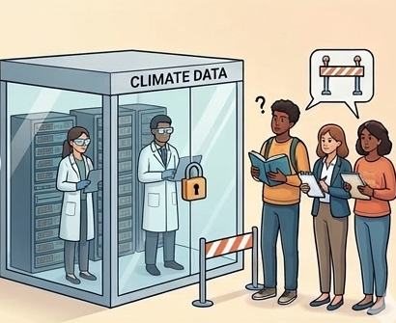
Problem Breakdown
Ever wondered if studying climatic conditions can be fun?
In order to study the geographical politics of climate, one has to undergo hours of brainstorming through various numbers which can turn out to be very hectic, stressful and boring.
Visualizing climate simulation output is vital for scientific understanding, yet raw multi-dimensional NetCDF data remains complex and difficult to parse. Currently, there is a lack of rapid-prototype tools that allow researchers and the public to interactively "slice and dice" this data in real-time. This technical barrier prevents raw climate numbers from being transformed into a compelling story for public outreach. Without accessible visualization, critical trends in variables like temperature or precipitation remain locked in raw datasets.

Slide 3
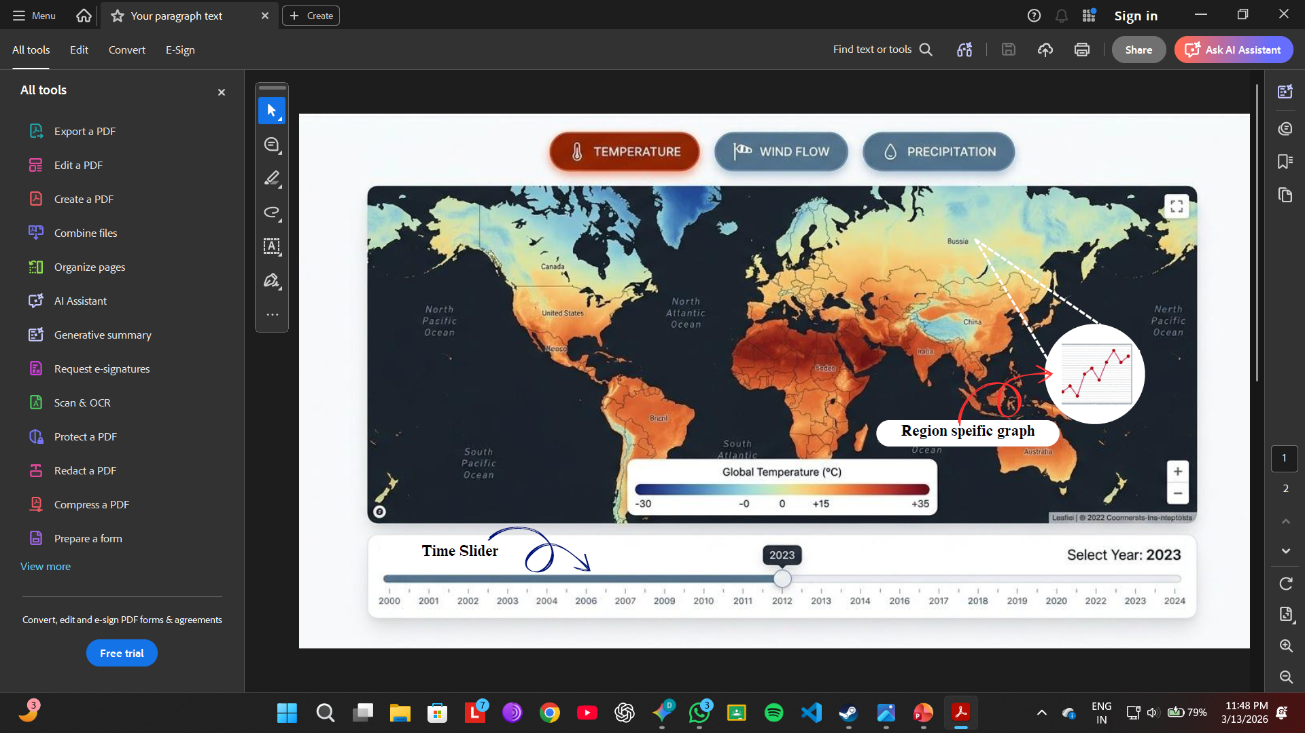
Proposed Solution
PyClimaExplorer is an interactive web-based dashboard designed to transform raw NetCDF climate data into a compelling planetary story in real-time. By leveraging Streamlit and Xarray, our tool enables researchers and the public to "slice and dice" multi-dimensional simulation outputs (like CESM or ERA5) with ease. This rapid-prototype solution bridges the gap between complex scientific numbers and intuitive visual understanding.
Interactive Rapid Prototyping: A functional web interface that processes complex climate datasets within a single day.
Narrative-Driven Visualization: Transforms raw variables like Temperature and Wind Speed into spatial heatmaps and temporal plots
Accessibility & Insight: Designed for both expert researchers needing quick data looks and the general public interested in climate trends.

Slide 4
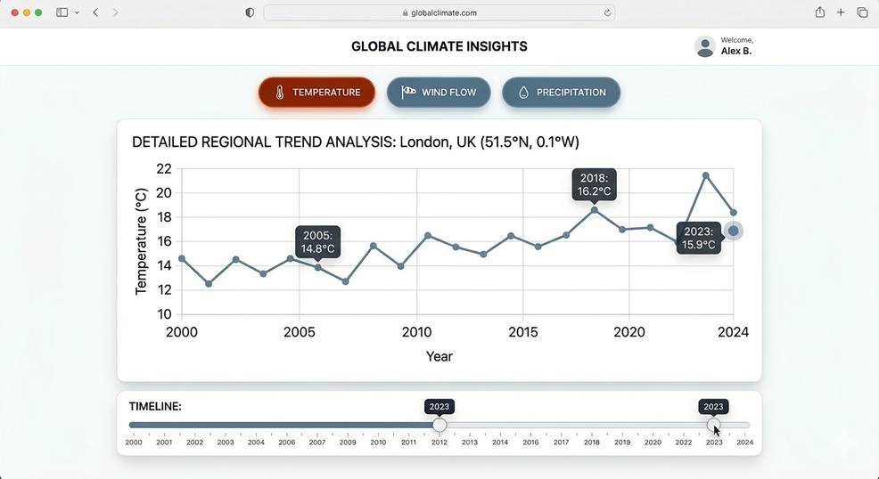
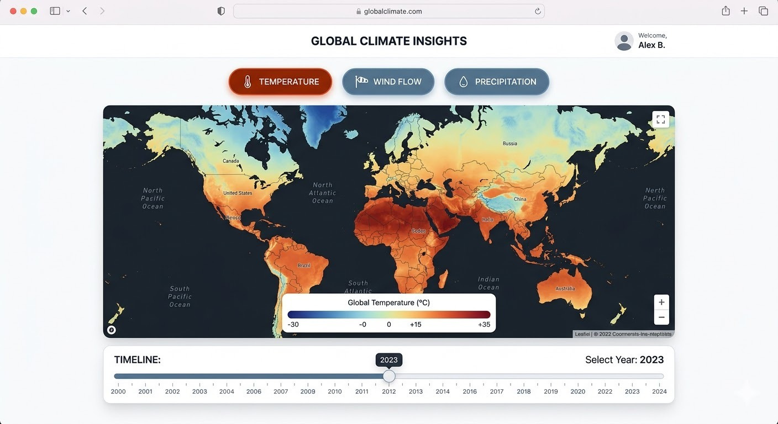
Features and Implementation
PyClimaExplorer offers a highly interactive experience where users can select between Temperature, Wind Flow, and Precipitation to visualize global trends. The interface features a dynamic timeline slider that allows for real-time transitions across a selected period, such as January 2020 to January 2021. By clicking any coordinate on the interactive globe, the tool instantly generates a localized variation graph. This seamless integration of spatial and temporal data turns complex datasets into an intuitive narrative of planetary change.
Multi-Parameter Exploration: Toggle between critical climate variables including Temperature, Precipitation, and Wind Speed.
Dynamic Time-Sliding: A synchronized slider that updates the global heatmap instantly as the user moves between initial and final timeframes
Point-Specific Temporal Analysis: On-click interaction that triggers a line plot showing localized variable fluctuations over the chosen time gap.
PyClimaExplorer
Slider for Time Variation
Graphical Analysis for Particular Region

Slide 5
Technical Implementation
The implementation relies on Xarray to efficiently slice multi-dimensional NetCDF files across latitude, longitude, and time coordinates. The frontend is built using Streamlit, which manages the state of the user’s selections and the interactive timeline slider. For the visualizations, Plotly or PyDeck renders the global heatmap, while a callback function captures click events to trigger the temporal analysis. This architecture ensures that data processing remains rapid enough for a responsive, real-time dashboard.
Data Handling (Xarray & NumPy): Performs high-speed indexing of .nc files to extract specific variable slices for the requested time range
Interactive UI (Streamlit): Coordinates the dashboard logic, ensuring the globe and time-series plots update dynamically based on user inputs.
Dynamic Mapping & Plotting: Uses Plotly to render the interactive globe and generate temporal graphs through localized coordinate extraction.

Slide 6
Impact and Future Roadmap
PyClimaExplorer serves as a high-impact bridge between complex scientific reanalysis and intuitive public outreach. By transforming dense NetCDF data into interactive visual narratives, it allows researchers to rapidly prototype ideas and the public to grasp critical climate trends in real-time. The project turns raw, multi-dimensional numbers into a compelling story about our changing planet, making data actionable and accessible. This foundation sets the stage for a sophisticated climate analysis platform.
Immersive 3D Rendering: Integrating PyDeck or PyVista to transition from 2D heatmaps to high-fidelity 3D globe visualizations.
Comparative Analysis Mode: Implementing side-by-side comparison features to visualize changes between distinct timeframes, such as 1990 vs. 2020
Interactive "Story Mode": Developing a guided tour that automatically highlights and explains specific climate anomalies and extreme events
Scalable Data Pipelines: Expanding backend compatibility to support diverse datasets beyond CESM and ERA5 reanalysis

Slide 7
Bibliography
ERA5 Reanalysis Documentation: "ERA5: Fifth generation of ECMWF atmospheric reanalyses of the global climate.“
UCAR/NCAR CESM Resources: "The Community Earth System Model (CESM) Project," University Corporation for Atmospheric Research.
Unidata NetCDF: "Network Common Data Form (NetCDF) Users Guide," Unidata.
Gemini AI.
TEAM NAME : THE POINTLESS POINTERS
COLLEGE NAME : INDIAN INSTITUTE OF TECHNOLOGY (BHU), VARANASI
PARTICIPANTS:
1 - DHAIRYA KANT KISLAY
2 – DIKSHA UPADHYAY
3 – HIMANSHU MISHRA (L)
4 – VANSHIKA DHOOT
THANK YOU!
TECHNEX ‘26, IIT BHU.

