Slide 1
BUSINESS ANALYTICS • 2026
COFFEE SHOP
SALES DASHBOARD
REVENUE
PRODUCTS
A practical guide to revenue, product mix, store performance, and sales timing.
STORE MIX
BBA BUSINESS ANALYTICS • SECOND-YEAR PROJECT LEVEL
Note: figures in this sample deck come from a simulated practice dataset, not the public source dataset.
COFFEE SHOP SALES INTELLIGENCE • PRACTICE PROJECT
1

Slide 2
01 — DASHBOARD OVERVIEW
ONE SCREEN, SIX WAYS TO READ SALES
The dashboard combines headline KPIs with focused views for products, stores, and time patterns.
TOTAL REVENUE
EST. PROFIT
TRANSACTIONS
$6,504
$3,155
1,500
UNITS SOLD
PROFIT MARGIN
PRODUCT CATEGORIES
2,060
48.5%
4
Use filters for month, store location, and product category when building the interactive version.
COFFEE SHOP SALES INTELLIGENCE • PRACTICE PROJECT
2

Slide 3
02 — HEADLINE METRICS
SIX NUMBERS SET THE BUSINESS CONTEXT
These metrics are calculated from the included practice CSV. Replace them after importing the real dataset.
• Revenue: $6,503.82 — sum of transaction revenue after discounts.
• Estimated profit: $3,154.57 — revenue minus estimated product cost.
• Transactions: 1,500 — each row represents one transaction.
• Units sold: 2,060 — total quantity across all transactions.
• Profit margin: 48.5% — estimated profit divided by revenue.
• Average order value: revenue ÷ transaction count.
COFFEE SHOP SALES INTELLIGENCE • PRACTICE PROJECT
3

Slide 4
03 — PROFIT GAUGE
PROFIT MARGIN SHOWS HOW MUCH REVENUE REMAINS
A gauge can compare actual margin with a target set by the business; the target should not be chosen just to make the chart look good.
CURRENT ESTIMATED MARGIN: 48.5%
Illustrative target: 35% margin. Actual target should come from the business owner.
Caution: cost is simulated in this practice file. Do not present estimated profit as audited financial performance.
COFFEE SHOP SALES INTELLIGENCE • PRACTICE PROJECT
4

Slide 5
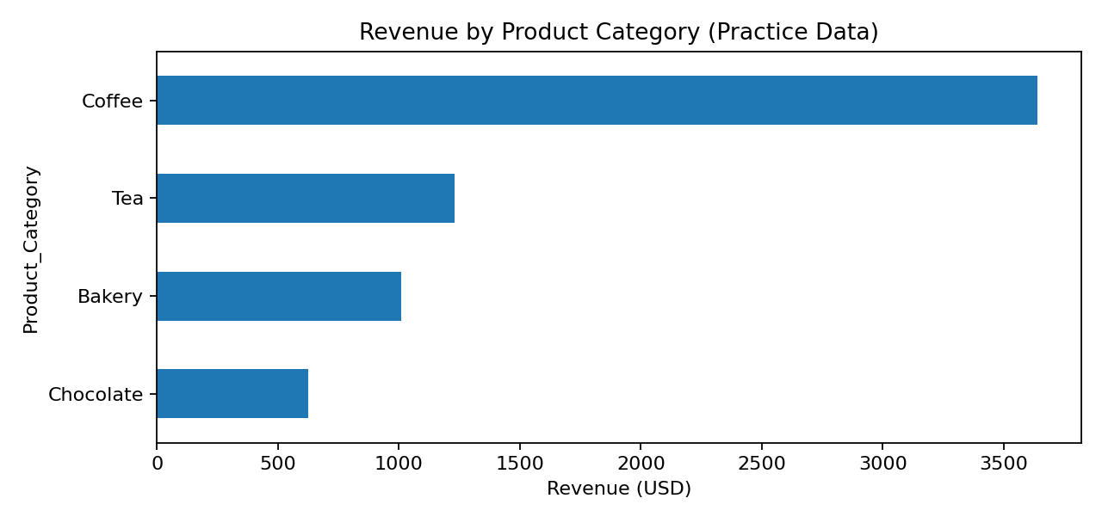
04 — PRODUCT CATEGORY BREAKDOWN
COFFEE IS THE MAIN REVENUE DRIVER IN THIS PRACTICE SAMPLE
Compare category revenue and profit before deciding which products deserve more shelf space or promotion.
TOP CATEGORY
Coffee
$3,639 revenue
55.9% of total revenue
COFFEE SHOP SALES INTELLIGENCE • PRACTICE PROJECT
5

Slide 6
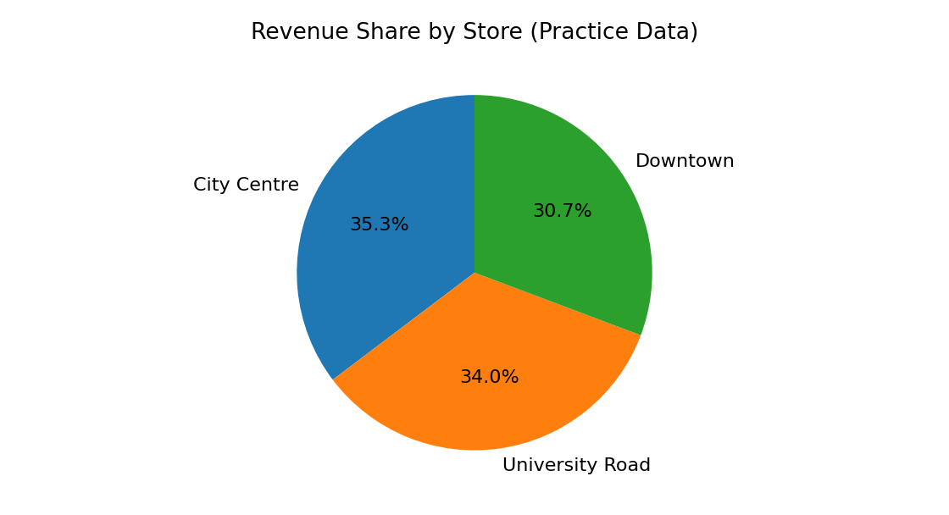
05 — STORE PERFORMANCE
REVENUE IS NOT THE SAME AS PROFITABILITY
A high-revenue store may also have higher costs. The final dashboard should compare both measures where real cost data exists.
QUESTIONS TO ASK
• Which store generates the most revenue?
• Is the top store also the most profitable?
• Are sales differences caused by location, opening hours, or product mix?
COFFEE SHOP SALES INTELLIGENCE • PRACTICE PROJECT
6

Slide 7
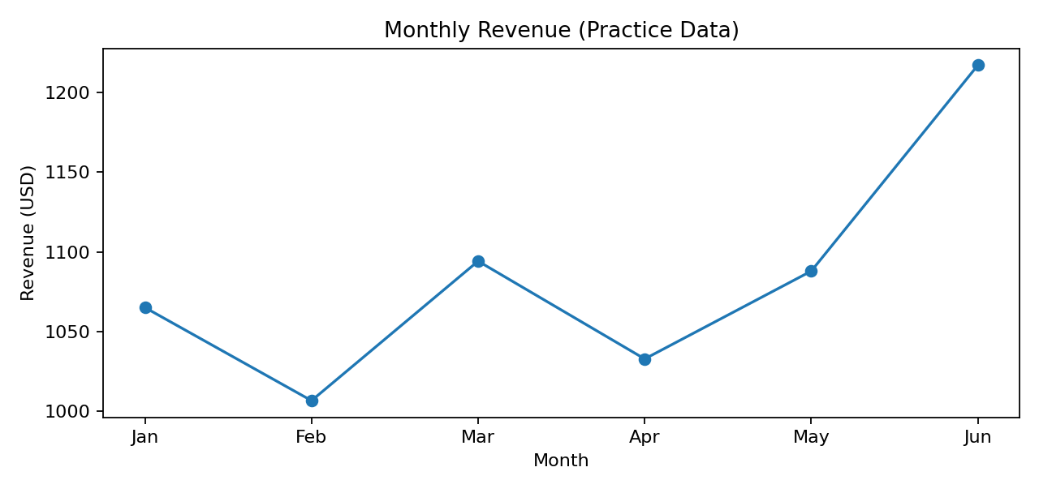
06 — SALES OVER TIME
MONTHLY TRENDS HELP PLAN STAFFING AND INVENTORY
Use a line chart for a time series. Avoid treating category comparisons as if they were time trends.
ANALYSIS CHECKS
• Best sales month
• Lowest sales month
• Weekend vs weekday demand
• Peak hours by transaction count
COFFEE SHOP SALES INTELLIGENCE • PRACTICE PROJECT
7

Slide 8
07 — CUSTOMER PURCHASE TIMING
PEAK HOURS CAN GUIDE STAFFING
The public dataset includes transaction time, so hourly demand can be calculated directly.
RECOMMENDED VISUALS
BUSINESS USE
• Column chart: transactions by hour
• Bar chart: sales by weekday
• Heatmap: weekday × hour
Schedule enough staff during busy periods, prepare high-demand items in advance, and avoid overstaffing during quiet periods.
COFFEE SHOP SALES INTELLIGENCE • PRACTICE PROJECT
8

Slide 9
08 — DATA QUALITY & ANALYST CAUTION
DON’T TURN A DASHBOARD INTO A MISLEADING STORY
Good analysis includes limitations, not just attractive charts.
• The attached practice CSV is simulated and is not the real Kaggle dataset.
• Estimated costs and profit are synthetic assumptions; replace with verified cost data.
• Revenue is not profit. Discounts can increase volume while reducing margin.
• Use average ratings only if actual customer-rating data exists; this coffee dataset does not include ratings.
• Check missing values, duplicates, date types, and outliers before charting.
COFFEE SHOP SALES INTELLIGENCE • PRACTICE PROJECT
9

Slide 10
09 — DATASET & NEXT STEPS
USE THE PUBLIC DATASET FOR YOUR FINAL ANALYSIS
The public Coffee Shop Sales dataset has 149,116 transactions covering January–June 2023.
SOURCE DATASET
Kaggle — Coffee Shop Sales.csv (149,116 transactions)
https://www.kaggle.com/code/lalit7881/coffee-shop-sales-eda-100/input
Suggested workflow
1. Download the source CSV • 2. Clean dates and missing values • 3. Calculate revenue and KPIs • 4. Build visuals in Excel or Power BI • 5. Write 4–6 evidence-based insights
Public dataset facts: source listing reports 149,116 transactions, product details, prices, quantities, store locations, and timestamps.
COFFEE SHOP SALES INTELLIGENCE • PRACTICE PROJECT
10

Slide 11
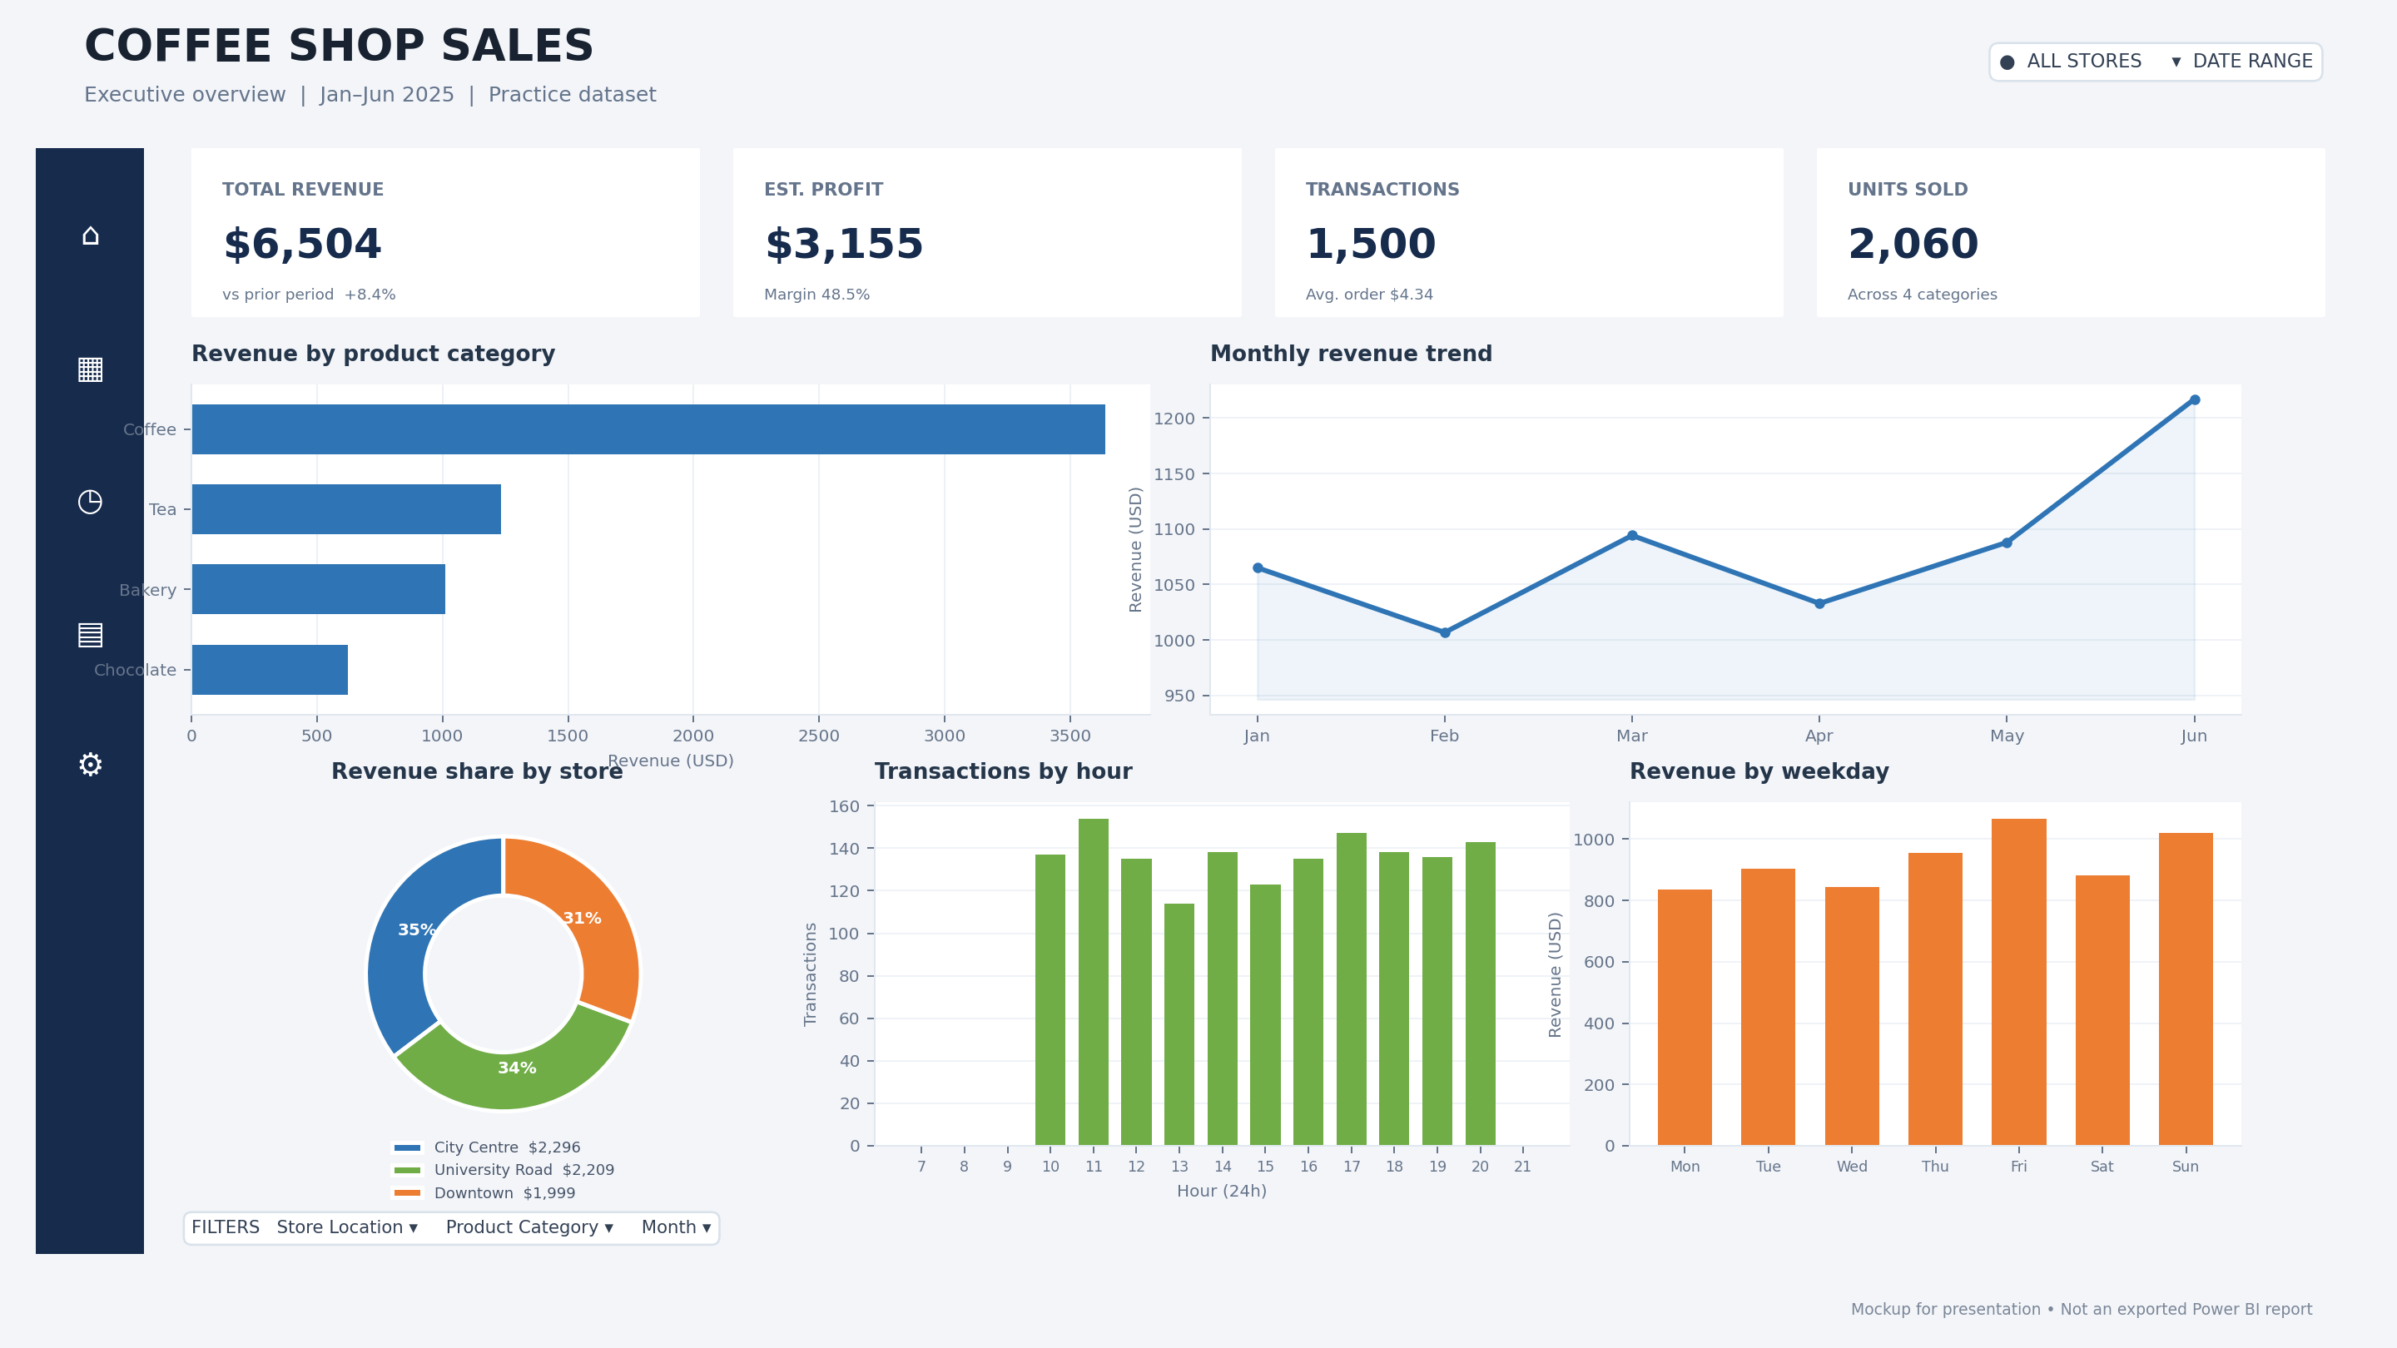
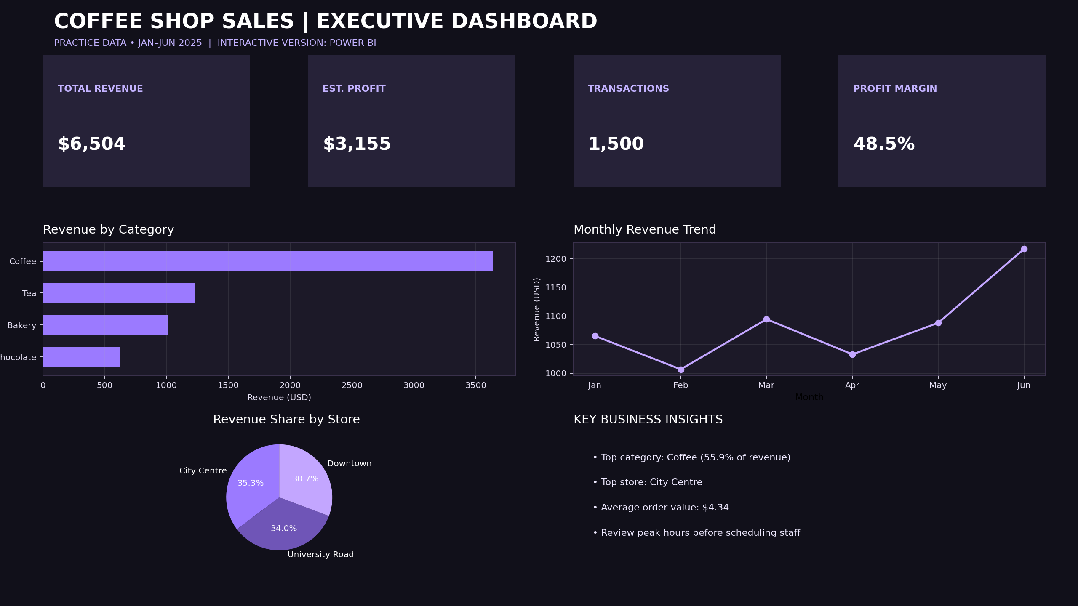
10 — FINAL POWER BI DASHBOARD
COFFEE SHOP SALES | OVERALL VIEW
Power BI-inspired dashboard mockup built from the simulated practice data
Note: this is a dashboard mockup image, not an exported screenshot from the Power BI application.

