Slide 1
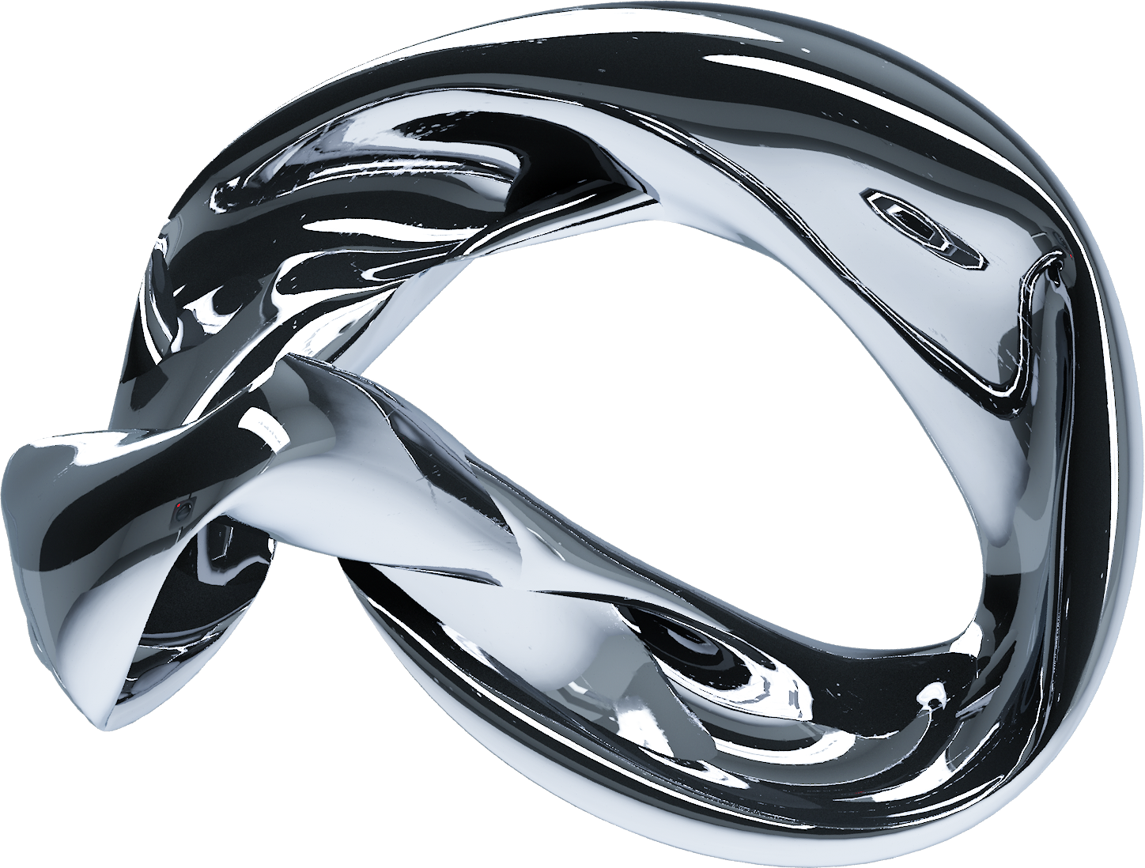
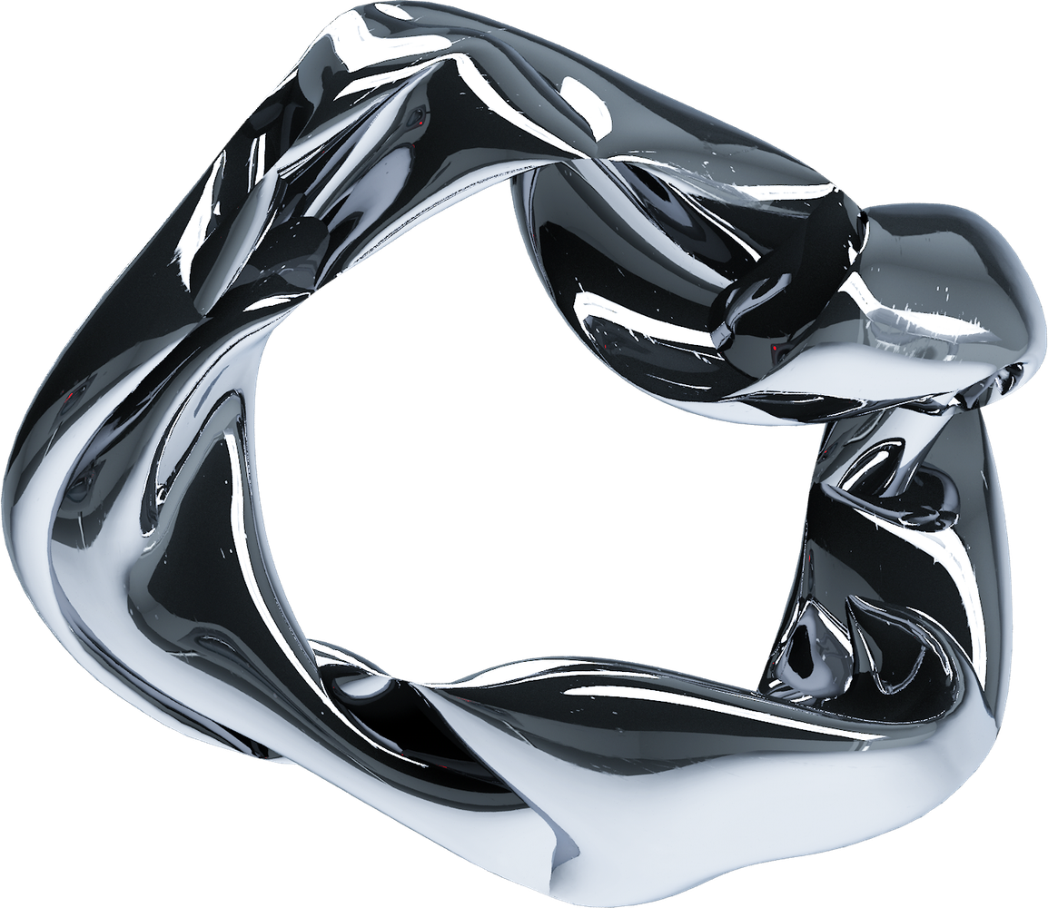
TEAM : NEED FOR SPEED
Shivansh pathak
(AI/ML & Data Engineer)
Dhairya Mittal
(AI/ML & Full-Stack Engineer)

Slide 2
TYRE DEGRADATION INTELLIGENCE
ISOLATING TRUE TYRE WEAR FROM FUEL LOAD, TRAFFIC, TRACK EVOLUTION AND OTHER CONFOUNDING FACTORS.

Slide 3
NEED FOR SPEED
Tyre performance during practice is affected by multiple variables:
  Fuel load
  Traffic & dirty air
  Track evolution
  Driver behaviour
  Weather & track conditions
How do we determine how quickly a tyre is actually degrading?
THE CHALLENGE!

Slide 4
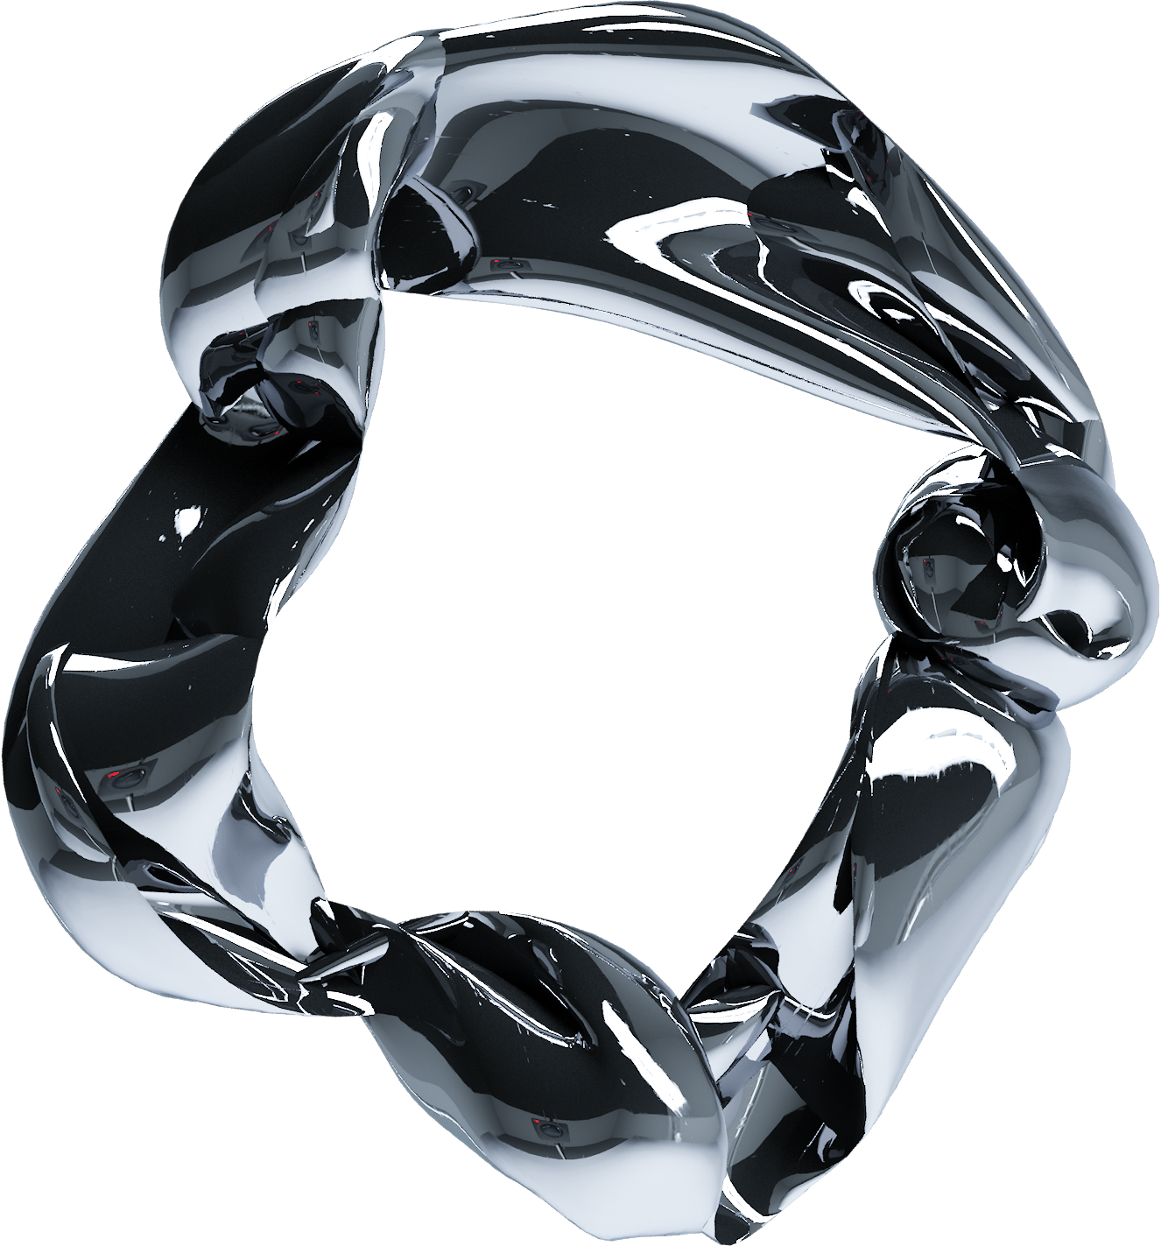
NEED FOR SPEED
Tyre Degradation Intelligence uses ML to separate tyre wear from external factors and generate a clean degradation curve.
Practice Data → Noise Removal → ML Model → Degradation Curve → Race Strategy
OUR APPROACH

Slide 5
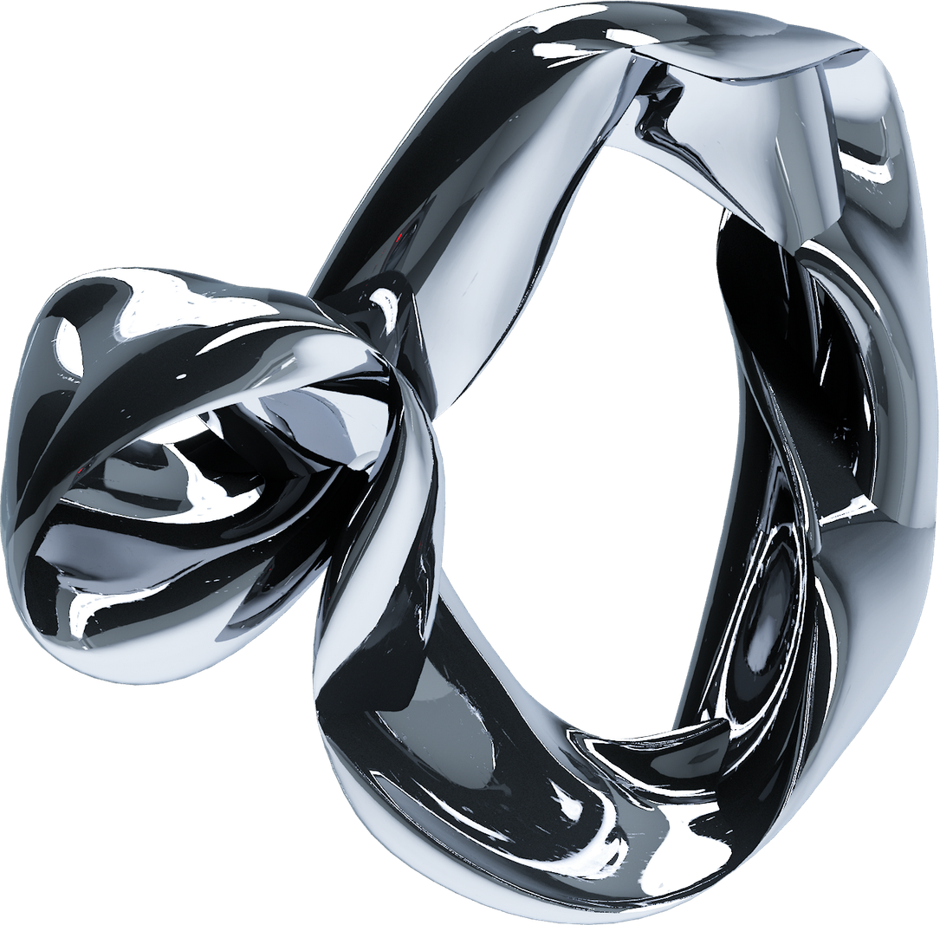
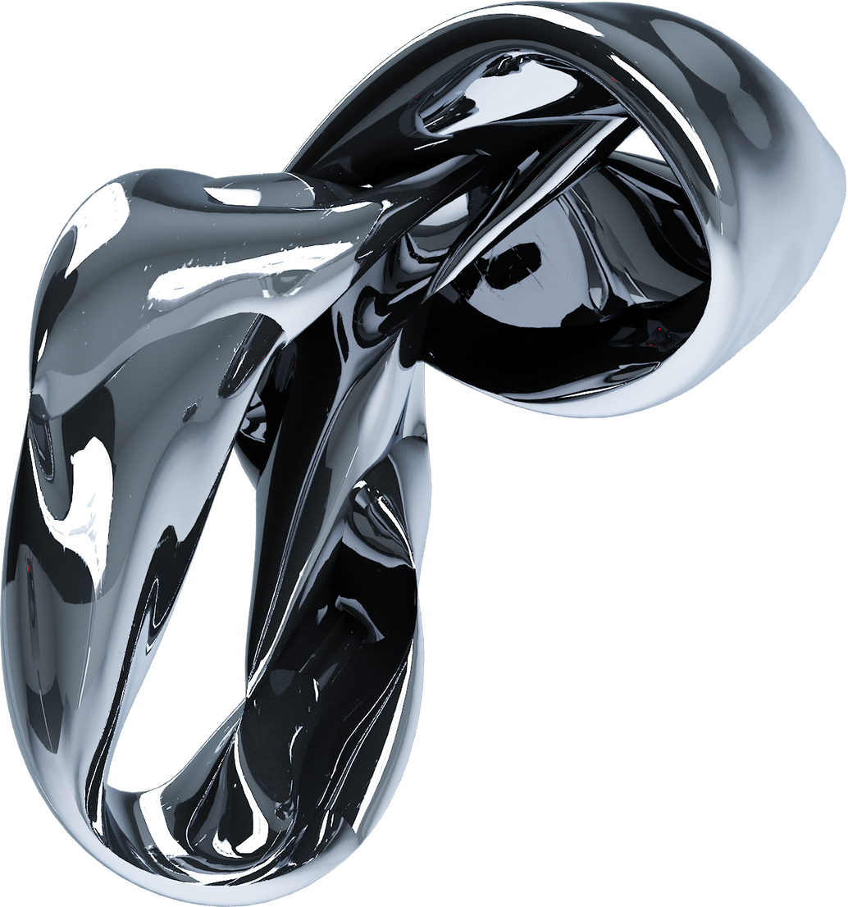
HOW IT WORKS
Data Collection
Lap times • Tyre compound • Fuel load • Track conditions • Traffic • Telemetry
↓
Feature Engineering
Lap-level tyre age + fuel-adjusted pace + traffic effects + track evolution
↓
ML Modelling
Estimate the contribution of each factor to lap-time loss
↓
Degradation Isolation
Extract the underlying tyre wear signal
↓
Prediction & Validation
Predict race-day degradation and compare against actual performance
NEED FOR SPEED

Slide 6
AI PIPELINE
Feature Engineering
Data Collection
ML Modelling
Turn tyre data into actionable race strategy.
Prediction & Validation

Slide 7
DASHBOARD
NEED FOR SPEED
TYRE DEGRADATION
0.XX sec/lap
EXPECTED STINT LIFE
XX laps
BEST COMPOUND
Medium
CONFIDENCE
XX%
And underneath:
Degradation Curve
A graph showing:
Lap Number → Lap Time Loss
with separate curves for Soft / Medium / Hard.

Slide 8
NEED FOR SPEED
TECH
STACK
Data
ML
EXPLAINABILITY
Python • Pandas • NumPy
Clean & process telemetry
Scikit-learn • XGBoost
Model performance & degradation
SHAP & Understanding model decisions

Slide 9
NEED FOR SPEED
FUTURE VISION
Beyond the Hackathon:
Tyre Degradation Intelligence → Race Strategy Engine
Future extensions:
  Real-time degradation estimation
  Live pit-stop recommendations
  Driver-specific tyre models

Slide 10
THANK YOU
NEED FOR SPEED

