Slide 1


STEGANOGRAPHY (A new technique to hide information within image file)
Prepared by: Dhairya shah(16It119)
Anal shah(16it115)
Guided by: Prof. jalpesh vasa
(Assistant Prof.)

Slide 2
Contents:
1. Introduction
2. Objective
3. Scope
4. Introduction to Project
5. Technology Used/required
6. Advantages
7. application
8. reference

Slide 3
Introduction:
Greek Words=
STEGANOS – “Covered”
GRAPHIA – “Writing”
Steganography is the art and science of writing hidden messages in such a way that no one apart from the intended recipient knows of the existence of the message.
• This can be achieve by concealing the existence of information within seemingly harmless carriers or covers (text, image, video, audio, etc.)

Slide 4
Continue-
Steganography is often confused with cryptography because the two are similar in the way that they both are used to protect important information.
The difference between two is that steganography involves hiding information so it appears that no information is hidden at all.
If a person or persons views the object that the information is hidden inside of he or she will have no idea that there is any hidden information, therefore the person will not attempt to decrypt the information.

Slide 5
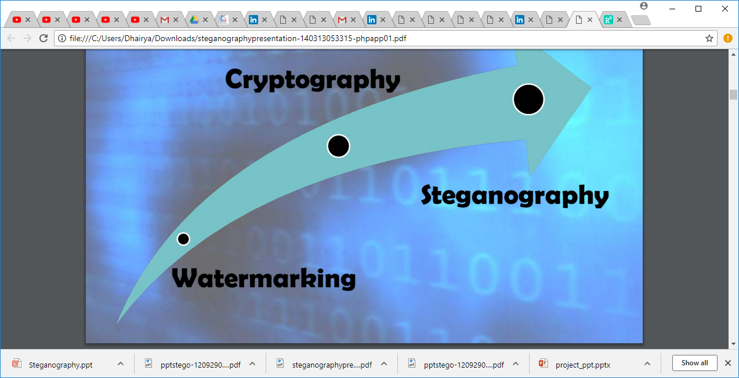
Evolution:
Cryptography: change the data so it is not readable. Adversary
can see there is a data communicated but can’t understand it.
Watermarking: either visible or invisible and used to identify
ownership and copyright.
Steganography: hide the very existence of the data. Adversary doesn’t know of a secret communication.

Slide 6
Objective:
To product security tool based on steganography techniques.
To explore techniques of hiding data using encryption module of this project
To extract techniques of getting secret data using decryption module.
Steganography sometimes is used when encryption is not permitted.
Or, more commonly, steganography is used to supplement encryption. An encrypted file may still hide information using steganography, so even if the encrypted file is disappeared, the hidden message is not seen.

Slide 7
Scope:
The scope of the project is to limit unauthorized access and provide better security during message transmission.
In this project, the proposed approach finds the suitable algorithm for embedding the data in an image using steganography which provides the better security pattern for sending messages through a network

Slide 8
Introduction to project:
Types of steganography:
“Steganography in “TEXT”
“Steganography in “IMAGES”
“Steganography in “AUDIO”
We will understand image steganography and their different ways in detail.

Slide 9
Image steganography
The most common approaches to information hiding in images :
Least Significant bit insertion
Masking and Filtering
Algorithms and transformations

Slide 10
Least Significant bit insertion
Replaces least significant bits with the message to be encoded.
Most popular technique when dealing with images.
Simple, but susceptible to lossy compression and image manipulation.

Slide 11
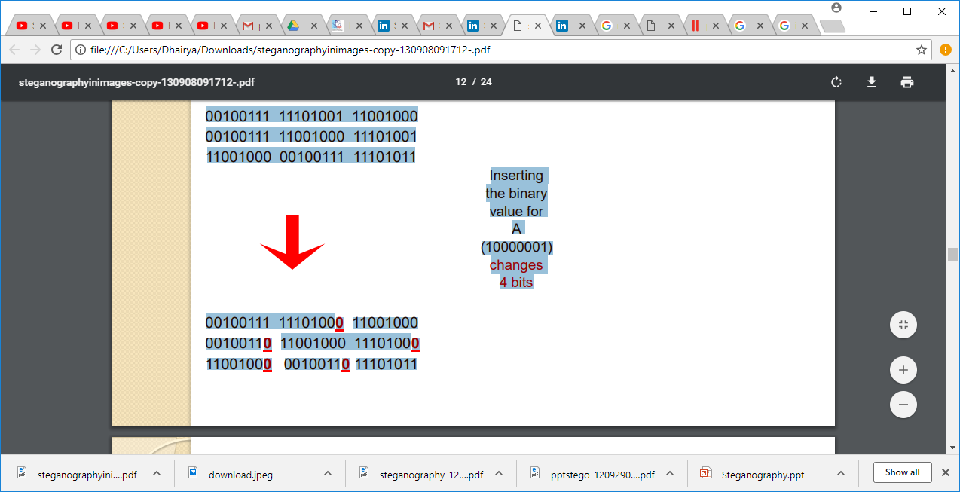
Example for lsb

Slide 12
Types of image steganography
Image Compression:
Image compression offers a solution to large image files. Two kinds of image compression are lossless and lossy compression. Both methods save storage space but have differing effects on any uncompressed hidden data in the image. “Lossy” JPEG(Joint Photographic Experts Group) format files, offers high compression, but may not maintain the original image's integrity. Hence it is called “lossy”
“Lossless” compression maintains the original image data exactly, It is thus more favoured by steganographic techniques. Eg: (BMP ),(GIF) Formats.

Slide 13
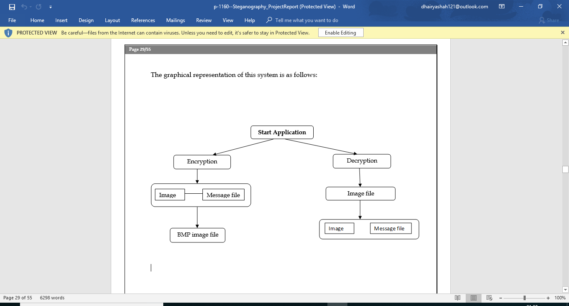
Graphical representation:

Slide 14
Technology used:
Software Requirements:
.NET Framework 3.5
Hardware Requirements:
Processor: Preferably 1.0 GHz or Greater.
RAM : 512 MB or Greater.

Slide 15
Advantages:
Advantages:
It is used in the way of hiding not the Information but the password to reach that Information.
• Messages do not attract attention to themselves ie difficult to detect. Only receiver can detect.
• Can be applied differently in digital image, audio & video file.

Slide 16
Applications:
Confidential communication and secret data storing
• Protection of data alteration
• Used in modern printers
• Protect copyrights, to maintain confidentiality.

Slide 17
References:
https://en.wikipedia.org/wiki/Steganography8
http://computer.howstuffworks.com/file-compression3.htm
http://www.scribd.com/doc/49683406/1/Steganography-vs-Cryptography

Slide 18
Thank you!!!

