Slide 1
ENTERPRISE MACROECONOMIC INTELLIGENCE
Global Trade Analytics &
Predictive Intelligence Platform
Macroeconomic Trade Balances • Box-Jenkins ARIMA & Machine Learning Projections • Geospatial Vector Mapping • What-If Tariff Simulation • Automated Executive Briefings
Author & Lead Developer: Dhairyasheel Gaikwad | Email: dhairyasheelgaikwad8@gmail.com | GitHub: @dhairyasheel37
Technology Stack: Python 3.12 • FastAPI • React 19 • Vite • SQLite • Scikit-Learn • Statsmodels • ReportLab • D3 / TopoJSON

Slide 2
PROJECT RATIONALE
Executive Summary & Problem Statement
Bridging the gap between static trade records and predictive macroeconomic decision-making
THE PROBLEM
• Fragmented Trade Reporting: Asymmetric reporting periods and inconsistent commodity classifications across 190+ nations.
• Static Historical Reporting: Most institutional portals offer retrospective views without forward-looking trajectory modeling.
• Lack of Shock Simulation: Inability for policy analysts to simulate real-time tariff hikes, border carbon levies, or supply shocks.
• Absence of Real-Time Alerting: Critical trade deficit spikes and balance reversals go unnoticed until quarterly releases.
OUR SOLUTION
• Unified Micro-to-Macro Pipeline: Normalizes 3,900+ raw UN Comtrade records into clean, validated, queryable SQLite aggregates.
• Advanced Econometric Suite: Formalized international indices (Lafay TBI, Revealed Trade Advantage, Grubel-Lloyd, HHI).
• 4-Model Forecasting Engine: Box-Jenkins ARIMA, Holt-Winters ETS, Random Forest, and Linear Regression with AIC/BIC arena.
• Interactive Policy Simulator: Dynamic Armington elasticity modeling simulating price pass-through, tariff revenue, and flow diversion.
KEY PLATFORM METRICS
• 190 Sovereign Economies: Full geospatial TopoJSON vector coverage with directional trade flows.
• 2026–2030 Projections: Multi-step recursive forecasts with expanding 95% confidence intervals.
• 167 Automated Pytest Tests: 100% test pass rate with mathematical consistency regression guards.
• Enterprise Executive Delivery: Scheduled multi-page ReportLab PDF dossiers dispatched via TLS SMTP or in-app Outbox.
Global Trade Analytics Platform • UN Comtrade Intelligence • Dhairyasheel Gaikwad Slide 2 of 15

Slide 3
SYSTEM ARCHITECTURE
Decoupled Enterprise Architecture & Technology Stack
Modular design separating high-throughput ingestion, predictive computation, and interactive visualization
DATA & INGESTION LAYER
• UN Comtrade v1 REST Client: Dynamic rate limiting, pagination, M49 geographic code resolution.
• SQLite Relational Core: Indexed composite tables (trade_records_v2, alert_rules, outbox_logs).
• Data Cleaning Pipeline: Zero-guarded numeric coercion, schema validation, strict deduplication.
• Scheduled 24h Background Cron: Autonomous background synchronization worker in FastAPI lifespan.
API & COMPUTATION LAYER
• FastAPI Asynchronous Gateway: JWT Bearer authentication, role-based access control (Admin / Trader).
• Predictive Modeling Core: Box-Jenkins ARIMA (p,d,q), Holt-Winters ETS, Random Forest (50 trees), OLS Regression.
• Scenario Simulator Engine: Armington elasticity equations computing price pass-through, diversion, and tariffs.
• ReportLab & OpenPyXL: Dynamic vector PDF charts and styled financial Excel workbooks.
FRONTEND & DELIVERY LAYER
• React 19 & Vite 8 SPA: Component-driven architecture with glassmorphic enterprise styling.
• D3 & TopoJSON Vector Map: Interactive offline global choropleth with slide-out country drawer.
• Recharts Data Visualization: Multi-series line charts, grouped bars, area envelopes, sensitivity curves.
• Enterprise Outbox Dispatcher: Real-time SMTP client with TLS, simulated outbox fallback, and PDF downloads.
Global Trade Analytics Platform • UN Comtrade Intelligence • Dhairyasheel Gaikwad Slide 3 of 15

Slide 4
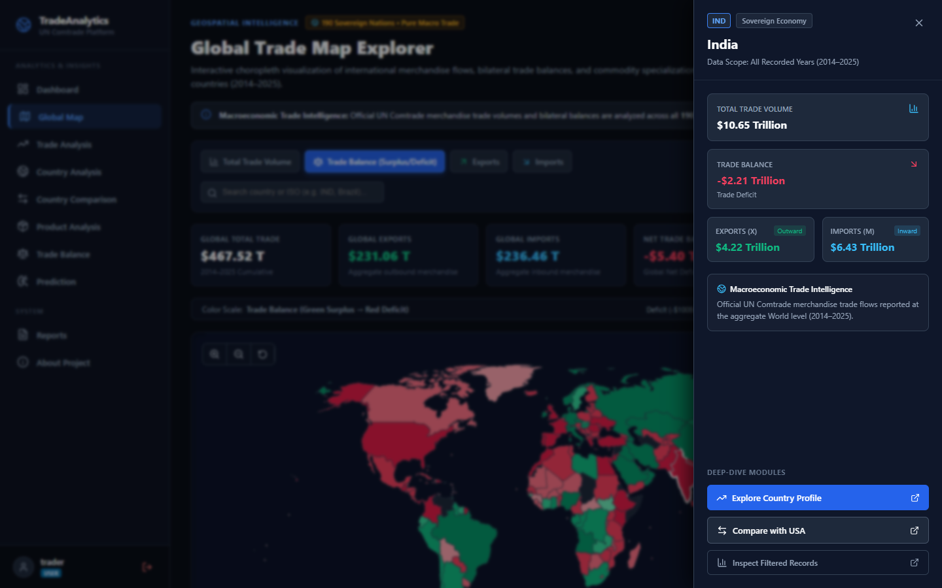
GEOSPATIAL VISUALIZATIONS
Interactive Global Trade Vector Choropleth
Zero-dependency D3 & TopoJSON choropleth rendering 190 sovereign nations with real-time balance classification
CORE CAPABILITIES
• 100% Offline Vector Rendering: Utilizes local TopoJSON vector geometries without external map tile dependencies.
• Macro Trade Classification: Color-coded trade balance equilibrium:
• Emerald: Surplus Powerhouse (Net Exporter)
• Blue: Balanced Partner (Equilibrium)
• Amber/Red: Structural Net Importer
• Slide-Out Country Dossier Drawer: Clicking any sovereign territory smoothly slides out deep-dive metrics: bilateral exports, import sources, and historical growth.
• Cross-Device Responsive: Tested across desktop (1440px), tablet (768px), and mobile (375px) viewports.
Global Trade Analytics Platform • UN Comtrade Intelligence • Dhairyasheel Gaikwad Slide 4 of 15

Slide 5
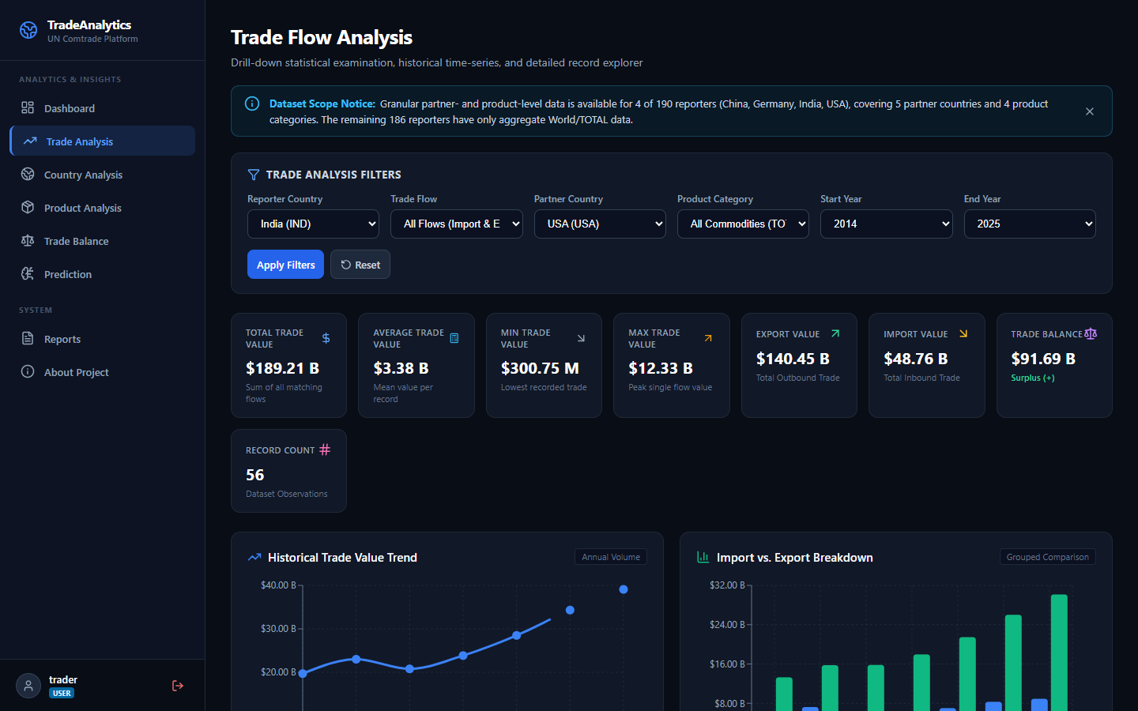
BILATERAL ANALYTICS
Bilateral Flow Analytics & HS Commodity Deep-Dive
Multi-tiered directional analysis tracking merchandise flows, sector market shares, and partner concentration
ANALYTICAL HIGHLIGHTS
• Directional Balance Separation: Simultaneously tracks gross exports, gross imports, and net trade balance per bilateral pair.
• Harmonized System (HS) Chapters: Granular drill-down across industrial sectors (electronics, machinery, agriculture, mineral fuels).
• Server-Side Data Grid: High-throughput pagination, multi-column sorting, and 1-click CSV data export for econometric modeling.
• Supplier Concentration Ranking: Identifies leading sovereign export partners and import dependencies with percentage market shares.
Global Trade Analytics Platform • UN Comtrade Intelligence • Dhairyasheel Gaikwad Slide 5 of 15

Slide 6
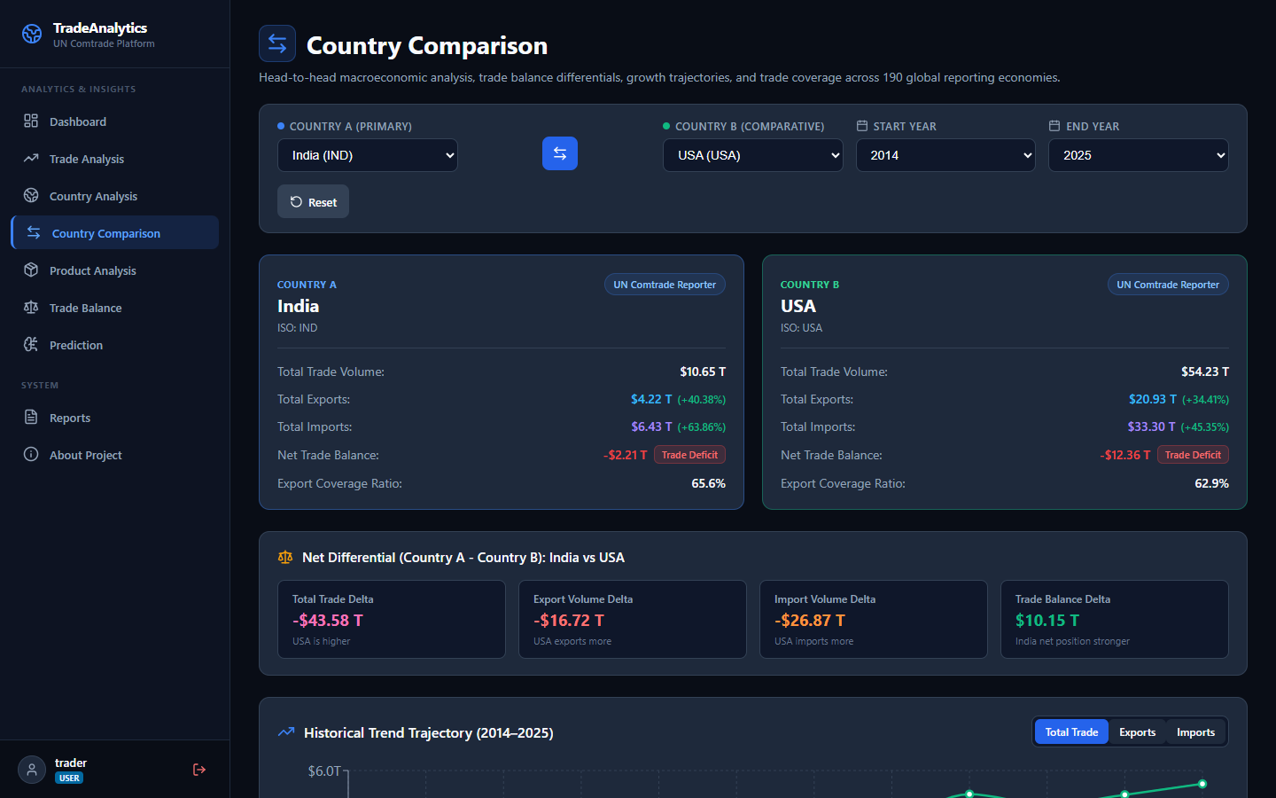
COMPARATIVE ECONOMICS
Bilateral Country Profile & Head-to-Head Comparison
Side-by-side macroeconomic trade disparity benchmarking with mathematical symmetry verification
COMPARATIVE BENCHMARKING
• Head-to-Head Country Comparison: Select any 2 nations to instantly calculate trade volume disparities and net balance gaps.
• Mathematical Swap Symmetry: Strict verification that comparing Country A vs B produces mathematically mirrored differentials compared to B vs A.
• Zero-Guarded Growth Rates: Prevents division-by-zero artifacts on emerging sectors with zero baseline volumes.
• Bilateral Exposure Ratios: Visualizes bilateral dependencies (e.g. USA vs India, China vs Germany, Brazil vs France).
Global Trade Analytics Platform • UN Comtrade Intelligence • Dhairyasheel Gaikwad Slide 6 of 15

Slide 7
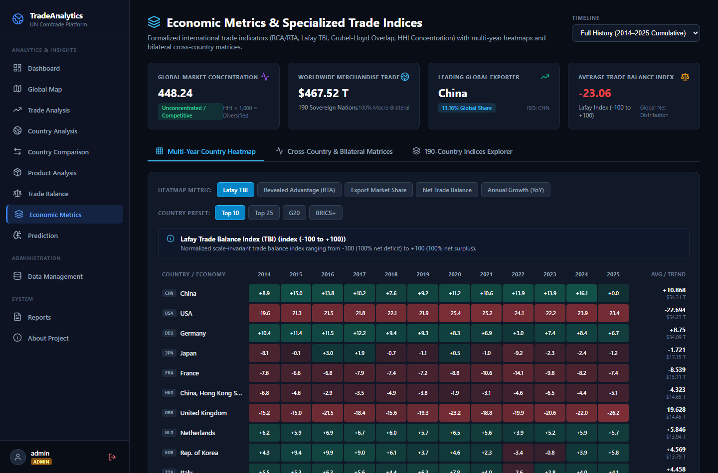
MACROECONOMIC THEORY
Specialized International Trade Economic Indices
Empirical calculation of formalized trade competitiveness, specialization, and market overlap indices
FORMALIZED INDICES
• Lafay Trade Balance Index (TBI):
TBI = 100 * (X - M) / (X + M), normalized in [-100, +100].
• Revealed Trade Advantage (RTA / Balassa):
RTA = (X_i/X_w) / (M_i/M_w), evaluating true export advantage.
• Grubel-Lloyd Index (GLI):
GLI = 1 - (|X - M| / (X + M)), quantifying intra-industry macro overlap.
• Hirschman-Herfindahl Index (HHI):
Measures partner diversification and market concentration.
• Interactive 2D Matrix Heatmaps: Hover tooltips with export-import split bars and crosshair highlighting.
Global Trade Analytics Platform • UN Comtrade Intelligence • Dhairyasheel Gaikwad Slide 7 of 15

Slide 8
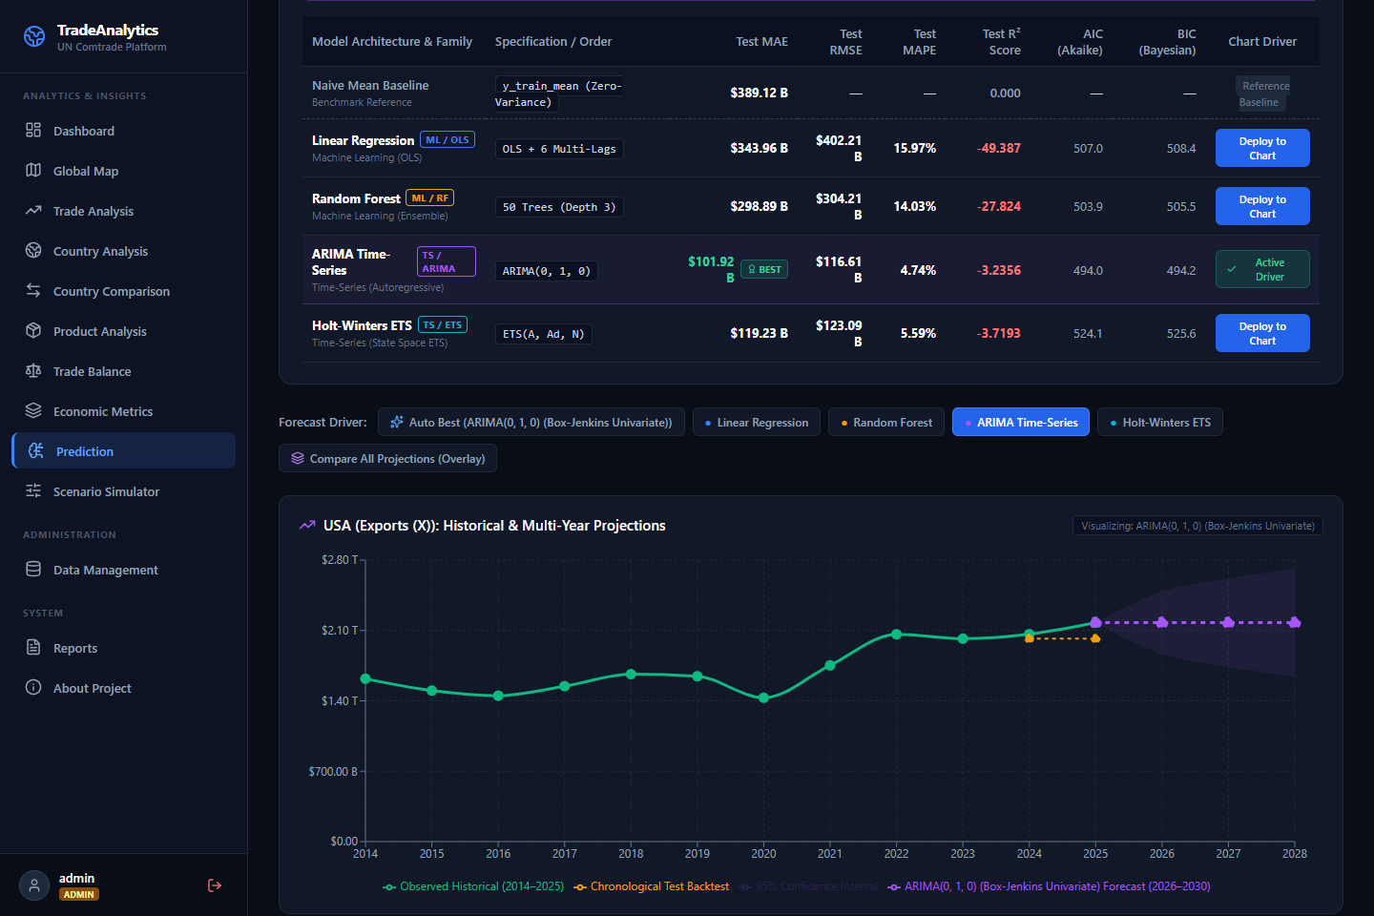
PREDICTIVE INTELLIGENCE
Advanced Machine Learning Forecasting Engine
Dedicated univariate Box-Jenkins time-series and ensemble algorithms generating 2026–2030 projections
4-MODEL FORECASTING SUITE
• Box-Jenkins ARIMA (p,d,q): Automated grid search minimizing Akaike Information Criterion (AIC), stationarity differencing (d=1), and analytical variance propagation.
• Holt-Winters ETS (A, Ad, N): State-space exponential smoothing with additive damped trend and level decay optimization (alpha, beta, phi).
• Random Forest Regressor: 50 shallow decision trees with bootstrap aggregation to prevent macro overfitting.
• Linear Regression (OLS): 3-year autoregressive lags, rolling mean, and linear time trend baseline.
• Expanding 95% Confidence Intervals: Calculates statistical bounds expanding over multi-step forecast horizons (2026–2030).
Global Trade Analytics Platform • UN Comtrade Intelligence • Dhairyasheel Gaikwad Slide 8 of 15

Slide 9
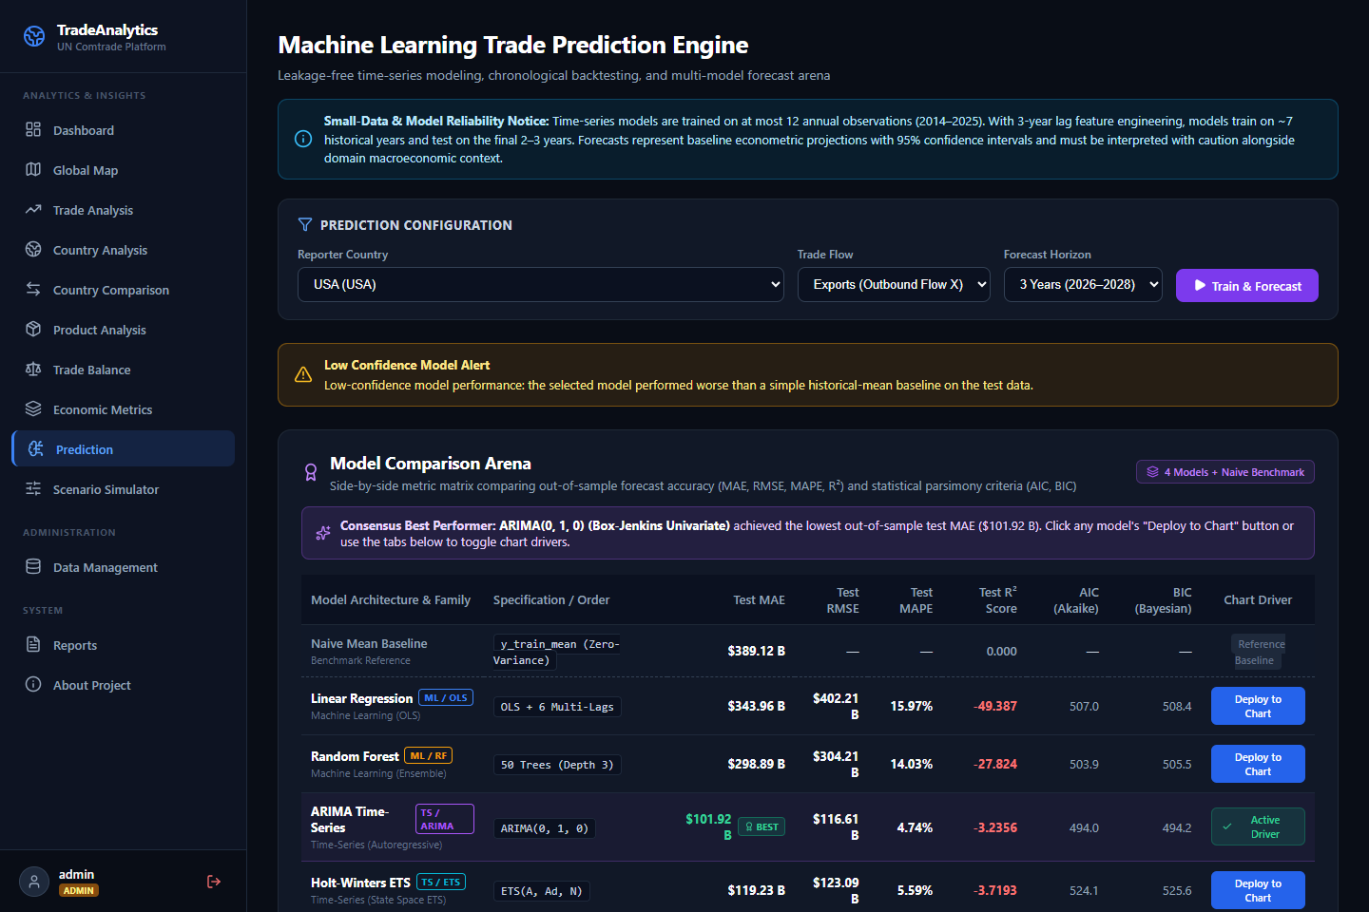
MODEL BENCHMARKING
Model Comparison Arena & Multi-Model Curve Overlay
Side-by-side metric matrix comparing out-of-sample accuracy, parsimony criteria, and simultaneous multi-curve overlays
THE COMPARISON ARENA
• Out-of-Sample Metric Matrix: Side-by-side comparison of MAE, RMSE, MAPE, and R² across all 4 models and the Naive Mean Baseline.
• Akaike (AIC) & Bayesian (BIC) Scores: Penalizes model complexity to select the most statistically parsimonious architecture.
• 1-Click 'Deploy to Chart': Dynamically toggle which model drives the master trajectory.
• Multi-Model Overlay View: Renders projections from all 4 models simultaneously branching from historical actuals into 2026–2030.
• Consensus Mean Aggregation: Computes ensemble mean across all models with model divergence metrics.
Global Trade Analytics Platform • UN Comtrade Intelligence • Dhairyasheel Gaikwad Slide 9 of 15

Slide 10
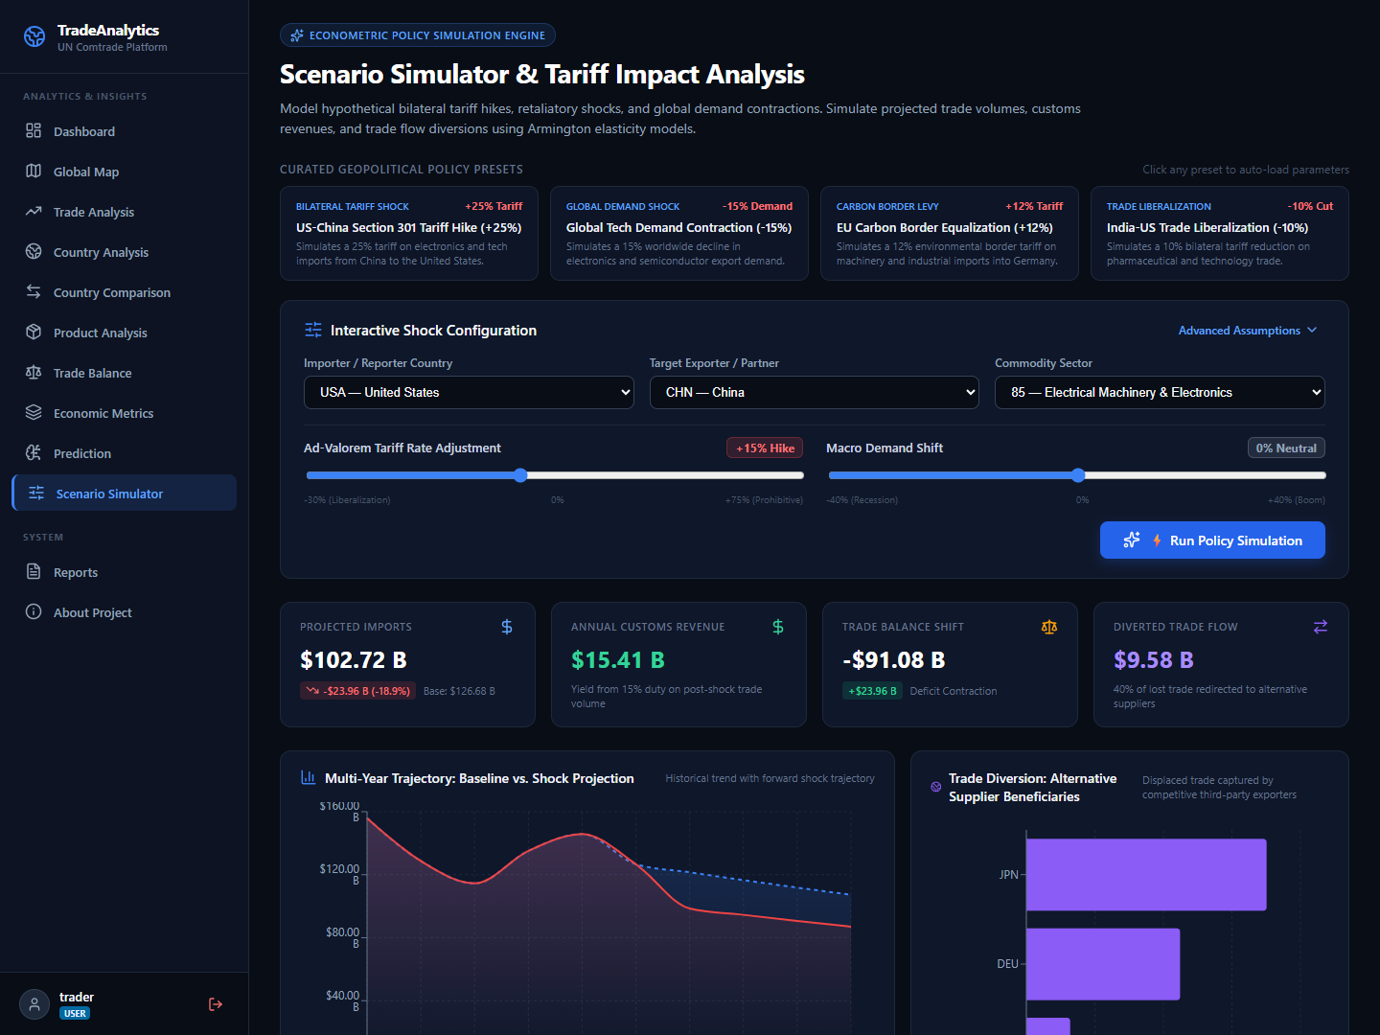
ECONOMIC POLICY MODELING
Scenario Simulator & Tariff Impact Engine ('What-If')
Simulates geopolitical shocks, tariff hikes, consumer price pass-through, and trade flow diversion
SIMULATION CAPABILITIES
• Armington Price Elasticity: Computes price pass-through and quantity demand shifts (%ΔQ = ε_d * τ) with logarithmic boundaries.
• Curated Geopolitical Presets:
• US-China Section 301 Tariff Hike (+25%)
• Global Tech & Electronics Slump (-15%)
• EU Carbon Border Adjustment Levy (+12%)
• Indo-US Free Trade Liberalization (-10%)
• Laffer-Style Sensitivity Curves: Evaluates optimal customs revenue yields versus trade volume destruction.
• Trade Diversion Winners: Models substitution effects where third-party nations capture redirected trade flows.
• Automated Policy Briefing: Generates natural language executive policy summaries with 1-click CSV/JSON export.
Global Trade Analytics Platform • UN Comtrade Intelligence • Dhairyasheel Gaikwad Slide 10 of 15

Slide 11
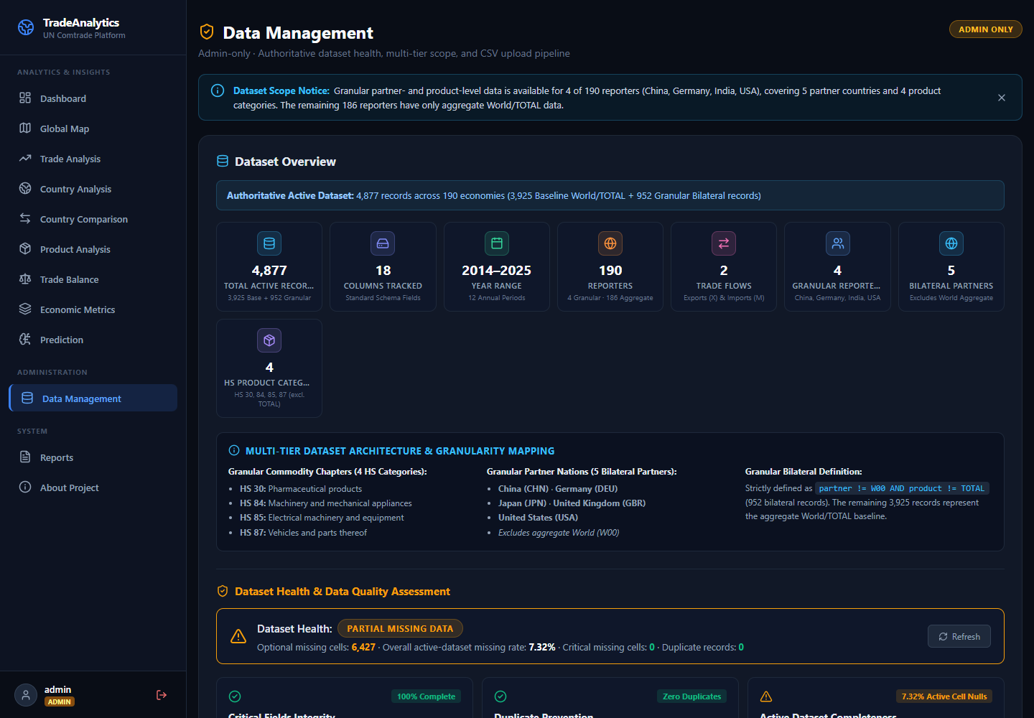
DATA OPERATIONS
Live UN Comtrade API Ingestion & Data Management
Automated synchronization pipeline querying UN Comtrade v1 REST APIs with rate limiting and audit trail logging
DATA PIPELINE HIGHLIGHTS
• UN Comtrade v1 REST Client: Dynamic rate limiting, pagination, M49 geographic code resolution, and reference metadata caching.
• Background 24h Scheduler: Asynchronous background worker in FastAPI lifespan executing validation, cleaning, deduplication, and database indexing.
• Drag-and-Drop Ingestion Portal: Drag-and-drop dropzone on /data-management with instant schema checking and audit trail logging.
• Zero-Data Corruption Guard: Enforces database transactions and rollback safety on malformed CSV records.
Global Trade Analytics Platform • UN Comtrade Intelligence • Dhairyasheel Gaikwad Slide 11 of 15

Slide 12
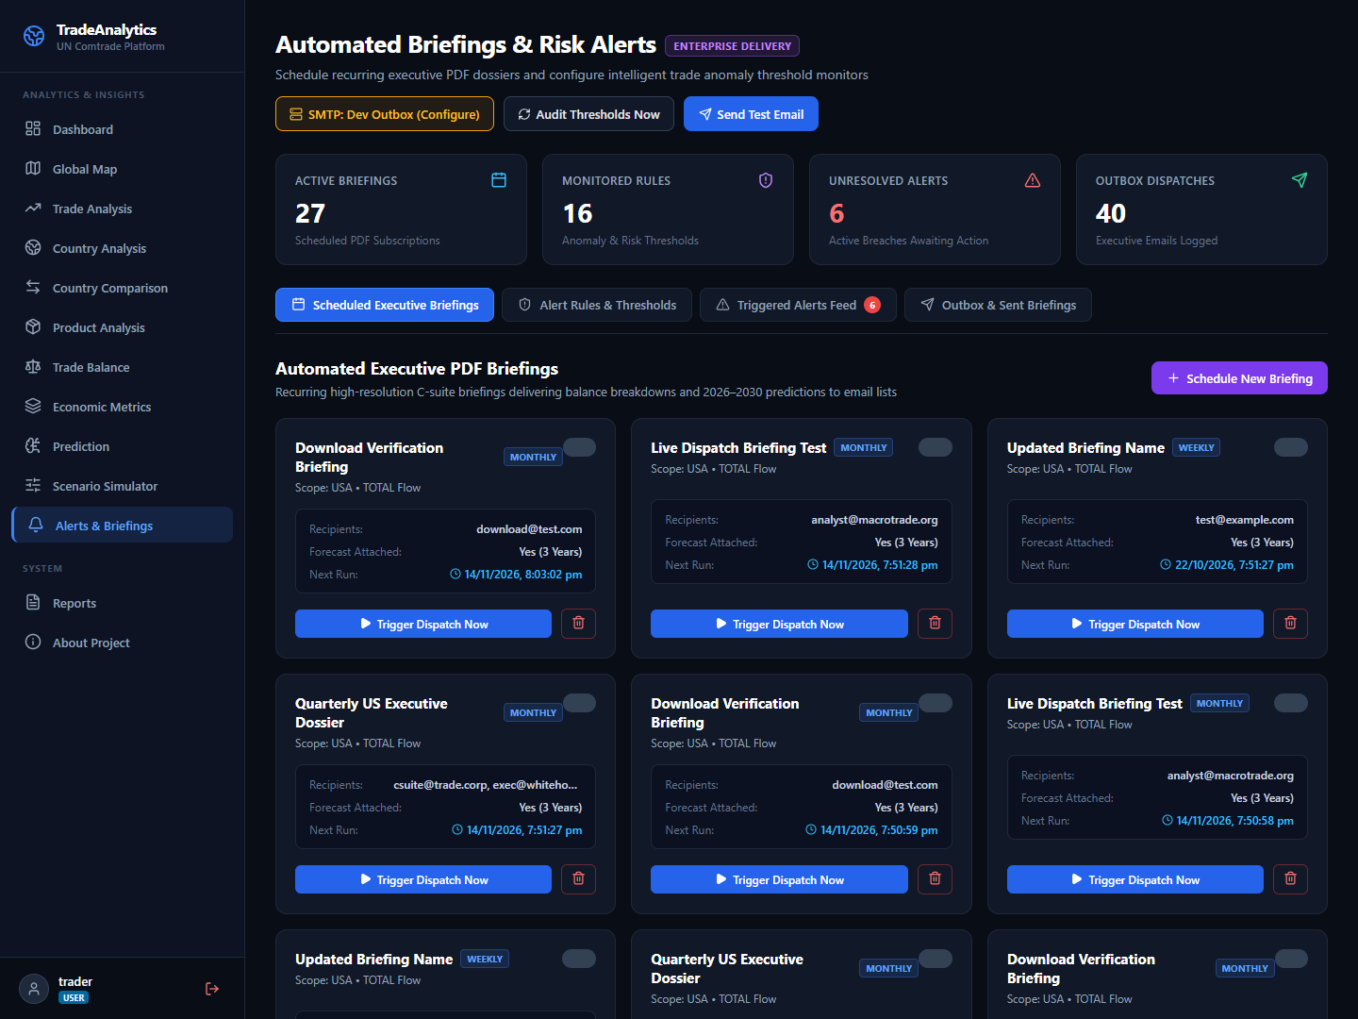
ENTERPRISE DELIVERY
Automated Executive Briefings & Risk Alerts Engine
Automated PDF dossier subscriptions and intelligent macroeconomic anomaly threshold monitors
DELIVERY & ALERTING
• Recurring Executive PDF Dossiers: Dispatches high-resolution multi-page PDF reports (Daily, Weekly, Monthly, On-Sync).
• Macroeconomic Threshold Rules:
• Deficit Expansion YoY (> 20%)
• Severe Export Contraction (> 15%)
• Sudden Inbound Import Surge
• Surplus-to-Deficit Reversal Flips
• Incident Lifecycle Management: Full operational workflow tracking (TRIGGERED -> ACKNOWLEDGED -> RESOLVED).
• Enterprise Outbox Dispatcher: SMTP with STARTTLS support, simulated in-app Development Outbox fallback, and direct in-portal PDF downloads.
Global Trade Analytics Platform • UN Comtrade Intelligence • Dhairyasheel Gaikwad Slide 12 of 15

Slide 13
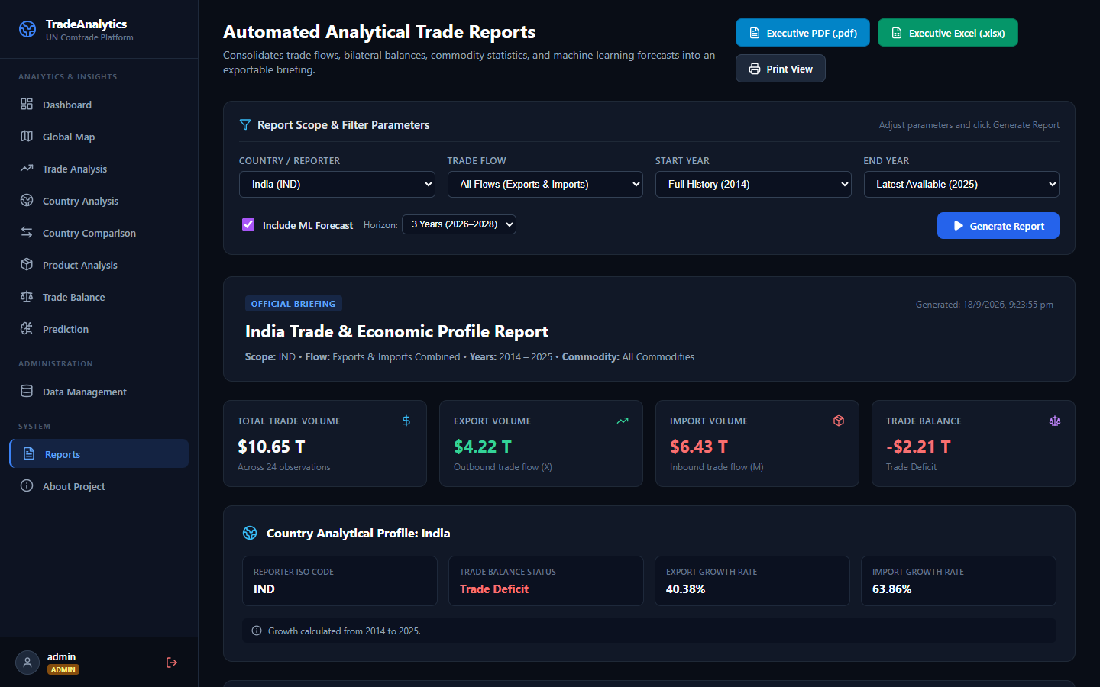
REPORTING SUBSYSTEM
Multi-Page Executive PDF & Excel Financial Models
Automated publication engine producing boardroom-ready PDF briefing dossiers and formatted OpenPyXL spreadsheets
REPORTING HIGHLIGHTS
• ReportLab PDF Dossiers: Multi-page high-resolution executive reports with branded headers, KPI grids, trade balance distributions, and automated page numbering.
• Integrated ML Projections: Embedded forecast tables displaying projected values, 95% confidence bands, and algorithm parameters.
• OpenPyXL Financial Models: Styled header fills, formatted currency cells ($USD Billions), auto-fitted column widths, and summary statistical rows.
• Verbatim Transparency Disclaimers: Prominent methodology notices explaining short-horizon caveats and baseline comparisons.
Global Trade Analytics Platform • UN Comtrade Intelligence • Dhairyasheel Gaikwad Slide 13 of 15

Slide 14
QUALITY ENGINEERING
Comprehensive Testing, Reliability & Verification
Rigorous automated test suites verifying mathematical consistency, security, and UI responsiveness
167 PYTEST TESTS (100%)
• 167 Passed, 0 Failed (~50s execution across 17 test modules).
• Authentication & Security: Role-based access control, password hashing, JWT expiration.
• Mathematical Consistency: Bilateral balance symmetry (Ind vs USA == - USA vs Ind).
• ML Bounds Enforcement: Out-of-sample MAE comparisons, AIC/BIC validation, 95% CI expansion.
• Alert Audits: Deficit delta thresholds, deduplication guards, outbox PDF persistence.
CLEAN FRONTEND BUILD
• Vite 8 & React 19: Clean production compilation in ~1.15 seconds.
• 2,539 Modules Transformed with zero syntax or bundling errors.
• Gzip Optimization: Minified chunk distribution with asset caching.
• Responsive Breakpoint Verification: Desktop (1440px), Tablet (768px), and Mobile (375px).
PLAYWRIGHT AUTOMATION
• Headless Browser Verification: End-to-end user journey simulation.
• 0 Console Errors: Clean execution without unhandled exceptions.
• Automated Screenshot Captures: Preserves visual proof across all module workflows.
• Real-Time Interaction Testing: Presets, sliders, tab navigation, modals, and download links.
Global Trade Analytics Platform • UN Comtrade Intelligence • Dhairyasheel Gaikwad Slide 14 of 15

Slide 15
CONCLUSION & ROADMAP
Summary, Real-World Impact & Future Horizons
Transforming global trade data into proactive macroeconomic intelligence
KEY ACHIEVEMENTS
• Comprehensive End-to-End System: Covers full lifecycle from raw Comtrade ingestion to boardroom PDF briefing distribution.
• Rigorous Econometric Foundations: Formalized international trade indices, Armington elasticities, and Box-Jenkins time-series models.
• Zero-Regression Architecture: 167 automated tests guaranteeing 100% mathematical consistency and API reliability.
• Enterprise-Grade UX: Modern responsive design with glassmorphism, interactive charts, and instant downloads.
FUTURE ROADMAP & CONNECT
• Granular HS 6-Digit Expansion: Drill down to micro-product lines (e.g. semiconductors, lithium-ion cells).
• Real-Time FX & Currency Adjustments: Purchasing power parity (PPP) and real effective exchange rate (REER) normalization.
• Multilateral Trade Treaty Modeling: Simulating regional trade bloc agreements (RCEP, USMCA, CPTPP).
• Author: Dhairyasheel Gaikwad
• GitHub: https://github.com/dhairyasheel37
• Email: dhairyasheelgaikwad8@gmail.com
Global Trade Analytics Platform • UN Comtrade Intelligence • Dhairyasheel Gaikwad Slide 15 of 15

