Slide 1

Video Frame Selection
The primary goal of this project is to curate visually appealing frames from a video dataset using computer vision techniques. The focus is on identifying frames based on attractiveness, clarity, and emotional expression, particularly happiness. The process involves several key stages, including emotion recognition, face detection, frame scoring, and final frame curation.

Slide 2
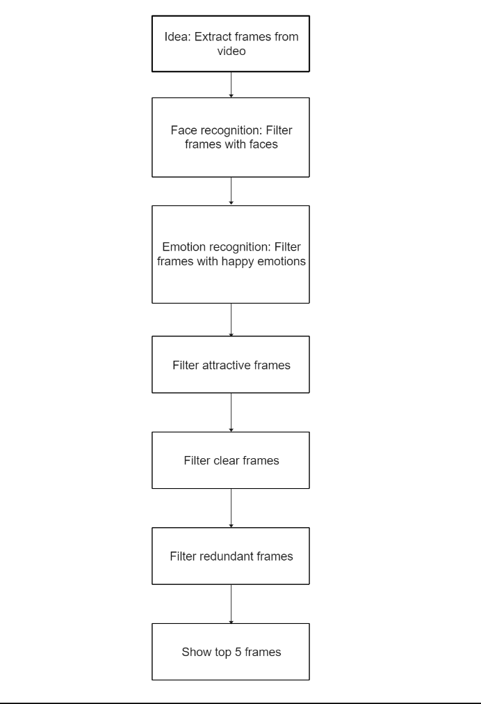
Flow Diagram

Slide 3
Overview
1
Face Detection
Utilize face detection algorithms to identify faces within each frame of the video dataset, ensuring accurate localization of facial regions.
2
Emotion Recognition
It's crucial to train a robust model for emotion recognition capable of identifying happiness and other facial expressions from a diverse dataset.
3
Frame Scoring
The assessment includes measuring attractiveness using a pre-trained model, analyzing facial features, and quantifying clarity by evaluating blur levels in the facial region of interest.
4
Frame Selection
This stage involves sorting frames based on overall scores, removing redundancy, and choosing the top-ranked frames as the final selection.

Slide 4
Detailed Process
Emotion Recognition Model Training
It's essential to train a robust model for emotion recognition capable of identifying happiness and other facial expressions from a diverse dataset. [FER-2013]
Frame Scoring
Assess attractiveness using a pre-trained model analyzing facial features, measure clarity by quantifying blur levels in the facial region of interest, and score frames based on attractiveness and clarity. Using celeb adataset [celeba-dataset]
Face Detection
Utilize face detection algorithms to identify
faces within each frame of the video dataset,
ensuring accurate localization of facial regions.
Frame Selection
Sort frames based on overall scores, remove redundancy to ensure diversity in the final selection, and choose the top-ranked frames as the final selection based on specific requirements.

Slide 5

Conclusion
Objective
Key Stages
The multi-stage process aims to extract visually appealing and emotionally expressive moments from a video dataset, prioritizing frames based on attractiveness, clarity, and emotional expression.
The stages involve face detection, emotion recognition, frame scoring, and final frame curation, each playing a crucial role in the process.

Slide 6
References
OpenCV Documentation
TensorFlow Documentation
Emotion Recognition Dataset - [FER-2013]
Face Detection Algorithms: Haar Cascades.

Slide 7
Requirements Installation Guide
Clone the repository: git clone https://github.com/your/repository.git
Install required packages: pip install -r requirements.txt

