Slide 1

NUMERICAL SIMULATION OF NONLINEAR NEWTONIAN BLOOD FLOW THROUGH A STENOSED ARTERY UNDER THE INFLUENCES OF PERIODIC BODY ACCELERATION
by
Soumen De
Department of Applied Mathematics
University of Calcutta, Kolkata
India

Slide 2
Outline of the Presentation

Slide 3
Outline
  Introduction
    Motivation /Problem definition
    Literature Survey
  Mathematical model of blood flow in artery
    Governing equations
    Initial and Boundary conditions
  Solving procedure Of the model
  Results and Discussions
  Conclusions and Future work
  References

Slide 4
Introduction

Slide 5
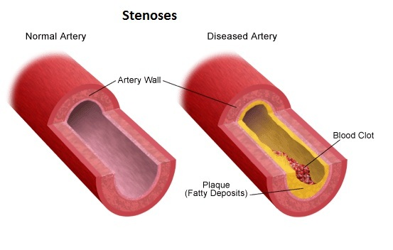
Problem definition
The study of blood flow through arteries under stenotic condition is very important because of the fact that the cause of many cardiovascular diseases ( heart attack and stroke) are related to the nature of blood movement .
The arterial narrowing or stenosis
is caused by a deposition of fats
in the arterial lumen.
The pumping action of hearts which
produce a pressure gradient
throughout the arterial system.

Slide 6
Literature survey
David N.Ku(1997)
    Review of Blood flow in arteries .
    Blood can be consider as Newtonian or non-Newtonian depend on the size of the arteries.
Md.A.Ikbal ,Chakravarty, Kelvin K.L. Wong, J.Majumdar, P.K.Mondal (2009)
    Unsteady non-Newtonian blood flow through a stenosed artery in magnetic field.
    Geometry of stenosis is considered time dependent.
    Finite difference simulations of Navier-Stokes equations for Re = 400, 600.
S. Mukhopadhyay, and G. C. Layek, (2009)
    Solved 2-D Navier-Stokes equations using finite difference method in saggered distribution.
    Blood considered as a incompressible Newtonian fluid.
    No external body force.
    The Geometry of Flow Fields in a Wavy-Walled Tube with Tapering.

Slide 7
Literature survey (contd)
Chakravarty and Mondal(1994)
    Linear approximation model of Navier stokes equation has been taken.
    blood flow through an overlapping arterial time dependent stenosis
    Solved the model by finite difference method in transformed domain using Laplace transformation
    The artery has been taken as elastic cylindrical tube
    Blood considered as Non-Newtonian fluid.
K.C. Ang, J.N. Mazumdar (1997)
    Mathematical modelling of three-dimensional flow through an asymmetric arterial stenosis.
    Blood considered as Newtonian fluid.
    Solved by using CFD software PHOENICS which uses the finite volume method.
S. Sankar (2011)
    Two-phase non-linear model for blood flow in asymmetric and axi-symmetric stenosed arteries.
    The perturbation method is applied to solve the model.

Slide 8
Literature survey (contd)
V.K.Sud, G.S.Sekhon(1985)
    Blood flow under periodic body acceleration
    Solved the linear model using Laplace transformation.
Fang-BaoTian , Luoding Zhu,Pak-Wing Fok, Xi-Yun Lu (2013)
    Simulation of a pulsatile flow through stenosed 2D artery.
    non-Newtonian uses Carreau–Yasuda model .

Slide 9
Mathematical model of blood flow through stenosed arteries

Slide 10
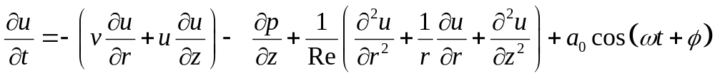
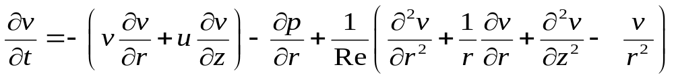
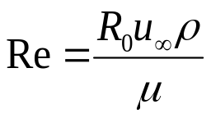
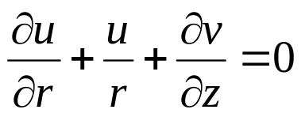
Mathematical model
we have considered the blood flow to be unsteady and incompressible through an
axi-symmetric cylindrical tube.
The 2D Navier-Stokes equations in cylindrical coordinate system,
in non-dimensional form are given by,
Where
The continuity equation is

Slide 11
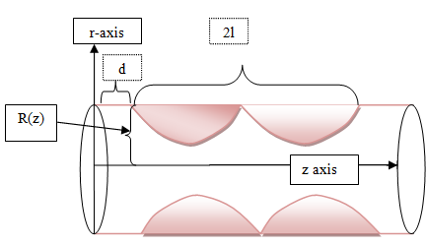
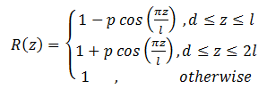
The geometry of stenosis
Here we have consider the cosine shape stenosis in dimensionless form

Slide 12
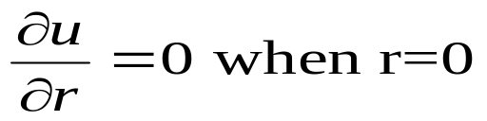
Initial and Boundary conditions
Initial condition is taken as
No-slip boundary condition on the stenosed arterial wall
Since there are no shear rate of the fluid along the axis

Slide 13
Solving procedure of the model

Slide 14
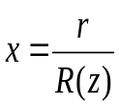
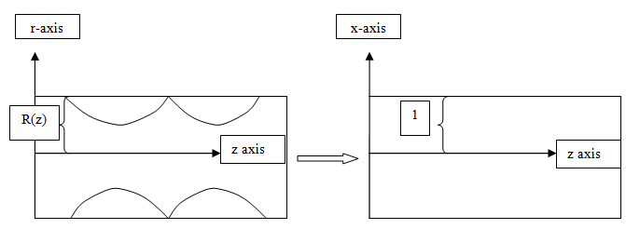
Solving procedure
We have used radial coordinate transformation to map the constricted domain into rectangular .

Slide 15

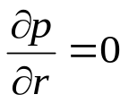

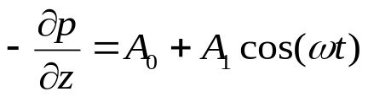

Solving procedure(contd)
We have assumed that the pressure gradient is very very small in the radial direction
According to Burton the pulsatile pressure gradient
Produced by pumping action of heart for human beings has been taken as

Slide 16
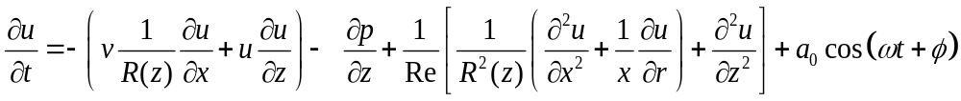
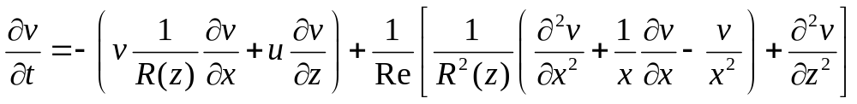
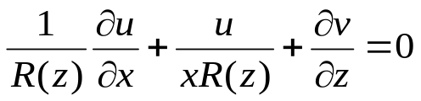
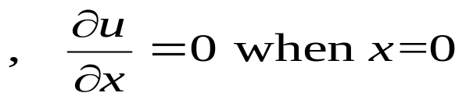
Model in Transformed domain(z-x)
The 2D Navier- Stokes equation becomes
The continuity equations becomes
The initial condition becomes
No-slip boundary condition on the stenosed arterial wall

Slide 17
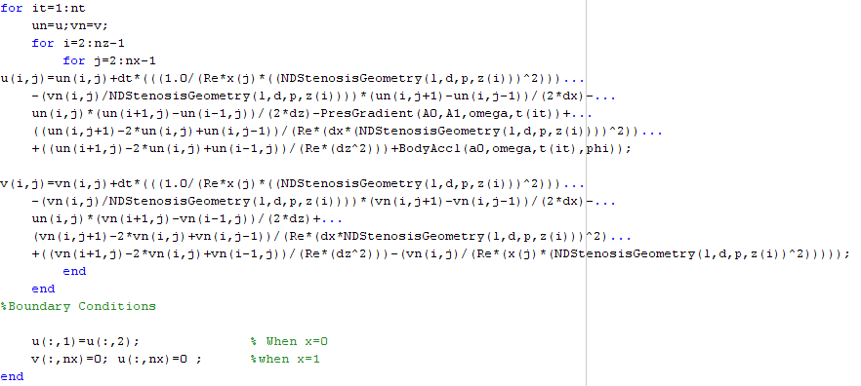

Matlab implementation using Finite difference approximation

Slide 18
Results and Discussions

Slide 19
Details of simulation parameters of the present study
Reynolds numbers - 300 ,400, 600, 800.
Range of z : 0 to 10
Range of x : 0 to 1
nx=60 ,80,100 ;%Number grid along x-direction
nt=100;%Number of grid along time
nz=60,80,100;%Number of Grid along z-direction
dt=0.01, .001 ;%time step
A0=0.1; %Amplitude
A1=0.2*A0;
Programming Language used: Matlab (Version : 7.7.0-R2008B)
phi=pi/4;%Phase Angel
l=2;%Length of Stenosis
d=3;%Location of Stenosis
p=0.5;
f=1.2;%Frequency

Slide 20
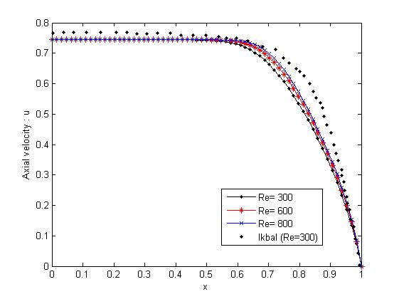
Axial velocity For varies Reynolds number under the influence of body acceleration

Slide 21
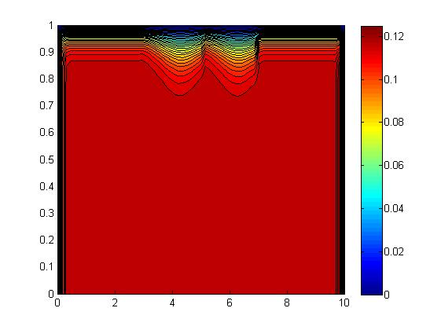
Contour distribution of axial velocities for Reynolds number Re=400 without body acceleration.

Slide 22
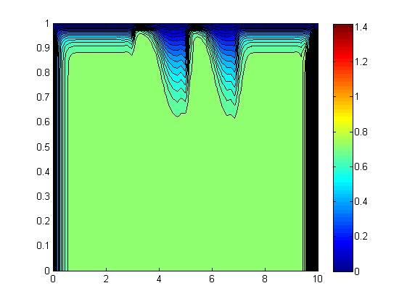
Contour distribution of axial velocities for Reynolds number Re=400 with body acceleration

Slide 23
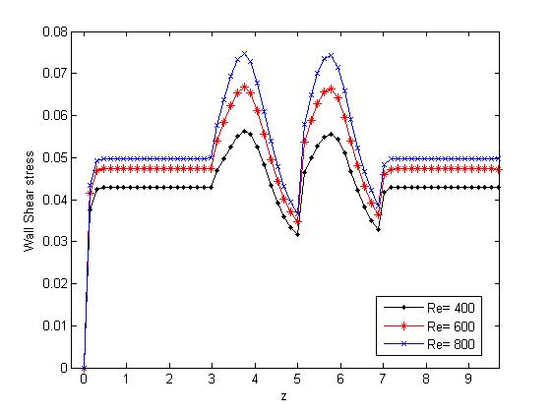
The wall shear stress without body acceleration

Slide 24
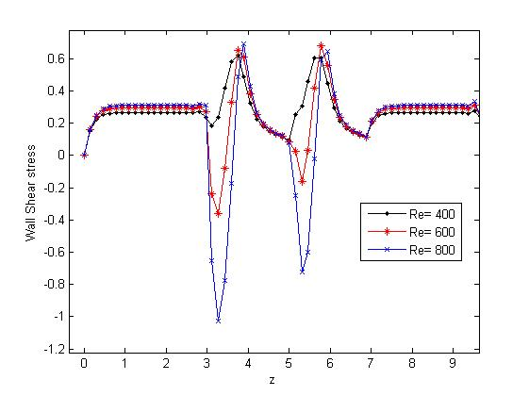
The wall shear stress with body acceleration

Slide 25
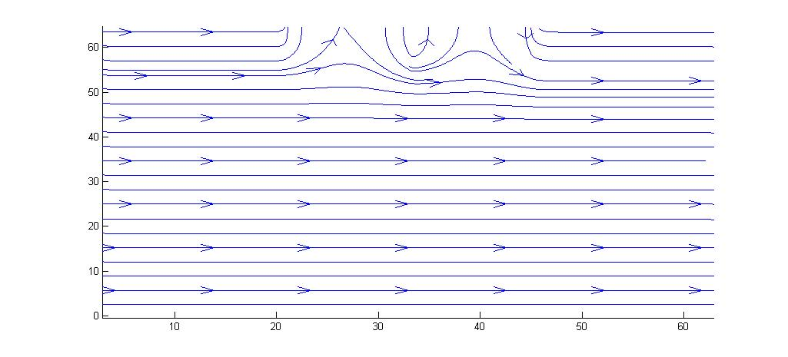
Streamlines of the flow without body acceleration

Slide 26
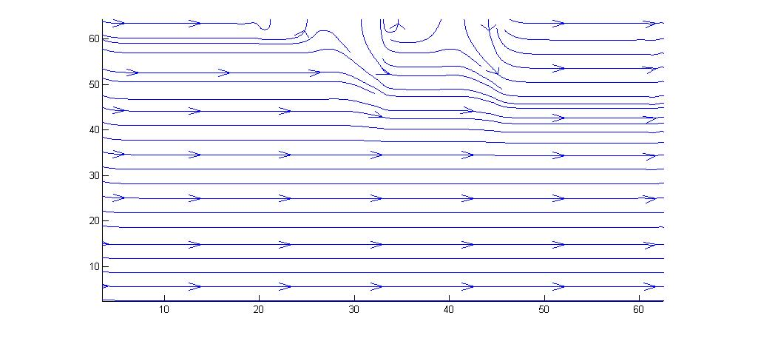
Streamlines of the flow with body acceleration

Slide 27
Conclusions and Future works

Slide 28
Concluding Remarks
The hemodynamic of the flow in an arterial segment containg muti stenosis have been studied .
The non-linear 2D-Navier stokes equation in irregular domain is solved numerically .
The affect of body acceleration in the flow have been investigated.

Slide 29
Scope for Future work
This study assumed that the flow is Newtonian , one can model pulsatile flow of blood for Non-newtonian .
One can use finite element method to tackle the same problem and compare the result with this.
Detection the geometry of the stenosis from real image using some edge detection method.
Last but not the least, one can do this study in three dimensions and see the result.

Slide 30
References

Slide 31
References
David N.Ku, Review of Blood flow in arteries , Annu. Rev. Fluid Mech. 29 (1997)399–434.
Md.A.Ikbal ,Chakravarty,Kelvin K.L. Wong,J.Majumdar,P.K.Mondal, Unsteady response of non-Newtonian blood flow through a stenosed artery in magnetic field,Journal of Computational and Applied Mathematics archive
230(2009) 243-259.
K.C. Ang, J.N. Mazumdar , Mathematical modelling of three-dimensional flow through an asymmetric arterial stenosis,Mathematical and Computer Modelling, 25( 1997)19–29.
K.W.Lee ,X. Y. Xu ,Modelling of Flowand wall behaviour in a mildly stenosed tube ,Medical engineering and Physics,24(2002),575-586.
Stangeby, D and Eithier, C. ,Computational analysis of coupled blood – wall arterial LDC transport, J. Biomech. Eng., 124(2002),1–8.

Slide 32
References(Contd.)
A.C. Burton, Introductory Text, Physiology and Biophysics of the Circulation, Year Book Medical Publisher, Chicago, 1966.
Fang-BaoTian , Luoding Zhu,Pak-Wing Fok,Xi-Yun Lu , Simulation of a pulsatile non-Newtonian flow past a stenosed 2D artery with atherosclerosis,Computers in Biology and Medicine 43(2013)1098–1113.
Biyue Liu , Dalin Tang , A numerical simulation of viscous flows in collapsible tubes with stenoses, Applied Numerical Mathematics 32 (2000) 87–101.
Chakravarty and Mondal,Mathematical modelling of blood flow through an overlapping arterial stenosis,Mathematical and Computer Modelling Volume, 19(1994) 59–70.

Slide 33
References(Contd.)
S. Mukhopadhyay, and G. C. Layek , Analysis of Flow Fields in a Wavy-Walled Tube with Tapering, Chinese journal of physics 47(2009).
D.S. Sankar, Usik Lee , Two-fluid non-linear model for flowin catheterized blood vessels, International Journal of Non-Linear Mechanics 43 (2008) 622 – 631.
D.S. Sankar ,Two-phase non-linear model for blood flow in asymmetric and axisymmetric stenosed arteries , International Journal of Non-Linear Mechanics 46 (2011) 296–305.
Kh. S. Mekheimer, M. H. Haroun, M.A.Elkot, Effects of magnetic field, porosity, and wall properties for elastic multi-stenosis arteries on
blood flow characteristics, Appl. Math. Mech. -Engl. Ed., 32(2011), 1047–1064 .

Slide 34
Thank You

