Slide 1
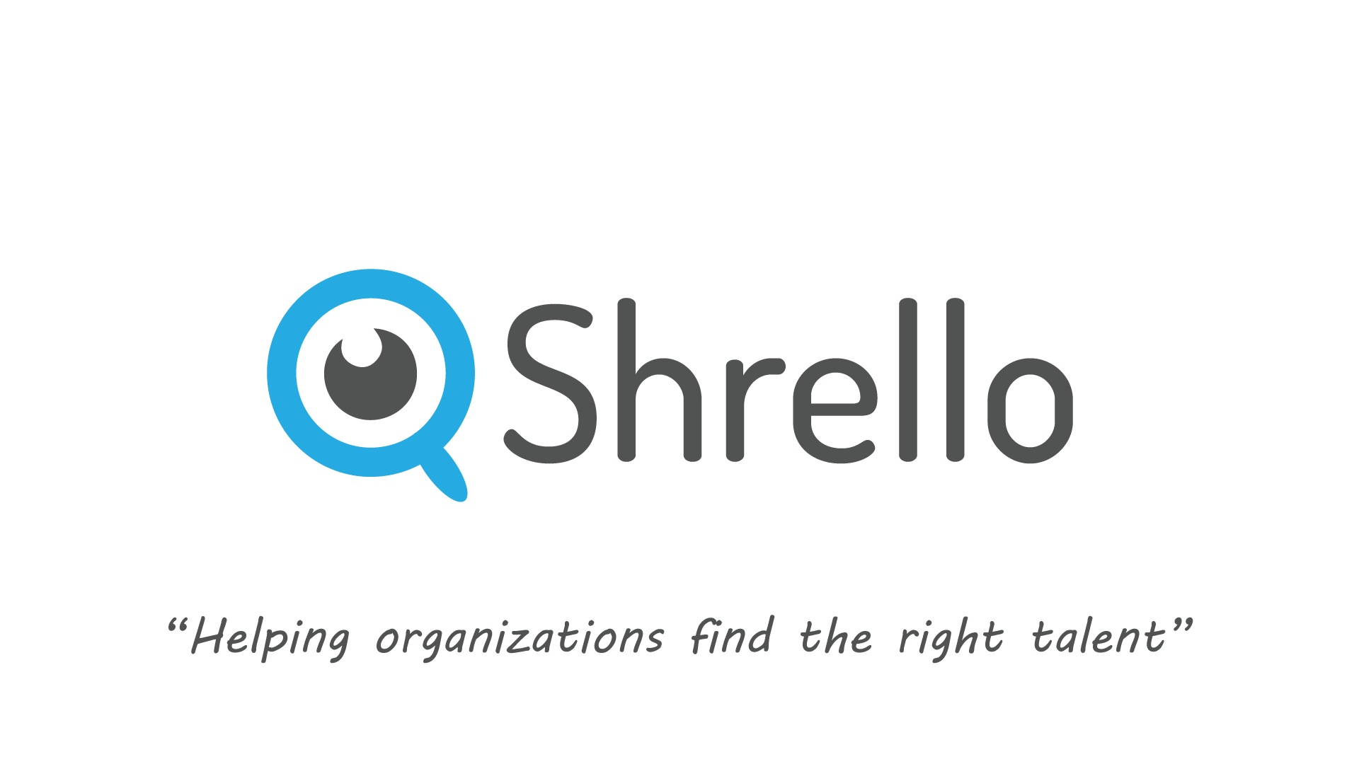

Slide 2
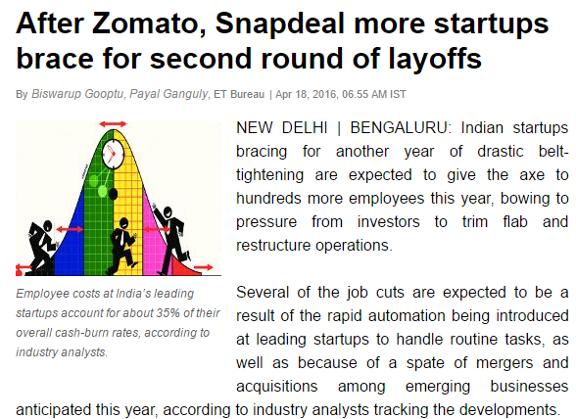
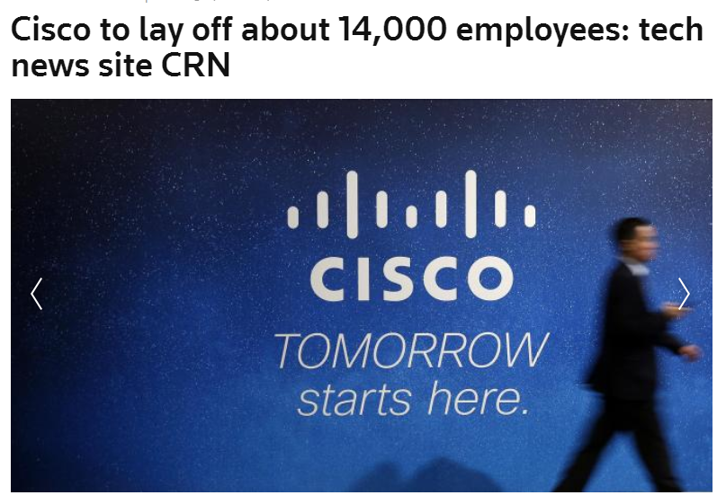
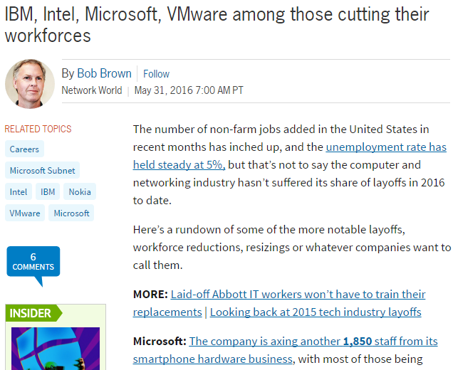
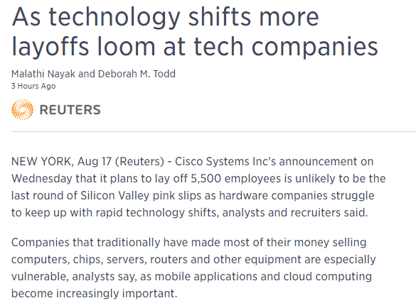

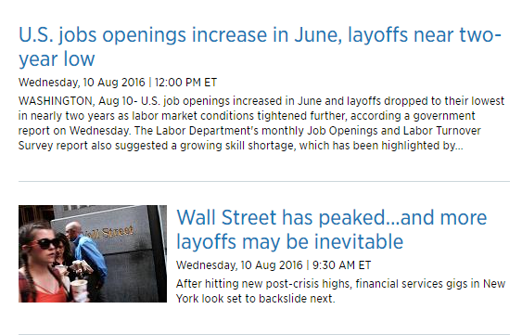
Problem
Low ROIs, high burn rate

Slide 3

Less opportunity to, Showcase talent!

Slide 4

Not easy to refer/get referred

Slide 5
Smart Sourcing
In depth analysis of profiles
Call to action
A web app for organizations which hand picks talent
Showcase your talent
Get customized recommendations;
Refer/get referred
Apply
A smart mobile app which uniquely recommends customized jobs

Slide 6

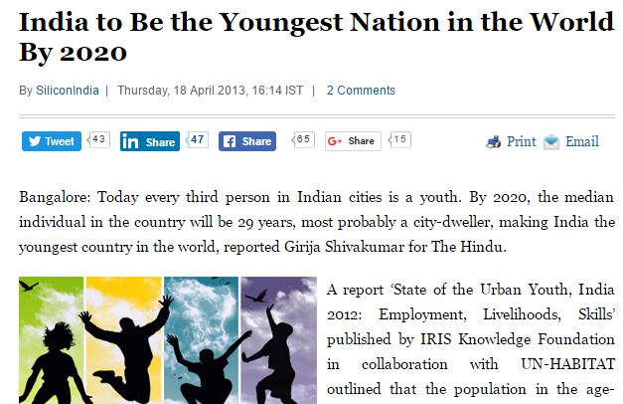
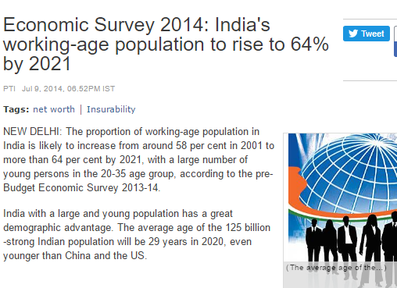

10 years ago; Digital Footprints weren’t possible
Demographics: A key dividend to be reaped
11,500
Year: 2020
Startups: To increase at a large scale
4,200
Year: 2015
Startups

Slide 7
952K +
Active companies
50K +
Tech companies
700 Million+
Employees
3.5 Million+
Employees
Source :
http://qz.com/384432/map-indian-states-with-the-highest-and-lowest-number-of-private-companies/

Slide 8







Bread & butter
Adds salad
hachi

