Slide 1
Predicting outcomes of soccer matches
Saroj Dhakal

Slide 2
Motivation and wider scope
It is human nature to predict the outcome based on information available in the past.
As a regular follower of the premier league, I like to predict the position my team will likely finish before every season. Then, before every match, I want to predict the outcome among friends, and if you can get the prediction correctly, you have the bragging rights or can win the bets among friends.
Betting on sports events is based on a guess about the future match outcome.
Development of statistical models to improve decision-making is of interest to both bettors and odd setters

Slide 3
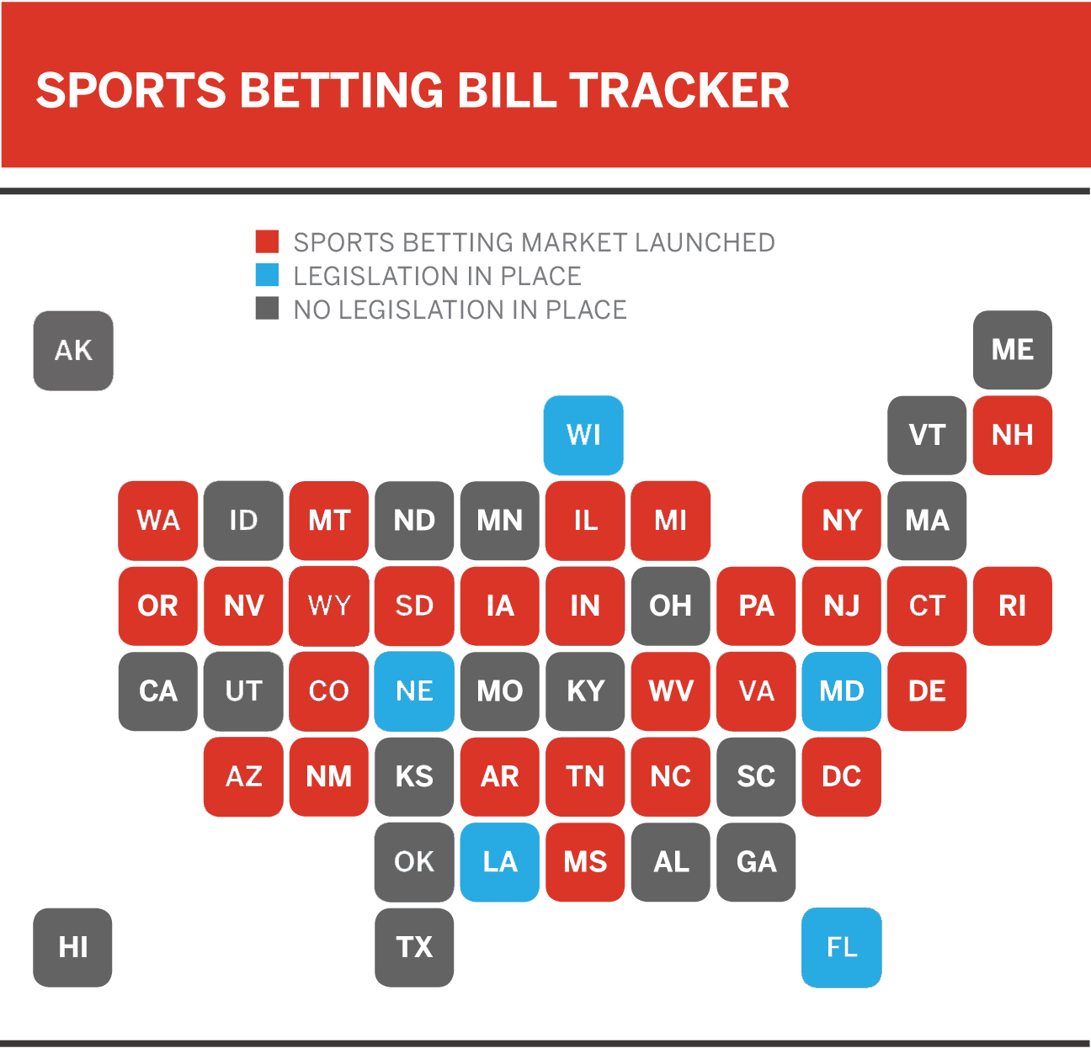
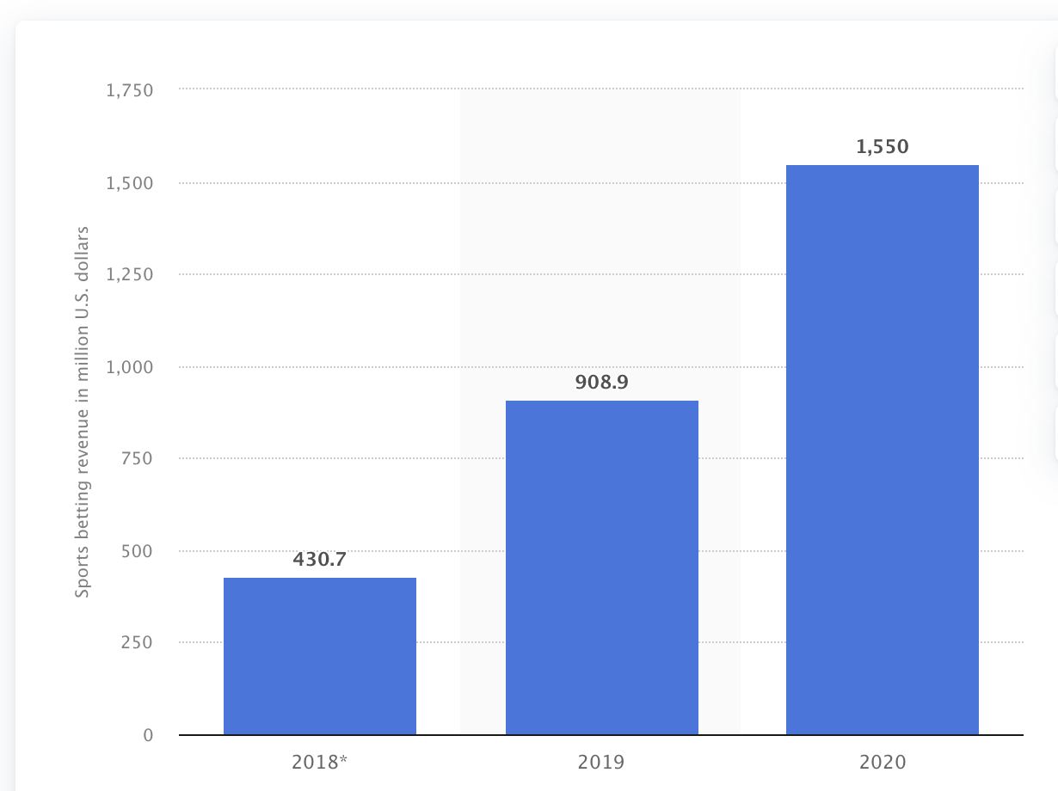
[1]
[2]
2

Slide 4
Data collection
For the preliminary result, I have used the data set for the Kaggle [3].
By the completion of the project, I will implement the Web Scrapping technique to collect the data.
Python
Pandas
Beautiful soup

Slide 5
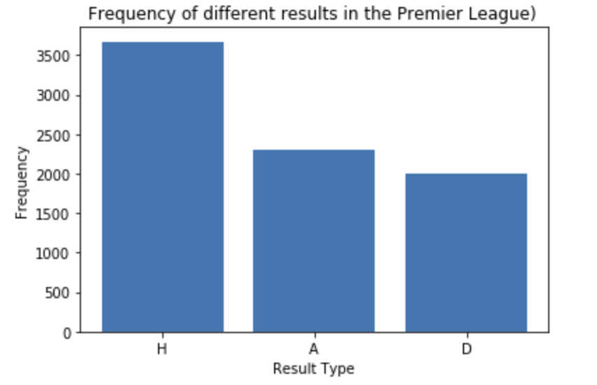
Preliminary Results
We transform label data using one-hot encoded variable technique
Eg: Hometeam win: 1, Awayteam= 2, draw = 3

Slide 6
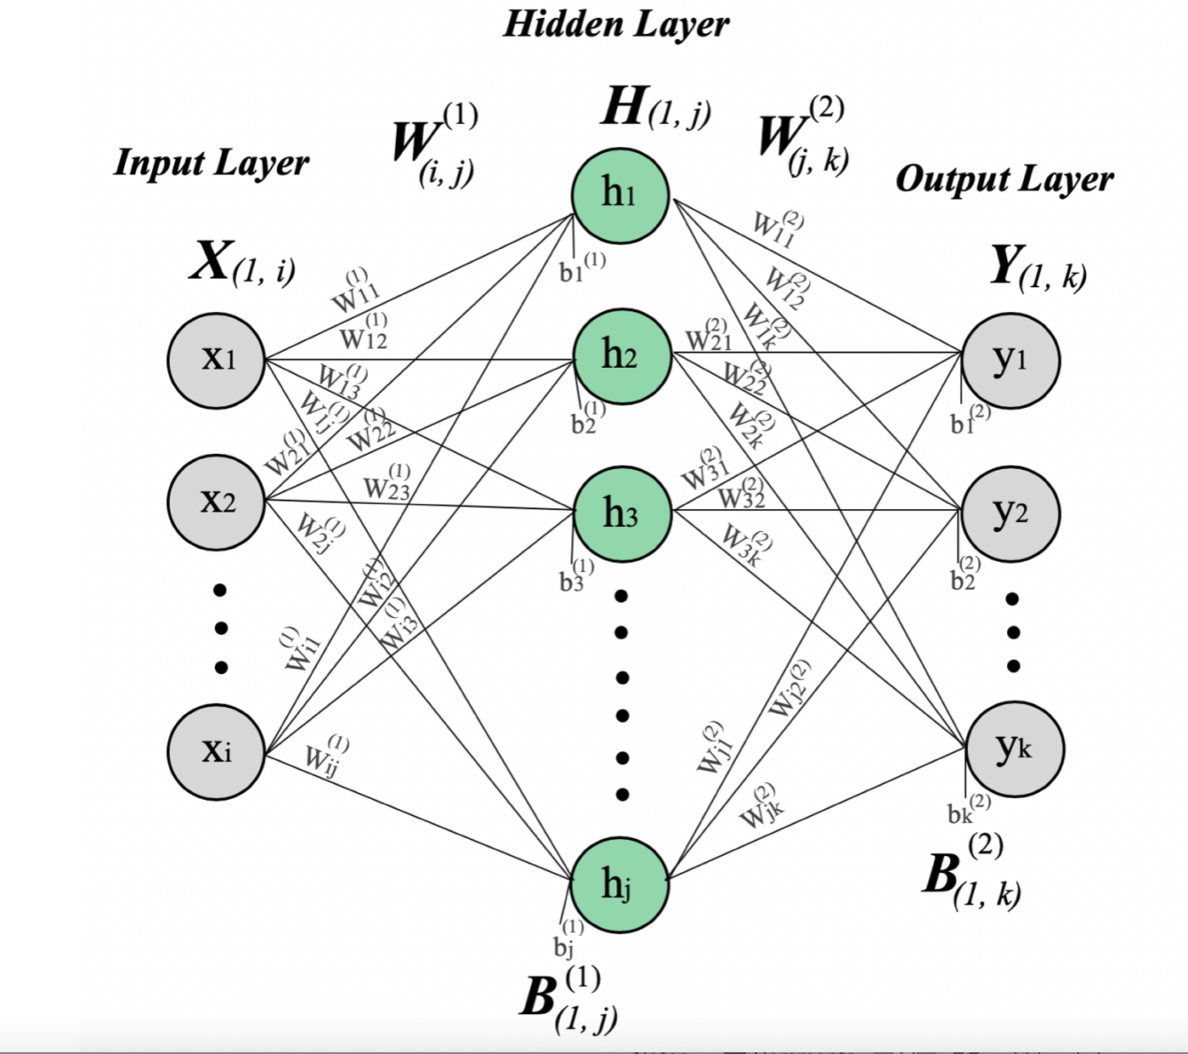
Neural Network
3 Layer Neural network
1 Input layer with 110 input features
1 Intermediate layer
1 output layer with activation Softmax. (Three prediction variables)
Home win
Away win
Draw

Slide 7
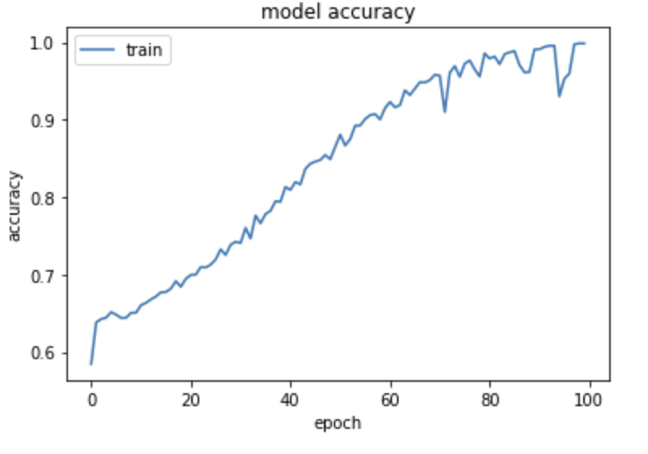
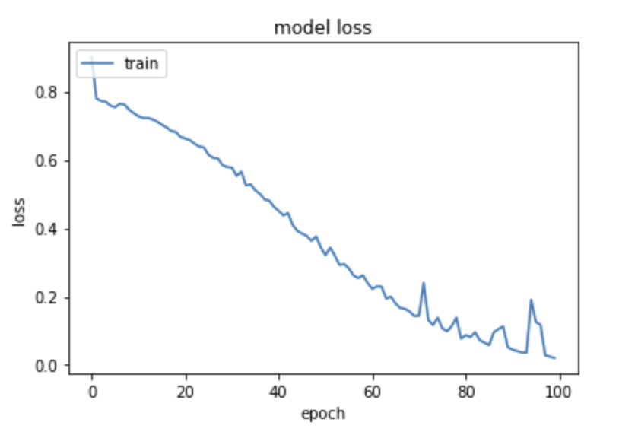
Test Accuracy: 0.58200

Slide 8
Future Work and timeframe
Data collection using web scrapping : (First Week)
Model optimization to increase accuracy: (Second- Third week)
Hosting this model in the Heroku App (Fourth Week)

Slide 9
Reference
https://www.espn.com/chalk/story/_/id/19740480/the-united-states-sports-betting-where-all-50-states-stand-legalization
https://www.statista.com/statistics/1126480/sports-betting-revenue-us/
https://www.kaggle.com/irkaal/english-premier-league-results

