Slide 1

STUDENT NAME: Dhakshini Priya.S
REGISTER NO :2426J1592
NMID: 6B804BDF935858F98A0415F6E84716E2
DEPARTMENT: B.Sc(IT)
COLLEGE: Dr.R.V. Arts And Science College/Bharathiar University

Slide 2
STUDENT PORTFOLIO

Slide 3



Problem Statement
Project Overview
End Users
Tools and Technologies
Portfolio design and Layout
Features and Functionality
Results and Screenshots
Conclusion
Github Link
3/21/2024 Annual Review

Slide 4
Students lack a centralized platform to showcase their academic, co-curricular, and extracurricular achievements.
Traditional resumes fail to represent creativity, skills, and digital presence effectively.

Slide 5
Development of a Student Digital Portfolio that compiles personal details, skills, projects, certifications, and achievements.
Provides an organized and visually appealing way to present professional and academic growth.

Slide 6

Students – to showcase their work.
Teachers & Mentors – to evaluate progress.
Recruiters & Employers – to access student achievements.
Institutions – to track alumni success and student development.

Slide 7
Frontend: HTML, CSS, JavaScript
Backend: PHP / Node.js (if needed)
Database: MySQL / MongoDB
Design Tools: Canva / Figma
Version Control: GitHub

Slide 8
POTFOLIO DESIGN AND LAYOUT
Home Page: Introduction & Personal Details
About Section: Academic background, Interests, and Goals
Projects Section: Details with screenshots and descriptions
Skills Section: Technical & Soft Skills
Achievements/Certificates Section
Contact Section: Social links, email, GitHub

Slide 9

Easy-to-navigate interface
Responsive design (mobile & desktop friendly)
Secure login & profile management
Upload/Update documents and certificates
Interactive project showcase with images and links

Slide 10

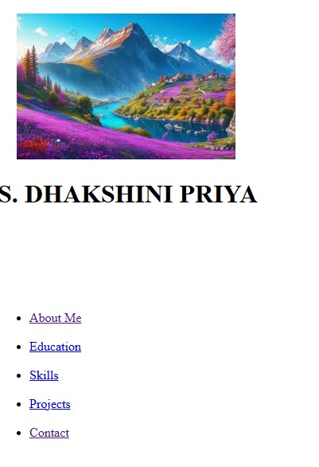
Sample screenshots of portfolio pages (Home, Projects, Skills, Certificates, Contact).
Demonstration of navigation, design flow, and responsiveness.
3/21/2024 Annual Review

Slide 11

The Student Portfolio provides a modern, digital-first solution for students to present their skills and achievements.
Enhances opportunities for internships, jobs, and higher studies.
A step towards professional branding for every student.

