Slide 1
STUDENT GRIEVANCE SYSTEM First Review Date:15.04.2024
Presented by
Mr.Prasana
Mr.Gowtham
Mr.Dhakshna moorthy
Mrs.Manisha devi
Under The Guidence of
Dr. C. Sri venkateswaran, Professor
Department of Artificial Intelligence and Data Science
Centre Co-ordinater
Mrs. Nithya
Assistant Professor
Department of Computer Science & Engineering.

Slide 2
Outline of the Presentation
Abstract
Literature Survey
Existing work
Proposed Work
Model/Technology
Scope of the project
References

Slide 3
ABSTRACT
The model is a powerful tool for identifying insect bites and insect providing valuable
Information to help users avoid further consequences, its deep learning approach
Allows it to classify bites with a high degree of accuracy, making it a reliable resource
For anyone who needs to identify an insect bite.

Slide 4
Existing Problem
The current setup is entirely manual. The person has to visit to the respected expertise to kown about the insect ,their bite and their cause in body:
1. Visit the relevant expertise in physical to know about the insect and bite
2.The current system needs a manual process.

Slide 5
Proposed Methodology
In this project, we're designing a solution for insect and their bite
1.This system provides an interface to capture insect or nsect bite
2.The two main users of this system are:
i. Common people
ii. Travellers/Trekkers
3.To know poisonous and non poisonus
4.Feedback
5.automatic information about the insect

Slide 6
Extra Parameter
We added two extra parameter with some modulation to our projection
gene sepreation
Identity hiding.
Our project is based on web application.
AI is used to make our project automatic.

Slide 7
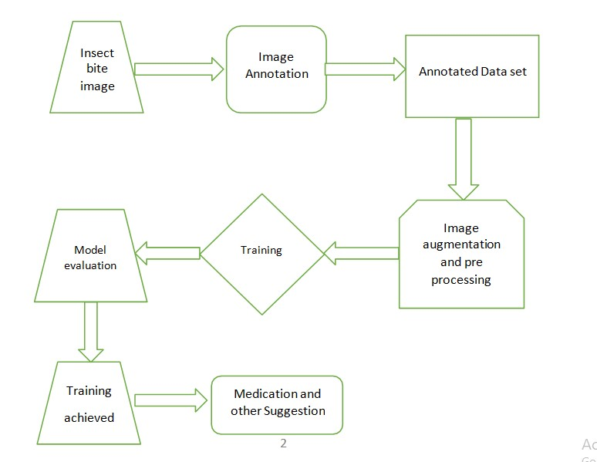
Architecture of proposed technique

Slide 8
Scope of the project
To get to know about the insectbite and their cause.
To get to know their information.
To know whether it is poisonus or not.
Measure to treat it.
It will save time.

Slide 9
THANK YOU ALL !!!!

