Slide 1

Project Title -Seasonal Agriculture Performance Analysis
[Student Name : DHALIYA ISMAIL
College Name : De Paul Institute of Science & Technology
AICTE STU ID : STU6a291c8e55cca1781079182

Slide 2

PROBLEM STATEMENT
Agricultural activities are influenced by seasonal variations in environmental conditions, farming practices, resource availability and market conditions. As a result, agricultural performance may differ from one season to another.
However, raw agricultural data does not clearly explain how agricultural performance changes across seasons or what patterns can be observed in different seasonal conditions.
The problem is to analyze the given agricultural dataset and investigate seasonal differences in agricultural performance by identifying meaningful patterns, trends, relationships and variations within the available data.

Slide 3
Project Description
This project focuses on analysing seasonal agricultural data to understand how farming performance varies across different seasons, regions, and farming conditions. The dataset includes information on farming practices, environmental conditions, crop production, resource usage, and economic outcomes recorded across multiple seasons.
Agricultural output is known to be influenced by seasonal changes — factors like weather, resource availability, and market conditions shift from one season to another, which in turn affects crop yield, resource consumption, and profitability. However, without structured analysis, these seasonal effects are not immediately clear from raw data alone.
The goal of this project is to explore the dataset in depth, clean and prepare it for analysis, and apply appropriate statistical and visualization techniques to uncover how agricultural performance differs across seasons. This includes comparing key metrics between seasons, identifying notable trends or unusual patterns, and examining relationships between environmental conditions and farming outcomes.
The insights generated from this analysis are intended to support evidence-based agricultural planning — helping stakeholders understand seasonal variation, anticipate resource needs, and make informed decisions for future planning cycles.

Slide 4

WHO ARE THE END USERS?
Farmers
Government Agriculture Department
Agribusiness
Researchers

Slide 5

Technology Used
Python
Pandas
Numpy
Matplotlib
Seaborn

Slide 6
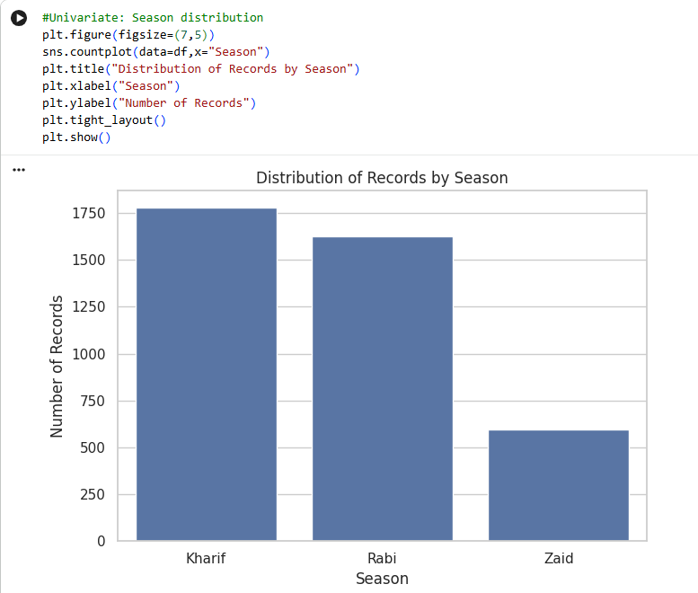
RESULTS
This code creates a bar chart that shows how many records exist for each season in the dataset.
It counts the number of rows belonging to each season and displays a bar for every season, where a taller bar means more records for that season. Essentially, it answers whether the data is roughly evenly spread across seasons or if one season has noticeably more records than the others. This matters because if a season has very few records compared to the rest, any averages or comparisons involving that season later on might be less reliable, since they'd be based on a smaller sample.

Slide 7
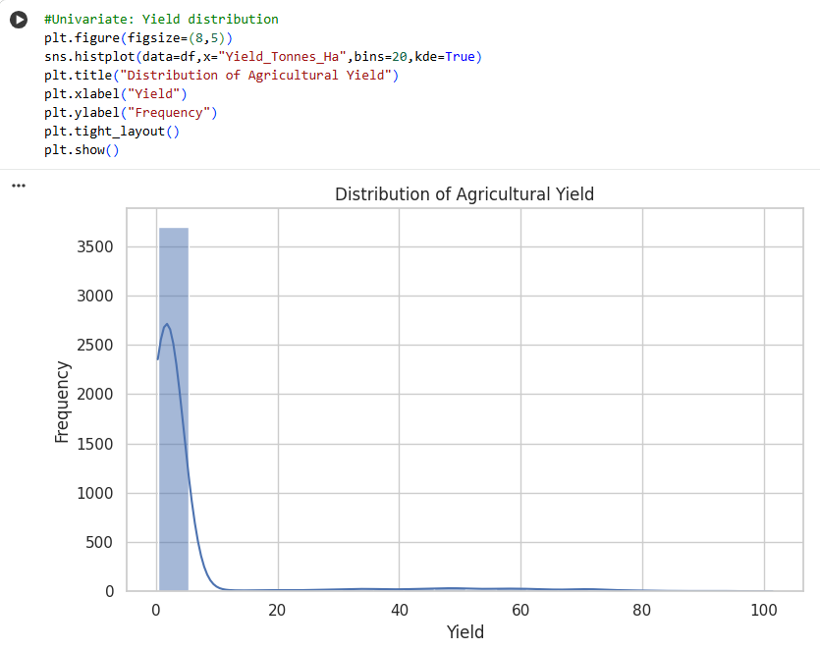
RESULTS
This code creates a histogram showing how agricultural yield values are spread across the entire dataset. It divides the yield values into bins and shows how many farm records fall into each bin, so it can be seen which yield ranges are most common and which are rare. The smooth curve overlaid on the bars shows the overall shape of this distribution, making it easier to tell whether yield is fairly symmetric, skewed toward lower or higher values, or has multiple peaks. This is useful early on because understanding the general shape of yield values helps to interpret later comparisons, like whether a season's yield is unusually high or low relative to the overall pattern.

Slide 8
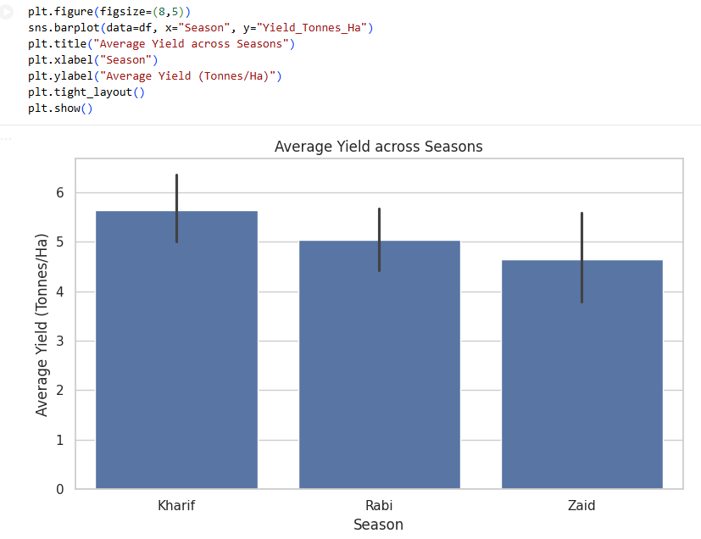
RESULTS
This code creates a bar chart comparing the average agricultural yield across each season. For every season, it calculates the mean yield value and displays it as a single bar, with the small vertical line on top of each bar indicating the uncertainty around that average. This makes it easy to directly compare which season tends to produce higher or lower yield on average, without getting distracted by the spread of individual data points the way a boxplot would show.

Slide 9
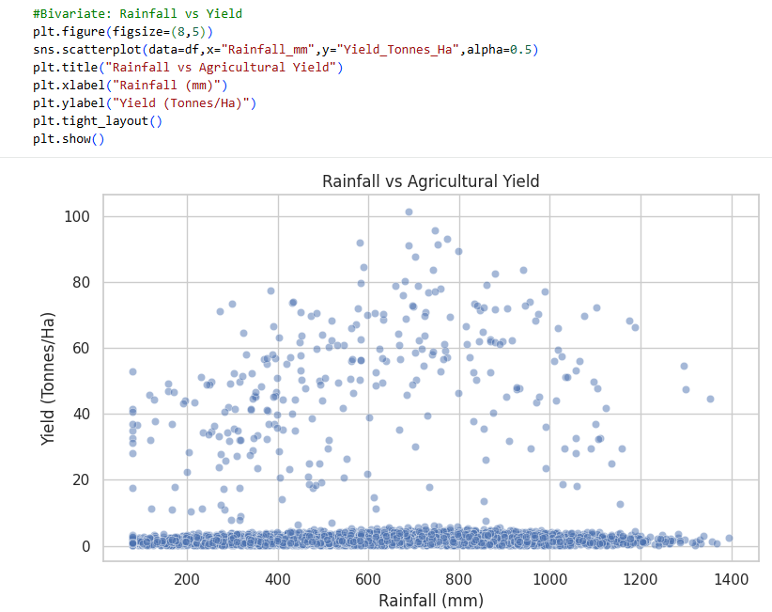
RESULTS
This code creates a scatter plot showing the relationship between rainfall and agricultural yield, with each point representing one farm record. The x-axis shows how much rainfall that farm received, and the y-axis shows the yield it produced, so plotting them together lets to visually check whether higher rainfall tends to go along with higher or lower yield. The transparency setting on the points (alpha=0.5) makes overlapping points easier to see, which helps when many farms have similar rainfall and yield values. Overall, this plot helps answer whether rainfall appears to be associated with yield, and whether that relationship looks like a clear trend, a weak pattern, or no relationship at all.

Slide 10
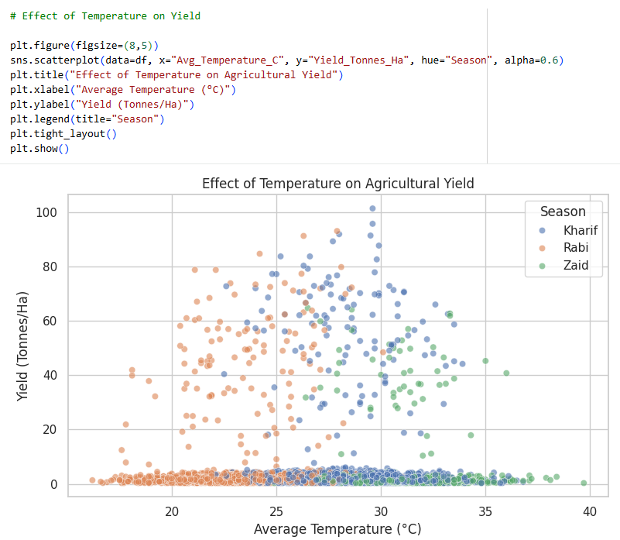
RESULTS
This code creates a scatter plot showing how average temperature relates to agricultural yield, with each point representing one farm record. Unlike the rainfall plot, this one also colours each point by season so it can be seen if not just the overall temperature-yield relationship, but whether that relationship looks different depending on the season. The transparency setting again helps make overlapping points easier to distinguish. Overall, this plot helps answer whether yield tends to rise or fall as temperature changes, and whether that pattern holds consistently across all seasons or varies from one season to another.

Slide 11
Future scope
This project focused on exploratory analysis using historical data, but there are several ways it could be extended. Incorporating additional variables not present in this dataset — such as soil type, pest/disease incidence, fertilizer usage, and real-time market prices — could help explain yield and profit differences more completely. Applying statistical significance testing instead of just comparing averages would help confirm whether the seasonal differences observed are statistically meaningful or could be due to chance.
The analysis could also be extended into predictive modelling, using machine learning to forecast yield or profit based on season, weather, and farming practices, which would move the project from descriptive analysis toward decision-support. Adding geographic/regional data would allow location-specific recommendations rather than generalized seasonal ones, since agricultural conditions often vary significantly by region even within the same season.
If this analysis were repeated with multiple years of data instead of a single snapshot, it would help distinguish genuine seasonal patterns from year-specific anomalies making the findings more reliable for long-term planning.

Slide 12
GitHub Link
https://github.com/dhaliyaismail/Seasonal-Agriculture-Performance-Analysis.git

Slide 13

VOIS Course completion certificate - Course name- Data Visualization

Slide 14
Thank you
.
.

