Slide 1
Lessons from the evolution of the Batfish configuration analysis tool
Matt Brown, Ari Fogel,
Daniel Halperin, Victor Heorhiadi, Ratul Mahajan, and Todd Millstein Intentionet, UW, UCLA
Notes:
I’m here to talk about what we’ve learned as a team spending 11 years putting Batfish into to production.

Slide 2





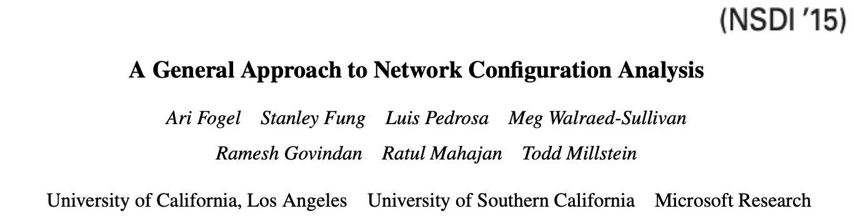
11 years of Batfish
2012
2015
2017
2022
Batfish is…
open source, with 1700+ users in our Slack channels
used at 50+ companies and organizations
the heart of Oracle Cloud’s Network Path Analyzer
a research foundation for 20+ publications
Notes:
Batfish started in 2012 as a project with Microsoft, UCLA, and USC. The paper was published at NSDI 2015, and in 2017 Ari Ratul and Todd founded Intentionet, the rest of us joined, and we have spent the last 6 years building an open source project and an enterprise product around Batfish.
Today, Batfish has 1700 slack users from more than 50 companies and organizations. Oracle used Batfish inside it’s Network Path Analyzer product that lets customers reason about accessibility of their cloud resources. And Batfish has become a foundational tool enabling more than 20 research projects
In 2022, the Batfish developers joined AWS, where we are putting these tools to use in one of the world’s largest and highest SLA networks.

Slide 3
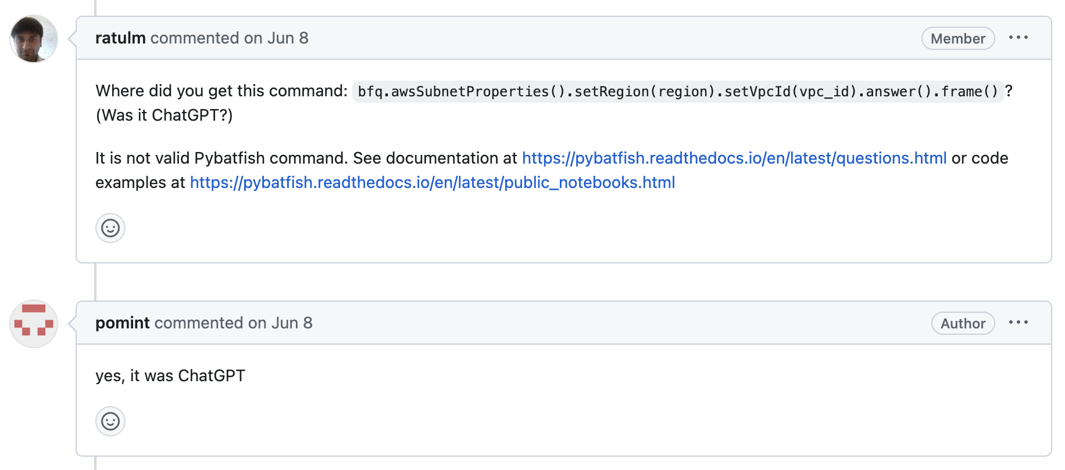
Notes:
And of course the real sign of a successful open source project is ChatGPT hallucinations in our bug reports!

Slide 4
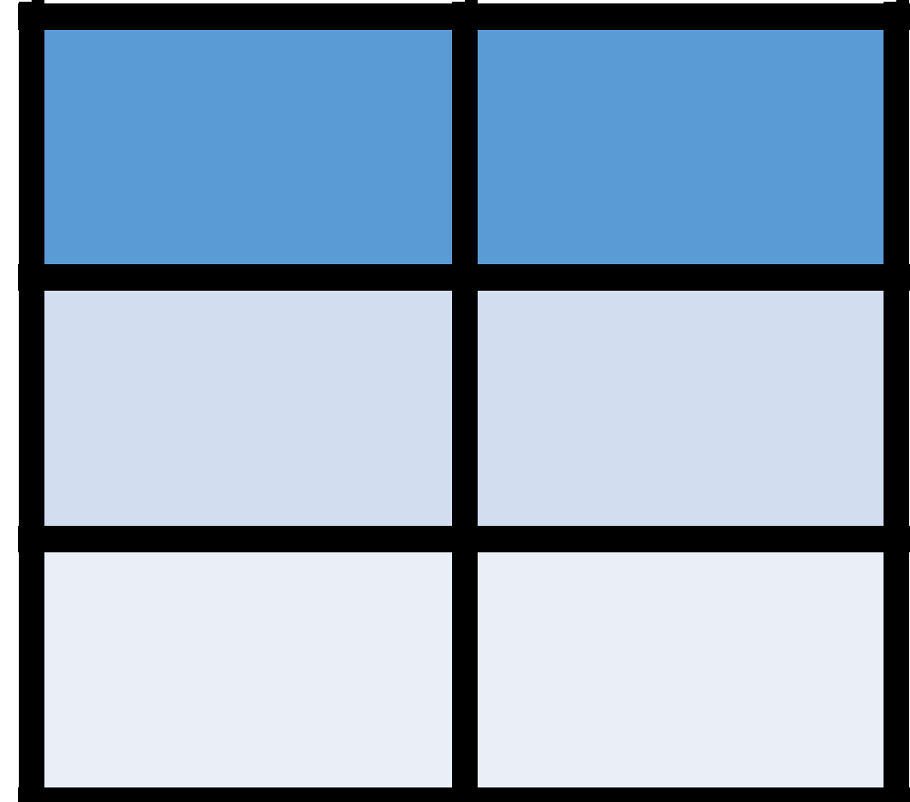

Batfish: proactive network verification
❌
Data plane state
Forwarding bugs
“What if?” Analysis
Verify changes or operational scenarios before they affect the network
Notes:
When Batfish was in its early days, there was a new idea of data plane verification. The idea was that if you had a snapshot of the data plane state, you could leverage new classes of automated reasoning to prove correctness of desired properties or find bugs.
The goal of Batfish was to go one step further: enabling testing changes or analyzing operational scenarios – “what if I change this BGP policy? What if this link failed?” before they could have impact on the network.

Slide 5





Batfish’s original 4-stage pipeline
Configuration
Device model
Data plane
Violating flow
Bug report
❌
Parsing
Routing simulation
Verification
Explanation
Notes:
Batfish’s key idea was that given a network’s configuration alone, you can perform data plane verification. Batfish used a 4 stage pipeline to do this:
parse configuration with ANTLR4 to product a model of a device, including its interfaces, routing processes, etc.
Use Datalog to model the data plane, aka, computing the RIBs and FIBs for each device. Datalog provided stratified evaluation which handled changing best paths and it provided provenance: this RIB entry is from this OSPF route learned from this neighbor.
Use Datalog on Z3 to test desired reachability properties or find a counterexample packet.
Batfish then used Datalog to explain the counter example, providing the concrete path through the network and linking it back to that provenance.

Slide 6
Batfish’s original 4-stage pipeline
2023
Configuration
Device model
Data plane
Violating flow
Bug report
❌
New!
New!
New!
New!
New!
Fidelity
Parsing
Routing simulation
Verification
Explanation
1500x faster, 400x larger networks
Notes:
In 2023, this picture looks pretty much the same. The pipeline has held up. However, we reimplemented every single stage, which cumulatively makes Batfish 1500x faster, scale to 400x larger networks, while handling more devices and features than ever.
As Batfish matured, we also added a new stage dedicated to the fidelity of Batfish models.

Slide 7
5 key lessons
Notes:
This is a short talk, so for details you’ll have to go to the paper. But I wanted to touch on 5 key lessons from our experience.

Slide 8

Lesson 1: Datalog was great for prototyping, but not for production use
Three key challenges:
Expressiveness
Performance
Deterministic convergence
Solution: replace Datalog with imperative code
Parsing
Routing simulation
Verification
Explanation
Notes:
We found that Datalog was not a good fit for real production networks. Core features used in real networks, such as regular expressions over BGP communities, aren’t well supported in even extended Datalog, proving a maintenance overhead.
Performance was another problem. Datalog is a high level, declarative language that by design hides execution details. But this prevented us from applying optimizations like converging OSPF before BGP, resulting in wasted work and too much memory.
Finally, the lock step nature of stratified Datalog meant that some networks never converged. We needed to control the order or break symmetry to fix it.

Slide 9
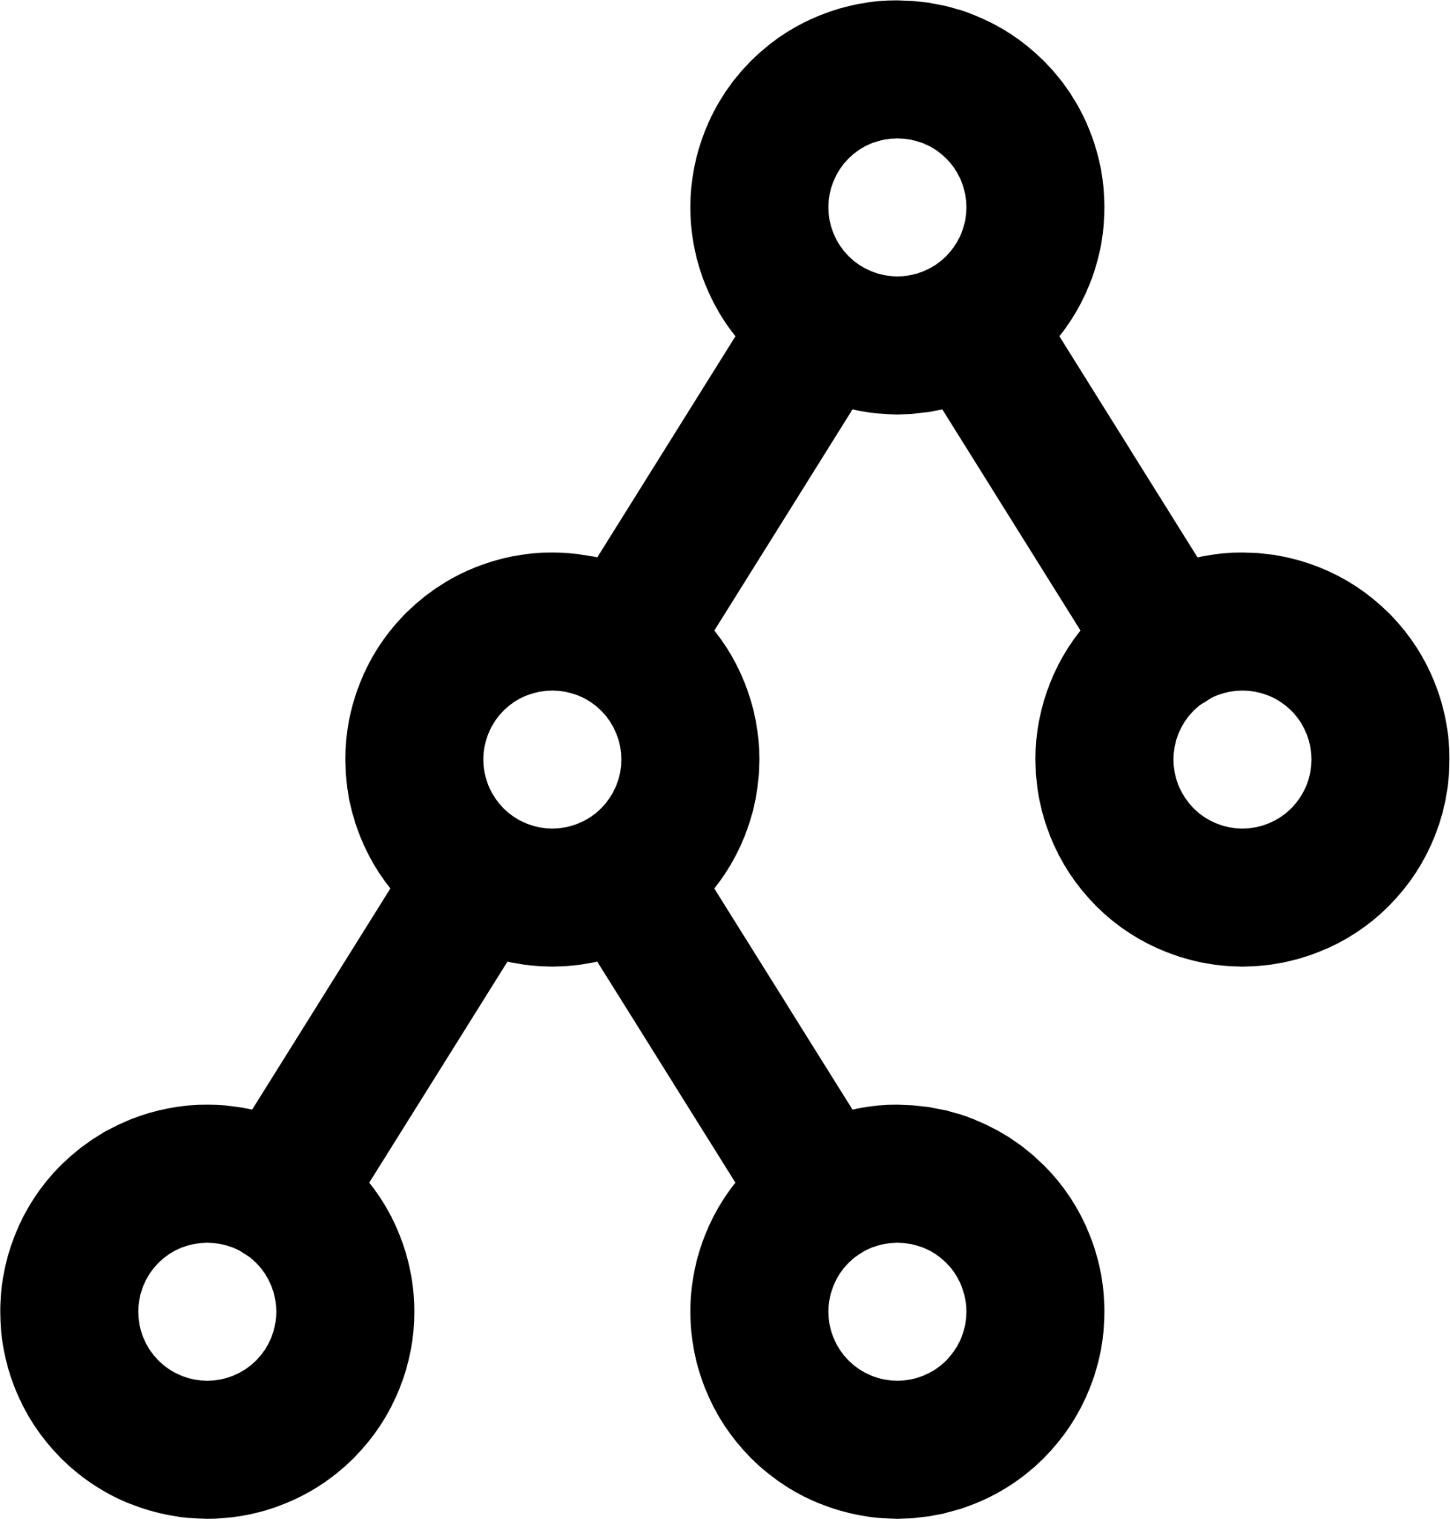
Lesson 2: BDDs are great for data plane analysis
Our SMT+Datalog verification didn’t scale to larger networks
Solution: replace Z3 with custom Binary Decision Diagrams
simple (4800 LOC) and performant (tens of ms)
Parsing
Routing simulation
Verification
Explanation
Notes:
With a routing simulation that was 3 orders of magnitude faster, the verification became the bottleneck.
We replaced Z3 with a custom Binary Decision Diagram library that is simple (4800 LOC) and performant (tens of millis, even on networks with thousands of nodes).

Slide 10

Lesson 3: Model fidelity is hard, but not why you think
Concern: “Every software version is going to have different semantics that matter!”
Reality: In our experience, this was rarely the case. Undocumented semantics is the real challenge
Solution: New stage systematically testing Batfish against an emulator
Fidelity
Parsing
Routing simulation
Verification
Explanation
Notes:
Users think that Batfish’s configuration based approach can’t work because minor releases from vendors would make our models invalid. In our experience, this was not the issue: commercial vendors would be out of a job if configuration that worked yesterday didn’t work the same way tomorrow.
Instead, we found undocumented semantics to be the real challenge. What happens if a BGP import policy calls a route-map that is not configured on the box? The answer is, it is different with every vendor, and with how every feature is used.
You can’t learn this from the documentation, so we build a lab validation framework to systematically test Batfish against an emulator.
This is one key difference between Batfish and systems like Hoyan: because Batfish deals with general, third-party networks we need to handle, and test, a lot more.

Slide 11
Lesson 4: Usability is hard for reasons you think, and then some more
Ambiguity: “Hosts A should be able to reach hosts B”
ALL applications should be able to reach SOME DNS server (e.g., in the same AZ)
ALL infrastructure elements should be reachable by SOME SNMP collector
ALL service frontends should be able to reach ALL backend VIPs
Solution: custom assertions for each use case.
Notes:
Batfish originally gave users access to a swiss army knife for reachability: give me path and packet constraints and we’ll find a match. But how do users who are used to traceroute use it? They can only try one concrete source and destination at a time.
The statement “hosts A should reach hosts B” could be interpreted almost any way: every A should reach every B, every A should reach some B in its local area, some A should reach some B, etc. Ultimately, we resolved this by hiding the swiss army knife and instead adding a library of typed assertions for common uses.

Slide 12

Lesson 5: Deep configuration modeling has many applications
Configuration
Vendor-specific model
Vendor-independent model
Vendor-specific model replaces ad-hoc text-based tools. Vendor-independent model provides network-wide insights.
Presence and consistency of settings, e.g., NTP/DNS/TACACS+/etc.
Network-wide: IP uniqueness, BGP session compatibility across peers
Notes:
We expected the core value of Batfish was in proactive forwarding analysis. However, the models we built in the early part of the pipeline proved some of the most useful to our users.
With a structured model of configuration, Batfish lets customer throw out their in-house libraries of regexes that they use to prove they have the required secure configuration, and finds bugs.
The vendor-independent model provides a unified way to access interfaces, IPs, BGP configuration, and more, so that users could make sure Ips were unique, MTU was configured properly, and more.

Slide 13
Wrapping up
Go read the paper to learn about the design of key components and detailed user stories, and performance data.
Tackle unsolved challenges in control plane complexity and user accessibility.
We’re hiring! Join us at AWS as we tackle the research, operational, and experiential aspects of automated reasoning for networks.
Notes:
That concludes this short teaser. Go read the paper to learn more about the design, users, and benchmarks of Batfish.
If I could give you one piece of advice, it would be this: basic network verification in simple networks just works; instead we should tackle the unsolved problems in cases with real world complexity and make the results user accessible.
Finally, if you work in this area and find these problem interesting, we’re hiring! Come work with us at AWS where we’re making it real.

Slide 14
Lessons from the evolution of the Batfish configuration analysis tool
Matt Brown, Ari Fogel,
Daniel Halperin, Victor Heorhiadi, Ratul Mahajan, and Todd Millstein Intentionet, UW, UCLA

