Slide 1

Kickstarter Campaign Predictor
Is Kickstarter the right choice for your project?
Daniel Halteh
MSIA 423
June 2020

Slide 2
App Motivation
Kickstarter is arguably today’s most popular crowdfunding site for entrepreneurs and innovators
Uses an “all-or-nothing” funding approach—if funding goal is not met by the deadline, then the project fails
Goal is to help any aspiring project creator gauge their likelihood of success with Kickstarter before committing to a campaign
Demo!

Slide 3
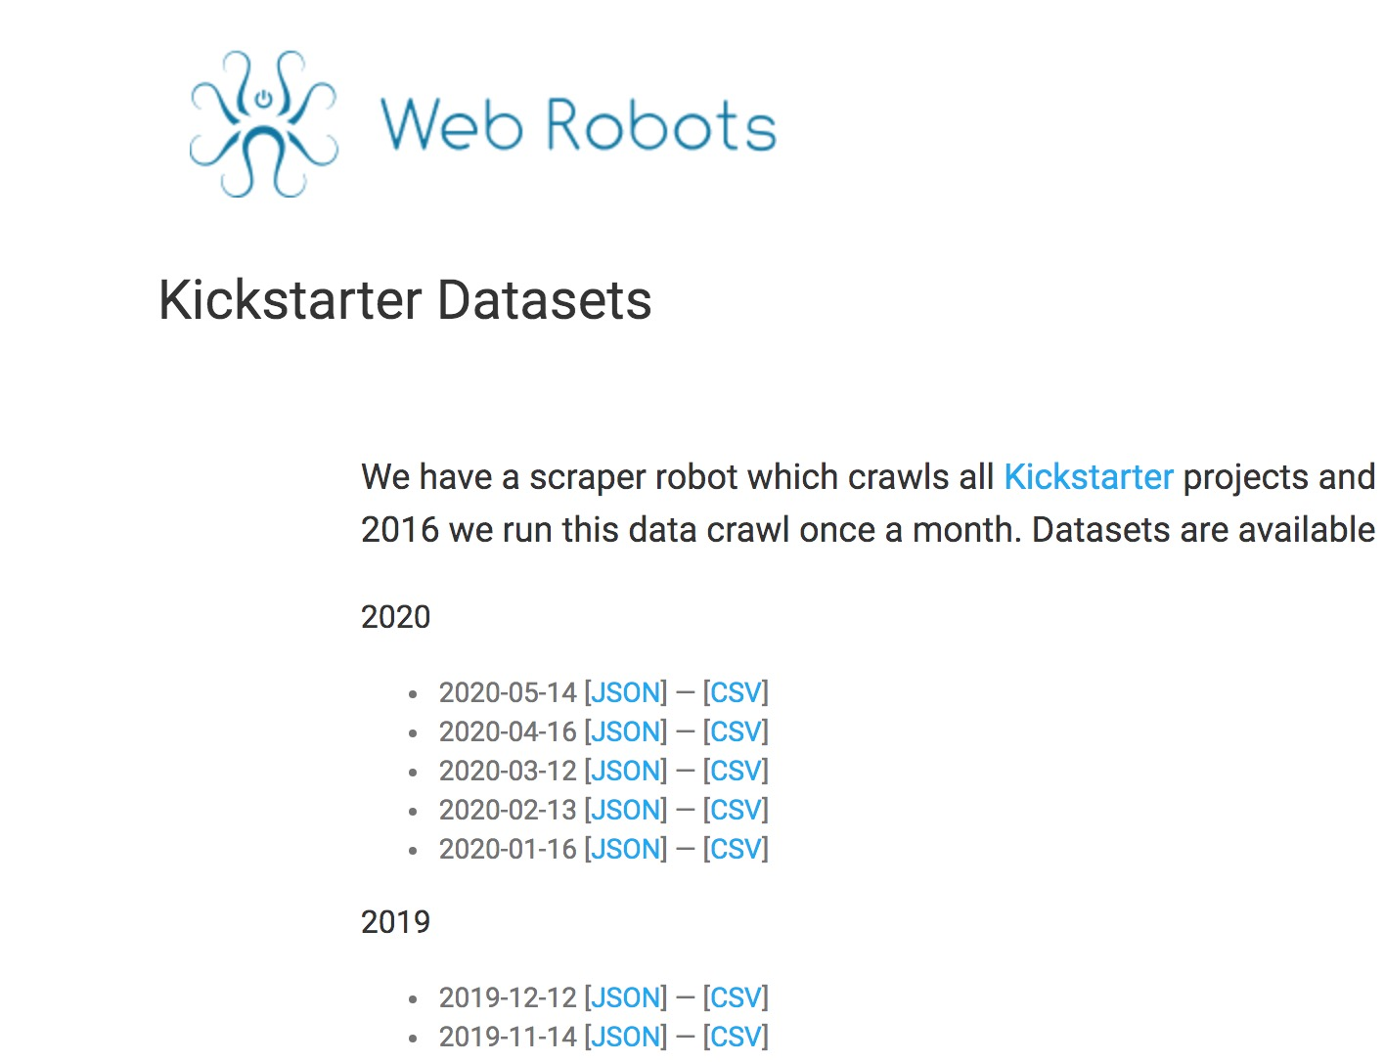
Data
webrobots.io scraped data from all of Kickstarter’s past projects
For sake of relevance and ease of computation, only used the 21,000 most recent projects
Each observation represents a given campaign, and contains a number of information such as:
Campaign Name & Description
Number of Backers
Primary/Parent Categories
Campaign Goal & Deadline
Campaign State—Success or Failure

Slide 4
Model—Metrics for Success
Used a Random Forest model to predict the “final state” of a campaign
After dummy encoding categorical variables, resulted in 201 features
Initial metric for success was to achieve an AUC of 0.90+
Model achieved a test AUC of 0.884 and an test accuracy of 80%
Test Data Evaluation
AUC | Accuracy
0.884 | 0.802

Slide 5
Key Insights
Most important features from model:
Campaign Goal—smaller goals lead to higher probability of success
Campaign Duration—longer campaigns provide a larger window to meet goal
Length of Campaign Name and Blurb (respectively)—better descriptions can attract more funding
Staff Pick?—getting featured will give your project page more web-traffic
Product Design and Food related products tend to be more successful
Projects started in the U.S. are more likely to succeed

Slide 6
Thank you!
Daniel Halteh
Email: dhalteh@gmail.com

