Slide 1
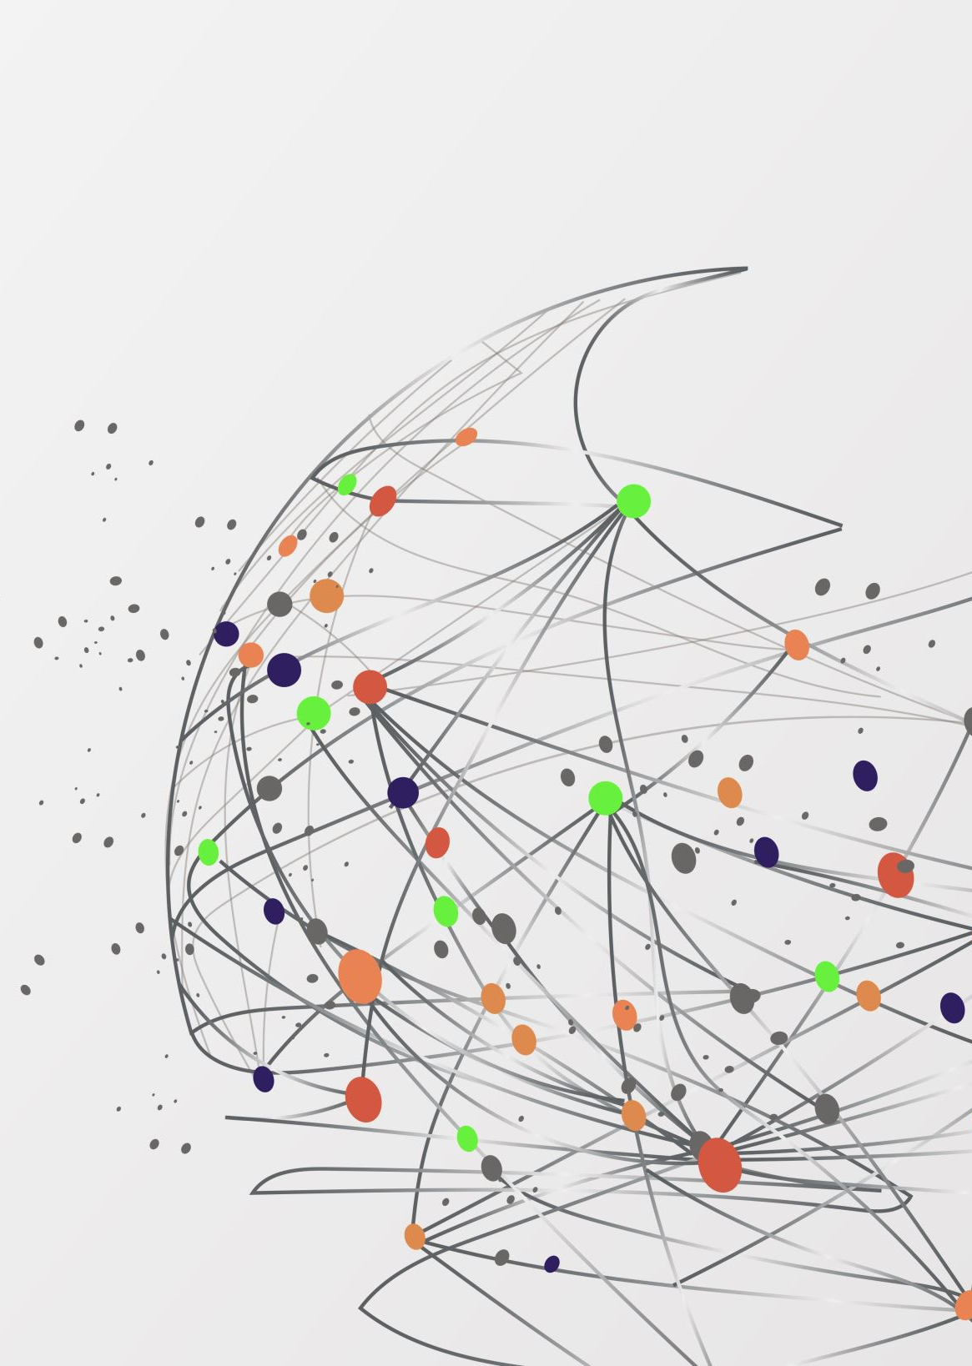
Digital Forensic Analysis Using NetworkMiner
BHAWANA DHAMALA

Slide 2
Introduction to Digital Forensics
Focuses on uncovering hidden network evidence when system data is unavailable.
Digital forensics involves identifying, collecting, analyzing, and presenting digital evidence in a structured and legally acceptable manner.
This will help answer important questions.
1. What happened?
2. How did this happen?
3. Who was responsible?
Network data is particularly valuable because it records activity even when local evidence has been removed.

Slide 3
Overview of Network Miner
Acts passively, ensuring that the original evidence remains intact.
NetworkMiner is a network forensics tool used to analyze packet capture files (PCAP) and extract evidence such as files, images, credentials, and communications.
It operates passively, so it does not interfere with the network and is suitable for forensic investigations.

Slide 4
Purpose and Applicability
NetworkMiner is used in:
1. Cybercrime investigations
2. Data leak detection
3. Analysis of malicious communications
4. Insider Threat Investigations
This is particularly useful when endpoint data is missing or has been intentionally deleted.

Slide 5
How the Tool Works
Network Miner analyzes PCAP files and reconstructs network activity in the following ways:
1. Define a communication session
2. Recovery of transferred data
3. View interactions between devices
4.This tool rebuilds TCP sessions and extracts artifacts from application layer protocols such as HTTP.

Slide 6
Core Features
File extraction (documents, images, executables)
1. Session reconstruction
2. Credential detection
3. Host and OS identification
4. Communication visualization
These features enable efficient identification of forensic evidence.

Slide 7
Case Study Scenario
Unusual activity identified during non-operational hours (e.g., early morning traffic spike).
A financial institution detects unusual outbound traffic from an internal workstation during non-business hours.
A system scan did not detect any suspicious files, suggesting that evidence may have been deleted.
Investigators used intercepted network traffic to determine whether sensitive data was being sent out and reconstruct its activities.

Slide 8
Investigation Approach
Tracked external connections to identify suspicious endpoints.
1. PCAP files were analyzed using Network Miner.
2. Sessions were reconstructed to trace communication.
3. External IP interactions were identified.
4. Transferred files and hidden communications were recovered for further analysis.

Slide 9

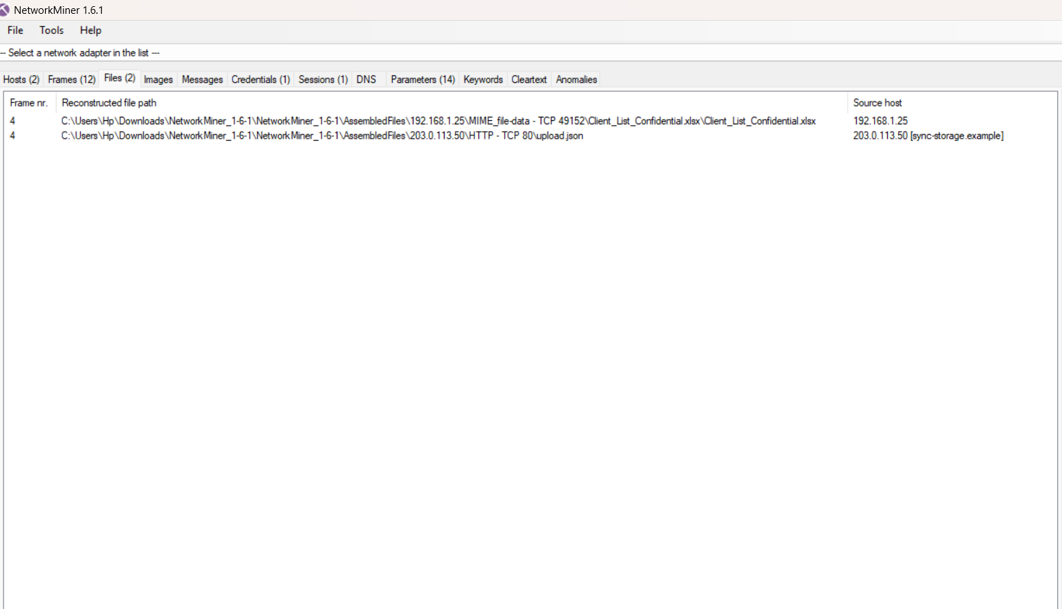
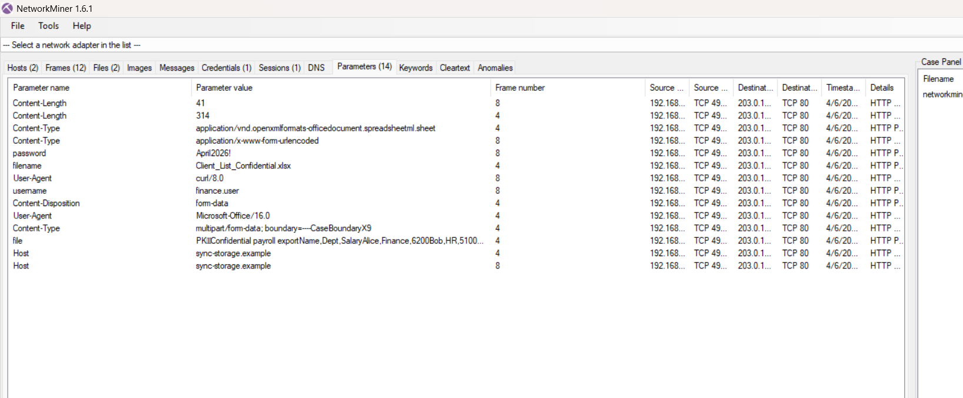
Tool Demonstration PCAP files were analyzed using Network Miner to identify communications between internal hosts and external servers. The scan revealed file transfer activity, indicating a potential data breach.

Slide 10

Findings and Evidence
The recovered session indicated a possible unauthorized file transfer to an external system..
1. Analysis of network traffic revealed file transfer activity to external IP addresses, indicating possible data theft.
2. A sensitive file named Client_list_confidential.xlsx was detected in the network traffic.
3. Activity occurred outside working hours, indicating suspicious behavior around (7.58.05 am).
5. User related information (finance.user) was observed during the transmission.
6. The data transfer was performed using HTTP protocol.

Slide 11
Forensic Interpretation
The observed trends are consistent with indicators of compromise, such as unusual timing and data flows.
The results show that sensitive data was transferred and then deleted from the system.
Even if evidence is deleted locally, it can still be recovered from network traffic.
Network Miner helps recover these hidden activities.
This demonstrates an important forensic concept:

Slide 12
Comparison with Alternatives
Tool
Strength
Limitation
Network Miner
Wireshark
Xplico
Easy & fast extraction
Deep packet analysis
Session reconstruction
Limited depth
Complex
Slower
Among, all the tools network miner proved to be most effective because of its ability to extract and reconstruct files from network traffic in an easy and effective way and also provides practical solution for identifying key evidence from network traffic

Slide 13
STRENGTHS,LIMITATIONS AND WEAKNESSES
Strengths
Limitations
Weaknesses
1. Fast and efficient evidence recovery
2. Investigator-friendly interface
3. Passive and non-intrusive analysis (no data modification)
4. Ability to recover deleted or hidden data
1. Detailed packaging inspection is limited compared to advanced tools
2. It may not be possible to fully decrypt encrypted or fragmented data.
3. Depends on captured traffic or available logs
4. Not very effective for real-time monitoring.
1. It is impossible to analyze data that is not collected.
2. Limited support for complex network protocols
3.we might miss hidden or steganographic data.
4. Additional tools are required for full forensic analysis.

Slide 14
Improvements & Evaluation
Future improvements may include encrypted traffic handling and intelligent anomaly detection.
1. Improved management of encrypted traffic
2. Anomaly detection using AI
3. Improved visualization
Note: Although NetworkMiner is very effective for quick forensic analysis, it must be combined with other tools for complex investigations.
I would like to have it in my toolbox because of its practicality and effectiveness.

Slide 15
Conclusion
NetworkMiner is a valuable network investigation tool that can recover hidden or deleted evidence from network traffic.
Its ease of use and real-world applicability make it an essential tool in modern digital investigations.
Network Miner will be in my forensic toolbox because it can recover hidden evidence from network traffic without changing the original data.

Slide 16
REFERENCE
Netresec. (2024) NetworkMiner Official Tool Documentation.
Bejtlich, R. (2013) The Practice of Network Security Monitoring
Casey, E. (2011) Digital Evidence and Computer Crime. 3rd edn. Academic Press.
Wireshark Foundation. (2024) Wireshark User Guide
Garfinkel, S. (2010) Digital Forensics Research: The Next 10 Years. Digital Investigation Journal.

