Slide 1
RUBY PROGRAMMING LANGUAGE
Ruby is a dynamic programming language with a complex but expressive grammar and a core class library with a rich and powerful API. Ruby draws inspiration from Lisp, Smalltalk, and Perl, but uses a grammar that is easy for C and Java™ programmers to learn. Ruby is a pure object-oriented language, but it is also suitable for procedural and functional programming styles. It includes powerful metaprogramming capabilities and can be used to create domain-specific languages or DSLs.

Slide 2
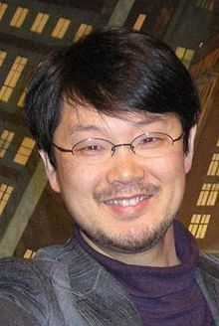
HISTORY
Ruby was conceived on February 24, 1993 by Yukihiro Matsumoto who wished to create a new language that balanced functional programming with imperative programming. Matsumoto has stated, "I wanted a scripting language that was more powerful than Perl, and more object-oriented than Python. That's why I decided to design my own language".

Slide 3
HISTORY
ETYMOLOGY
The name "Ruby" was decided on during an online chat session between Matsumoto and Keiju Ishitsuka on February 24, 1993, before any code had been written for the language. Initially two names were proposed: "Coral" and "Ruby", with the latter being chosen by Matsumoto in a later email to Ishitsuka. Matsumoto has later stated that a factor in choosing the name "Ruby" was because it was the birthstone of one of his colleagues.

Slide 4
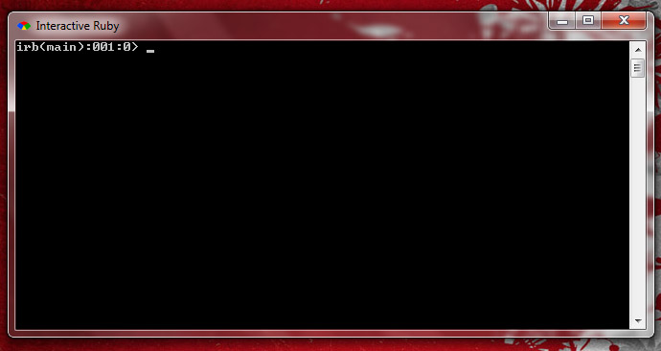
ENVIRONMENT

Slide 5
DATA TYPES
Numeric/Numbers
  Integer (Fixnum or Bignum)
    Use underscore as comma separator
    0b – Binary (Base 2)
    0 – Octal (Base 8)
    0x – Hexadecimal (Base 16)
  Float
  Complex (Standard Library)
  Big Decimal (Standart Library)
  Rational (Standard Library)
Text
  String Literal e.g. “This is a string”
  Character Literal e.g. ?A

Slide 6
DATA TYPES
Arrays
  numArray = [1,2,3,4]
Hashes
  numHash ={
  :one => 1
  :two=> 2
  }
Ranges
  year = 1990..2000 # from year 1990 to 2000
  Year = 1990…2000 #from year 1990 to 2000 excluding 2000
Symbols
  :symbol
True, False, Nil
Objects

Slide 7
VARIABLE DECLARATION
Global Variable - $global_variable = 1
Instance Variable - @instance_variable = 2
Class Variable - @@class_variable = 3
Local Variable – local_variable = 4
Psuedo-Variables – true,false,nil,self,
              __FILE__,__LINE__
Class and Local variables must be initialized or else it will throw an NameError exception.
An uninitialized Global and Instance variable has a value of nil (null).

Slide 8
NAMING CONVENTIONS
Variable should only begin with a letter or an underscore and must only contain alphanumeric characters and underscores.
In naming variable or methods, avoid doing this getName (Camel Back) . Instead do this get_name (Use underscores).
.
In naming constant, use a capital letter on the beginning and followed by letters or underscored. It is convenient to use all caps ( e.g. MILES_TO_KILOMETER).
Methods should start with a small letter
Classes should start with a capital letter and should follow Mixed Cases (e.g. GreatestCommonFactor).

Slide 9
CONDITIONAL STATEMENTS
If
  if <condition>
  <statements>*
  end
  if <condition> then <statement>* end #the then separator
If-Else
  if <condition>
  <statements>*
  else
  <statements>*
  end

Slide 10
CONDITIONAL STATEMENTS
Elsif
  if <condition>
  <statements>*
  elsif <condition>
  <statements>*
  elsif <condition>
  <statements>*
  else
  <statements>*
  end

Slide 11
CONDITIONAL STATEMENTS
Unless
  Single-way
  unless <condition>
  <statements>*
  end
  Two-way
  unless <condition>
  <statements>*
  else
  <statements>*
  end

Slide 12
CONDITIONAL STATEMENTS
Case
case
  when <condition> then <statements>*
  when <condition> then <statements>*
  when <condition> then <statements>*
  else <statements>
  end
Conditional Operator
result =expression1?expression2:<statement1>:<statement2>

Slide 13
TYPE CASTING
Since all values are object you can easily type cast a value by calling its

Slide 14
LOOPING
While Loop
    <initialization>
  while <condition> do
  <statements>*
  end
Until Loop
  <initialization>
  until <condition> do
  <statements>*
  end

Slide 15
LOOPING
For/in Loop
  for <variable> in <collection> do
  <statements>*
  end

