Slide 1
EDGE DETECTION
- DOG
By
Dhanalakshmi A
2023510019

Slide 2
EDGE DETECTION ?
Edge detection is a technique used to identify points in a image where Intensity changes sharply .
METHODS
Sobel Operator
Perwitt Operator
Robert Operator
Canny
LoG
DoG
We find edges in images because they reveal the structure, simplify processing, and are essential for recognizing objects — just like how we sketch the outline to understand what we see.

Slide 3

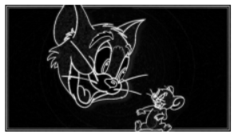
,
→

Slide 4
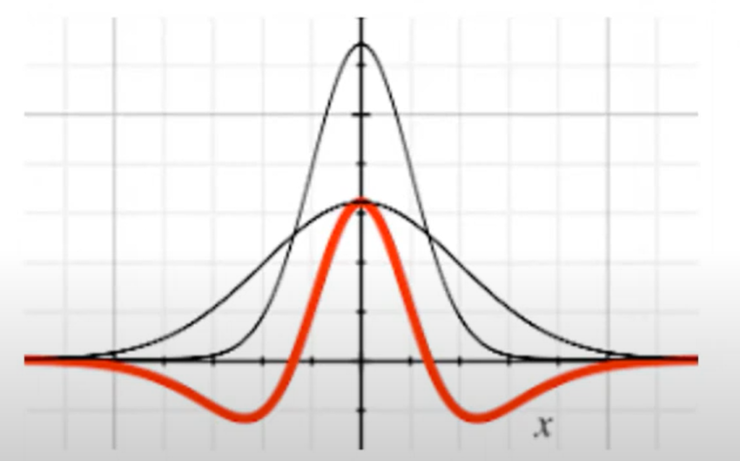
DOG
APPROXIMATION OF LoG
DoG is a method where we blur the image twice using two different Gaussian filters and then subtract one blurred image from the other. This highlights regions where intensity changes
1st has lesser standard deviation .
2nd having more standard deviation
1-2 positive left and right has negative

Slide 5
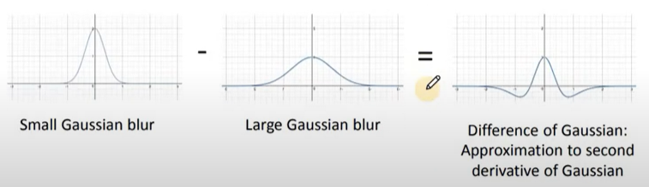

Slide 6
In signal processing, gaussian function is called as low pass filter which implies higher frequencies get suppressed leaving the lower frequencies alone ……
The suppression is determined by standard deviation of gaussian function.
Two gaussian filters are subtracted using different deviation
endup with band pass filter
The frequencies are area of high contrast which corresponds to edges
Although it is an approximation of LoG , it is faster compared to LoG

Slide 7
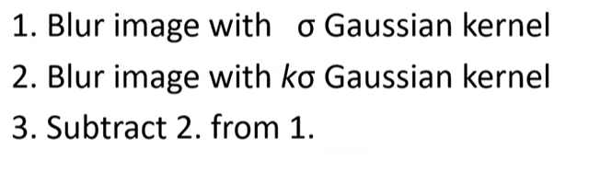


PROCEDURE:
LAPLACIAN:
DOG:

Slide 8
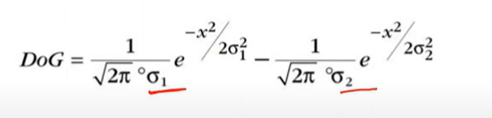
By keeping the results of Gaussian filtering applied to an image, we can extract edges simply by taking the difference between successive filtered images, without needing to calculate image derivatives directly.

Slide 9



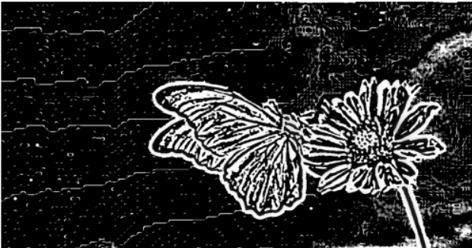
ORIGINAL →
-
=
Sigma = 0.4
Sigma=0.2

Slide 10
When DoG is preferred:
Performance & Speed
LoG (Laplacian of Gaussian) requires computing second-order derivatives, which is computationally more expensive.
DoG (Difference of Gaussians) just needs two Gaussian blurs and a subtraction — it's faster and easier to implement.
DoG is preferred in feature detection pipelines (e.g., SIFT) because it helps in identifying scale-invariant feature
DoG is a computationally efficient approximation of LoG.

Slide 11
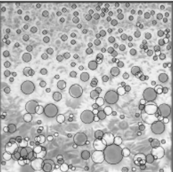
APPLICATIONS
Feature Detection
Edge Detection
Biological Vision Models
Robotics and Real-Time Vision
Image Compression & Enhancement

Slide 12
Thank you for your time !!!

