Slide 1
AI POWERED DEAF ASSISTANT
A cheap solution for a complex problem
VISHWATH KUMAR B S – 18BEC1289
RAM S KAUSHIK – 18BEC1024
DHANUSH – 18BEC1018
YOGEESHWAR – 18BEC1343

Slide 2
OBJECTIVE
Our project mainly aims at efficient Audio Optimisation of the received waves using Generative Adversarial Networks according to the surroundings, this optimization can be done by signal processing and the intelligence is created by deep Convolutional Neural Networks which makes the model predict the audio quality and the surroundings and computational noise reduction is achieved through GANs which generates noiseless audio waves accordingly. This hearing aid can further convert sound energy into vibrations and pass it directly to the inner part of the ear through Bone Conduction Technology which is helpful for most of the completely deaf people.

Slide 3
TOOLS REQUIRED:
HARDWARE:
Bone conduction transducer / vibration motor
Raspberry pi or similar microprocessor
Mic
Bluetooth module
Arduino uno
SOFTWARE:
Python
MATLAB
Colab / Jupyter Notebook

Slide 4
EMBEDDED SYSTEM DESIGN PROCESS:
REQUIREMENTS
Purpose: An advanced hearing aid for assisting deaf people.
Input: Voice signal with background noise.
Output: Optimised Vibrations with respect to surroundings.
Functions:
Optimization can be done by signal processing and the intelligence is created by deep Convolutional Neural Networks which makes the model predict the audio quality and the surroundings.
Computational noise reduction is achieved through GANs which generates noiseless audio waves accordingly.

Slide 5
REQUIREMENTS
Non-functional:
Low power consumption
Robust
Moderate cost (Rs.3600 approx)
The user is able to hear the voice within 1 second latency.

Slide 6
SPECIFICATION:
Microprocessor – Raspberry pi 3 – For deploying GAN model and computing
Quad Core 1.2GHz Broadcom BCM2837 64bit CPU
1GB RAM
BCM43438 wireless LAN and Bluetooth Low Energy (BLE) on board
100 Base Ethernet
40-pin extended GPIO
4 USB 2 ports
4 Pole stereo output and composite video port
Full size HDMI
CSI camera port for connecting a Raspberry Pi camera
DSI display port for connecting a Raspberry Pi touchscreen display
Micro SD port for loading your operating system and storing data
Upgraded switched Micro USB power source up to 2.5A

Slide 7
SPECIFICATION:
BLUETOOTH MODULE:
KCX_BT_V1.1 module is a Bluetooth audio transmitter module that integrates a computer USB sound card to Bluetooth transmission and line audio input and launch. It adopts Bluetooth 4.1 technology to greatly ensure the quality and stability of the audio transmission. This product can be used for most of the products. Bluetooth transmitter function for desktop computers, notebook computers, TVs, projectors, game consoles, iPod, CD players, MP3s, etc., to transmit audio signals to Bluetooth audio receivers such as Bluetooth headsets or Bluetooth speakers to form a wireless audio transmission system. Let your life truly enter the wireless era.
VIBRATION MOTOR:
Vibrators developed on bone conduction principle. The BC transducer turns sound into vibrations, conducts vibrations through the bones of the skull to the inner ear where they are detected and perceived as sound.

Slide 8
SPECIFICATIONS
DC Current for 3.3V Pin: 50 mA
Flash memory: 32 KB of which 0.5 KB used by bootloader
SRAM: 2 KB
EEPROM: 1 KB
Clock Speed: 16 MHz
Length: 68.6 mm
Width: 53.4 mm
Weight: 25 g
Arduino Uno: For integrating bluetooth transmitter module and microphone.
Operating Voltage: 5 Volts
Input Voltage: 7 to 20 Volts
Digital I/O Pins: 14 (of which 6 can provide PWM output)
UART: 1
I2C: 1
SPI: 1
Analog Input Pins: 6
DC Current per I/O Pin: 20 mA

Slide 9
SPECIFICATIONS
Jupyter notebook: The Jupyter Notebook is an open-source web application that allows you to create and share documents that contain live code, equations, visualizations and narrative text. Uses include: data cleaning and transformation, numerical simulation, statistical modeling, data visualization, machine learning, and much more.
MATLAB: MATLAB is a programming and numeric computing platform used to analyze and visualize data, develop algorithms, and create models.

Slide 10
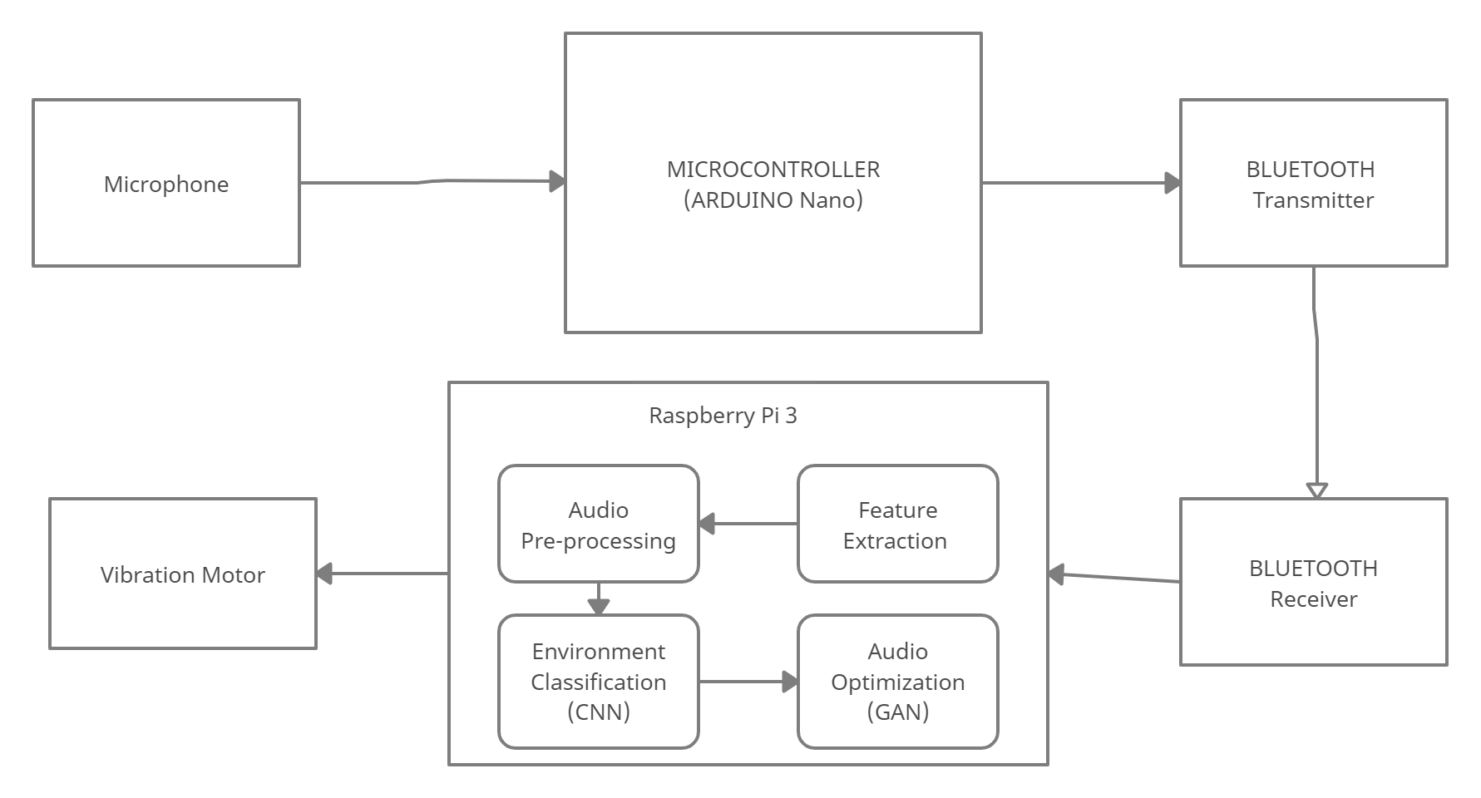
ARCHITECTURE – OVERALL SYSTEM DIAGRAM

Slide 11
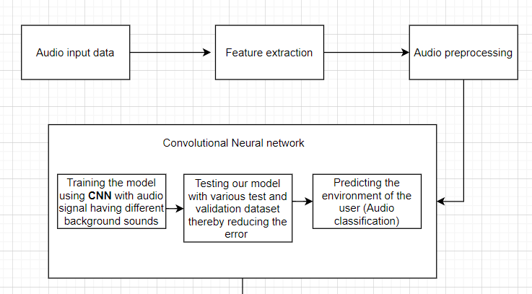
ARCHITECTURE – SOFTWARE(CNN MODEL)

Slide 12
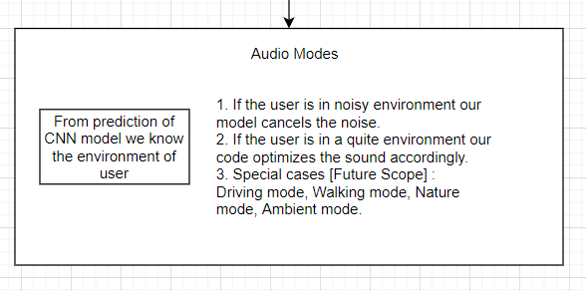
ARCHITECTURE – SOFTWARE(CNN MODEL)

Slide 13
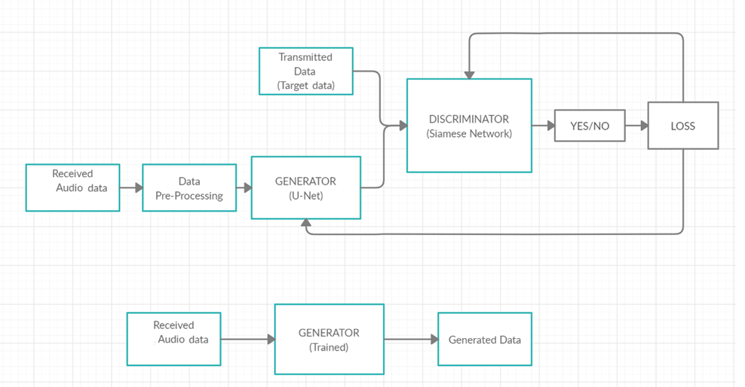
ARCHITECTURE – SOFTWARE(GAN MODEL)

Slide 14
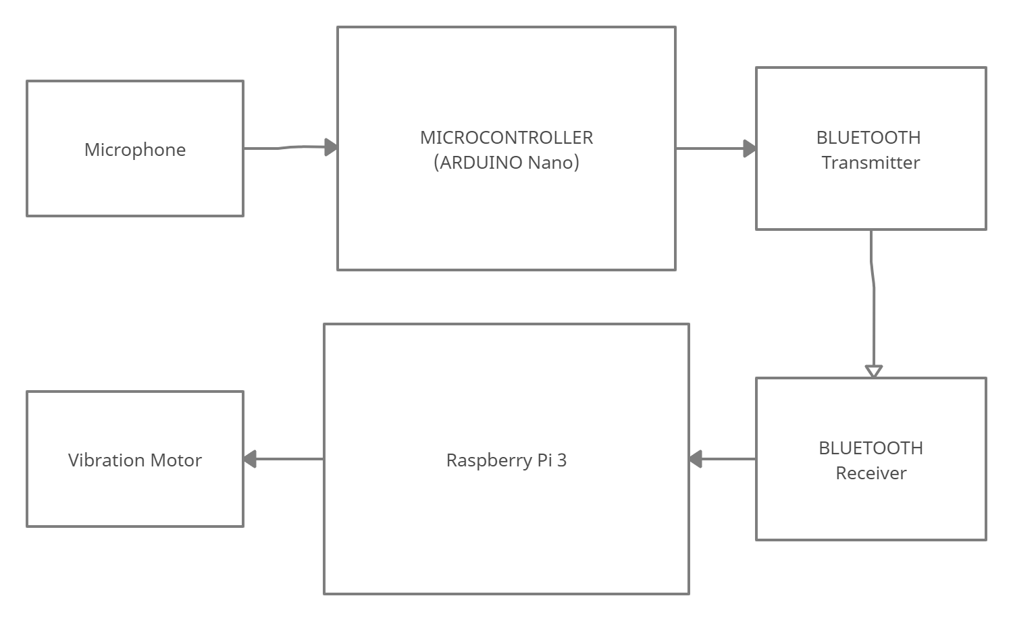
ARCHITECTURE - HARDWARE

Slide 15
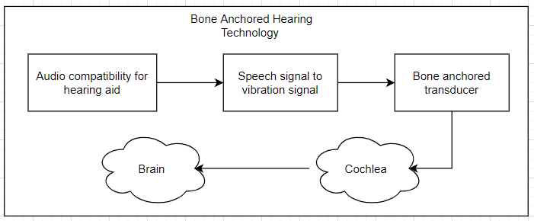
ARCHITECTURE - HARDWARE

Slide 16
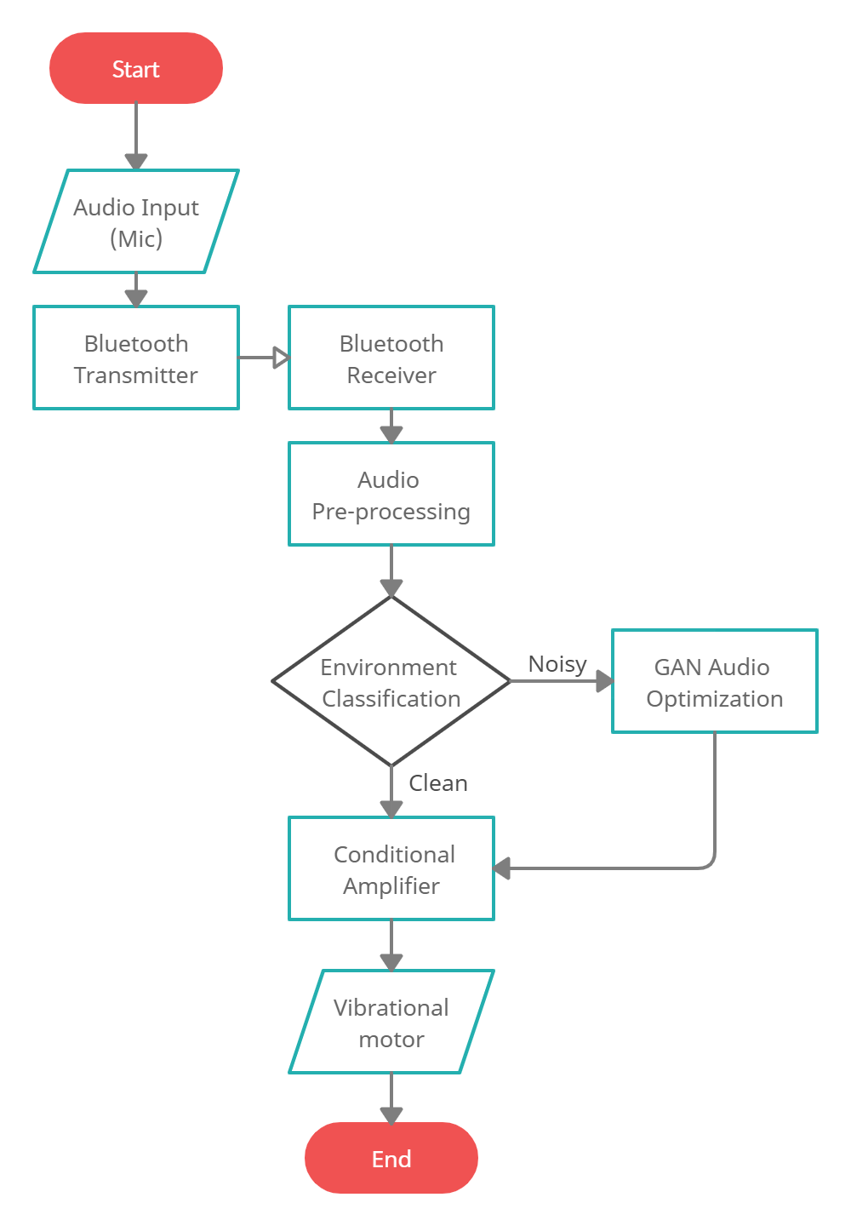
ALGORITHM

Slide 17
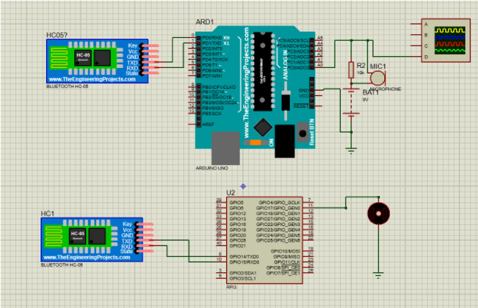
SCHEMATIC DIAGRAM

Slide 18
COMPONENTS - HARDWARE
Raspberry pi 3 microcontroller for application codes and Arduino nano for digital signal processing at receiver end.
Microphone to receive surrounding environment sounds and noises.
Bluetooth module to transmit and receive signals from Raspberry pi 3.
Bone conduction transducer is converts analog signals to vibrations.
Resistors
Oscilloscope
9v battery to power microphone.

Slide 19
SYSTEM INTEGRATION:
APPROACH: Top – Down
Performance metric:
1. Response Time: Time required to for the cycle to comple from the input of the sensor to the output
2. precesion: To detect input consistently with each input
3. Power requirement: Total power required to run the system
Testing and Debugging:
(possible errors)
Hardware :
1. Running the model on less computing power.
2. Measuring the latency after connecting Bluetooth model.
Software:
1. Model computation time for working in real time.

Slide 20
SOFTWARE/HARDWARE IMPLEMENTATION
Batch size: 64
Epochs: 100
Size dataset: 10K
TESTING:
Audio generated for some types of noise and various levels of noise; able to generate clean audio without distortion ranging from 15dB, 10dB, 8dB, 5dB, where it fails to generate a very clear audio or there is some distortion seen when SNR crosses 3dB; the point where the model fails.
AUDIO SAMPLES/PROOFS:
https://colab.research.google.com/drive/1TEaJfQI_sG8UjfDBQtNpCWc26hTnzhay
{audio samples generated for various noises and levels}

Slide 21
THANKYOU

