Slide 1
Building a News Recommender for JhakaasNewsVala
Group – 9 ML
IDC 410 MACHINE LEARNING
Dhanasekhar ( MS18067 )
Soham( MS18158)
Suhasi (MS18210 )
Sakshi ( MS18213)
Harshit (MS18004)

Slide 2
OVERVIEW
BOT-1
TF-IDF
BOT-2
Content-based filtering
Final
Hybrid Recommendation System
PCA
K-Mean Cluster Algorithm
Collaborative filtering
Bot – 1
Recommend top 10 articles
Yes
Check whether the user is new
Section 1: content-based filtering
True
No
Bot – 2
Is data<threshold
False
section – 2 collaborative filtering
Notes:
We constituted 2 bots, 1 for new user and bot 2 for exixting user. And finally we synchronized them to a final hybrid recommendation system. So here you can see the main strategy, initially we will check if the user is new user, if the user is new we will recomment top 10 article from our data base relavent at that time. And if the user is an already existing then based on his clickstream data , if we have . It is a hybrid of bot1( which forms clusters of the news corpus and recommends the latest news articles from each cluster. This bot comes into action when the user has no click stream data), and bot 2 (which decides whether to recommend news articles by collaborative filtering or content based filtering depending on the volume of click stream data of the user ).

Slide 3
News Article Scrapping
Lemmatization
Lowering
Tokenization
Removing Stop Words
Stored the cleaned data in suitable database
Corpus Data
Removing Punctuation
News Corpus
NCBI
Reuters
TOI
IB-Times
NDTV
Cleaning Data
Notes:
We scraped articles from these channels and after performing these cleaning processes, namely lowering case, tokenization, removal of punctuation marks, removal of stop words, lemmatization, we stored the cleaned news in the database as a new column entry. This is the data we used for analysis.

Slide 4
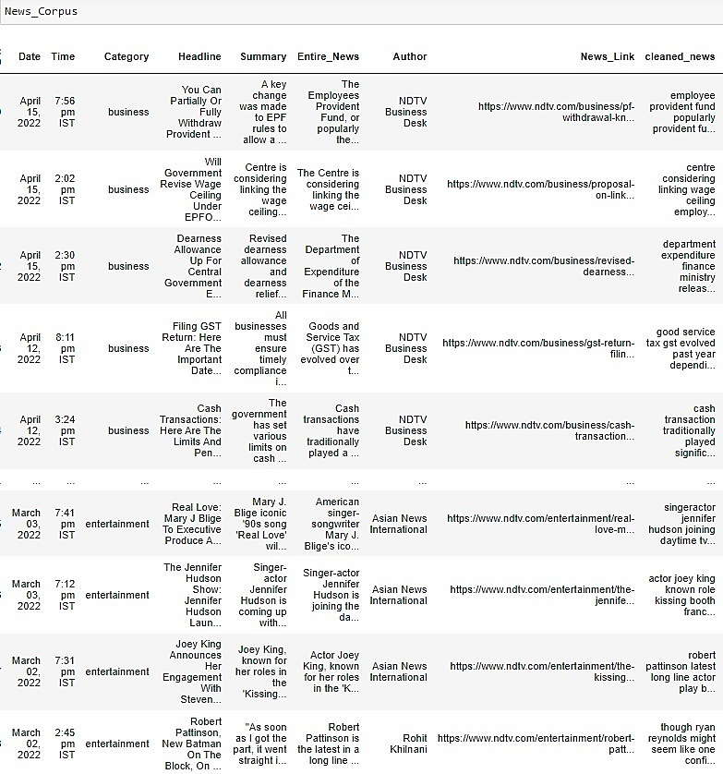
News Corpus
Notes:
The news corpus updated with cleaned news using the Text_processing python module that is created by ourselves

Slide 5
BOT-1
TF-IDF(Term frequency- inverse document frequency)& Vectorization
b) K-Mean Cluster Algorithm
Notes:
Then we performed term frequency- inverse document frequency – TF-IDF using
tfidvectorizer from sklearn, through which important terms and keywords in the document were identified.
It is based on the assumption that less frequently occurring words have higher weightage.
The obtained data is proceeded with K- mean clustering , and updated the news corpus data with new column which contains the cluster labels
Based on the cluster label in the data frame, we made the recommendation function which displays one news link from each cluster.
we directly went ahead with 10 clusters, as we have to display 10 news articles.
From every cluster, we picked 1 news and recommended 10 article through BOT1.

Slide 6
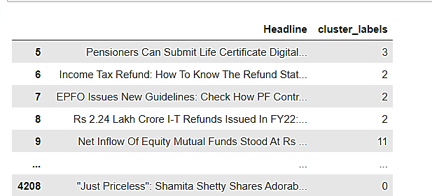
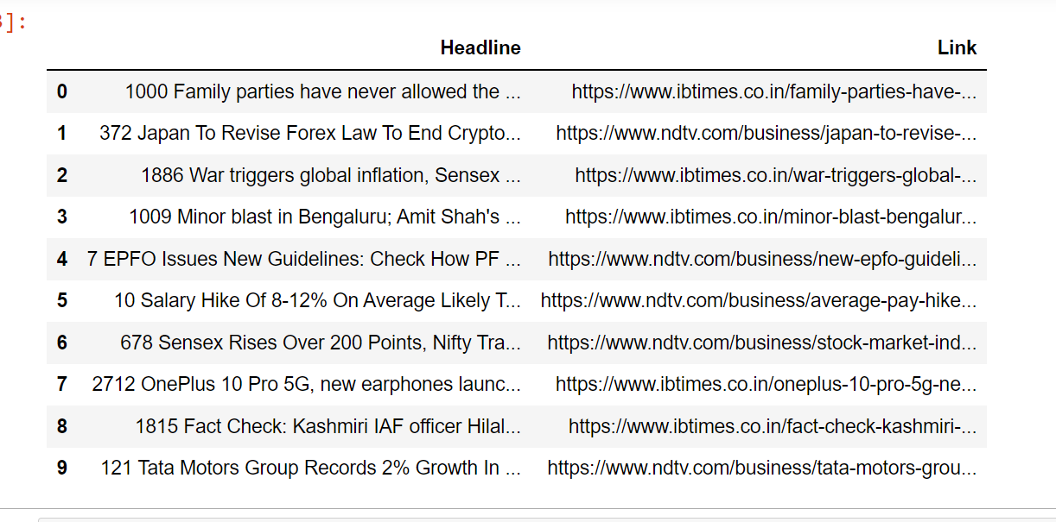
TF-IDF & K- Mean
Notes:
We can see the cluster labels in the image and the recommended news articles.

Slide 7
BOT-2
a) Content-based filtering
b) Collaborative filtering

Slide 8
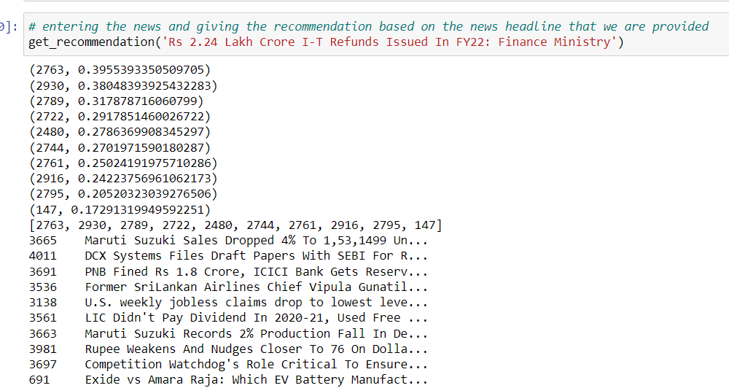
Content-based filtering
TF-IDF & COSINE SIMILARITY
TfidfVectorizer
Linear_ kernel
Recommendation function
Based on a single news heading , which it takes as input value & calculates the similarity scores
Recommendation function that finds the top 10 highest news that have the highest scores & locate the corresponding news links
Notes:
Content based filtering will be executed when the data from the user is not sufficient to compare with other users. We vectorized the articles using tfidf and then through Linear_kernel from sklearn we found the cosine score which gives an evaluation of the similarity between the articles. The function takes one news headline as input and gives ten articles with highest cosine scores to this article.

Slide 9
Changes Implemented From Initial Strategy
Yet to be done
Collaborative filtering (BOT-2)
Webpage
PCA (Principal Component Analysis), Due to time constraint PCA was not implemented. Kmean implemented
K-means elbow method was not used for K-mean clustering.
Notes:
Although if we had more time we would have implemented PCA, as it reduces the dimension of the data significantly.

