Slide 1

BLOOD BANK REPORTING SYSTEM
Presented by
Dhanalakshmi Karri
Associate Software Engineer
Notes:
Image source: Microsoft 365 content library

Slide 2

Requirement GIVEN
We were provided with backend data of an application called Blood Bank Management System.
The data was given as a SQL file containing the table creation DDLs and insert statements.
We were asked to build a reporting system considering this data as source
The data contains daily activities like donations, blood tests, and requests, which are not optimized for reporting.
Notes:
Operational systems used by blood banks are primarily designed to support day-to-day transactions such as recording donations, updating test results, managing inventory, and logging hospital requests. These systems are optimized for fast inserts and updates, not for complex analytical queries. As a result, generating reports directly from operational databases often leads to performance issues and incomplete insights. Another major challenge is the limited support for historical trend analysis. Operational systems typically store the latest state of data, making it difficult to track changes in donor behavior, inventory levels, or demand patterns over time. This limitation directly impacts decision-making, as stakeholders cannot easily answer questions such as which blood groups face recurring shortages, how donor participation changes seasonally, or which regions require targeted campaigns. Additionally, data in operational systems may contain inconsistencies, missing values, or unstandardized formats, further reducing its analytical value. Manual reporting efforts often become time-consuming and error-prone, relying heavily on ad hoc queries and spreadsheets. These challenges highlight the need for a dedicated analytical data pipeline. By separating operational workloads from analytical processing, organizations can ensure system stability while enabling deeper insights. A structured pipeline allows data to be cleaned, validated, and modeled specifically for reporting, transforming raw transactional data into meaningful, business-ready information that supports informed and timely decisions. Image source: Microsoft 365 content library

Slide 3
REPORTING REQUIREMENTS
Monthly donation trends by blood type
Donor Demographics
Donor retention risk
Hospital Demand vs supply
Urgent Requests Analysis
Daily Operations summary
Notes:
Operational systems used by blood banks are primarily designed to support day-to-day transactions such as recording donations, updating test results, managing inventory, and logging hospital requests. These systems are optimized for fast inserts and updates, not for complex analytical queries. As a result, generating reports directly from operational databases often leads to performance issues and incomplete insights. Another major challenge is the limited support for historical trend analysis. Operational systems typically store the latest state of data, making it difficult to track changes in donor behavior, inventory levels, or demand patterns over time. This limitation directly impacts decision-making, as stakeholders cannot easily answer questions such as which blood groups face recurring shortages, how donor participation changes seasonally, or which regions require targeted campaigns. Additionally, data in operational systems may contain inconsistencies, missing values, or unstandardized formats, further reducing its analytical value. Manual reporting efforts often become time-consuming and error-prone, relying heavily on ad hoc queries and spreadsheets. These challenges highlight the need for a dedicated analytical data pipeline. By separating operational workloads from analytical processing, organizations can ensure system stability while enabling deeper insights. A structured pipeline allows data to be cleaned, validated, and modeled specifically for reporting, transforming raw transactional data into meaningful, business-ready information that supports informed and timely decisions. Image source: Microsoft 365 content library

Slide 4
OLTP vs OLAP
OLTP (Operational Systems)
Used for daily operations like transactions and data entry
Handles frequent inserts and updates
OLAP (Analytical Systems)
Used for reporting and data analysis
Handles complex data queries
Notes:
Operational systems used by blood banks are primarily designed to support day-to-day transactions such as recording donations, updating test results, managing inventory, and logging hospital requests. These systems are optimized for fast inserts and updates, not for complex analytical queries. As a result, generating reports directly from operational databases often leads to performance issues and incomplete insights. Another major challenge is the limited support for historical trend analysis. Operational systems typically store the latest state of data, making it difficult to track changes in donor behavior, inventory levels, or demand patterns over time. This limitation directly impacts decision-making, as stakeholders cannot easily answer questions such as which blood groups face recurring shortages, how donor participation changes seasonally, or which regions require targeted campaigns. Additionally, data in operational systems may contain inconsistencies, missing values, or unstandardized formats, further reducing its analytical value. Manual reporting efforts often become time-consuming and error-prone, relying heavily on ad hoc queries and spreadsheets. These challenges highlight the need for a dedicated analytical data pipeline. By separating operational workloads from analytical processing, organizations can ensure system stability while enabling deeper insights. A structured pipeline allows data to be cleaned, validated, and modeled specifically for reporting, transforming raw transactional data into meaningful, business-ready information that supports informed and timely decisions. Image source: Microsoft 365 content library

Slide 5

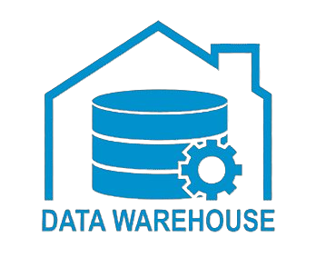

SOLUTION OVERVIEW
We used the blood bank dataset given as source data.
The source data was loaded into data warehouse for further processing.
Built a layered data pipeline to clean, transform and organize the data.
The prepared data was used to generate reports and derive business insights
Extract
Load
Analyze
Prepared data
Source
PostgreSQL
Power BI (Visualization tool)
Notes:
Operational systems used by blood banks are primarily designed to support day-to-day transactions such as recording donations, updating test results, managing inventory, and logging hospital requests. These systems are optimized for fast inserts and updates, not for complex analytical queries. As a result, generating reports directly from operational databases often leads to performance issues and incomplete insights. Another major challenge is the limited support for historical trend analysis. Operational systems typically store the latest state of data, making it difficult to track changes in donor behavior, inventory levels, or demand patterns over time. This limitation directly impacts decision-making, as stakeholders cannot easily answer questions such as which blood groups face recurring shortages, how donor participation changes seasonally, or which regions require targeted campaigns. Additionally, data in operational systems may contain inconsistencies, missing values, or unstandardized formats, further reducing its analytical value. Manual reporting efforts often become time-consuming and error-prone, relying heavily on ad hoc queries and spreadsheets. These challenges highlight the need for a dedicated analytical data pipeline. By separating operational workloads from analytical processing, organizations can ensure system stability while enabling deeper insights. A structured pipeline allows data to be cleaned, validated, and modeled specifically for reporting, transforming raw transactional data into meaningful, business-ready information that supports informed and timely decisions. Image source: Microsoft 365 content library

Slide 6

TOOLS AND TECHNOLOGIES USED
Python was used to generate large-scale mock data for fact and dimension tables.
dbt helps us clean and transform raw data and build the analytical data used for reporting.
SQL was used to write queries for transforming data and writing reporting queries.
PostgreSQL was used as the data warehouse to store processed data and run analytical queries.
Git was used to manage versions of the code and track changes.
Microsoft Power BI was used to create reports and dashboards to visualize insights from the data.
Notes:
Operational systems used by blood banks are primarily designed to support day-to-day transactions such as recording donations, updating test results, managing inventory, and logging hospital requests. These systems are optimized for fast inserts and updates, not for complex analytical queries. As a result, generating reports directly from operational databases often leads to performance issues and incomplete insights. Another major challenge is the limited support for historical trend analysis. Operational systems typically store the latest state of data, making it difficult to track changes in donor behavior, inventory levels, or demand patterns over time. This limitation directly impacts decision-making, as stakeholders cannot easily answer questions such as which blood groups face recurring shortages, how donor participation changes seasonally, or which regions require targeted campaigns. Additionally, data in operational systems may contain inconsistencies, missing values, or unstandardized formats, further reducing its analytical value. Manual reporting efforts often become time-consuming and error-prone, relying heavily on ad hoc queries and spreadsheets. These challenges highlight the need for a dedicated analytical data pipeline. By separating operational workloads from analytical processing, organizations can ensure system stability while enabling deeper insights. A structured pipeline allows data to be cleaned, validated, and modeled specifically for reporting, transforming raw transactional data into meaningful, business-ready information that supports informed and timely decisions. Image source: Microsoft 365 content library

Slide 7
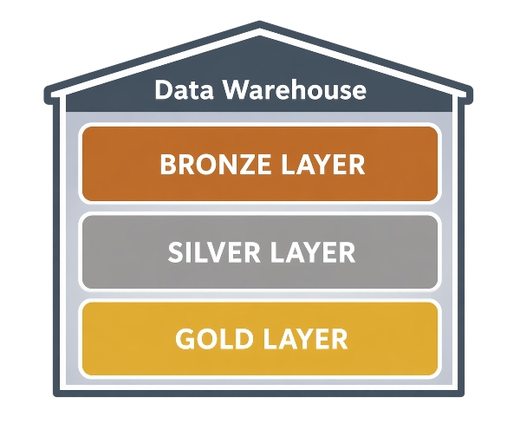
Data WAREHOUSE Architecture
MEDALLION ARCHITECTURE
Raw Layer
Source dataset tables are replicated in the warehouse and assumed that data is already extracted into raw layer.
Staging Layer
Data is cleaned, standardized, and validated for further processing.
Analytics layer
The data was structured into facts and dimensions and prepared to support reporting and analysis.
Extract
Load
Analyze
Prepared data
Source
PostgreSQL
Power BI
Notes:
Operational systems used by blood banks are primarily designed to support day-to-day transactions such as recording donations, updating test results, managing inventory, and logging hospital requests. These systems are optimized for fast inserts and updates, not for complex analytical queries. As a result, generating reports directly from operational databases often leads to performance issues and incomplete insights. Another major challenge is the limited support for historical trend analysis. Operational systems typically store the latest state of data, making it difficult to track changes in donor behavior, inventory levels, or demand patterns over time. This limitation directly impacts decision-making, as stakeholders cannot easily answer questions such as which blood groups face recurring shortages, how donor participation changes seasonally, or which regions require targeted campaigns. Additionally, data in operational systems may contain inconsistencies, missing values, or unstandardized formats, further reducing its analytical value. Manual reporting efforts often become time-consuming and error-prone, relying heavily on ad hoc queries and spreadsheets. These challenges highlight the need for a dedicated analytical data pipeline. By separating operational workloads from analytical processing, organizations can ensure system stability while enabling deeper insights. A structured pipeline allows data to be cleaned, validated, and modeled specifically for reporting, transforming raw transactional data into meaningful, business-ready information that supports informed and timely decisions. Image source: Microsoft 365 content library

Slide 8
Dimension Tables
Dimension tables store descriptive information such as donors, hospitals, and dates information.
These tables provide additional context to the events stored in fact tables.
Snapshots (scd type-2) are created separately to track historical changes and identify data inconsistencies over time.
This approach supports both current reporting and future historical analysis when needed.
Notes:
Operational systems used by blood banks are primarily designed to support day-to-day transactions such as recording donations, updating test results, managing inventory, and logging hospital requests. These systems are optimized for fast inserts and updates, not for complex analytical queries. As a result, generating reports directly from operational databases often leads to performance issues and incomplete insights. Another major challenge is the limited support for historical trend analysis. Operational systems typically store the latest state of data, making it difficult to track changes in donor behavior, inventory levels, or demand patterns over time. This limitation directly impacts decision-making, as stakeholders cannot easily answer questions such as which blood groups face recurring shortages, how donor participation changes seasonally, or which regions require targeted campaigns. Additionally, data in operational systems may contain inconsistencies, missing values, or unstandardized formats, further reducing its analytical value. Manual reporting efforts often become time-consuming and error-prone, relying heavily on ad hoc queries and spreadsheets. These challenges highlight the need for a dedicated analytical data pipeline. By separating operational workloads from analytical processing, organizations can ensure system stability while enabling deeper insights. A structured pipeline allows data to be cleaned, validated, and modeled specifically for reporting, transforming raw transactional data into meaningful, business-ready information that supports informed and timely decisions. Image source: Microsoft 365 content library

Slide 9
Fact Tables
Fact tables store measurable events that happen in the system, such as donations, blood tests, and hospital requests.
Fact tables are connected with dimension tables to add more details like donor, recipient and date.
Fact tables were built using an incremental approach, where only new or changed records are processed.
This approach helps avoid reprocessing the entire dataset and improves performance.
Notes:
Operational systems used by blood banks are primarily designed to support day-to-day transactions such as recording donations, updating test results, managing inventory, and logging hospital requests. These systems are optimized for fast inserts and updates, not for complex analytical queries. As a result, generating reports directly from operational databases often leads to performance issues and incomplete insights. Another major challenge is the limited support for historical trend analysis. Operational systems typically store the latest state of data, making it difficult to track changes in donor behavior, inventory levels, or demand patterns over time. This limitation directly impacts decision-making, as stakeholders cannot easily answer questions such as which blood groups face recurring shortages, how donor participation changes seasonally, or which regions require targeted campaigns. Additionally, data in operational systems may contain inconsistencies, missing values, or unstandardized formats, further reducing its analytical value. Manual reporting efforts often become time-consuming and error-prone, relying heavily on ad hoc queries and spreadsheets. These challenges highlight the need for a dedicated analytical data pipeline. By separating operational workloads from analytical processing, organizations can ensure system stability while enabling deeper insights. A structured pipeline allows data to be cleaned, validated, and modeled specifically for reporting, transforming raw transactional data into meaningful, business-ready information that supports informed and timely decisions. Image source: Microsoft 365 content library

Slide 10
ANALYTICAL INSIGHTS
Notes:
Image source: Microsoft 365 content library

Slide 11
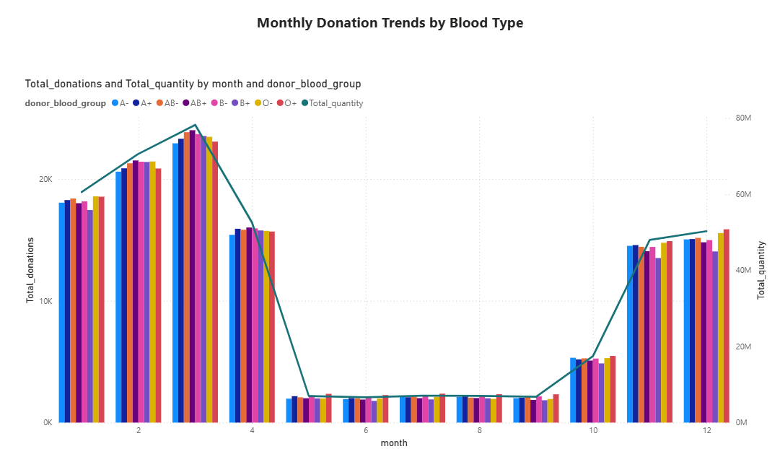
monthly donation trends
Trend Analysis Tracks donation volume across months.
Blood Group Comparison
Shows contribution of each blood type.
Identifying Patterns Highlights months with higher or lower donations.
Planning Campaigns Helps plan donation drives based on trends.
Notes:
Operational systems used by blood banks are primarily designed to support day-to-day transactions such as recording donations, updating test results, managing inventory, and logging hospital requests. These systems are optimized for fast inserts and updates, not for complex analytical queries. As a result, generating reports directly from operational databases often leads to performance issues and incomplete insights. Another major challenge is the limited support for historical trend analysis. Operational systems typically store the latest state of data, making it difficult to track changes in donor behavior, inventory levels, or demand patterns over time. This limitation directly impacts decision-making, as stakeholders cannot easily answer questions such as which blood groups face recurring shortages, how donor participation changes seasonally, or which regions require targeted campaigns. Additionally, data in operational systems may contain inconsistencies, missing values, or unstandardized formats, further reducing its analytical value. Manual reporting efforts often become time-consuming and error-prone, relying heavily on ad hoc queries and spreadsheets. These challenges highlight the need for a dedicated analytical data pipeline. By separating operational workloads from analytical processing, organizations can ensure system stability while enabling deeper insights. A structured pipeline allows data to be cleaned, validated, and modeled specifically for reporting, transforming raw transactional data into meaningful, business-ready information that supports informed and timely decisions. Image source: Microsoft 365 content library

Slide 12
CONCLUSION
Notes:
Image source: Microsoft 365 content library

Slide 13
CONCLUSION
Structured Data Pipeline Transformed operational data into analytics-ready datasets.
Reliable Data Models Fact and dimension tables support reporting needs.
Actionable Insights Reports help understand donors, inventory, and demand patterns.
Better Decision Making Enables data-driven strategies for blood donation management.
Notes:
Operational systems used by blood banks are primarily designed to support day-to-day transactions such as recording donations, updating test results, managing inventory, and logging hospital requests. These systems are optimized for fast inserts and updates, not for complex analytical queries. As a result, generating reports directly from operational databases often leads to performance issues and incomplete insights. Another major challenge is the limited support for historical trend analysis. Operational systems typically store the latest state of data, making it difficult to track changes in donor behavior, inventory levels, or demand patterns over time. This limitation directly impacts decision-making, as stakeholders cannot easily answer questions such as which blood groups face recurring shortages, how donor participation changes seasonally, or which regions require targeted campaigns. Additionally, data in operational systems may contain inconsistencies, missing values, or unstandardized formats, further reducing its analytical value. Manual reporting efforts often become time-consuming and error-prone, relying heavily on ad hoc queries and spreadsheets. These challenges highlight the need for a dedicated analytical data pipeline. By separating operational workloads from analytical processing, organizations can ensure system stability while enabling deeper insights. A structured pipeline allows data to be cleaned, validated, and modeled specifically for reporting, transforming raw transactional data into meaningful, business-ready information that supports informed and timely decisions. Image source: Microsoft 365 content library

