Slide 1
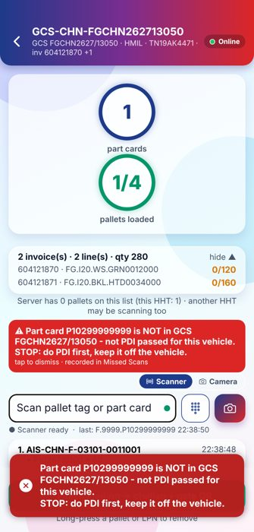

Process walkthrough
Every step with the actual HHT screen, web page and printed output - from dispatch to the pallet coming back home
Server 1.22 · HHT 2.12
Asahi India Glass Ltd. · Developed by DT
Notes:
Title. The deck walks through every process with real screens captured from the running system with sample data (Hyundai delivery FGCHN2627/13050).

Slide 2


Process map
In slideshow, click a process to open it. On a step, click ▶ (or the small screen) to see the actual picture; click ◀ Back to return.
1
2
3
4
5
Setup and sign-in
Every HHT user
Dispatch planning → GCS loading sheet
Dispatch Bench · ERP · Logistics
Vehicle loading against the GCS
FG Warehouse
OUT gate
Security - OUT gate
At the customer - receive delivery
Customer staff (customer HHT)
6
7
8
9
10
Return empty pallets - Option A (customer)
Customer staff (customer HHT)
IN gate - every inward is registered
Security - IN gate
Pallet yard in-ward
Pallet yard
Plant to plant - other plants’ pallets
Pallet yard · Logistics · Security
Monitoring on the web
Plant · Logistics · Management
Notes:
How to use the deck: process slides in order; each step links to its full picture. The pictures are at the end of the file and are reached only by clicking.

Slide 3


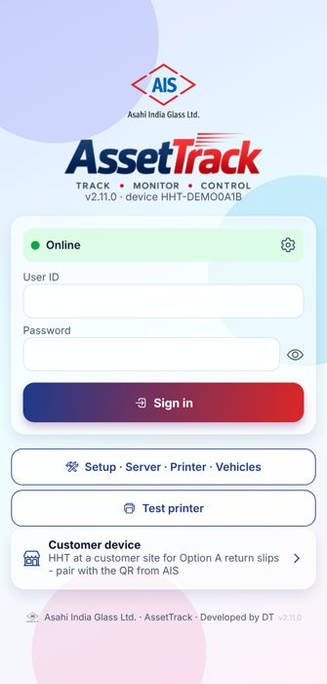
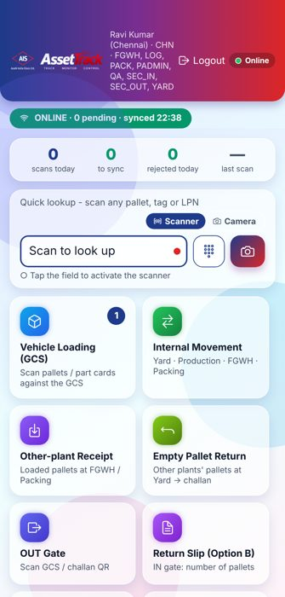


Setup and sign-in
Every HHT user
Connect the HHT to the server once, then sign in and pick the plant
›
›
›
1
Connect to the server
2
Sign in
3
Home menu by role
4
Vehicle list
Scan the server QR from the tray icon - no IP typing
Green dot = server online. Setup and Test printer work before sign-in
Each user sees only the tasks of their roles
Vehicles for return slips - works without network
Notes:
One server serves all plants. The HHT never shows the server address - only Online (green) or Offline (red). The plant is chosen at sign-in and every list on the HHT is for that plant.

Slide 4

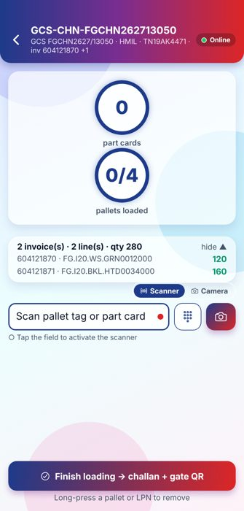
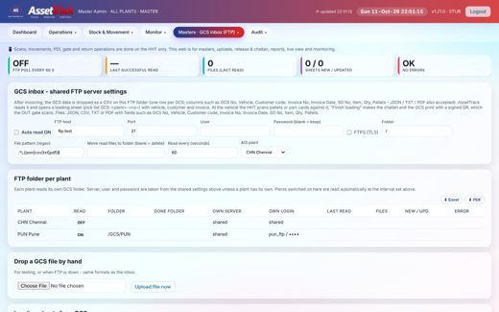
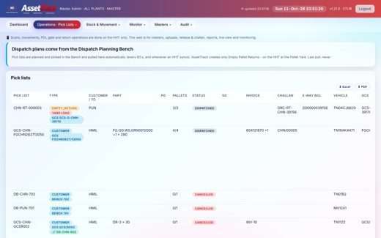
Dispatch planning → GCS loading sheet
Dispatch Bench · ERP · Logistics
The Bench plans the trip plant-wise; the ERP GCS file becomes the loading sheet on the HHT
›
›
›
1
GCS inbox (web)
2
Pick lists (web)
3
Loading sheets on the HHT
4
Loading sheet
ERP GCS files read from each plant FTP folder
Bench trip + GCS joined; status until dispatch
Only the chosen plant’s GCS lists
Invoices, items and quantity from the GCS
Notes:
Pick lists come from the Dispatch Planning Bench (PDI is done there). After invoicing, the ERP drops the GCS file on the FTP folder of the plant; AssetTrack reads it within 60 seconds and joins it with its Bench trip into one record. The HHT gets the loading sheet with vehicle, invoices, items and the part cards that passed PDI.

Slide 5
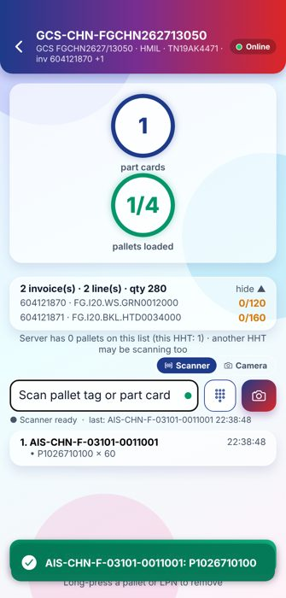
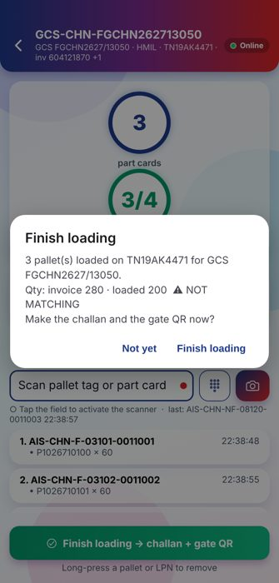
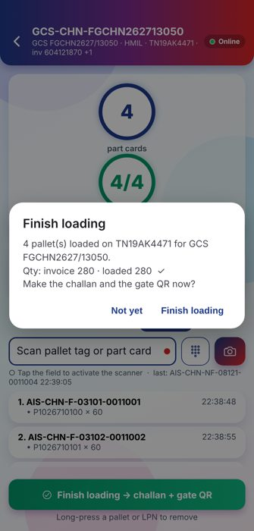
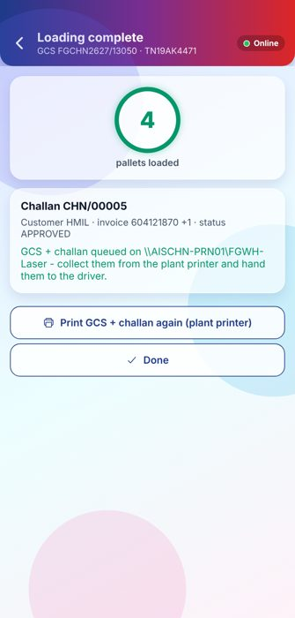
Vehicle loading against the GCS (1/2)
FG Warehouse
Scan each pallet or part card; only PDI-passed cards on this GCS can be loaded
›
›
›
›
1
Scan a pallet
2
STOP - do PDI
3
Quantity check
4
Finish loading
5
Challan + GCS printed
Its part card is picked from the GCS
Card not on this GCS is refused
Invoice 280 vs loaded 200 → NOT MATCHING
All 4 pallets: 280 = 280 ✓
On the plant network printer - no BT printer
Notes:
Scanning a pallet QR picks its part cards from the GCS automatically. A part card that is not on the GCS has not passed PDI for this vehicle - the HHT stops with a red alert and records it. Finish loading compares the loaded quantity with the invoice quantity, then makes the challan and prints the GCS + challan on the plant network printer.

Slide 6
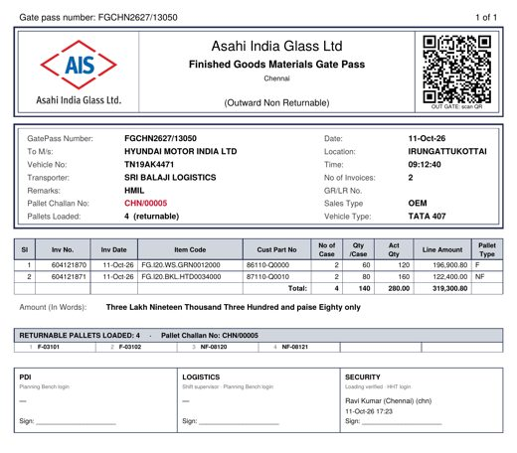
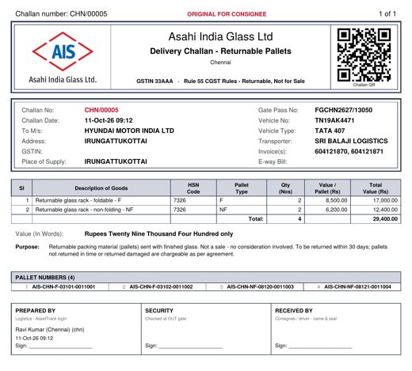
Vehicle loading against the GCS (2/2)
FG Warehouse
Scan each pallet or part card; only PDI-passed cards on this GCS can be loaded
›
6
Output: GCS gate pass
7
Output: pallet challan
Signed GCS QR for the OUT gate
Returnable pallets, Rule 55 - not for sale
Notes:
Scanning a pallet QR picks its part cards from the GCS automatically. A part card that is not on the GCS has not passed PDI for this vehicle - the HHT stops with a red alert and records it. Finish loading compares the loaded quantity with the invoice quantity, then makes the challan and prints the GCS + challan on the plant network printer.

Slide 7
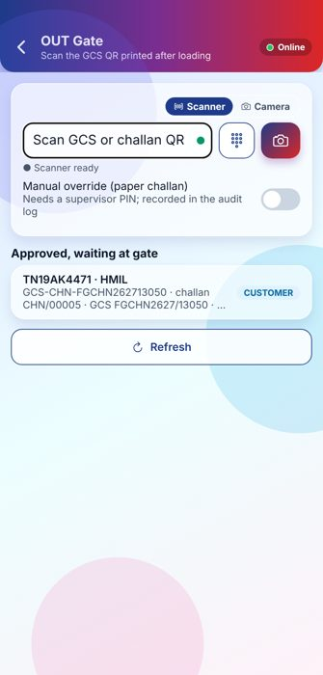
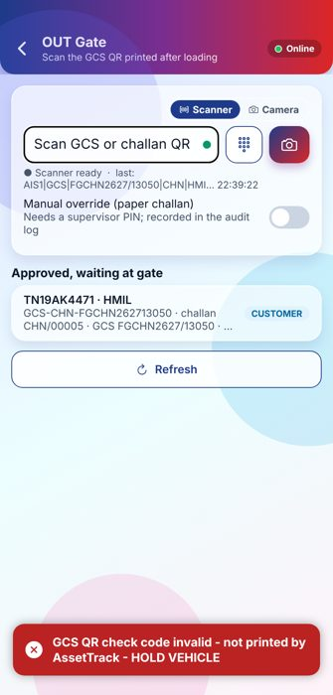
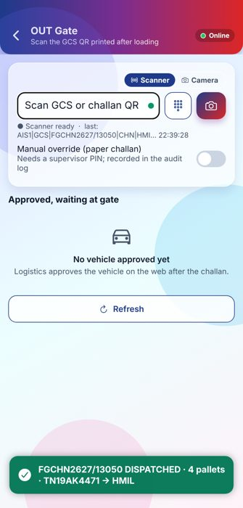
OUT gate
Security - OUT gate
Scan the GCS QR - only a genuine AssetTrack QR releases the vehicle
›
›
1
Vehicles waiting
2
Forged QR refused
3
Dispatched
Approved vehicles listed at the gate
Check code invalid → HOLD VEHICLE
4 pallets → HMIL, holding days start
Notes:
Approved vehicles wait at the gate. Security scans the GCS QR printed after loading. A changed or home-made QR fails the check code and the vehicle is held. On a genuine QR the pallets become AT CUSTOMER and holding days start.

Slide 8
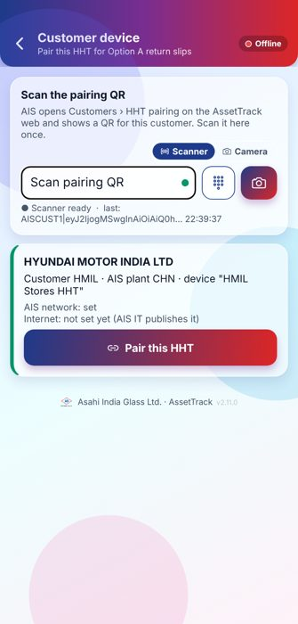
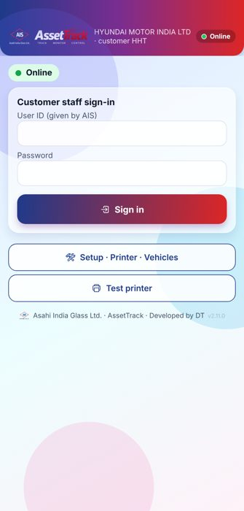
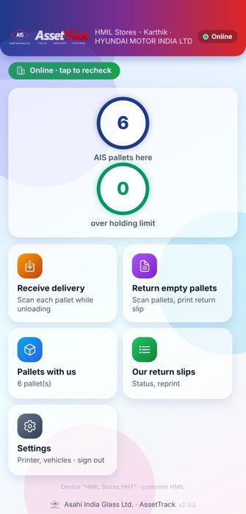
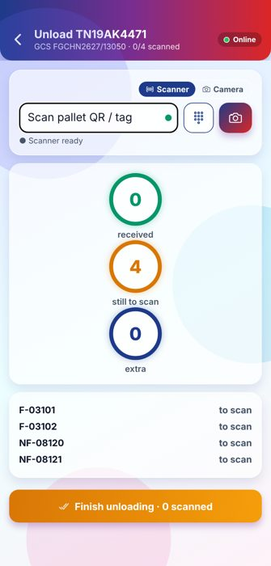
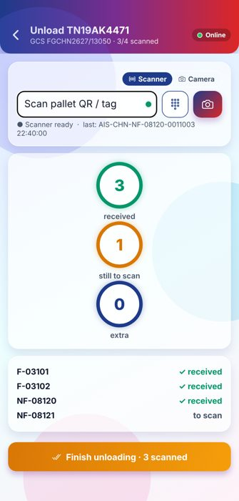

At the customer - receive delivery
Customer staff (customer HHT)
Customer staff sign in on a paired HHT and scan each pallet while unloading
›
›
›
›
›
1
Pair the customer HHT
2
Customer staff sign-in
3
Customer home
4
Unload: pallets to scan
5
Scan while unloading
6
Delivery received
One-time QR from AIS web
Own user per customer staff
Receive · Return · Pallets with us
List of pallets on this vehicle
Each pallet ticked; extras recorded
4/4 - visible to AIS at once
Notes:
The customer HHT is paired once with a QR from the AssetTrack web (Customers › HHT pairing). Customer staff have their own user (role Customer Staff). While unloading they scan each pallet; AIS sees received / missing / extra at once. The customer HHT also works without network and sends later.

Slide 9

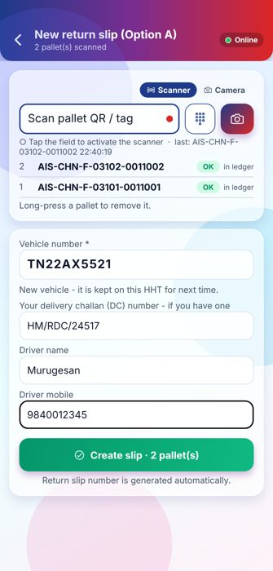
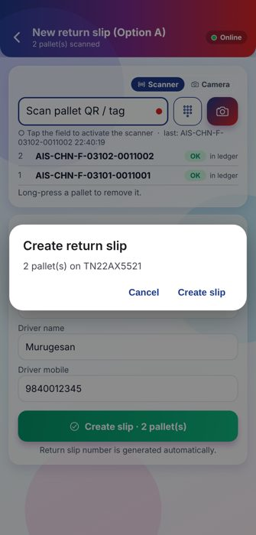
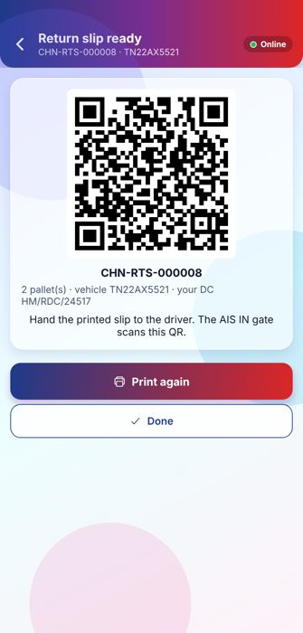
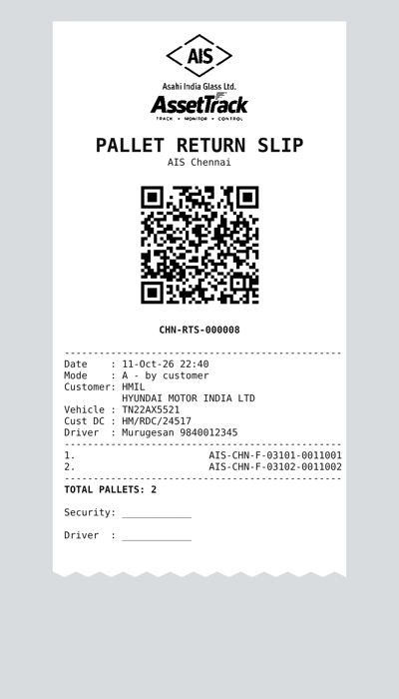
Return empty pallets - Option A (customer)
Customer staff (customer HHT)
Customer staff scan the empty pallets; the slip prints on their Bluetooth printer
›
›
›
›
1
Pallets with us
2
Scan pallets + vehicle
3
Confirm
4
Slip ready
5
Output: Option A slip
Days held and challan of each pallet
DC number optional; slip no. automatic
2 pallets on TN22AX5521
Signed QR - printed on BT printer
Thermal slip with pallet list
Notes:
Option A return slips are made only on the customer HHT. The return slip number is generated automatically. The customer DC number is optional. The slip QR is signed; without network the HHT signs it with its own device key (RO- slip) and it is still accepted at the AIS gate.

Slide 10

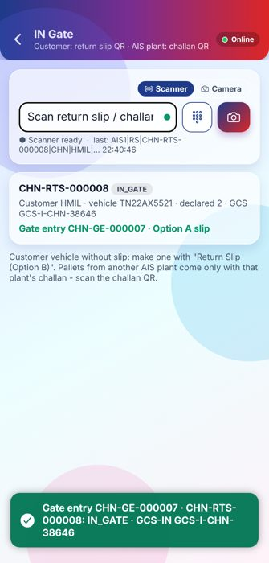
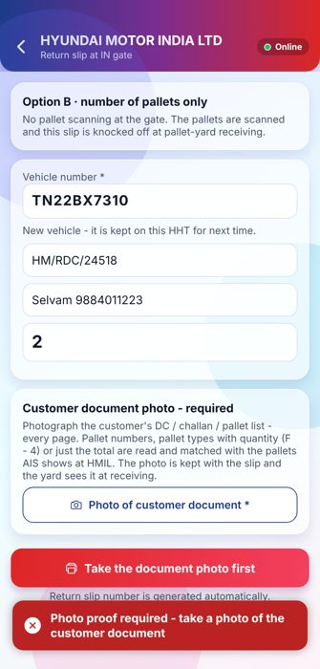
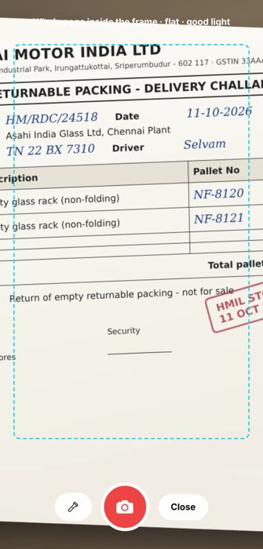
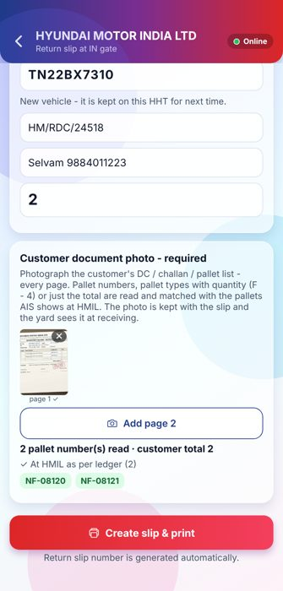
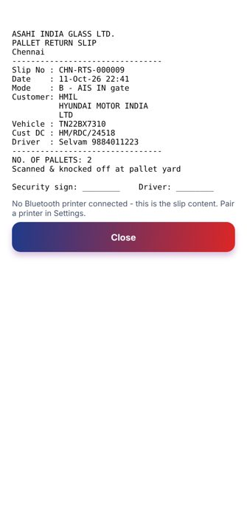
IN gate - every inward is registered (1/2)
Security - IN gate
Slip A → scan its QR · No slip → make Option B with document photo · Other plant → scan challan
›
›
›
›
›
1
IN gate
2
Option A registered
3
Option B: count + vehicle
4
Photo of customer DC
5
Read and matched
6
Option B slip
Slip QR or plant challan QR
Gate entry CHN-GE-000007 + GCS inward
Photo proof is required
Every page, inside the frame
NF-08120, NF-08121 at HMIL as per ledger
Gate entry made with the slip
Notes:
All inward vehicles are registered at gate entry: one gate entry number and one GCS inward each. Option A: scan the slip QR. Option B: security makes the slip at the gate - a photo of the customer document is required; the HHT reads it and matches the pallet numbers with the ledger. Other AIS plants: only with that plant challan (scan its QR).

Slide 11
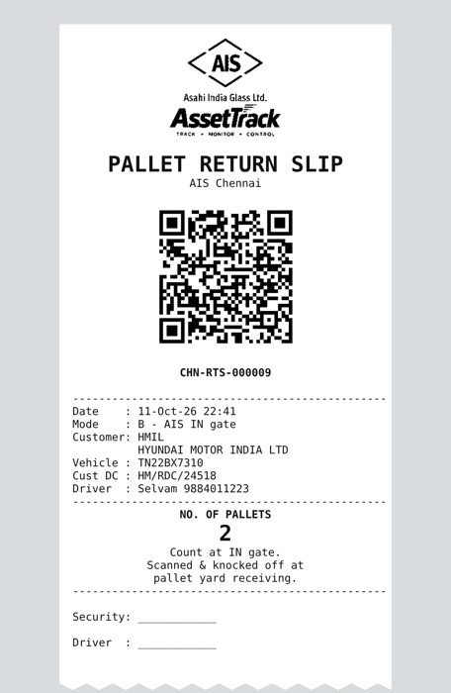
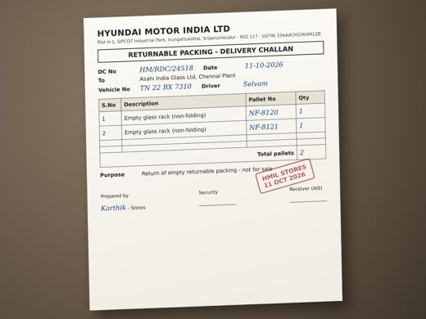
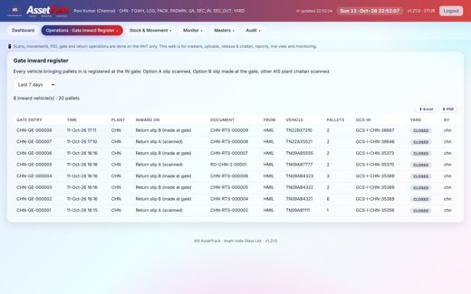
IN gate - every inward is registered (2/2)
Security - IN gate
Slip A → scan its QR · No slip → make Option B with document photo · Other plant → scan challan
›
›
7
Customer document
8
Output: Option B slip
9
Gate inward register (web)
Kept with the slip on the server
Count only - knocked off at the yard
Every inward with its yard status
Notes:
All inward vehicles are registered at gate entry: one gate entry number and one GCS inward each. Option A: scan the slip QR. Option B: security makes the slip at the gate - a photo of the customer document is required; the HHT reads it and matches the pallet numbers with the ledger. Other AIS plants: only with that plant challan (scan its QR).

Slide 12
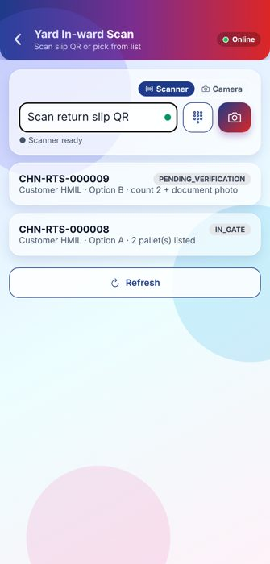
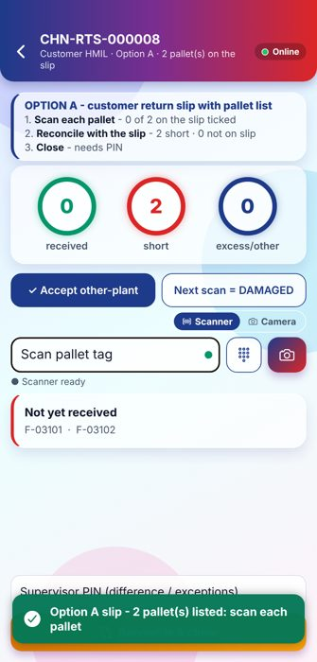
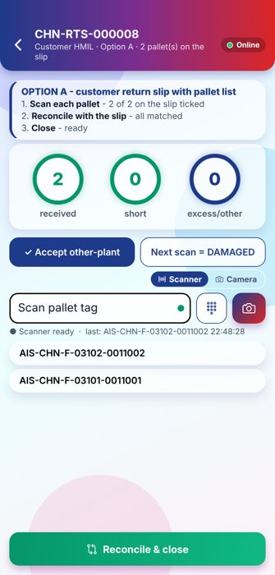
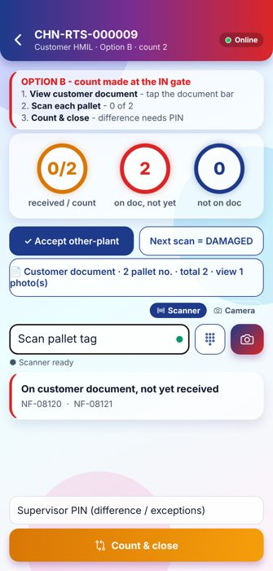
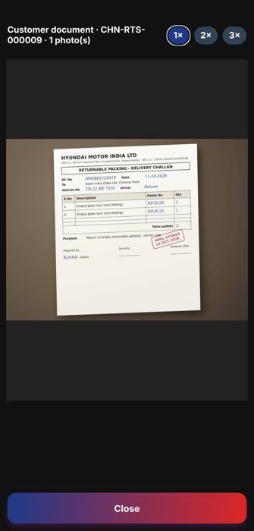
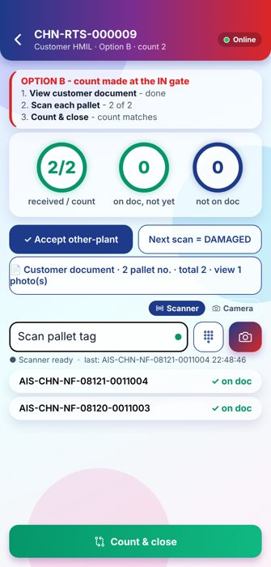
Pallet yard in-ward
Pallet yard
Scan the RTS - the HHT knows if it is Option A or B and follows that process
›
›
›
›
›
1
Slips to receive
2
Option A: steps
3
Option A: all matched
4
Option B: steps
5
Option B: view document
6
Option B: count matches
Option A / Option B shown per slip
Tick pallets against the slip list
2 of 2 ticked → Reconcile & close
1 photo · 2 scan · 3 count
Photo from the gate, zoom 1-3×
2/2 ✓ on doc → Count & close
Notes:
Option A: the slip has the pallet list - each scanned pallet is ticked against it, then reconcile and close. Option B: step 1 view the customer document photo (scanning starts after it), step 2 scan each pallet - matched with the document, step 3 the count must equal the gate count. Any difference needs the supervisor PIN.

Slide 13

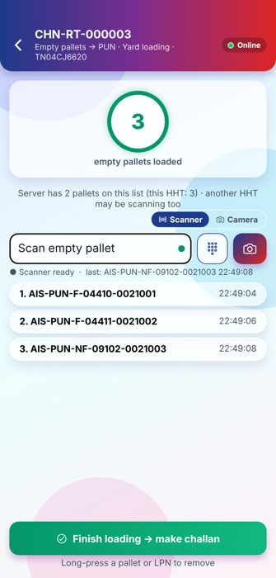
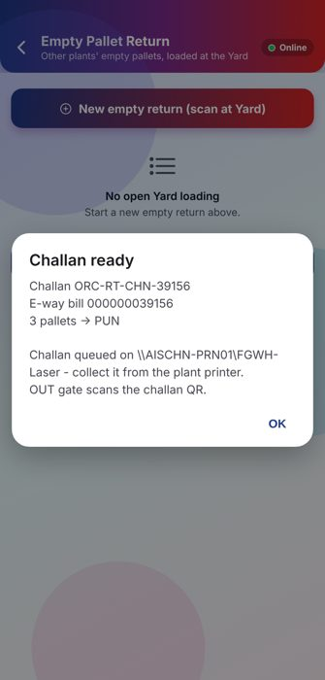
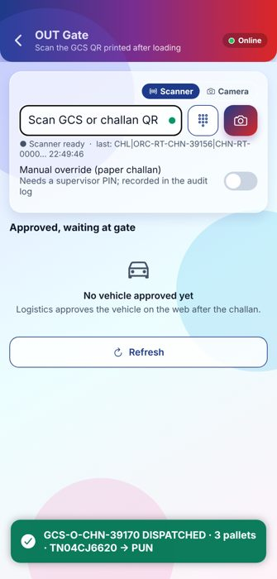
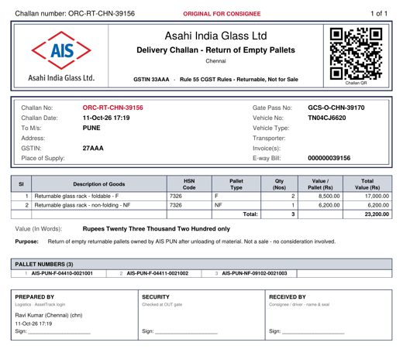
Plant to plant - other plants’ pallets (1/2)
Pallet yard · Logistics · Security
Pallets of another AIS plant go home on a challan; the owner plant receives them on that challan
›
›
›
›
1
New empty return
2
Load at the yard
3
Challan + e-way bill
4
Output: return challan
5
OUT gate
Owner plant PUN · 3 held
Scan each empty pallet
Printed on the plant printer
Return of empty pallets to PUN
Challan QR → dispatched to PUN
Notes:
Other plants pallets emptied in FGWH / Packing go to the Yard and are HELD for their owner. Empty Pallet Return: scan them at the Yard, finish loading - EBS challan and e-way bill are made and the challan prints on the plant printer. Logistics approves, OUT gate scans the challan. At the owner plant, the IN gate scans the same challan (gate entry), and the yard scans each pallet against the challan and closes it.

Slide 14
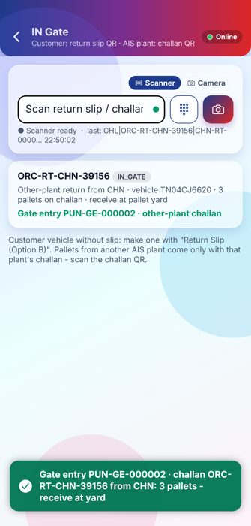
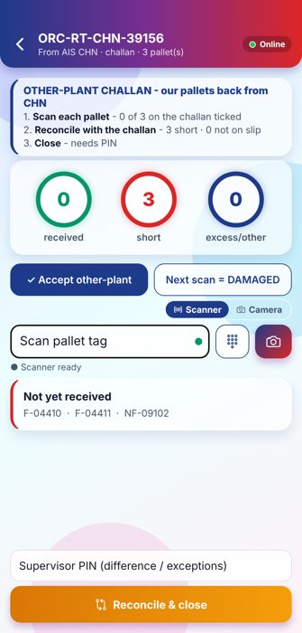
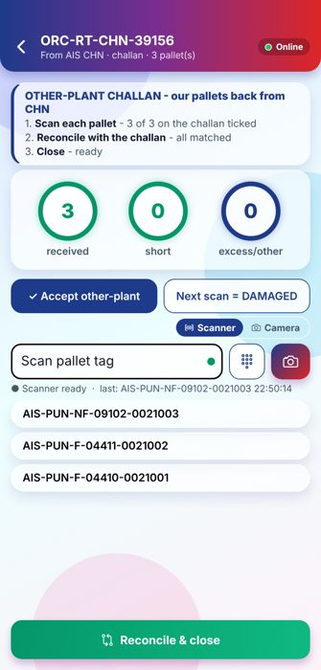
Plant to plant - other plants’ pallets (2/2)
Pallet yard · Logistics · Security
Pallets of another AIS plant go home on a challan; the owner plant receives them on that challan
›
›
6
PUN IN gate
7
PUN yard: challan
8
Received and closed
Same challan scanned → gate entry
Our pallets back from CHN
3 of 3 → AVAILABLE at home
Notes:
Other plants pallets emptied in FGWH / Packing go to the Yard and are HELD for their owner. Empty Pallet Return: scan them at the Yard, finish loading - EBS challan and e-way bill are made and the challan prints on the plant printer. Logistics approves, OUT gate scans the challan. At the owner plant, the IN gate scans the same challan (gate entry), and the yard scans each pallet against the challan and closes it.

Slide 15
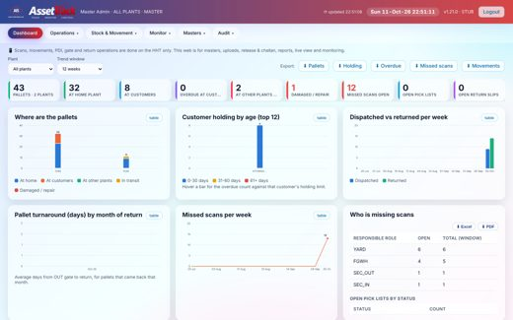
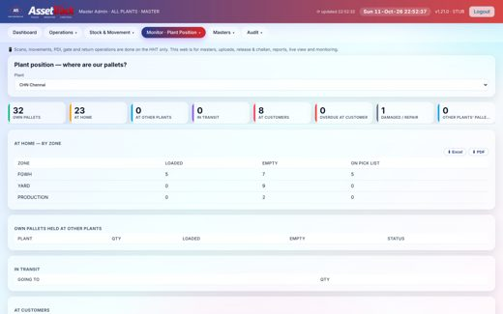
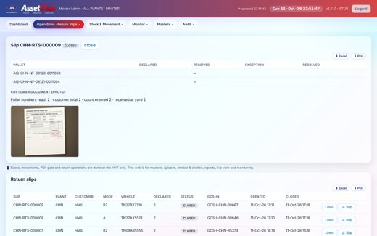
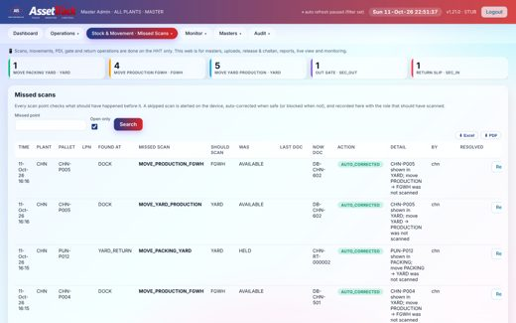
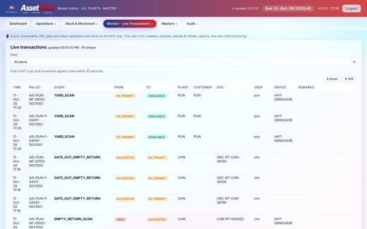

Monitoring on the web
Plant · Logistics · Management
Where every pallet is, what is overdue, what was missed - all plants on one server
›
›
›
›
›
1
Dashboard
2
Plant position
3
Return slip details
4
Missed scans
5
Live transactions
6
Transporter master
Pallets by place, holding, turnaround
Where are our pallets?
Pallets + customer document photo
Skipped scan points, auto-corrected
Every HHT scan within 10 s
Template + upload for plant users
Notes:
The web is for masters, uploads, approvals, reports and live view. Scanning is done only on the HHT. Every list has Excel and PDF export.

Slide 16







Controls built into the flow
STOP - do PDI
A part card not on the GCS cannot be loaded
Invoice vs loaded qty
Checked at Finish loading
Signed QR at the gates
Forged or altered QR → HOLD VEHICLE
Gate inward register
Every inward: slip A, slip B, plant challan
Photo proof for Option B
Read, matched, kept for the yard
Yard count + PIN
Differences need the supervisor PIN
Other plants: challan only
Received home on the same challan
Printers by job
GCS + challan: plant printer · slips: BT
Notes:
The controls that stop wrong material, wrong vehicles and lost pallets. Click a card title to open its process.

Slide 17



SETUP AND SIGN-IN · STEP 1 OF 4
Connect to the server
Setup › 1. Server: scan the "HHT setup QR" shown by the tray icon on the server PC.
The HHT tries every address in the QR and keeps the ones that answer. The address itself is never shown - only Online / Offline.
IT can still enter it under "Enter manually".
Back to steps
Notes:
Setup and sign-in - step 1: Connect to the server. Setup › 1. Server: scan the "HHT setup QR" shown by the tray icon on the server PC. The HHT tries every address in the QR and keeps the ones that answer. The address itself is never shown - only Online / Offline. IT can still enter it under "Enter manually".

Slide 18

SETUP AND SIGN-IN · STEP 2 OF 4
Sign in
The status line shows only Online (green) or Offline (red).
Setup (server, printer, vehicles) and Test printer are available before anyone signs in, so the Bluetooth printer can be checked at the start of the shift.
"Customer device" pairs an HHT that will be used at a customer site.
Back to steps
Notes:
Setup and sign-in - step 2: Sign in. The status line shows only Online (green) or Offline (red). Setup (server, printer, vehicles) and Test printer are available before anyone signs in, so the Bluetooth printer can be checked at the start of the shift. "Customer device" pairs an HHT that will be used at a customer site.

Slide 19

SETUP AND SIGN-IN · STEP 3 OF 4
Home menu by role
After sign-in the user (and plant) is shown on top with Online and pending-sync status.
Tiles come from the user roles: Vehicle Loading, OUT Gate, IN Gate, Return Slip (Option B), Yard In-ward, Empty Pallet Return, moves, lookup.
Users with extra plants choose the plant at sign-in; Bench trips and GCS lists follow that plant.
Back to steps
Notes:
Setup and sign-in - step 3: Home menu by role. After sign-in the user (and plant) is shown on top with Online and pending-sync status. Tiles come from the user roles: Vehicle Loading, OUT Gate, IN Gate, Return Slip (Option B), Yard In-ward, Empty Pallet Return, moves, lookup. Users with extra plants choose the plant at sign-in; Bench trips and GCS lists follow that plant.

Slide 20


SETUP AND SIGN-IN · STEP 4 OF 4
Vehicle list
Setup › 3. Vehicles: vehicles known to AIS come from the server (recent loads, transporter master); others can be added here.
The list is used for quick picking on return slips, also when the HHT has no network.
Back to steps
Notes:
Setup and sign-in - step 4: Vehicle list. Setup › 3. Vehicles: vehicles known to AIS come from the server (recent loads, transporter master); others can be added here. The list is used for quick picking on return slips, also when the HHT has no network.

Slide 21

DISPATCH PLANNING → GCS LOADING SHEET · STEP 1 OF 4
GCS inbox (web)
Masters › GCS inbox: every plant has its own FTP folder; files are read every 60 s.
One GCS file = one loading sheet: vehicle, customer, invoices, items, part cards (LPN) and pallet references.
A GCS cancelled in the ERP cancels the loading sheet.
Back to steps
Notes:
Dispatch planning → GCS loading sheet - step 1: GCS inbox (web). Masters › GCS inbox: every plant has its own FTP folder; files are read every 60 s. One GCS file = one loading sheet: vehicle, customer, invoices, items, part cards (LPN) and pallet references. A GCS cancelled in the ERP cancels the loading sheet.

Slide 22

DISPATCH PLANNING → GCS LOADING SHEET · STEP 2 OF 4
Pick lists (web)
Operations › Pick Lists shows each trip / GCS with pallets, invoice, challan, e-way bill and status.
A Dispatch Bench trip and its GCS are joined into one record (LINKED) so the trip is not loaded twice.
Empty pallet returns to other plants (Yard loading) appear here too.
Back to steps
Notes:
Dispatch planning → GCS loading sheet - step 2: Pick lists (web). Operations › Pick Lists shows each trip / GCS with pallets, invoice, challan, e-way bill and status. A Dispatch Bench trip and its GCS are joined into one record (LINKED) so the trip is not loaded twice. Empty pallet returns to other plants (Yard loading) appear here too.

Slide 23

DISPATCH PLANNING → GCS LOADING SHEET · STEP 3 OF 4
Loading sheets on the HHT
Vehicle Loading lists the open GCS loading sheets of the plant the user signed in to.
The GCS QR can also be scanned to open its sheet directly.
Back to steps
Notes:
Dispatch planning → GCS loading sheet - step 3: Loading sheets on the HHT. Vehicle Loading lists the open GCS loading sheets of the plant the user signed in to. The GCS QR can also be scanned to open its sheet directly.

Slide 24

DISPATCH PLANNING → GCS LOADING SHEET · STEP 4 OF 4
Loading sheet
Header: GCS number, customer, vehicle and invoices.
The invoice lines (item, quantity) and the expected pallets are shown; rings count part cards and pallets loaded.
Back to steps
Notes:
Dispatch planning → GCS loading sheet - step 4: Loading sheet. Header: GCS number, customer, vehicle and invoices. The invoice lines (item, quantity) and the expected pallets are shown; rings count part cards and pallets loaded.

Slide 25

VEHICLE LOADING AGAINST THE GCS · STEP 1 OF 7
Scan a pallet
Scan the pallet QR (or a part card). The part card on that pallet is taken from the GCS file automatically.
Rings: part cards and pallets loaded vs expected.
Back to steps
Notes:
Vehicle loading against the GCS - step 1: Scan a pallet. Scan the pallet QR (or a part card). The part card on that pallet is taken from the GCS file automatically. Rings: part cards and pallets loaded vs expected.

Slide 26

VEHICLE LOADING AGAINST THE GCS · STEP 2 OF 7
STOP - do PDI
A part card that is not in this GCS is not PDI-passed for this vehicle.
The HHT shows a red STOP banner: "do PDI first, keep it off the vehicle" and records it in Missed Scans.
A card belonging to another GCS is refused as "wrong vehicle".
Back to steps
Notes:
Vehicle loading against the GCS - step 2: STOP - do PDI. A part card that is not in this GCS is not PDI-passed for this vehicle. The HHT shows a red STOP banner: "do PDI first, keep it off the vehicle" and records it in Missed Scans. A card belonging to another GCS is refused as "wrong vehicle".

Slide 27

VEHICLE LOADING AGAINST THE GCS · STEP 3 OF 7
Quantity check
"Finish loading" first compares the invoice quantity (GCS) with the quantity on the part cards loaded.
Here 3 of 4 pallets are loaded: invoice 280, loaded 200 - NOT MATCHING. The user can go back ("Not yet") and load the rest.
Back to steps
Notes:
Vehicle loading against the GCS - step 3: Quantity check. "Finish loading" first compares the invoice quantity (GCS) with the quantity on the part cards loaded. Here 3 of 4 pallets are loaded: invoice 280, loaded 200 - NOT MATCHING. The user can go back ("Not yet") and load the rest.

Slide 28

VEHICLE LOADING AGAINST THE GCS · STEP 4 OF 7
Finish loading
All pallets loaded: invoice 280 · loaded 280 ✓.
Finish loading makes the returnable-pallet challan and the signed GCS QR for the OUT gate.
Back to steps
Notes:
Vehicle loading against the GCS - step 4: Finish loading. All pallets loaded: invoice 280 · loaded 280 ✓. Finish loading makes the returnable-pallet challan and the signed GCS QR for the OUT gate.

Slide 29

VEHICLE LOADING AGAINST THE GCS · STEP 5 OF 7
Challan + GCS printed
Challan CHN/00005 is made and the vehicle is APPROVED for the gate.
GCS + challan are queued on the plant shared / network printer set in Masters › Plants (here \\AISCHN-PRN01\FGWH-Laser).
No Bluetooth printer is used for dispatch. "Print again" reprints on the same plant printer.
Back to steps
Notes:
Vehicle loading against the GCS - step 5: Challan + GCS printed. Challan CHN/00005 is made and the vehicle is APPROVED for the gate. GCS + challan are queued on the plant shared / network printer set in Masters › Plants (here \\AISCHN-PRN01\FGWH-Laser). No Bluetooth printer is used for dispatch. "Print again" reprints on the same plant printer.

Slide 30

VEHICLE LOADING AGAINST THE GCS · STEP 6 OF 7
Output: GCS gate pass
Finished Goods gate pass from the ERP data: invoices, items, quantity, amount, pallets loaded and the pallet challan number.
The QR is signed by AssetTrack - the OUT gate accepts only this QR.
Sign boxes: PDI, Logistics, Security.
Back to steps
Notes:
Vehicle loading against the GCS - step 6: Output: GCS gate pass. Finished Goods gate pass from the ERP data: invoices, items, quantity, amount, pallets loaded and the pallet challan number. The QR is signed by AssetTrack - the OUT gate accepts only this QR. Sign boxes: PDI, Logistics, Security.

Slide 31

VEHICLE LOADING AGAINST THE GCS · STEP 7 OF 7
Output: pallet challan
Delivery challan for the returnable pallets: pallet types with HSN and value (from the Pallet Type master) and every pallet number.
Printed with the GCS on the plant printer (original / duplicate / triplicate).
Back to steps
Notes:
Vehicle loading against the GCS - step 7: Output: pallet challan. Delivery challan for the returnable pallets: pallet types with HSN and value (from the Pallet Type master) and every pallet number. Printed with the GCS on the plant printer (original / duplicate / triplicate).

Slide 32

OUT GATE · STEP 1 OF 3
Vehicles waiting
OUT Gate lists the vehicles approved and waiting.
A paper-challan override exists but needs a supervisor PIN and is written to the audit log.
Back to steps
Notes:
OUT gate - step 1: Vehicles waiting. OUT Gate lists the vehicles approved and waiting. A paper-challan override exists but needs a supervisor PIN and is written to the audit log.

Slide 33

OUT GATE · STEP 2 OF 3
Forged QR refused
A QR that was not printed by AssetTrack (or was altered) fails the check code.
The HHT says "HOLD VEHICLE" - nothing is dispatched.
Back to steps
Notes:
OUT gate - step 2: Forged QR refused. A QR that was not printed by AssetTrack (or was altered) fails the check code. The HHT says "HOLD VEHICLE" - nothing is dispatched.

Slide 34

OUT GATE · STEP 3 OF 3
Dispatched
Genuine GCS QR: the trip is DISPATCHED; the 4 pallets are now AT CUSTOMER (HMIL) with the challan reference.
Holding days start from here; reminders are mailed before and after the limit.
Back to steps
Notes:
OUT gate - step 3: Dispatched. Genuine GCS QR: the trip is DISPATCHED; the 4 pallets are now AT CUSTOMER (HMIL) with the challan reference. Holding days start from here; reminders are mailed before and after the limit.

Slide 35

AT THE CUSTOMER - RECEIVE DELIVERY · STEP 1 OF 6
Pair the customer HHT
On the login screen: Customer device › scan the pairing QR made on the AssetTrack web for this customer.
The HHT gets its own device key; AIS can remove it any time.
No server address is shown - only "set".
Back to steps
Notes:
At the customer - receive delivery - step 1: Pair the customer HHT. On the login screen: Customer device › scan the pairing QR made on the AssetTrack web for this customer. The HHT gets its own device key; AIS can remove it any time. No server address is shown - only "set".

Slide 36

AT THE CUSTOMER - RECEIVE DELIVERY · STEP 2 OF 6
Customer staff sign-in
Customer staff sign in with the user given by AIS (role Customer Staff, linked to the customer).
Sign-in also works without network after the first time.
Back to steps
Notes:
At the customer - receive delivery - step 2: Customer staff sign-in. Customer staff sign in with the user given by AIS (role Customer Staff, linked to the customer). Sign-in also works without network after the first time.

Slide 37

AT THE CUSTOMER - RECEIVE DELIVERY · STEP 3 OF 6
Customer home
Shows AIS pallets at this customer and how many are over the holding limit.
Tasks: Receive delivery, Return empty pallets, Pallets with us, Our return slips.
Back to steps
Notes:
At the customer - receive delivery - step 3: Customer home. Shows AIS pallets at this customer and how many are over the holding limit. Tasks: Receive delivery, Return empty pallets, Pallets with us, Our return slips.

Slide 38

AT THE CUSTOMER - RECEIVE DELIVERY · STEP 4 OF 6
Unload: pallets to scan
Pick the vehicle (or scan the gate pass QR). The pallets on the delivery are listed.
Rings: received · still to scan · extra.
Back to steps
Notes:
At the customer - receive delivery - step 4: Unload: pallets to scan. Pick the vehicle (or scan the gate pass QR). The pallets on the delivery are listed. Rings: received · still to scan · extra.

Slide 39

AT THE CUSTOMER - RECEIVE DELIVERY · STEP 5 OF 6
Scan while unloading
Each scanned pallet is ticked "received". A pallet not on this delivery is counted as extra.
Back to steps
Notes:
At the customer - receive delivery - step 5: Scan while unloading. Each scanned pallet is ticked "received". A pallet not on this delivery is counted as extra.

Slide 40

AT THE CUSTOMER - RECEIVE DELIVERY · STEP 6 OF 6
Delivery received
Finish unloading sends the result: 4/4 received.
AIS sees received / missing / extra per delivery.
Back to steps
Notes:
At the customer - receive delivery - step 6: Delivery received. Finish unloading sends the result: 4/4 received. AIS sees received / missing / extra per delivery.

Slide 41

RETURN EMPTY PALLETS - OPTION A (CUSTOMER) · STEP 1 OF 5
Pallets with us
Every AIS pallet at this customer with days held, pallet type, challan and date sent.
Back to steps
Notes:
Return empty pallets - Option A (customer) - step 1: Pallets with us. Every AIS pallet at this customer with days held, pallet type, challan and date sent.

Slide 42

RETURN EMPTY PALLETS - OPTION A (CUSTOMER) · STEP 2 OF 5
Scan pallets + vehicle
Scan each empty pallet - each is checked against the ledger (OK / CHECK).
Pick or type the vehicle; customer DC number, driver name and mobile are optional.
The return slip number is generated automatically.
Back to steps
Notes:
Return empty pallets - Option A (customer) - step 2: Scan pallets + vehicle. Scan each empty pallet - each is checked against the ledger (OK / CHECK). Pick or type the vehicle; customer DC number, driver name and mobile are optional. The return slip number is generated automatically.

Slide 43

RETURN EMPTY PALLETS - OPTION A (CUSTOMER) · STEP 3 OF 5
Confirm
A last check before the slip is made: number of pallets and vehicle.
Back to steps
Notes:
Return empty pallets - Option A (customer) - step 3: Confirm. A last check before the slip is made: number of pallets and vehicle.

Slide 44

RETURN EMPTY PALLETS - OPTION A (CUSTOMER) · STEP 4 OF 5
Slip ready
Return slip CHN-RTS-000008 with its signed QR.
Printed on the customer site Bluetooth printer (2 copies) and handed to the driver; the AIS IN gate scans this QR.
Back to steps
Notes:
Return empty pallets - Option A (customer) - step 4: Slip ready. Return slip CHN-RTS-000008 with its signed QR. Printed on the customer site Bluetooth printer (2 copies) and handed to the driver; the AIS IN gate scans this QR.

Slide 45

RETURN EMPTY PALLETS - OPTION A (CUSTOMER) · STEP 5 OF 5
Output: Option A slip
58 / 80 mm thermal slip from any Bluetooth printer (ESC/POS, CPCL, ZPL, TSPL).
Shows the slip number, signed QR, customer, vehicle, customer DC and every pallet returned.
Back to steps
Notes:
Return empty pallets - Option A (customer) - step 5: Output: Option A slip. 58 / 80 mm thermal slip from any Bluetooth printer (ESC/POS, CPCL, ZPL, TSPL). Shows the slip number, signed QR, customer, vehicle, customer DC and every pallet returned.

Slide 46

IN GATE - EVERY INWARD IS REGISTERED · STEP 1 OF 9
IN gate
Customer vehicle: scan the return slip QR. AIS plant vehicle: scan the challan QR.
Customer vehicle without a slip: make Option B (next steps).
Back to steps
Notes:
IN gate - every inward is registered - step 1: IN gate. Customer vehicle: scan the return slip QR. AIS plant vehicle: scan the challan QR. Customer vehicle without a slip: make Option B (next steps).

Slide 47

IN GATE - EVERY INWARD IS REGISTERED · STEP 2 OF 9
Option A registered
The signed slip QR is verified (an altered label is refused - HOLD VEHICLE).
Gate entry CHN-GE-000007 is made with the GCS inward number; the slip is IN GATE.
Back to steps
Notes:
IN gate - every inward is registered - step 2: Option A registered. The signed slip QR is verified (an altered label is refused - HOLD VEHICLE). Gate entry CHN-GE-000007 is made with the GCS inward number; the slip is IN GATE.

Slide 48

IN GATE - EVERY INWARD IS REGISTERED · STEP 3 OF 9
Option B: count + vehicle
Option B = number of pallets only, made by IN-gate security.
The slip cannot be made or printed until a photo of the customer document is taken.
Back to steps
Notes:
IN gate - every inward is registered - step 3: Option B: count + vehicle. Option B = number of pallets only, made by IN-gate security. The slip cannot be made or printed until a photo of the customer document is taken.

Slide 49

IN GATE - EVERY INWARD IS REGISTERED · STEP 4 OF 9
Photo of customer DC
Photograph the customer DC / challan / pallet list - every page.
Works offline; the photo uploads when the HHT is online.
Back to steps
Notes:
IN gate - every inward is registered - step 4: Photo of customer DC. Photograph the customer DC / challan / pallet list - every page. Works offline; the photo uploads when the HHT is online.

Slide 50

IN GATE - EVERY INWARD IS REGISTERED · STEP 5 OF 9
Read and matched
The text is read on the HHT and matched with the pallets AIS shows at this customer.
Pallet numbers, types with quantity (F - 4) or just a total are understood; DC, vehicle and PIN numbers are ignored.
Back to steps
Notes:
IN gate - every inward is registered - step 5: Read and matched. The text is read on the HHT and matched with the pallets AIS shows at this customer. Pallet numbers, types with quantity (F - 4) or just a total are understood; DC, vehicle and PIN numbers are ignored.

Slide 51

IN GATE - EVERY INWARD IS REGISTERED · STEP 6 OF 9
Option B slip
Slip CHN-RTS-000009 is made and gate entry CHN-GE-000008 registered in one step.
The slip (count only) prints on the gate Bluetooth printer; shown here as text because no printer is connected.
Back to steps
Notes:
IN gate - every inward is registered - step 6: Option B slip. Slip CHN-RTS-000009 is made and gate entry CHN-GE-000008 registered in one step. The slip (count only) prints on the gate Bluetooth printer; shown here as text because no printer is connected.

Slide 52

IN GATE - EVERY INWARD IS REGISTERED · STEP 7 OF 9
Customer document
The photo is stored with the slip for future reference.
The pallet yard sees it on the HHT while receiving, and the web shows it in the slip details.
Back to steps
Notes:
IN gate - every inward is registered - step 7: Customer document. The photo is stored with the slip for future reference. The pallet yard sees it on the HHT while receiving, and the web shows it in the slip details.

Slide 53

IN GATE - EVERY INWARD IS REGISTERED · STEP 8 OF 9
Output: Option B slip
Option B slip shows the number of pallets only - no pallet list.
It is scanned and knocked off at pallet-yard receiving.
Back to steps
Notes:
IN gate - every inward is registered - step 8: Output: Option B slip. Option B slip shows the number of pallets only - no pallet list. It is scanned and knocked off at pallet-yard receiving.

Slide 54

IN GATE - EVERY INWARD IS REGISTERED · STEP 9 OF 9
Gate inward register (web)
Operations › Gate Inward Register: every inward vehicle - Option A scanned, Option B made at gate, other-plant challan - with gate entry, GCS-IN and yard status.
Today / 7 / 30 / 90 days.
Back to steps
Notes:
IN gate - every inward is registered - step 9: Gate inward register (web). Operations › Gate Inward Register: every inward vehicle - Option A scanned, Option B made at gate, other-plant challan - with gate entry, GCS-IN and yard status. Today / 7 / 30 / 90 days.

Slide 55

PALLET YARD IN-WARD · STEP 1 OF 6
Slips to receive
Yard In-ward lists the open slips with their type: "Option A · 2 pallets listed", "Option B · count 2 + document photo".
Scan the slip QR or tap a slip.
Back to steps
Notes:
Pallet yard in-ward - step 1: Slips to receive. Yard In-ward lists the open slips with their type: "Option A · 2 pallets listed", "Option B · count 2 + document photo". Scan the slip QR or tap a slip.

Slide 56

PALLET YARD IN-WARD · STEP 2 OF 6
Option A: steps
Banner: OPTION A - customer return slip with pallet list.
1 Scan each pallet · 2 Reconcile with the slip · 3 Close.
Pallets on the slip not yet received are listed below.
Back to steps
Notes:
Pallet yard in-ward - step 2: Option A: steps. Banner: OPTION A - customer return slip with pallet list. 1 Scan each pallet · 2 Reconcile with the slip · 3 Close. Pallets on the slip not yet received are listed below.

Slide 57

PALLET YARD IN-WARD · STEP 3 OF 6
Option A: all matched
Both pallets received - all matched. Short or extra pallets would need the supervisor PIN.
Back to steps
Notes:
Pallet yard in-ward - step 3: Option A: all matched. Both pallets received - all matched. Short or extra pallets would need the supervisor PIN.

Slide 58

PALLET YARD IN-WARD · STEP 4 OF 6
Option B: steps
Banner: OPTION B - count made at the IN gate.
The customer document bar shows pallet numbers read and the total; the first scan opens the photo.
Back to steps
Notes:
Pallet yard in-ward - step 4: Option B: steps. Banner: OPTION B - count made at the IN gate. The customer document bar shows pallet numbers read and the total; the first scan opens the photo.

Slide 59

PALLET YARD IN-WARD · STEP 5 OF 6
Option B: view document
The photo taken at the IN gate, with zoom.
Scanning starts after the document has been viewed.
Back to steps
Notes:
Pallet yard in-ward - step 5: Option B: view document. The photo taken at the IN gate, with zoom. Scanning starts after the document has been viewed.

Slide 60

PALLET YARD IN-WARD · STEP 6 OF 6
Option B: count matches
Each pallet is marked "on doc" when it is on the customer document.
Count 2 = gate count 2: closes without PIN. A difference needs the supervisor PIN.
Back to steps
Notes:
Pallet yard in-ward - step 6: Option B: count matches. Each pallet is marked "on doc" when it is on the customer document. Count 2 = gate count 2: closes without PIN. A difference needs the supervisor PIN.

Slide 61

PLANT TO PLANT - OTHER PLANTS’ PALLETS · STEP 1 OF 8
New empty return
Empty Pallet Return › New: choose the owner plant (pallets HELD here for it are counted) and the vehicle.
Back to steps
Notes:
Plant to plant - other plants’ pallets - step 1: New empty return. Empty Pallet Return › New: choose the owner plant (pallets HELD here for it are counted) and the vehicle.

Slide 62

PLANT TO PLANT - OTHER PLANTS’ PALLETS · STEP 2 OF 8
Load at the yard
Scan each of the owner plant pallets loaded on the vehicle.
Back to steps
Notes:
Plant to plant - other plants’ pallets - step 2: Load at the yard. Scan each of the owner plant pallets loaded on the vehicle.

Slide 63

PLANT TO PLANT - OTHER PLANTS’ PALLETS · STEP 3 OF 8
Challan + e-way bill
Finish loading makes the EBS challan and e-way bill.
The challan prints automatically on the plant network printer.
Back to steps
Notes:
Plant to plant - other plants’ pallets - step 3: Challan + e-way bill. Finish loading makes the EBS challan and e-way bill. The challan prints automatically on the plant network printer.

Slide 64

PLANT TO PLANT - OTHER PLANTS’ PALLETS · STEP 4 OF 8
Output: return challan
Delivery challan - return of empty pallets owned by AIS PUN; types, HSN, value and pallet numbers.
Back to steps
Notes:
Plant to plant - other plants’ pallets - step 4: Output: return challan. Delivery challan - return of empty pallets owned by AIS PUN; types, HSN, value and pallet numbers.

Slide 65

PLANT TO PLANT - OTHER PLANTS’ PALLETS · STEP 5 OF 8
OUT gate
After logistics approval the OUT gate scans the challan QR: 3 pallets → PUN, IN TRANSIT.
Back to steps
Notes:
Plant to plant - other plants’ pallets - step 5: OUT gate. After logistics approval the OUT gate scans the challan QR: 3 pallets → PUN, IN TRANSIT.

Slide 66

PLANT TO PLANT - OTHER PLANTS’ PALLETS · STEP 6 OF 8
PUN IN gate
At the owner plant the IN gate scans the same challan: gate entry PUN-GE-000002, GCS inward.
Pallets from other plants are accepted only on that plant challan.
Back to steps
Notes:
Plant to plant - other plants’ pallets - step 6: PUN IN gate. At the owner plant the IN gate scans the same challan: gate entry PUN-GE-000002, GCS inward. Pallets from other plants are accepted only on that plant challan.

Slide 67

PLANT TO PLANT - OTHER PLANTS’ PALLETS · STEP 7 OF 8
PUN yard: challan
Yard In-ward shows the challan: OTHER-PLANT CHALLAN - our pallets back from CHN, with the pallets to scan.
Back to steps
Notes:
Plant to plant - other plants’ pallets - step 7: PUN yard: challan. Yard In-ward shows the challan: OTHER-PLANT CHALLAN - our pallets back from CHN, with the pallets to scan.

Slide 68

PLANT TO PLANT - OTHER PLANTS’ PALLETS · STEP 8 OF 8
Received and closed
All 3 pallets ticked; Reconcile & close. The pallets are AVAILABLE at their home plant.
Back to steps
Notes:
Plant to plant - other plants’ pallets - step 8: Received and closed. All 3 pallets ticked; Reconcile & close. The pallets are AVAILABLE at their home plant.

Slide 69

MONITORING ON THE WEB · STEP 1 OF 6
Dashboard
Pallets at home, at customers, at other plants, overdue, missed scans - per plant or all plants.
Holding by age, dispatched vs returned per week, turnaround days.
Back to steps
Notes:
Monitoring on the web - step 1: Dashboard. Pallets at home, at customers, at other plants, overdue, missed scans - per plant or all plants. Holding by age, dispatched vs returned per week, turnaround days.

Slide 70

MONITORING ON THE WEB · STEP 2 OF 6
Plant position
For one plant: own pallets at home by zone (loaded / empty), at other plants, in transit, at customers, damaged.
Back to steps
Notes:
Monitoring on the web - step 2: Plant position. For one plant: own pallets at home by zone (loaded / empty), at other plants, in transit, at customers, damaged.

Slide 71

MONITORING ON THE WEB · STEP 3 OF 6
Return slip details
Each slip with its pallets (declared / received / exception) and, for Option B, the document photo and the comparison.
Back to steps
Notes:
Monitoring on the web - step 3: Return slip details. Each slip with its pallets (declared / received / exception) and, for Option B, the document photo and the comparison.

Slide 72

MONITORING ON THE WEB · STEP 4 OF 6
Missed scans
Every scan point checks what should have happened before. A skipped scan is recorded with the role that missed it and corrected when safe.
Back to steps
Notes:
Monitoring on the web - step 4: Missed scans. Every scan point checks what should have happened before. A skipped scan is recorded with the role that missed it and corrected when safe.

Slide 73

MONITORING ON THE WEB · STEP 5 OF 6
Live transactions
Every HHT scan and movement, refreshed every 10 seconds.
Back to steps
Notes:
Monitoring on the web - step 5: Live transactions. Every HHT scan and movement, refreshed every 10 seconds.

Slide 74

MONITORING ON THE WEB · STEP 6 OF 6
Transporter master
Masters › Transporters: Template with sample, Current data, Upload - now also for Logistics and Plant Admin (own plant).
New transporters on a GCS file are added automatically with their vehicles.
Back to steps
Notes:
Monitoring on the web - step 6: Transporter master. Masters › Transporters: Template with sample, Current data, Upload - now also for Logistics and Plant Admin (own plant). New transporters on a GCS file are added automatically with their vehicles.

