Slide 1
Returnable Pallet Tracking
AIS → OEM / OES / AFM customers and back · Proposal for management approval · October 2026
Notes:
Opening: one closed loop, every pallet known by ID. Ask for approval of pilot at Chennai and the hardware list on the last slide.

Slide 2
Why: pallets leave by scan, but come back by count
15
0
Qty only
?
plants dispatch returnable pallets to customers
pallets currently known by ID while at customer
return recorded from a manual challan at the gate
pallets lost, aging or chargeable — not visible today
Today
What AssetTrack changes
Dispatch is scan-driven: pallet QR, green card, invoice QR, GCS QR
Return is count-driven: customer sends a manual challan, security records a quantity
Pallet IDs are identified only when the yard team scans at staging
No customer-wise holding, no aging, no reminder, no chargeable list
Pallets from other plants arrive mixed and cannot be processed
One barcode tag per pallet; every movement is a scan, validated by rules
Return Slip with QR replaces the manual challan (customer end or AIS gate)
Three-way reconciliation at the yard: ledger vs slip vs scan
Customer ledger by pallet ID with aging, reminders and chargeable list
Oracle EBS and GCS integrated: no double entry, gate fully system-controlled

Slide 3
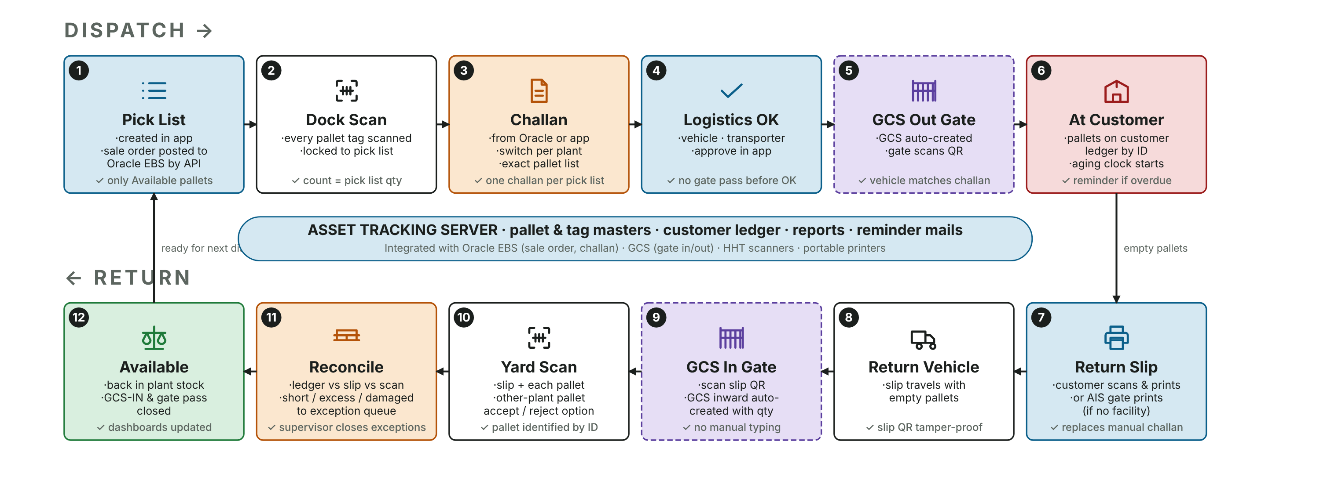
The closed loop in one picture
Dispatch left → right, return right → left. Blue = app, amber = control, dashed = Oracle EBS / GCS, red = customer, green = result.

Slide 4
Revised process flow
Overview, dispatch and return in detail, controls and masters

Slide 5
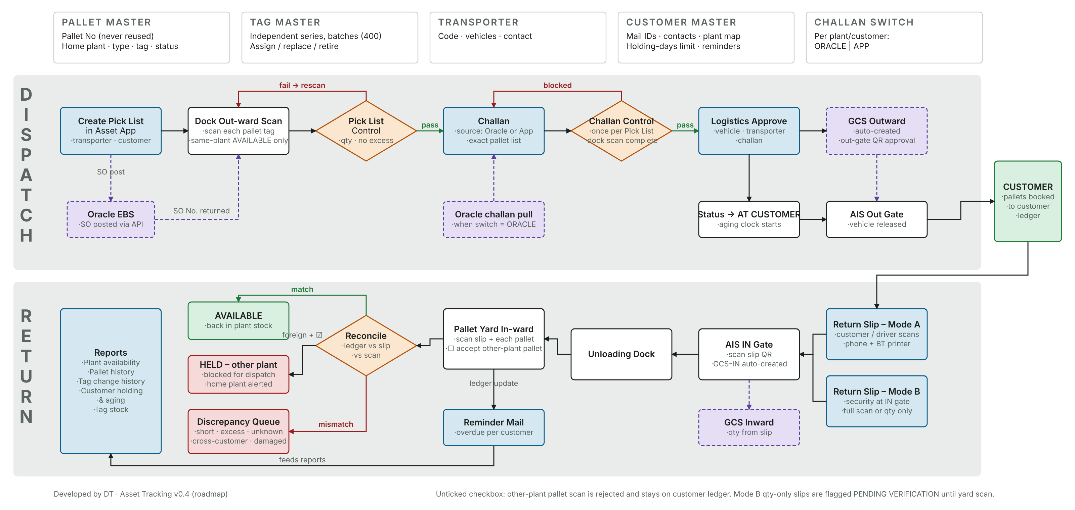
Revised end-to-end flow (v0.4)
Masters on top · DISPATCH lane: Pick List → EBS SO → dock scan → Pick List Control → challan → Challan Control → logistics approve → GCS out · RETURN lane: slip → IN gate → yard scan → reconcile

Slide 6
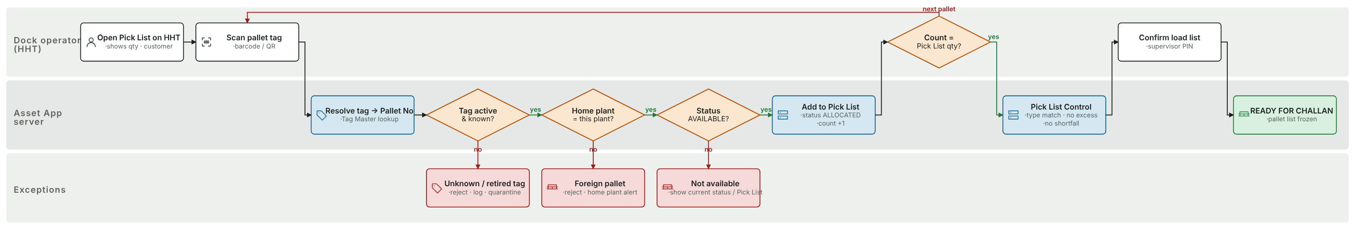
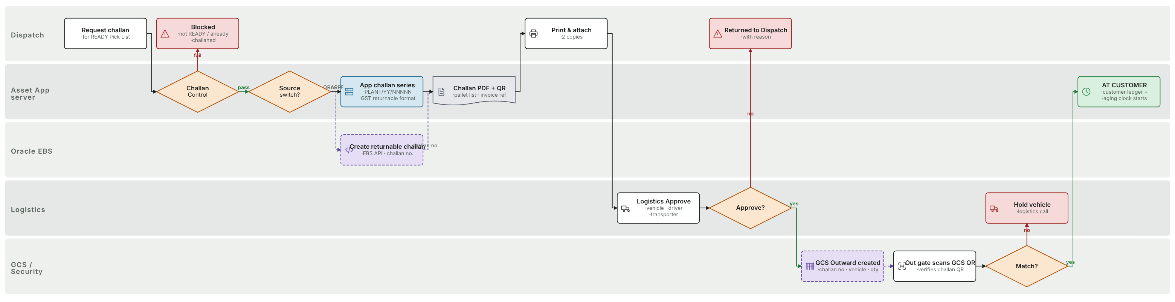
Dispatch in detail: pick list, dock scanning, challan, gate
Dock out-ward scan & Pick List Control: unknown / retired tag, foreign pallet, not AVAILABLE and quantity checks — every rule also runs offline on the HHT
Challan (ORACLE / APP switch) → Logistics approve → GCS outward → OUT gate QR match. Mismatch = vehicle held; override only with supervisor PIN and logged

Slide 7
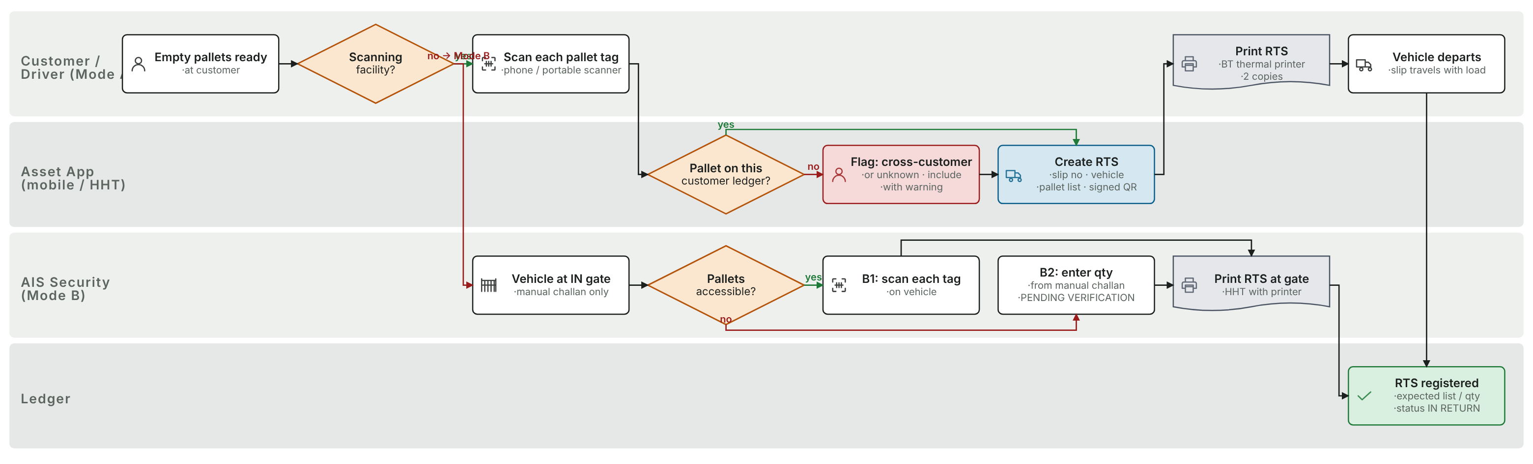
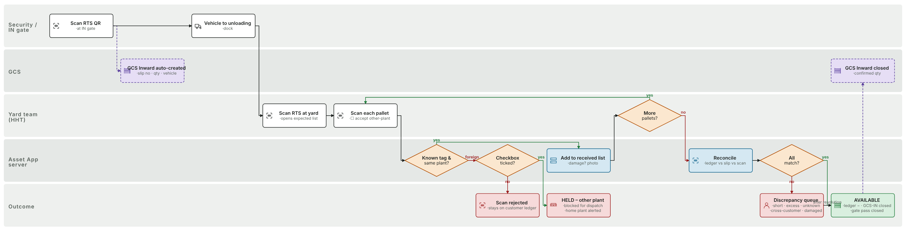
Return in detail: return slip, IN gate, yard reconciliation
Return Slip: Mode A at customer end (scan + Bluetooth print, or push via API) · Mode B at AIS gate: B1 full scan, B2 quantity only (PENDING VERIFICATION)
IN gate scan creates GCS-IN · yard scans each pallet with the "accept other-plant" option · three-way reconcile → AVAILABLE / HELD / exception queue · close needs supervisor PIN if exceptions remain

Slide 8
Four controls and how exceptions are handled
1
Pick List Control
2
Challan Control
3
Logistics Confirmation
4
Gate Control
Scanned count must equal pick-list qty; only same-plant AVAILABLE pallets; no duplicates
One challan per pick list, only after the dock scan is confirmed; source ORACLE or APP per plant/customer
Vehicle, transporter and challan approved in the app before any gate pass exists
OUT: GCS/challan QR must match an approved vehicle · IN: slip QR creates GCS-IN automatically
Exception queue at the yard
Short | on slip, not received → stays at customer, counted in reminders
Excess | received, not on slip → accepted, source customer corrected
Cross-customer | booked to X, returned by Y → moved between ledgers, flagged
Unknown tag | not in master → quarantine until identified / re-tagged
Damaged | photo, status DAMAGED, chargeable per customer master
Other-plant pallet | checkbox: accept → HELD + home plant alerted, or reject

Slide 9
Masters, plant restriction and user control
Plant Master
Roles per plant (permission matrix in Admin)
15 plants · GSTIN · pallet & tag series · challan switch · other-plant default
Security – IN Gate · Security – Logistics / OUT Gate
Pallet Yard In-charge · FG Warehouse · QA / PDI · Logistics
Plant Admin (own plant users) · Master Maintenance (central)
Central Admin · Management (all-plant dashboards, read-only)
Every user is tied to one plant: data, scans and reports are filtered automatically
A plant cannot dispatch or assign another plant's pallets
Supervisor PIN for sensitive actions: close with exceptions, reduce qty, gate override, discontinue pallet
Lock after 5 failed logins · HHT device registration · immutable audit & activity log
Pallet & Tag Master
Pallet No permanent (never reused) · tag series independent, vendor batches of 400 · replace / retire · full tag history
Customer Master
Mail IDs, contacts · holding-days limit · reminder & escalation days · chargeable · return mode A/B · API key
Transporter Master
Codes, vehicles, contacts · selected on pick list and slip

Slide 10
The solution
Architecture, contingency, actual screens, documents, integrations

Slide 11
Architecture: Python · SQL Server · Android
Central server
HHT app (Android)
Plant Edge Service
FastAPI (Python) on IIS · SQL Server · 4 workers behind one port · separate integration worker so a slow Oracle never blocks a scan
Rugged scanners or phones · offline-first outbox · camera or keyboard-wedge scanning · Bluetooth 2"/3" printer
Portable Python service on the plant PC · takes over on the LAN if WAN / central server is down · forwards when back
Web console
Integrations
Security & audit
Dashboard, masters, users, import, pick lists, slips, sync monitor, activity log, reports, Excel export
Oracle EBS: SO post, challan · GCS: gate in/out · External customer API (API key) for Mode A push · retry queue
JWT login, plant scoping, role matrix, supervisor PIN, device block, activity logger on every action

Slide 12
Production never stops: offline design and contingency
Failure | What keeps running | Normalisation after the fix
WAN / network down | Scans continue on HHT (local rules) or via plant edge service | Outbox replays in order; server de-duplicates
Central server down | Edge service serves the plant on LAN | Replay + reconciliation report; standby DB promoted
Oracle EBS down | Pick list saved SO PENDING; challan (APP mode) still prints; gate proceeds | SO posted by retry job every 5 min; number back-filled
GCS down | Manual gate-pass mode with challan QR + supervisor PIN | GCS created / closed in bulk when back; mismatch report
HHT lost / broken | Device blocked by admin; server knows its last heartbeat and pending count | Re-enter from paper slips; returned device outbox still accepted
Printer down | Print later; document stored | Reprint from any device or the web console
Rules in every mode: a truck is never held for the app · nothing is lost silently (UUID per event, two copies before acknowledgement) · central wins on conflict but never discards, it queues for review

Slide 13
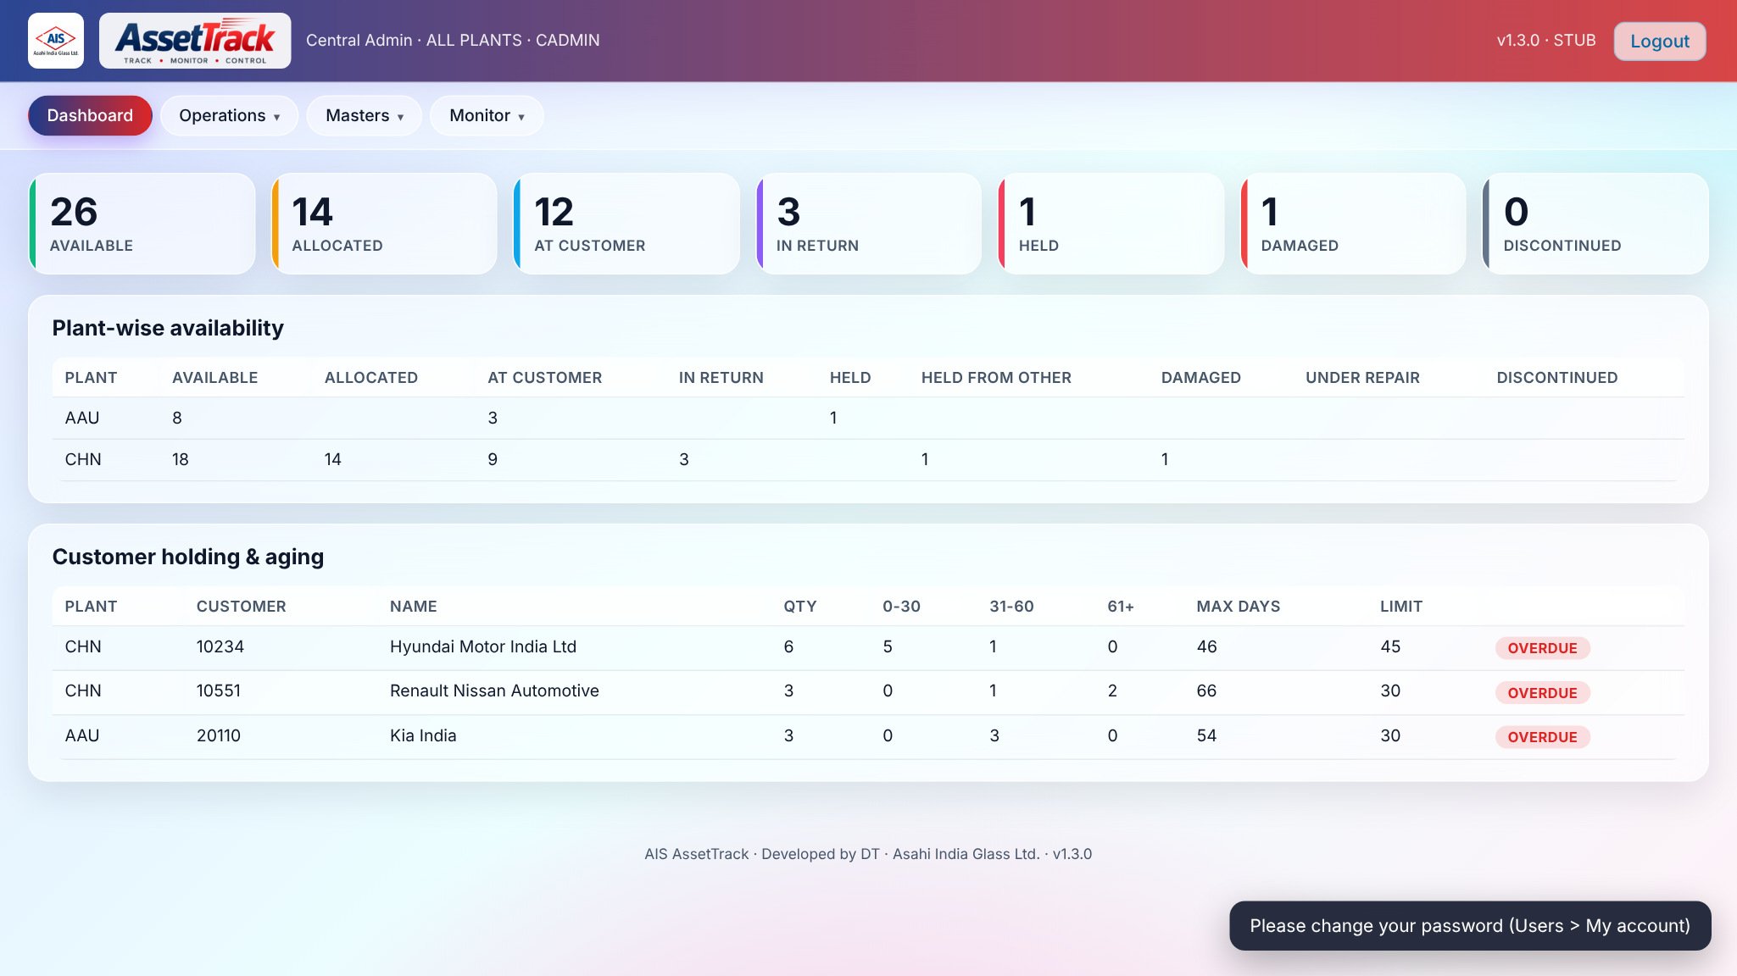
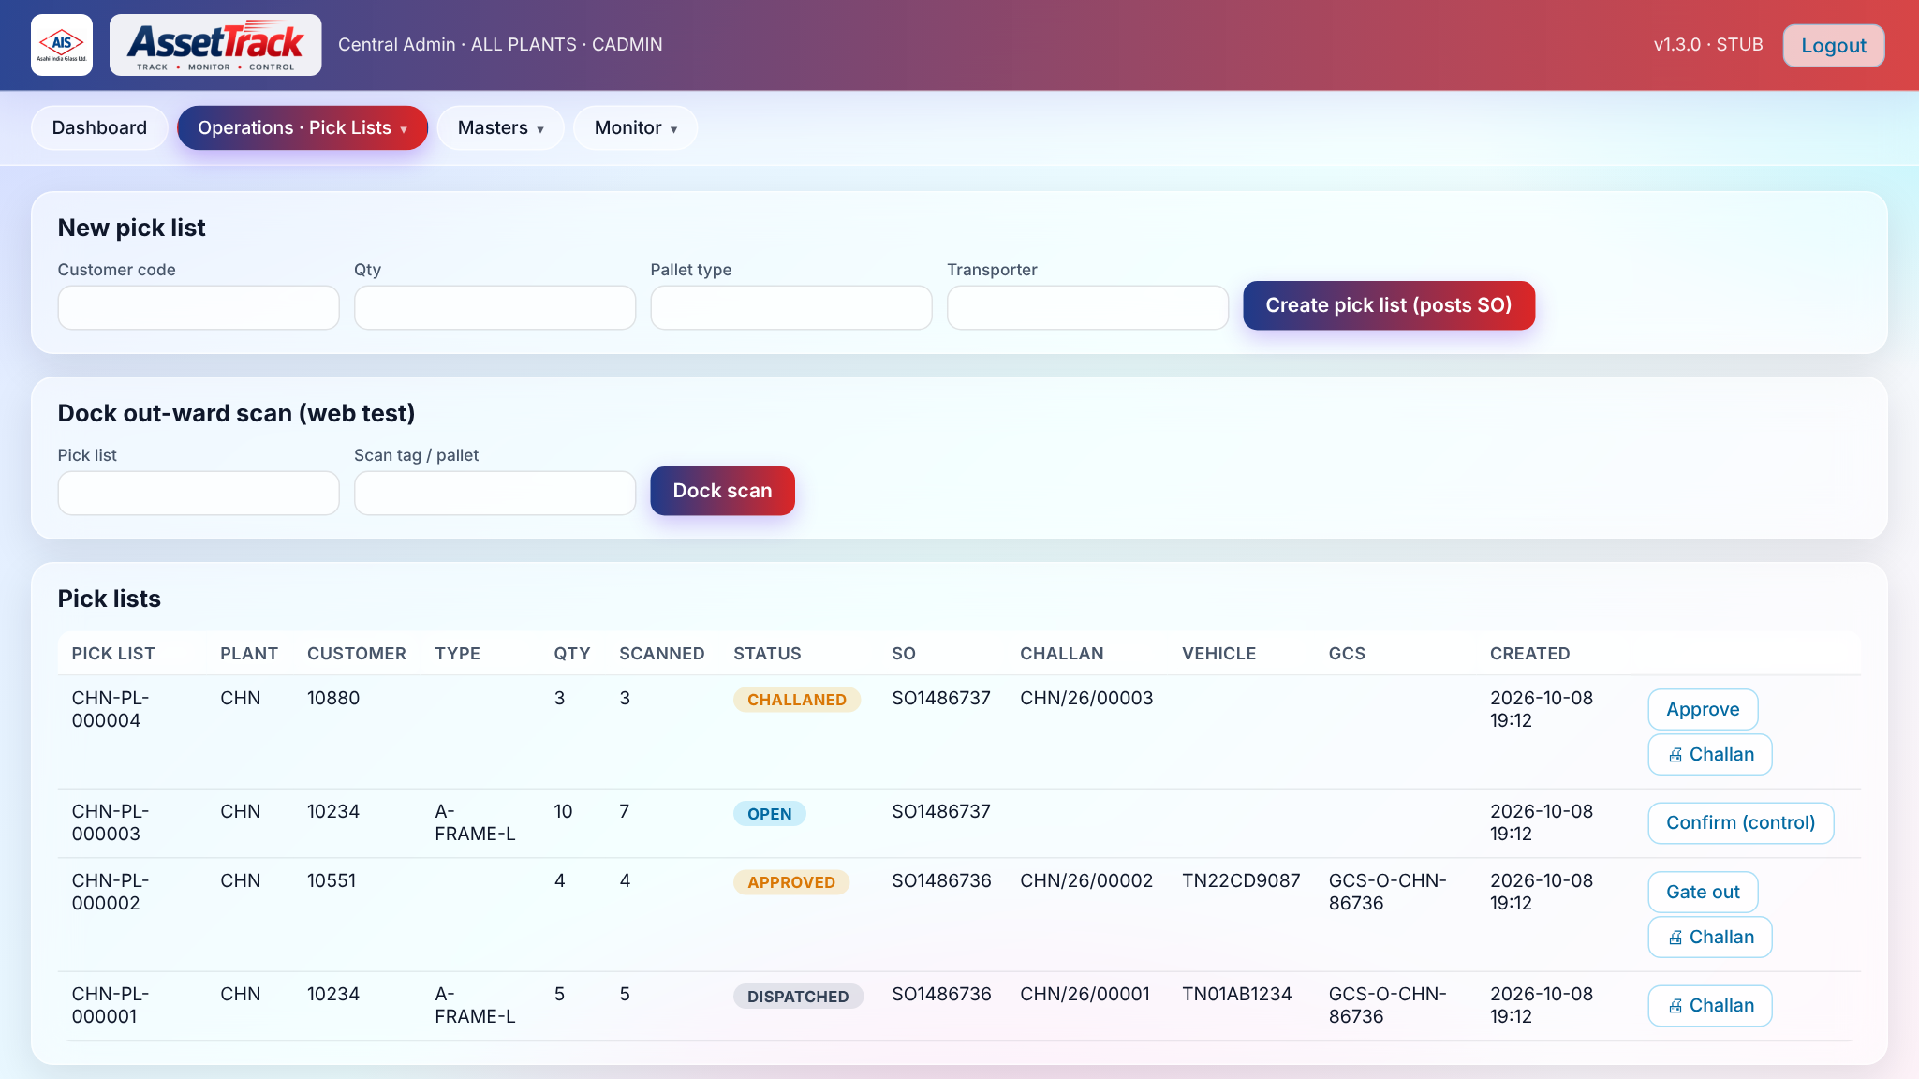
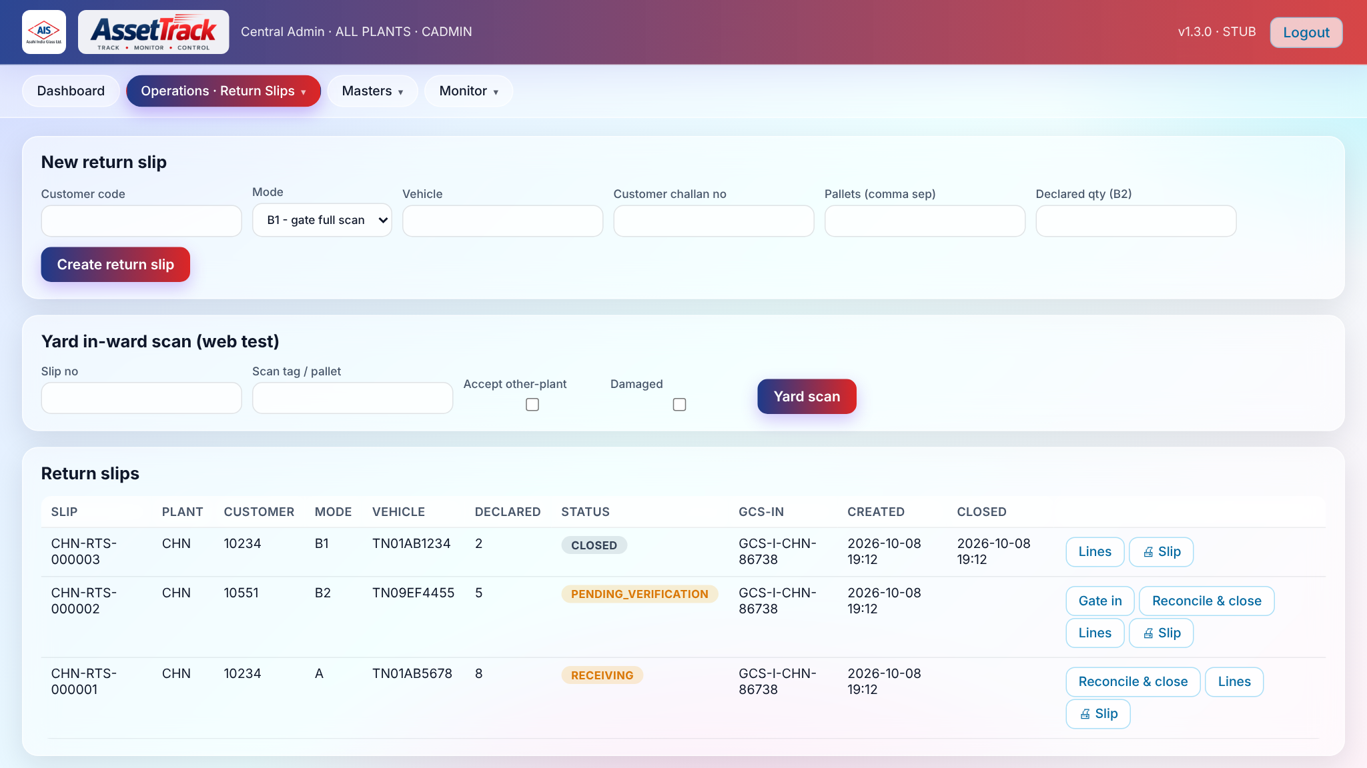
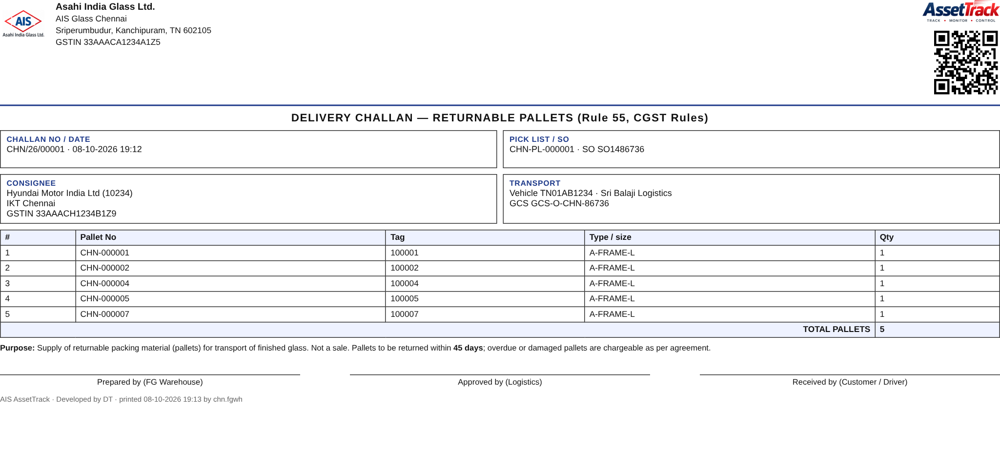
Server console: dashboard and dispatch control (actual screens)
Dashboard — plant-wise availability, customer holding & aging with OVERDUE flags
Pick lists — SO number from EBS, scanned count, challan, vehicle, GCS; action buttons by role
Return slips — Mode A (customer API) and B, GCS-IN, close with PIN
Printable A4 challan with AIS logo and QR

Slide 14
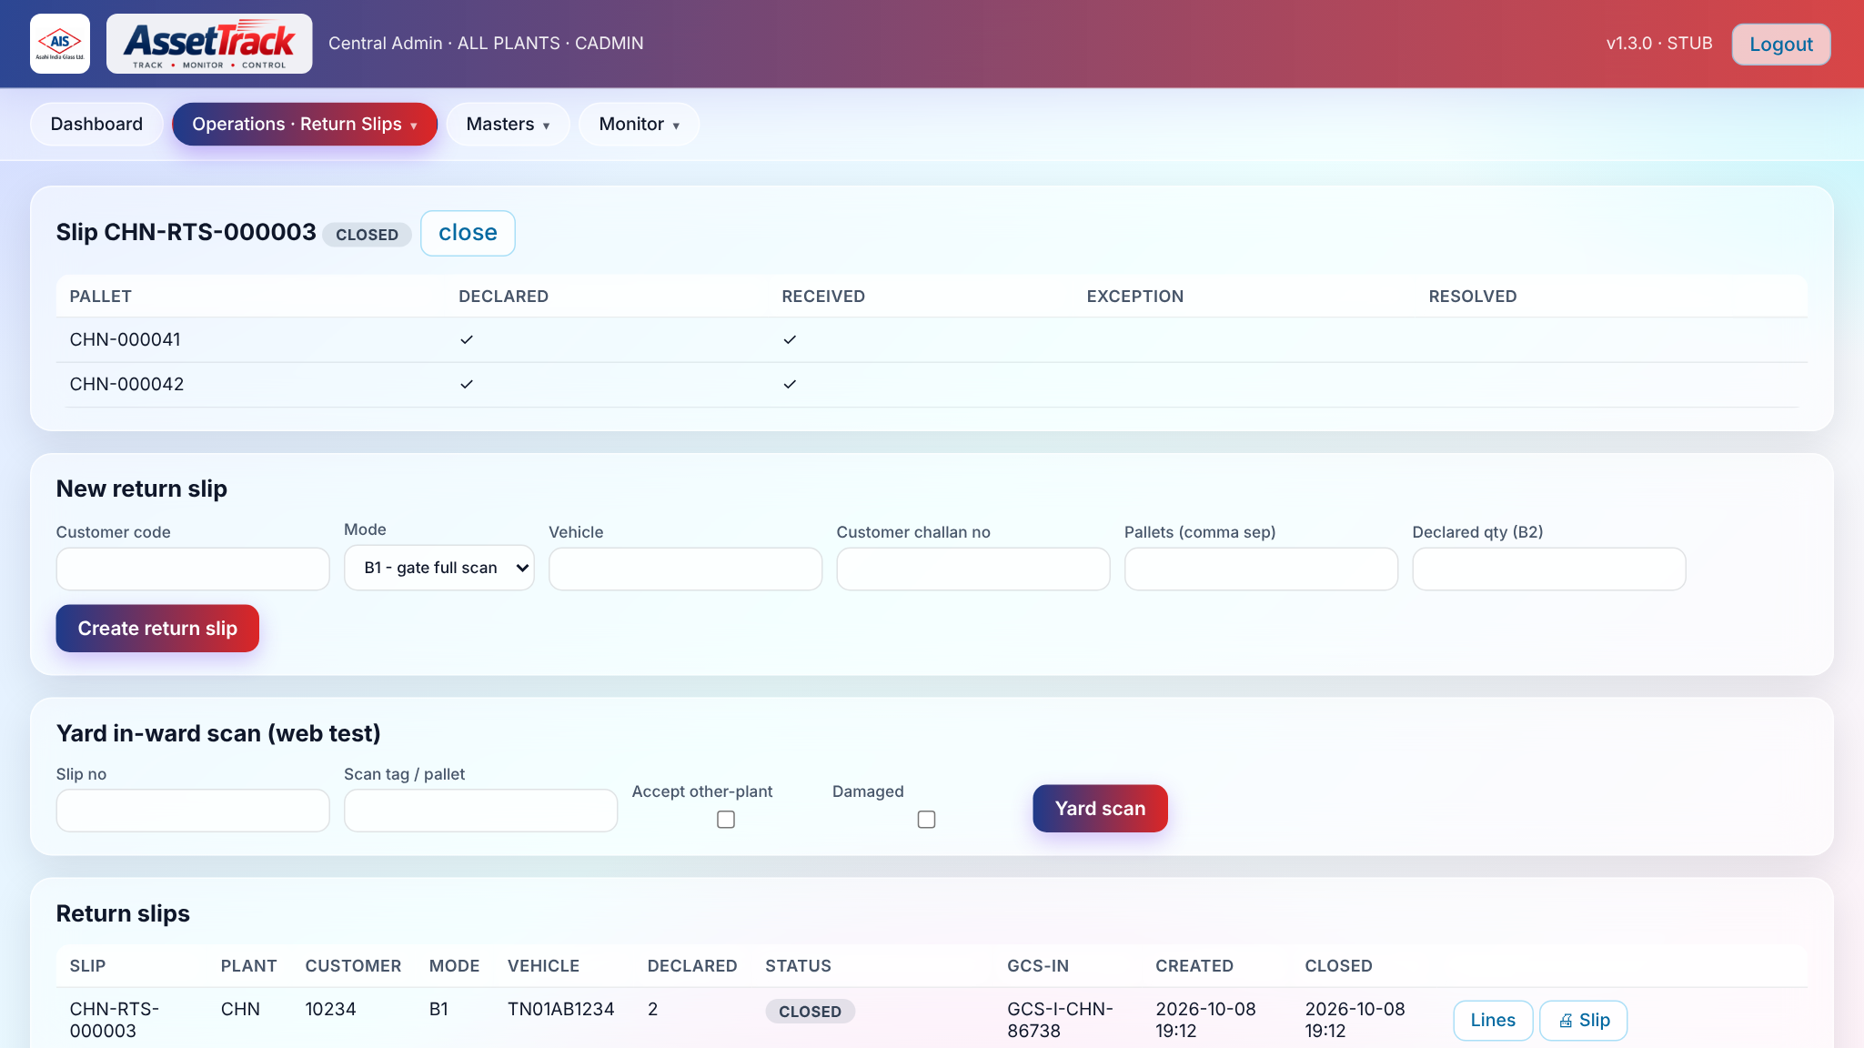
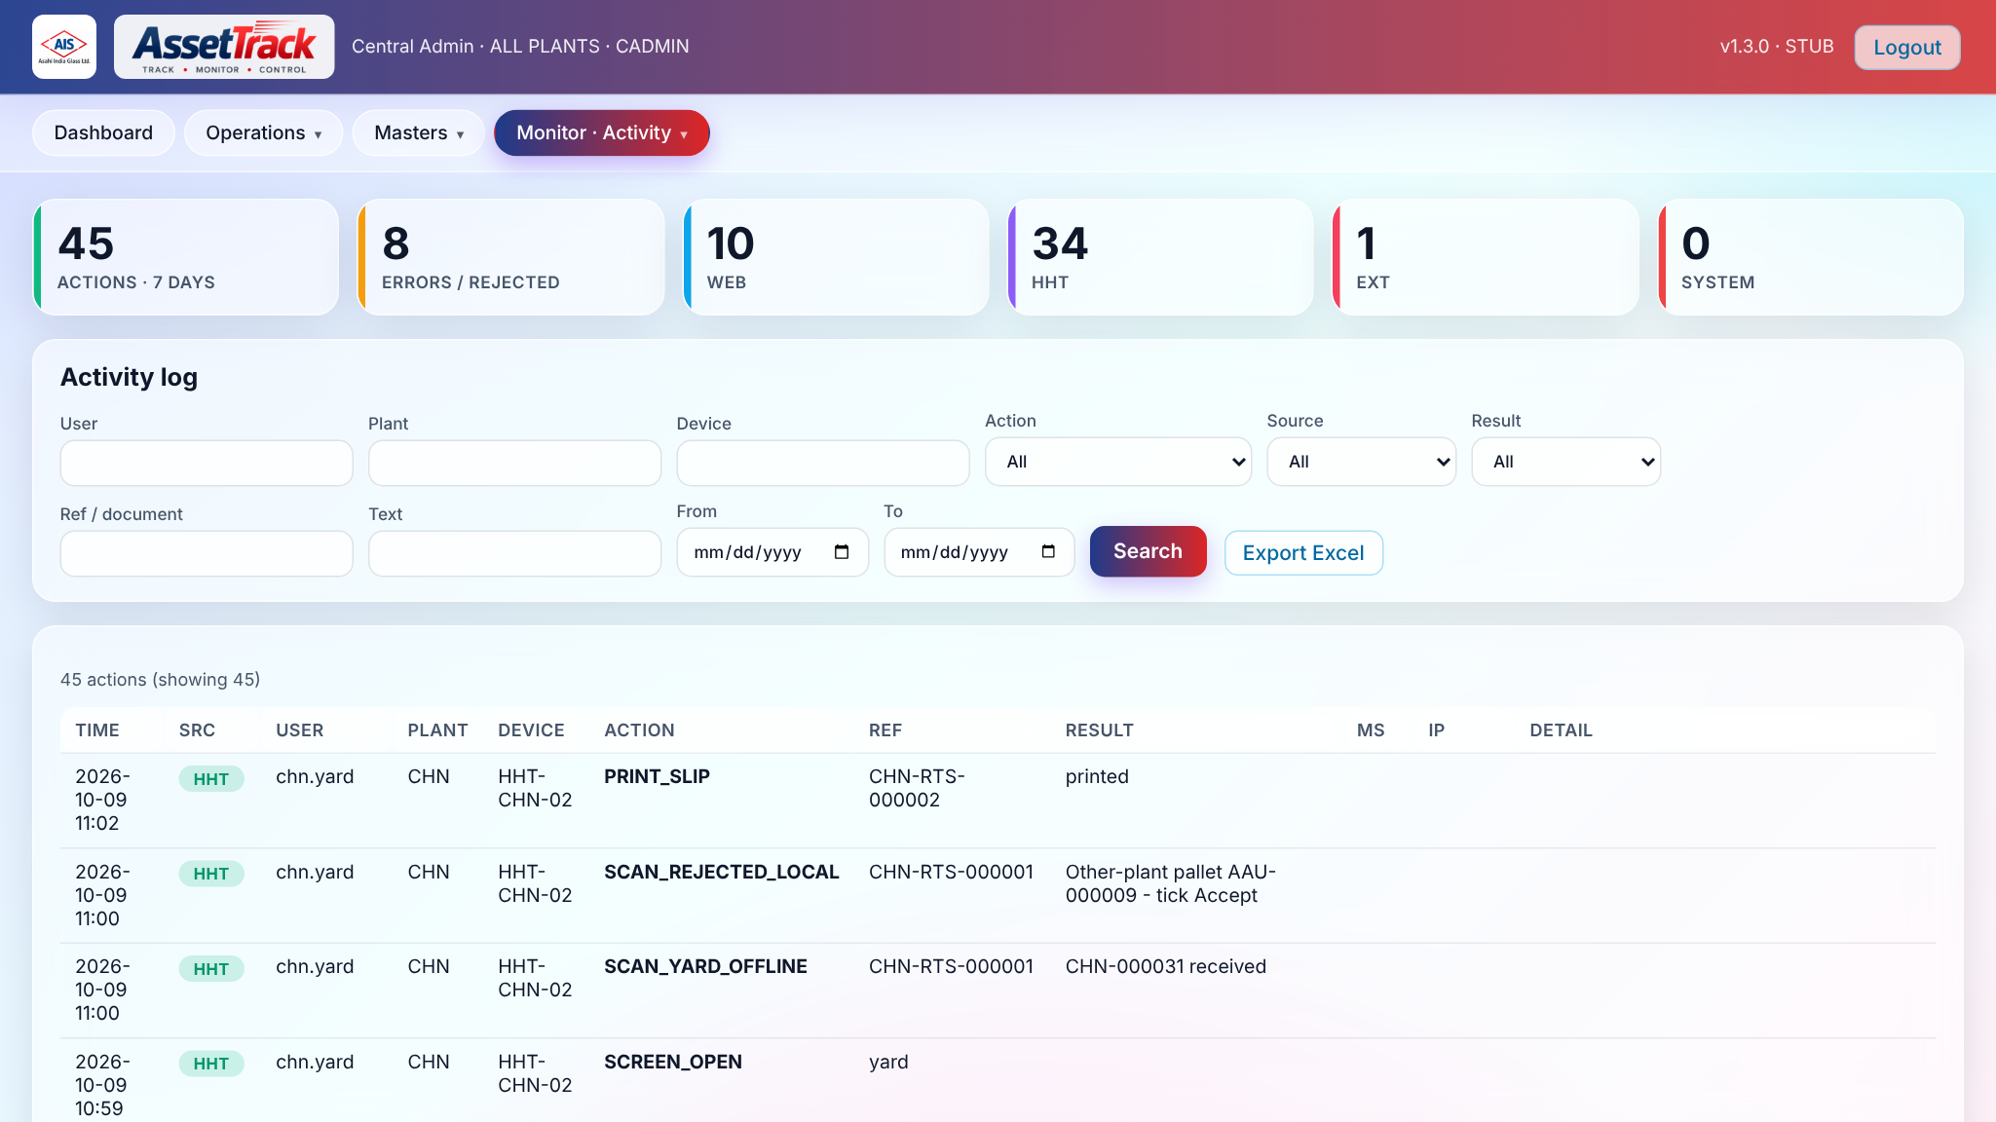
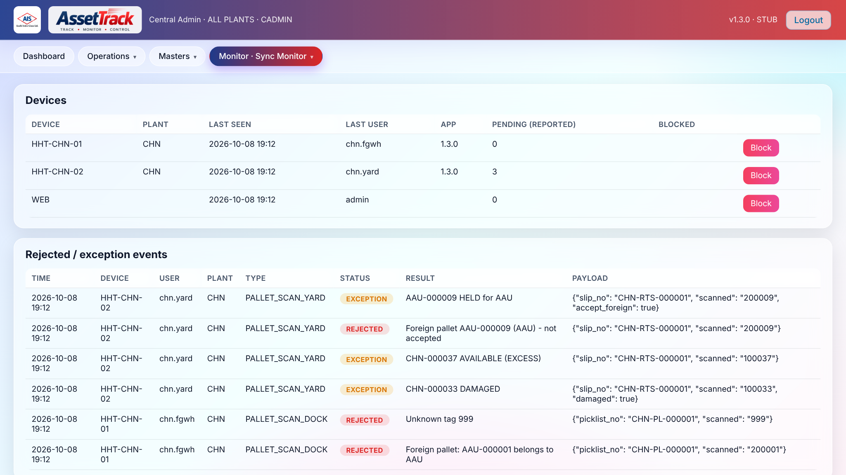
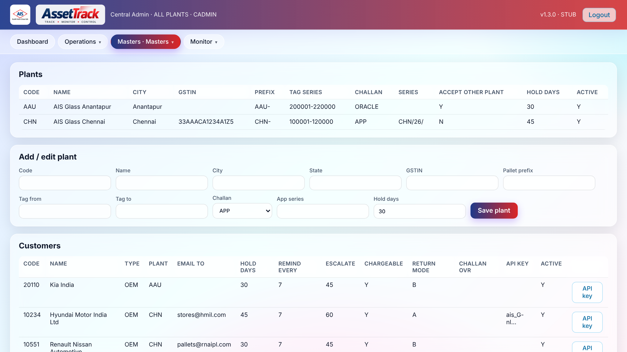
Server console: reconciliation, sync and activity (actual screens)
Slip lines — declared vs received, DAMAGED / FOREIGN / EXCESS exceptions, resolve per line
Activity log — every action from web, HHT, external API; filters and Excel export
Sync monitor — devices, last seen, pending events, rejected / exception events, integration retry queue
Masters — plants, customers (with API key), transporters, tag batches; Excel import

Slide 15
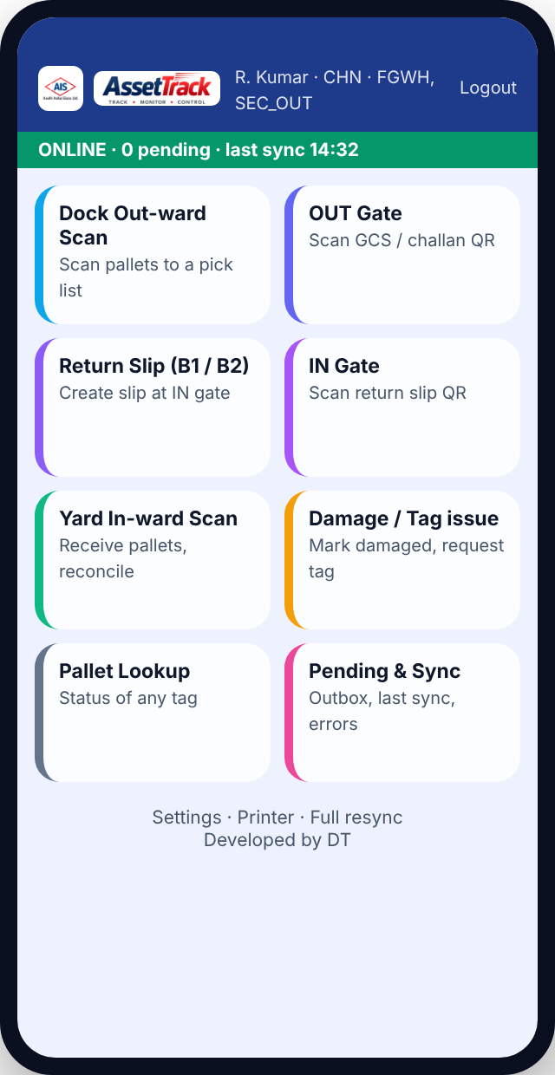
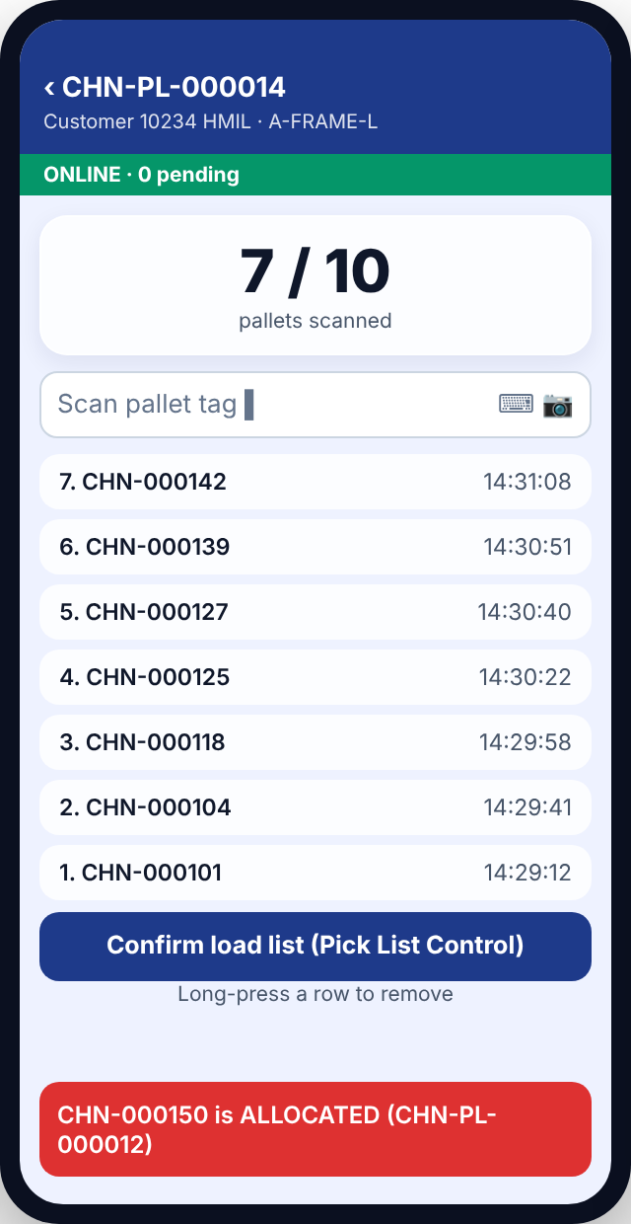
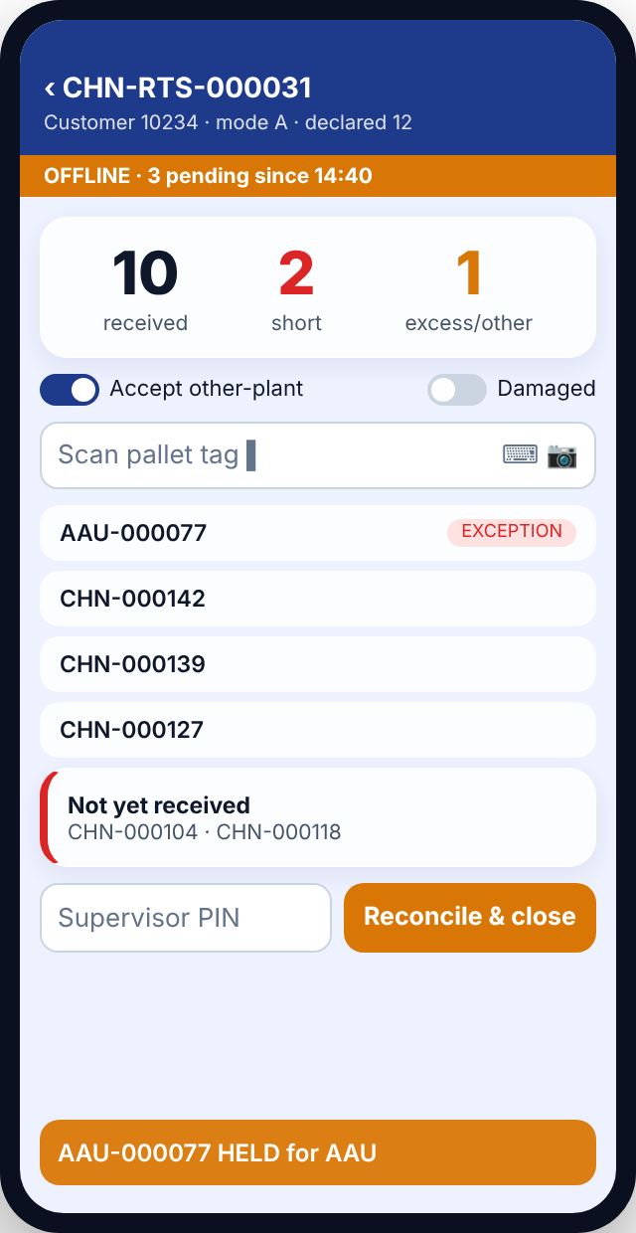
HHT app: home, dock scan, yard reconciliation
Role-based tiles; status bar: ONLINE/OFFLINE + pending
Count vs pick-list qty; rule failures beep in red
Received / short / excess; other-plant & damaged switches

Slide 16
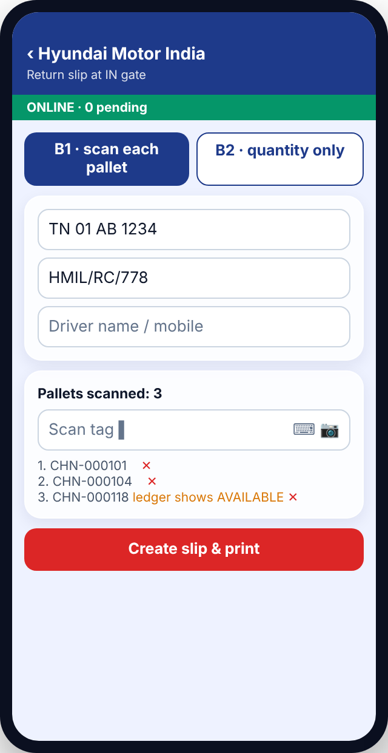
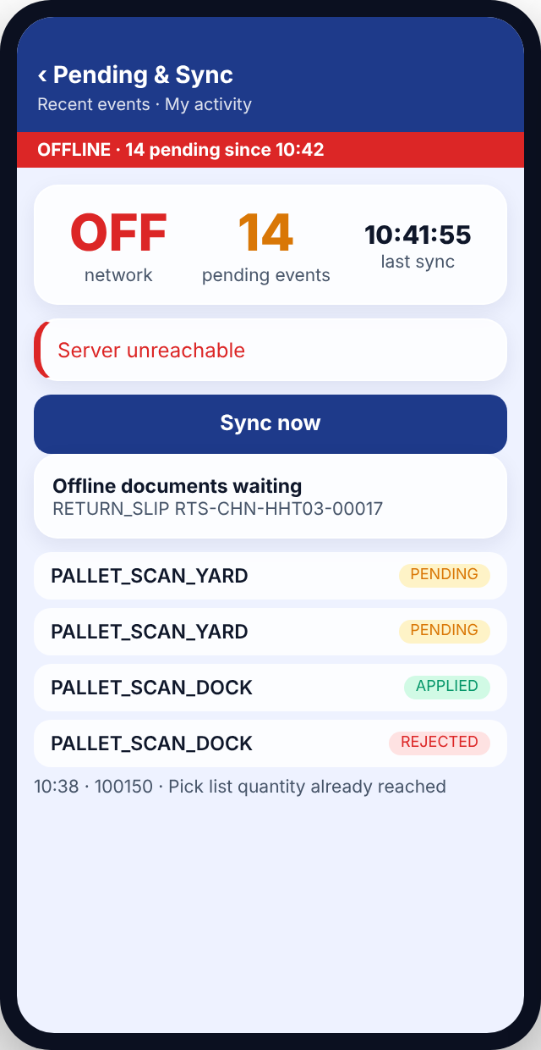
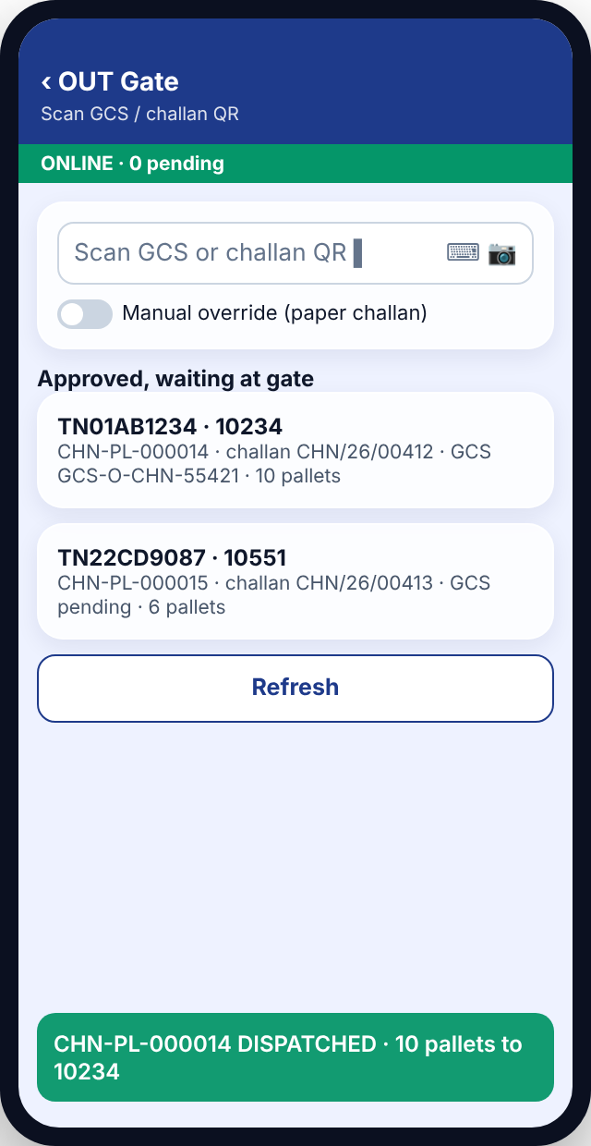
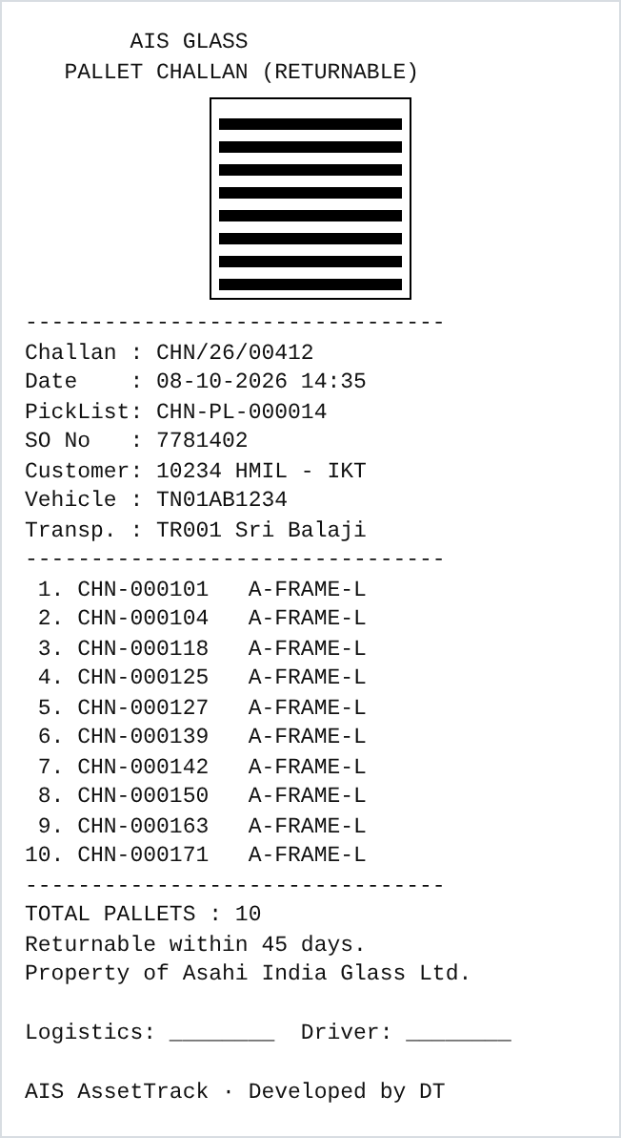
HHT app: return slip, sync, OUT gate, thermal challan
B1 scan / B2 qty; prints 2 copies with QR
Outbox, offline docs, my activity
QR must match approved vehicle
3" thermal challan with logo & QR

Slide 17
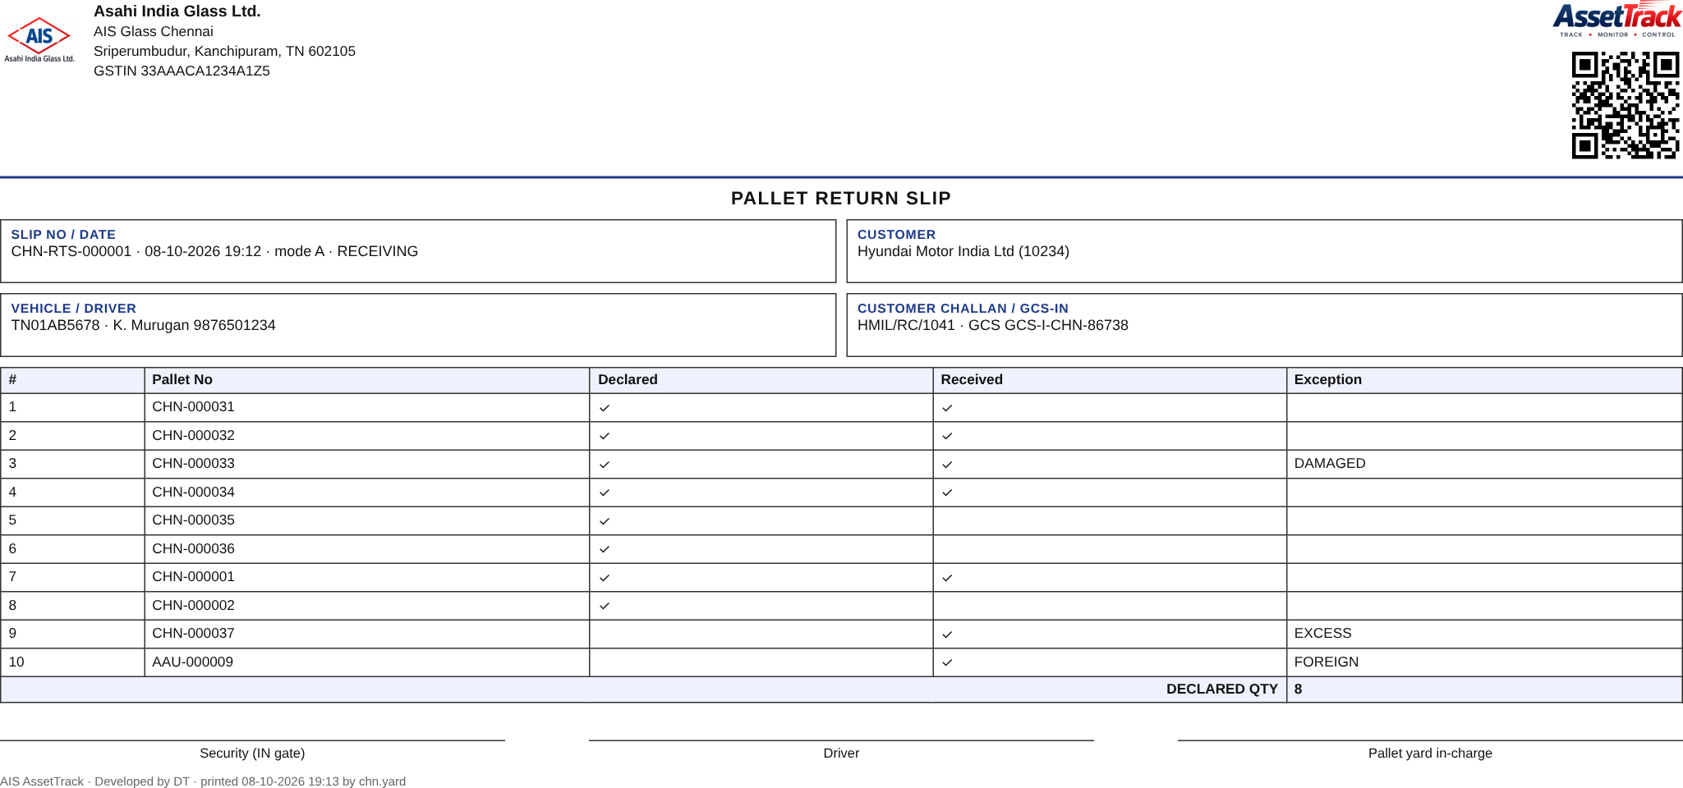
Documents generated by the system (actual output)
Delivery challan — returnable pallets (Rule 55): consignee, transport, pallet list with tags, return period, signatures, QR
Return slip — customer challan, vehicle, driver, declared vs received, exceptions, GCS-IN
Challan source switch
APP mode: numbered from the plant series, printed A4 and 3" thermal, posted to EBS as reference. ORACLE mode: challan number pulled from EBS and printed in the same layouts. Both carry the QR scanned at the OUT gate and by the customer.

Slide 18
Integrations and the customer end
Oracle EBS
GCS (internal gate system)
Customer end (outside AIS network)
Sale order posted by API when a pick list is created (SO number stored) · returnable challan from EBS when switch = ORACLE · pallet liability visible in ERP
Outward pass auto-created on logistics approval, approved on gate QR match · inward pass created from the return-slip QR, closed with the received quantity
External API with per-customer key, published through DMZ: holding list, validate tags, push return slip with pallets, vehicle and their challan · phone + Bluetooth printer kit
Reminders, aging and management reports
Nightly job: days at customer vs Customer Master limit → reminder mail with pallet list (To / CC from master), escalation to sales, chargeable list
Dashboards: plant-wise availability, customer holding by age bucket, overdue pallets, exception queue, tag stock
Reports: pallet transaction history, tag change history, audit log, activity log — all exportable to Excel

Slide 19
Roadmap
Phases, timeline and what each phase delivers

Slide 20
Roadmap: six phases from pilot to all 15 plants
Phase | Scope | Duration | What is built | Outcome
0 | Discovery & spec freeze | 2 wks | State machine, Return Slip & challan formats, API contracts (EBS SO, Oracle challan, GCS), master data from 15 plants, pallet census plan | Frozen spec, opening-stock approach
1 | Core + masters + yard | 3 wks | Server on IIS/SQL Server, masters & roles, Excel import, tags on pallets (census), HHT offline core, yard in-ward scan, sync monitor | Plant pallet inventory becomes real
2 | Dispatch validation | 3–4 wks | Pick list → EBS SO post, dock scan, Pick List Control, challan switch (ORACLE/APP), logistics approve, OUT gate | Every outgoing pallet known by ID and customer
3 | GCS integration | 2 wks | GCS outward auto-created and approved on gate QR; GCS inward from return-slip QR; manual gate-pass fallback | Gate fully system-controlled both ways
4 | Return module | 3–4 wks | Return slip Mode A (customer API / kit) and Mode B (gate), three-way reconciliation, exception queue, plant edge service | Returns tracked by pallet ID; no manual challan
5 | Analytics & rollout | 3 wks + rollout | Reminder mails, aging & chargeable list, dashboards, day-end check; rollout one plant every 2 weeks | Management visibility across the network
6 | Add-ons | later | Green-card API check at production, HMIL PDI hook, customer self-service portal, Vehicle Live Tracker link | Closed loop from manufacturing to customer portal
Status today: Phase 1–2 software (server v1.3, HHT v1.3) and Phase 4 return module are built and tested with sample data; integrations run in STUB mode until EBS / GCS endpoints are shared.

Slide 21
Timeline: Chennai pilot live in Q4, network rollout through 2027
Oct 26
Nov 26
Dec 26
Jan 27
Feb 27
Mar 27
Apr 27
May 27
Jun 27
Phase 0 · Spec freeze
Phase 1 · Core, masters, yard
Phase 2 · Dispatch validation
Phase 3 · GCS integration
Phase 4 · Return module + edge
Chennai pilot go-live
Phase 5 · Analytics, reminders
Rollout wave 1 · AAU, PUN, TAL
Rollout wave 2 · RKE, BWL + 4 plants
Rollout wave 3 · remaining plants
Phase 6 · Add-ons & portal
Assumes EBS and GCS endpoints available by mid-November and tags fixed on Chennai pallets during Phase 1. One plant goes live every two weeks once the pilot is stable.

Slide 22
Pilot plan and what each plant needs
Done
Phase 0 · 2 wks
Phase 1-2 · 4 wks
Phase 3-4 · 4 wks
Phase 5 · 3 wks
Rollout
Server v1.3, HHT app v1.3, masters template, flows & documents
Spec freeze with ERP & GCS teams: SO API, challan, GCS contracts; master data from 15 plants
Chennai pilot: masters, tags on pallets, dock scan, challan, logistics, gate · "pull the cable" test
GCS live, Oracle live, return slips with HMIL (Mode A), yard reconciliation
Reminder mails, dashboards, edge service, day-end check
One plant per 2 weeks: AAU, PUN, TAL, RKE, BWL … 15 plants
Hardware per plant (indicative)
Central (IT)
2–4 rugged Android HHTs (existing scanners can be reused)
1 HHT with built-in printer or 1 Bluetooth 3" printer at the IN gate
Barcode tags: ~400 per batch per plant (vendor printed)
Plant PC for the edge service (no admin rights needed)
Windows Server with IIS · SQL Server (Standard or Express for pilot)
DMZ rule for the external customer API only
Oracle SOA endpoints for SO & challan · GCS API or DB access
Mail relay for customer reminders

Slide 23
Approval requested
1
Approve the Chennai pilot
2
Nominate owners
Phase 0–2 start, 6 weeks, with HMIL as the first Mode A customer
ERP (SO/challan API), GCS team, plant logistics & security leads, Master Maintenance team
3
Sanction hardware
4
Agree the policy
HHTs, gate printer and tag batches for Chennai; central IIS / SQL Server instance
Customer holding-days limits, chargeable rule and write-off after escalation
Outcome: every AIS pallet tracked by ID from plant to customer and back · live availability · customer accountability · no double entry

