Slide 1
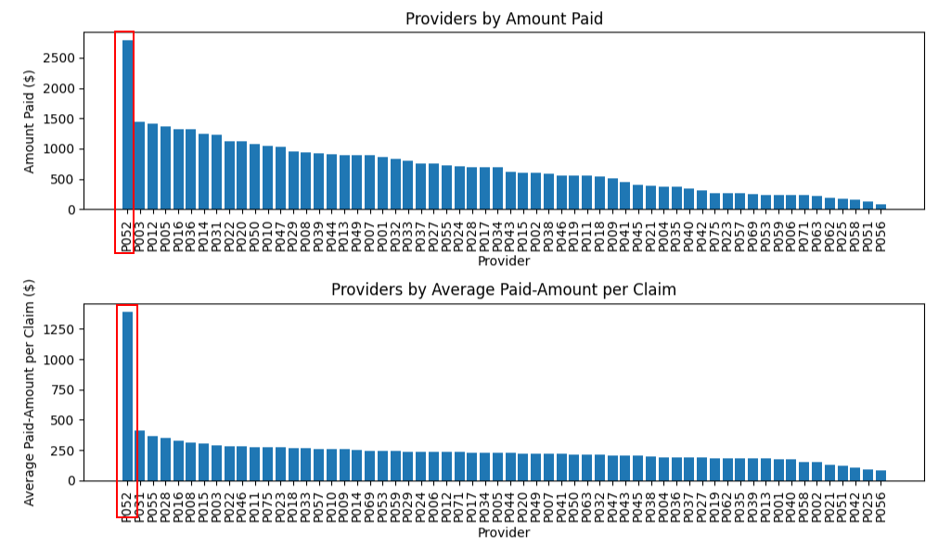
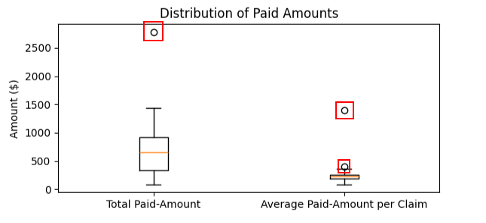
Outlier Analysis -provider
P052 – Standout
P052 – Standout
P052
Box plot gives another visual – P052 & P031 Standout in avg paid per claim area
P052 & P031

Slide 2
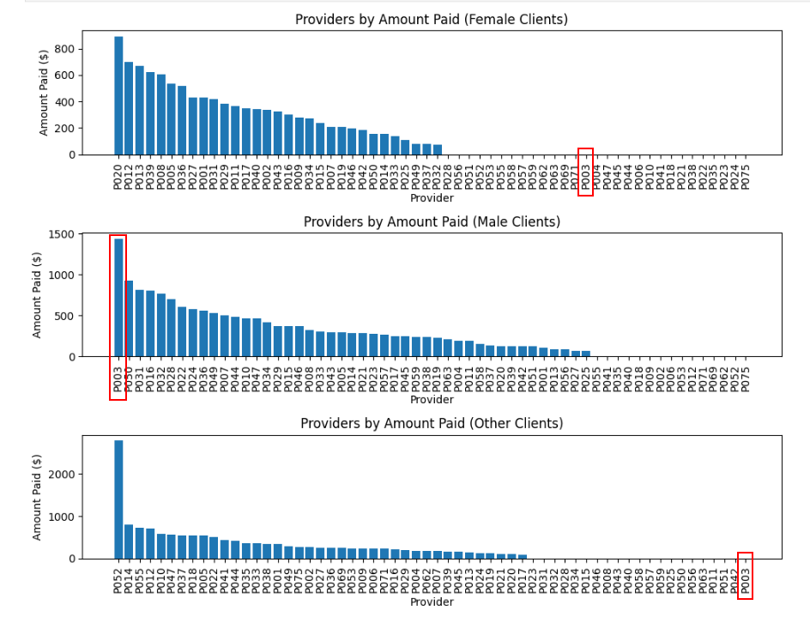
Outlier Analysis - Client
P003 clearly stands out and only attending male clients – he has 5 unique male clients

