Slide 1
VotingBlock
E-voting secured by Blockchain
By – Dhanajit kapali (12022)
Abhijeet Kumar (12002)
Himanshu Rawat (12031)
Jayant Kumar(12034)

Slide 2
Overview
Modern democracies are built upon traditional ballot or electronic voting (e-voting).
In these recent years, devices which is known as EVMs are hugely criticized due to irregular reports of the election results.
There have been many questions regarding the design and internal architecture of these devices and how it might be susceptible to attacks.
Online-voting is pushed as a potential solution to attract the young citizens and the non- resident of the country.
Moto of this application is to integrate the blockchain framework with both the modules for seamless voting.

Slide 3
Objectives
To improve the existing online voting system using Blockchain technology.
To reduce the workload of setting up an election booth and conducting elections in physical form.
Non-Resident Indian can cast their votes as it is totally online.
We are supposed to learn the concept of Blockchain and how it can be utilized to work on different sectors.

Slide 4
What is Blockchain
A blockchain is a decentralized, distributed, and oftentimes public, digital ledger consisting of records called blocks.
It is used to record transactions across many computers so that any involved block cannot be altered retroactively.
A blockchain has been described as a value-exchange protocol and it can maintain title rights, too.

Slide 5
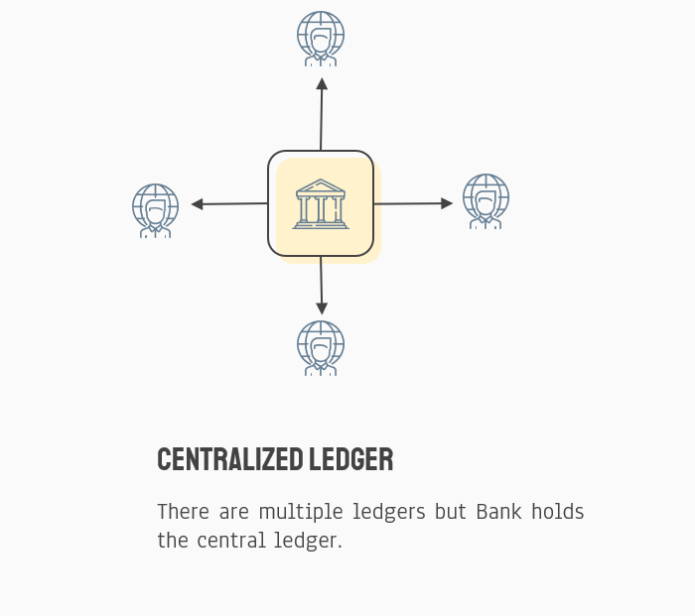
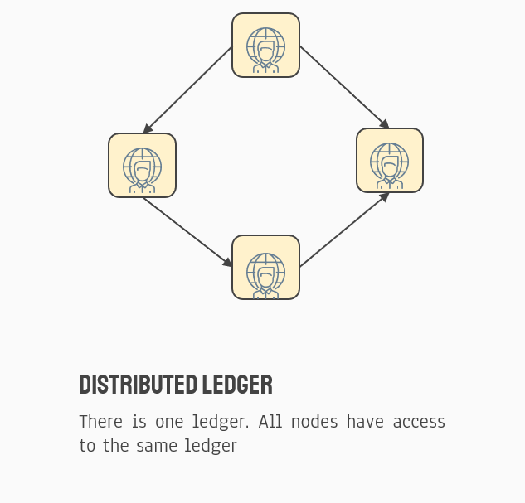
What is Blockchain

Slide 6
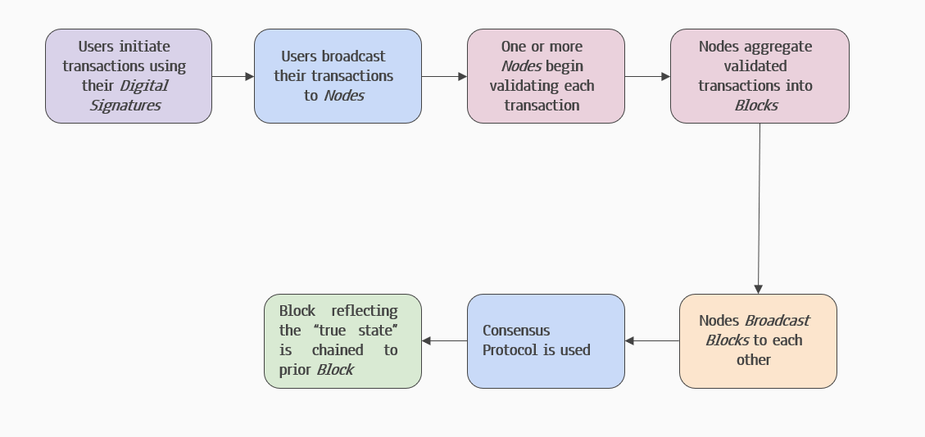
How Blockchain works

Slide 7
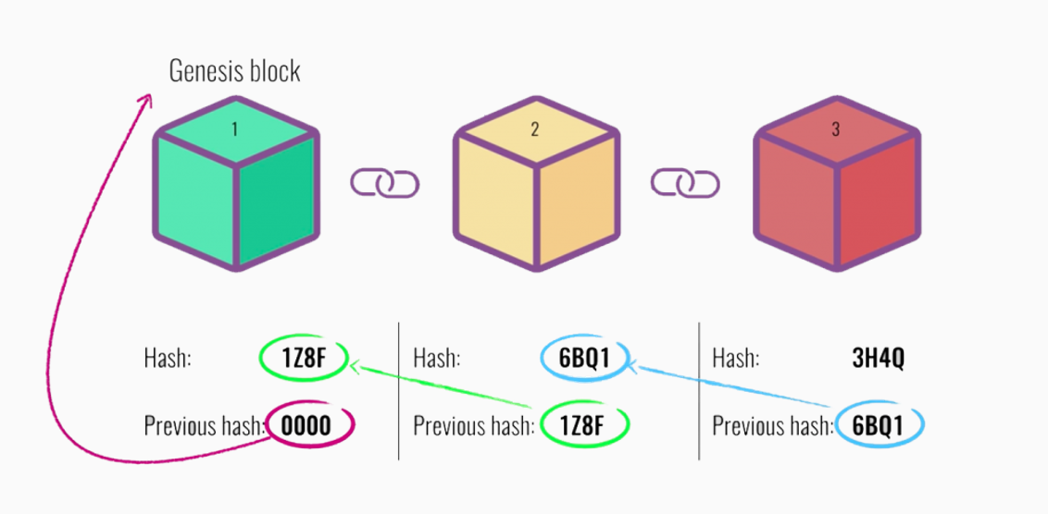
Blockchain

Slide 8
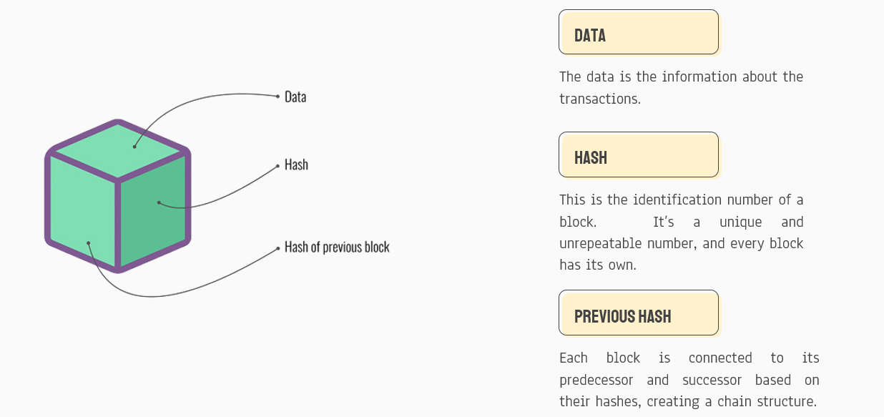
Block Overview

Slide 9
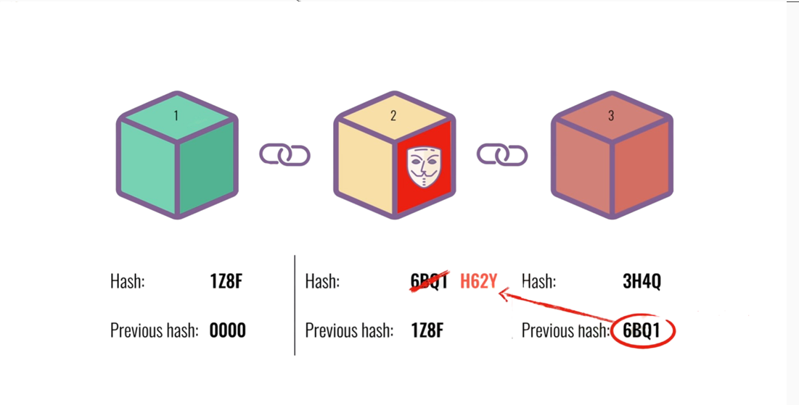
Blockchain security

Slide 10
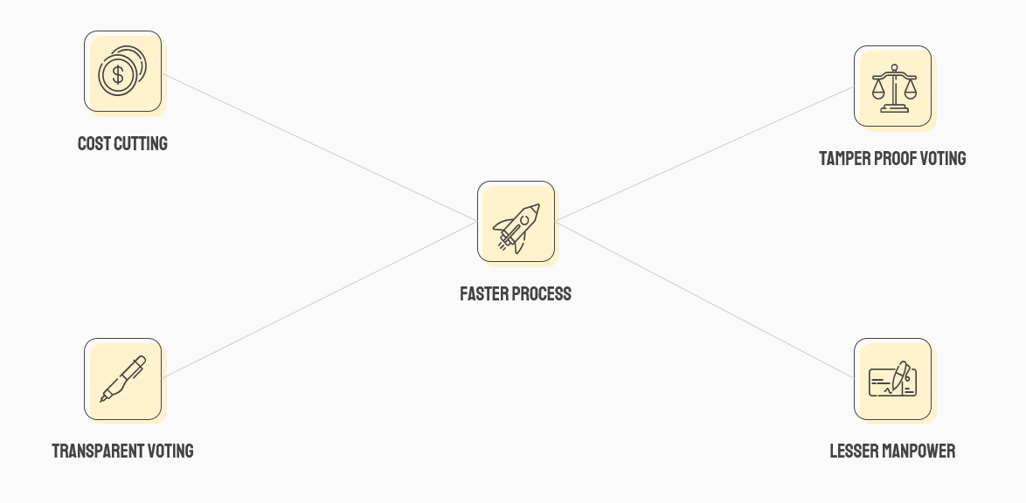
Advantages of Blockchain voting

Slide 11
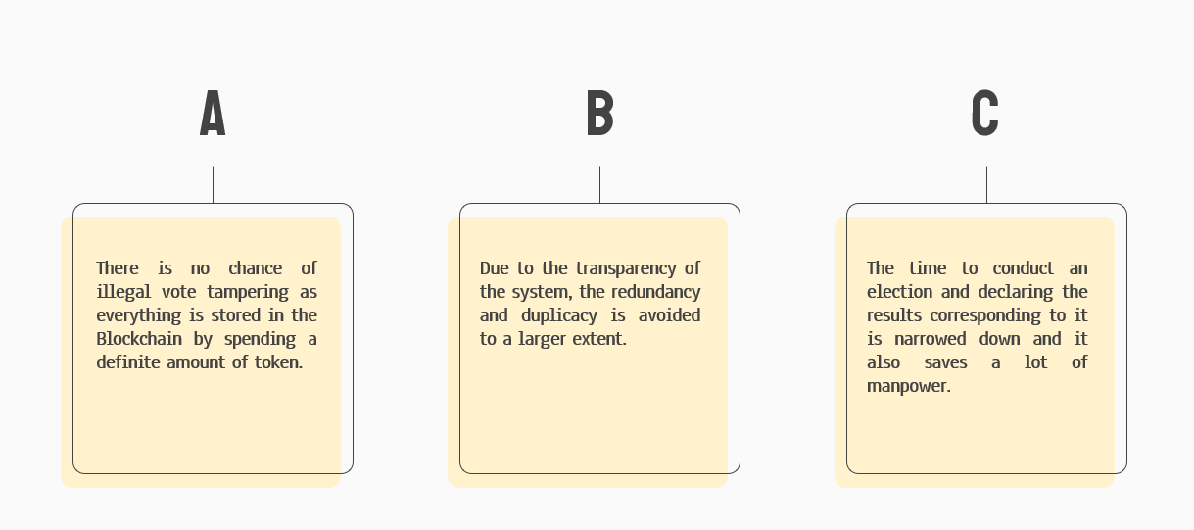
Conclusion

Slide 12


