Slide 1

TADF semiconductors
for OLEDs
How spin physics turns “wasted” triplets into useful light
Core story: voltage → excitons → spin statistics → triplet bottleneck → thermal recycling → photons
presentation + visual simulations
Notes:
Open by framing TADF as a quantum engineering trick. The whole topic is about moving from electrical energy to light, and avoiding the loss of triplet excitons.

Slide 2
The whole mechanism in one map
Use this as the mental route through the talk
1
2
3
4
5
6
Inject charges
Make excitons
Spin lottery
Bottleneck
TADF recycle
Photon out
electrons + holes enter organic layers
bound electron–hole excited states
25% singlet, 75% triplet
triplets are spin-forbidden to emit
RISC converts T₁ back to S₁
S₁ → S₀ gives fluorescence
Analogy: a factory line. Charges arrive, make excitons, most excitons enter the wrong room, and TADF builds a return route back to the light-emitting room.
Notes:
Explain that the talk is not many disconnected facts. It is one factory-line story: get charges in, bind them, deal with spin, then get photons out.

Slide 3
OLED = molecular layers that move charge and emit light
The emissive layer is where electron–hole pairs form excitons
e⁻
Cathode
electron injection
Electron transport layer
moves e⁻ toward emitter
Emissive layer
exciton formation + light
Hole transport layer
moves h⁺ toward emitter
Anode / transparent contact
hole injection
h⁺
Glass / substrate
lets light escape
Organic semiconductor ≠ silicon band picture only. It is often clearer to think in terms of molecular HOMO and LUMO levels.
Notes:
Use the sandwich analogy. Different layers are not decoration; they are engineered to inject and transport electrons and holes to the emissive layer.

Slide 4
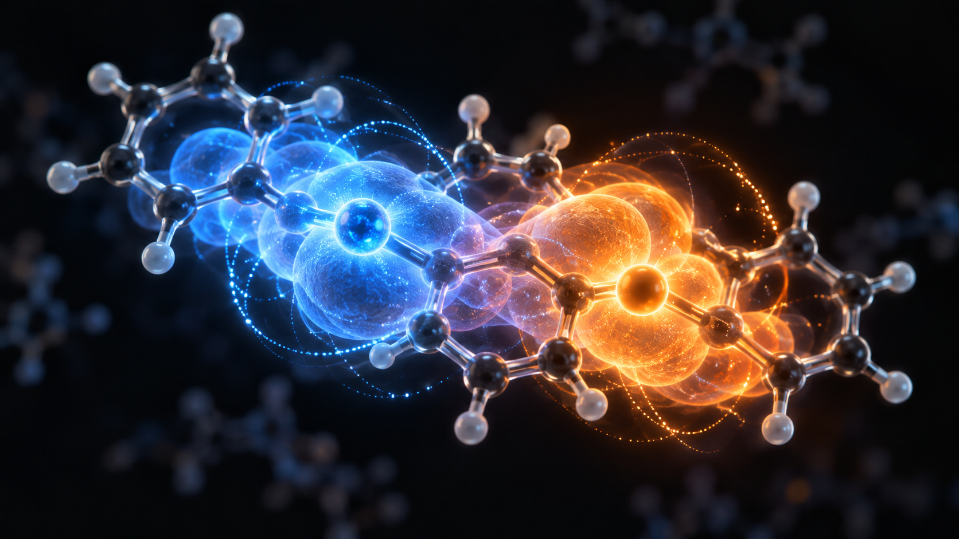
Charges meet: electron + hole → exciton
An exciton is a bound excited state, like a loose molecular “atom”
LUMO: electron-like state
HOMO: hole-like state
energy gap → colour
of emitted photon
hν = E(S₁) − E(S₀) = hc / λ
Analogy: the electron and hole are like two opposite dancers pulled together; their paired dance is the exciton.
Notes:
Define HOMO and LUMO carefully. Then say the exciton is not a real atom, but the analogy is useful: a negative electron bound to a positive hole.

Slide 5
Spin turns one exciton into two families
Coupling electron spin and hole spin gives singlet and triplet states
↑
S = 0
Singlet
1 state
electron spin ½
S
T
T
T
↓
hole spin ½
S = 1
Triplet
3 states
spin lottery
≈25% singlet
≈75% triplet
Four doors: one leads to the singlet room, three lead to the triplet room. Random exciton formation mostly creates triplets.
Notes:
Make the link to quantum mechanics: this is the same addition of two spin-one-half objects. One singlet state and three triplet projections give the famous 25/75 split.

Slide 6
Conventional fluorescence wastes most excitons
S₁ can emit easily; T₁ is spin-forbidden to S₀
Energy
S₁
Selection rule analogy: the triplet has energy to pay for a photon, but it is holding the wrong spin “passport”.
T₁
allowed
fluorescence
Result: ordinary fluorescent OLEDs can efficiently use the 25% singlet population, but triplets become a loss channel.
×
spin-forbidden
ΔS ≠ 0
S₀
Notes:
Emphasise forbidden means much less likely, not absolutely impossible. The key problem is that three-quarters of electrically generated excitons are triplets.

Slide 7
TADF builds a return route from triplet to singlet
Thermally activated delayed fluorescence
Energy
S₁
ISC
RISC
thermal climb
T₁
wait in triplet room
heat
thermal kick
S₁
back to fluorescent room
hν
photon leaves
T₁
photon
Delayed = the photon is still fluorescence from S₁ → S₀, but it appears after the exciton detours through T₁.
S₀
Notes:
Say the photon does not directly come from T1. The triplet is converted back to the singlet first. That is the recycling route.

Slide 8
Simulation 1: why ΔEₛₜ must be small
Thermal activation drops rapidly as the S₁–T₁ gap grows
At room temperature, kBT ≈ 0.026 eV. If ΔEₛₜ is only a few kBT, triplets can thermally climb back to S₁.
If ΔEₛₜ is large, the climb becomes a wall. RISC slows down and triplets are lost.
molecular target: ΔEₛₜ ≲ 0.1 eV
Notes:
Use this as a qualitative simulation. The exact RISC rate is more complex, but the Boltzmann factor explains why small energy gaps matter.

Slide 9
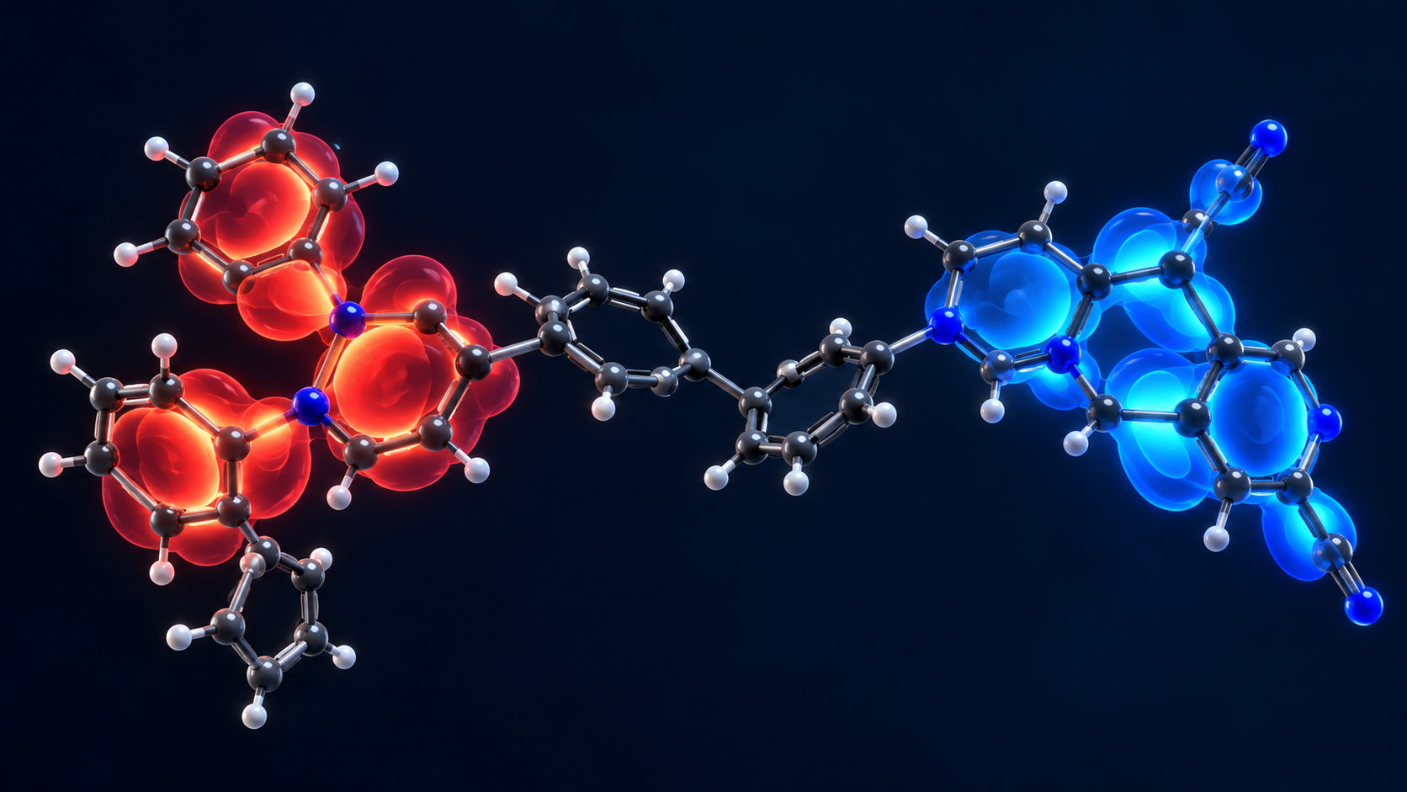
Molecular design: separate HOMO and LUMO just enough
Donor–acceptor molecules reduce exchange by reducing orbital overlap
Donor side: HOMO-rich
Accepts positive-hole character
Acceptor side: LUMO-rich
Hosts electron density
Twist/spacing lowers orbital overlap → smaller exchange integral → smaller ΔEₛₜ
ΔEₛₜ ∼ 2J and J ↓ when overlap ↓
Notes:
Explain the balance. We want HOMO and LUMO separated enough to lower exchange, but not so separated that emission becomes weak.

Slide 10
Simulation 2: the design trade-off
Orbital overlap helps emission but increases ΔEₛₜ
Too much overlap: bright transition, but ΔEₛₜ becomes too large.
Too little overlap: tiny ΔEₛₜ, but weak light emission.
Best TADF design lives in the compromise zone.
Notes:
This is a conceptual simulation, not a fitted dataset. It communicates the design tension: exchange splitting and light emission depend on orbital overlap in competing ways.

Slide 11
Simulation 3: prompt + delayed fluorescence
Delayed emission appears after triplets recycle through RISC
Prompt component: excitons already in S₁ emit quickly.
Delayed component: T₁ waits, thermally returns to S₁, then emits.
Long triplet lifetimes increase collision losses, so fast RISC is desirable.
Notes:
Point out that a delayed tail in transient photoluminescence is a signature of triplet recycling, but it must be interpreted carefully with other mechanisms ruled out.

Slide 12
Device efficiency: internal ≠ external
TADF improves exciton use, but optics and losses still matter
Internal quantum efficiency: fraction of excitons that become photons inside the device.
External quantum efficiency: photons that actually escape the OLED stack.
Roll-off: at high brightness, exciton–exciton and exciton–charge collisions reduce efficiency.
Notes:
Explain that 100% internal quantum efficiency is the ideal exciton-use limit. It does not mean every electron produces a visible photon escaping the display.

Slide 13
Good TADF molecules still need the right neighbourhood
Hosts and transport layers control where energy goes
ETL
electron transport
HOST + TADF
emitter isolated in host
HTL
hole transport
Host energy levels must confine excitons on the emitter, not steal them.
Analogy: the TADF molecule is the performer; the host is the stage, lighting, crowd control and safety barrier.
Notes:
Make clear that material design is not only a molecule problem. The host and transport layers can either support or ruin the emitter.

Slide 14
Click-through animation: charge injection
Step 1 of the mechanism
e⁻
h⁺
organic emissive layer
Electrons and holes are injected from opposite electrodes and driven toward each other.
Notes:
This slide and the next few act as a built animation. Advance slide-by-slide to show the mechanism.

Slide 15
Click-through animation: exciton formation
Step 2 of the mechanism
e⁻ + h⁺
exciton
The electron–hole pair is bound: an exciton. Now the decisive variable is spin.
Notes:
Now say: forming an exciton is not the end. It can be singlet or triplet depending on spin coupling.

Slide 16
Click-through animation: the spin lottery
Step 3 of the mechanism
S₁
25%
T₁
75% total
T₁
75% total
T₁
75% total
random formation gives one singlet door and three triplet doors
Conventional fluorescence uses the green door easily, but struggles with the three purple doors.
Notes:
Use the four-door analogy. This slide explains why OLED spin statistics are such a big issue.

Slide 17
Click-through animation: the TADF recycling route
Step 4: triplets return to singlets before emitting
heat
hν
T₁
triplet room
S₁
light room
S₀
ground
TADF does not make triplets emit directly. It converts them back into singlets, then uses ordinary fluorescence.
Notes:
End the animation by stressing the most common misconception: delayed fluorescence still comes from S1 to S0. The delay comes from time spent in T1.

Slide 18
One sentence version
Everything in the talk reduces to this chain
TADF is a quantum recycling strategy.
voltage
e⁻ + h⁺
exciton
S/T spin split
T₁ bottleneck
RISC
S₁ fluorescence
photon
Design levers: lower ΔEₛₜ, preserve oscillator strength, speed up RISC, suppress triplet losses, and engineer the host/device stack.
remember: triplets are not wasted if you can recycle them
Notes:
Close by tying the physics to device design. TADF is not magic: it is the deliberate manipulation of molecular wavefunctions and excited-state kinetics.

