Slide 1
Agile and Waterfall Methodologies
by Dhanalakshmi Tumu

Slide 2
What is methodology
A methodology refers to a system of methods, principles, and rules that guide a specific field of study, research, or practice. In essence, it is a structured approach to solving problems, completing tasks, or conducting studies. Methodologies provide a set of guidelines or a framework for organizing processes, making decisions, and achieving objectives efficiently and effectively.

Slide 3
Agile Methodology
Agile methodology is a project management and software development approach that emphasizes flexibility, collaboration, and continuous improvement. It focuses on delivering high-quality solutions through iterative processes, allowing teams to break projects into smaller, manageable increments rather than completing them all at once. Agile promotes close cooperation between cross-functional teams, including developers, testers, and stakeholders, and encourages regular customer feedback to ensure the product meets evolving requirements. By adapting to changing priorities and goals throughout the project lifecycle, Agile enables teams to respond quickly to changes and deliver value efficiently. Popular frameworks under Agile include Scrum, Kanban, and Extreme Programming (XP).

Slide 4
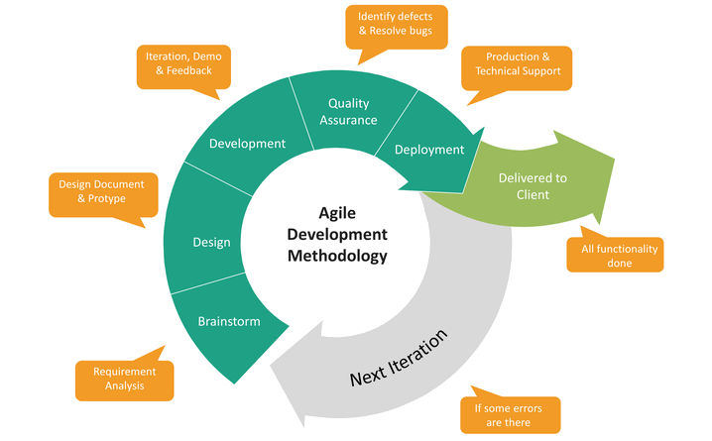
Life Cycle

Slide 5
Benefits of Agile
Flexibility and Adaptability
Faster Delivery
Improved Collaboration
Higher Customer Satisfaction
Enhanced Quality
Risk Reduction
Continuous Improvement

Slide 6
Disadvantages of Agile
Lack of Predictability
Requires High Team Involvement
Difficulty with Large Teams
Scope Creep
Limited Documentation
Not Suitable for Fixed Projects
Dependence on Skilled Teams
Potential Overheads

Slide 7
When to choose Agile
Agile methodology should be chosen when project requirements are unclear or likely to change, as it allows for flexibility and adaptation throughout the development process. It is ideal when frequent customer feedback is needed to refine the product, and when quick time-to-market is a priority. Agile also works well for projects that require high collaboration among team members and stakeholders, and for complex or uncertain projects where the scope may evolve over time. Additionally, Agile is suitable for environments where continuous improvement and frequent testing are important to maintain product quality and meet customer expectations.

Slide 8
Waterfall Methodology
Waterfall methodology is a traditional, linear approach to project management and software development, where each phase of the project is completed sequentially before moving on to the next. The process is structured and follows a clear, step-by-step progression, typically starting with requirements gathering, followed by design, development, testing, deployment, and maintenance. Each phase is distinct, and the project generally does not return to previous phases once completed. Waterfall is best suited for projects with well-defined requirements that are unlikely to change during development, making it ideal for industries with strict compliance or regulatory needs, where extensive documentation and upfront planning are essential.

Slide 9
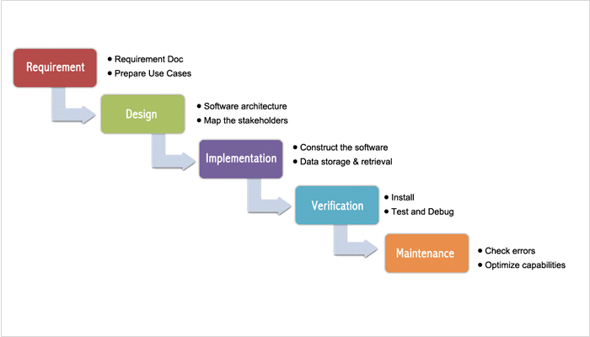
Life Cycle

Slide 10
Benefits of Waterfall
Structured and Predictable
Well-Defined Goals
Ease of Documentation
Simplicity
Effective for fixed Requirements
Early Identification of Risks
Easier Progress Tracking

Slide 11
Disadvantages of Waterfall
Inflexibility
Late Feedback
High Risk of Delays
Overemphasis on Documentation
Limited Visibility
Unsuitable for Complex Projects
Testing Comes Late
Resource Inefficiency

Slide 12
When to choose Waterfall
Waterfall methodology is best suited for projects where requirements are well-defined from the beginning and are unlikely to change throughout the development process. It is ideal for simple, straightforward projects with a clear scope and predictable outcomes. Waterfall is also preferred for projects that require strict adherence to regulatory or compliance standards, as its structured approach and emphasis on documentation ensure that all phases are thoroughly planned and executed. Additionally, Waterfall is effective when a fixed timeline and budget are essential, as it follows a linear progression with each phase completed before moving on to the next. It is most suitable when limited customer interaction is needed during development, and the focus is on completing tasks sequentially.

Slide 13
Agile vs Waterfall
Agile
Waterfall
Agile is flexible and iterative, best suited for projects with evolving requirements and frequent customer feedback. It divides work into short sprints, allowing for continuous improvement and adaptation.
Waterfall, on the other hand, follows a linear, step-by-step process with clearly defined phases, making it ideal for projects with stable, well-understood requirements and limited changes. While Agile offers flexibility and faster delivery through constant revisions, Waterfall is more structured and works best when requirements are fixed, and a detailed upfront plan is essential.

Slide 14
Conclusion
Both Agile and Waterfall methodologies have their strengths and are suited to different types of projects. Agile is ideal for projects that require flexibility, frequent feedback, and adaptability, making it perfect for dynamic and evolving environments, particularly in software development. It encourages collaboration and continuous improvement, delivering value incrementally. On the other hand, Waterfall is best for projects with well-defined requirements, where the scope is stable and predictable. Its structured, linear approach ensures thorough documentation and planning, making it suitable for industries with strict regulations or fixed timelines. Ultimately, the choice between Agile and Waterfall depends on the project’s complexity, requirements, and the need for flexibility or predictability.

Slide 15
Thank You

