Slide 1

Guided by
Dr.A.Maheshbabu
HOSPITAL MANAGEMENT SYSTEM
A Java-Based Application Using Data Structures KL University | 2025-26
P.Dhanalakhsmi-2510030312
V.shlokasree-2510030220
A.Harishitha-2510030212
Guided by Dr.A.Maheshbabu

Slide 2
Project Overview
🏥 What is it?
A console-based Hospital Management System built in Java.
⚙️ Core Technology
Uses Arrays, Linked Lists (Patient History), Stack (Undo Billing), Queue (Patient Queue), QuickSort.
💾 Data Persistence
Patient data stored and reloaded from file.

Slide 3
System Architecture & Data Structures
Arrays
Patient IDs, names & bills
Linked List
Patient transaction history
Stack
Undo billing operations
Queue
Patient service order
QuickSort
Sort patients by bill amount

Slide 4
Features & Operations
1 ➕ Add Patient
2 💰 Generate Bill
3 💸 Update Bill
4 ↩️ Undo Last Billing
5 📋 Add Patient to Queue
6 ✅ Process Patient
7 📊 Display All Patients
8 🔢 Sort Patients by Bill
9 📜 Show Patient History
10 🚪 Exit

Slide 5
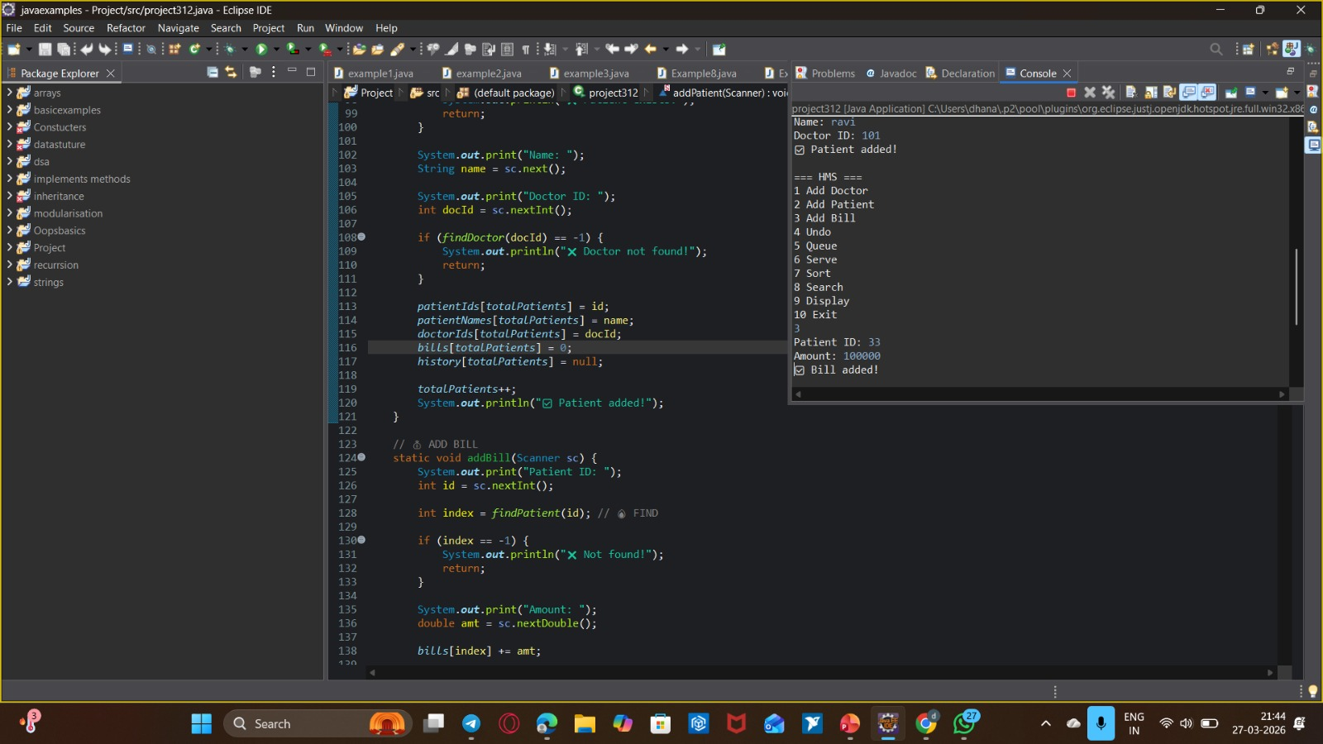
Operation 1: Add Patient — Code
addPatient() method — Java

Slide 6
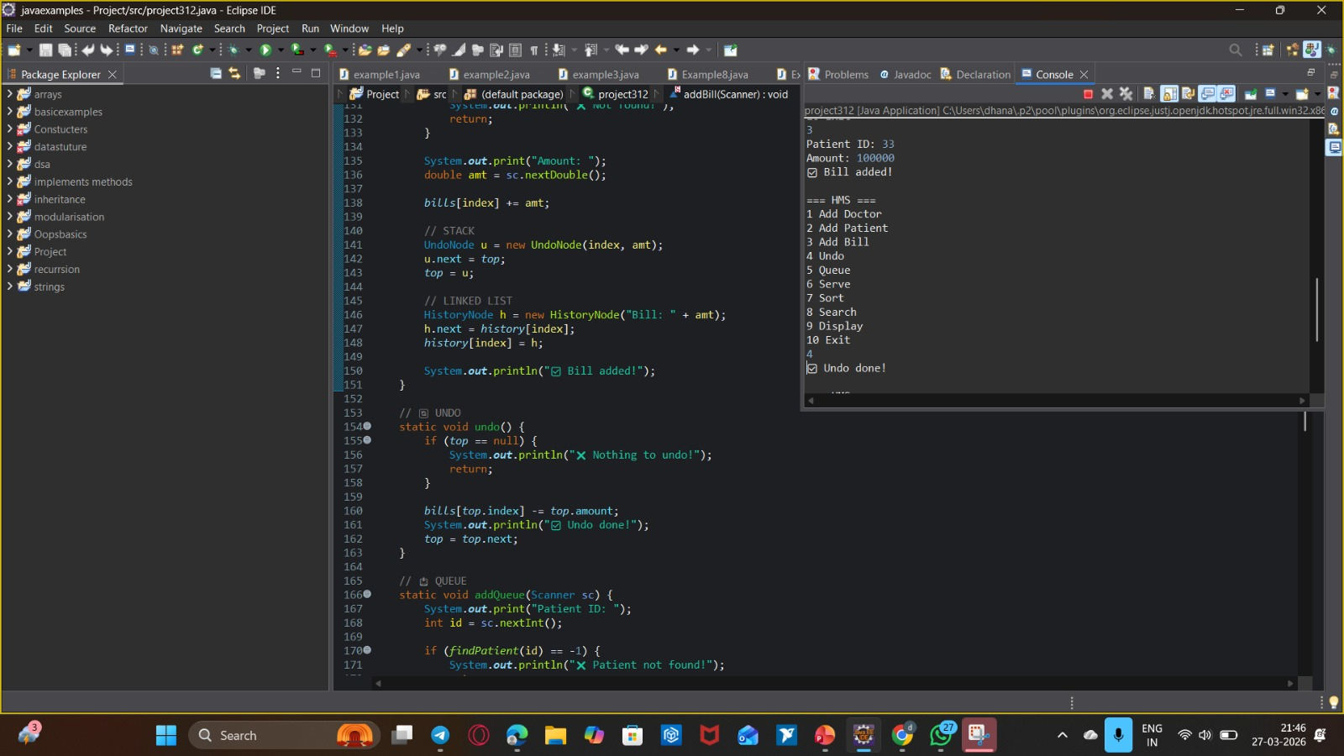
Operation 1: Add Patient — Output

Slide 7
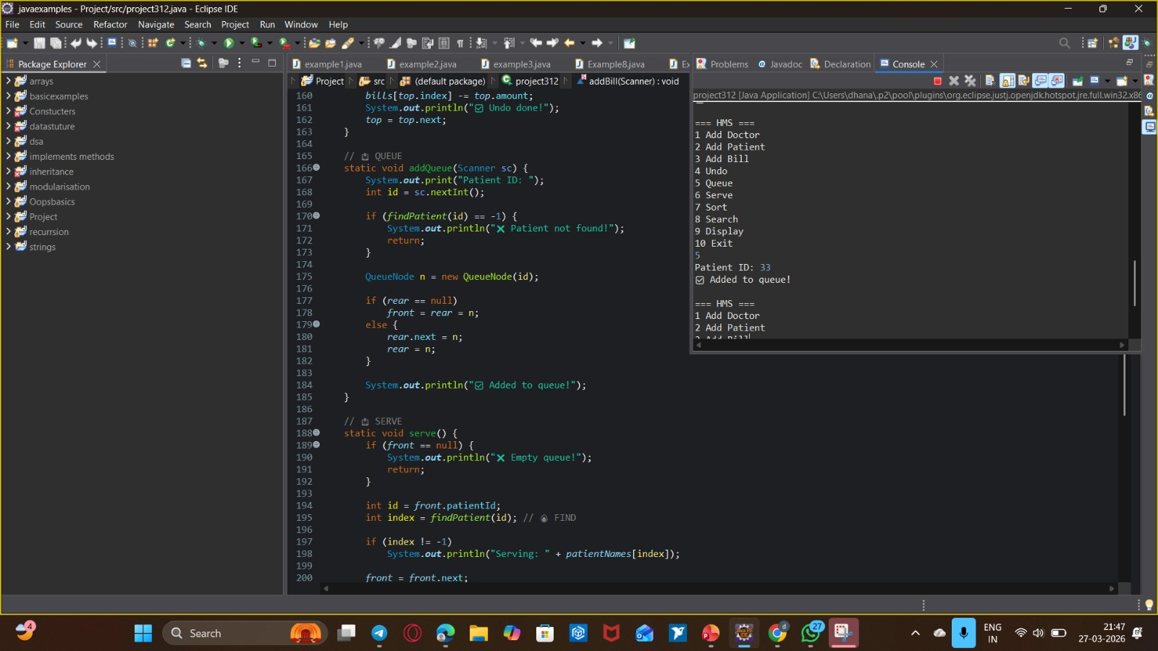
Operations 2 & 3: Billing — Code
generateBill() & updateBill() methods — Java

Slide 8
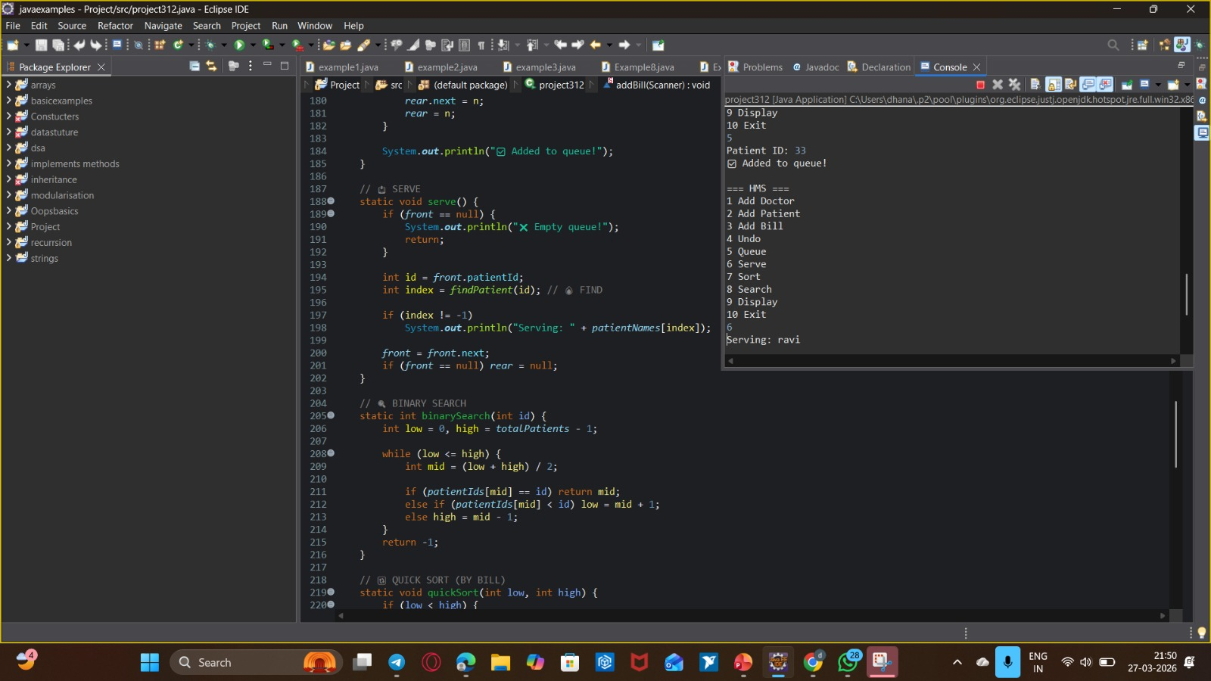
Operations 4, 5 & 6: Undo / Queue — Code
Stack (Undo Billing) & Queue (Patients) — Java

Slide 9
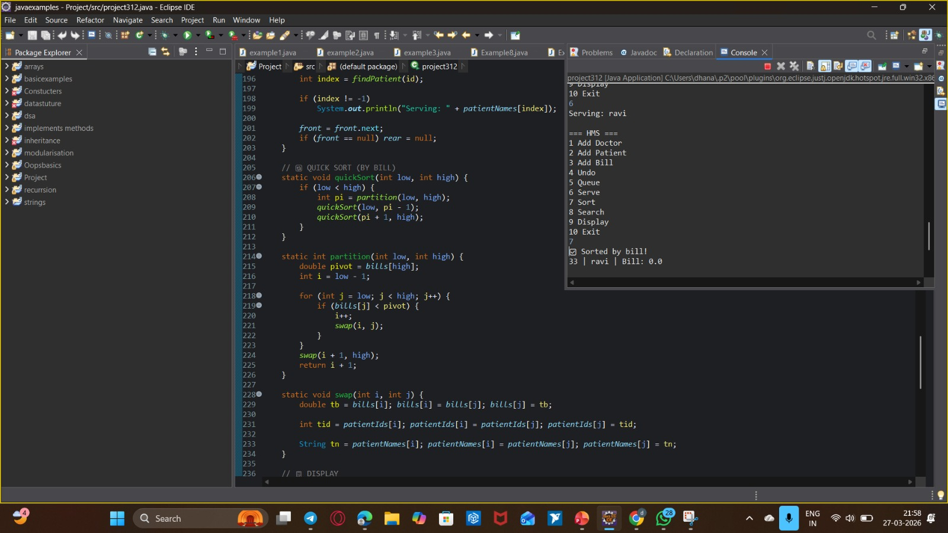
Data Structure Definitions
PatientNode, UndoNode, QueueNode — Java classes

Slide 10
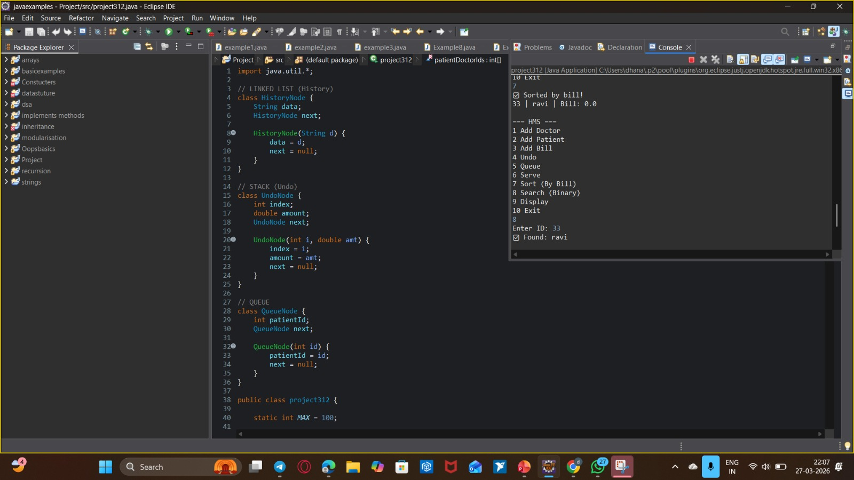
Sorting Patients — QuickSort Code
quickSort() & partition() — Java

Slide 11
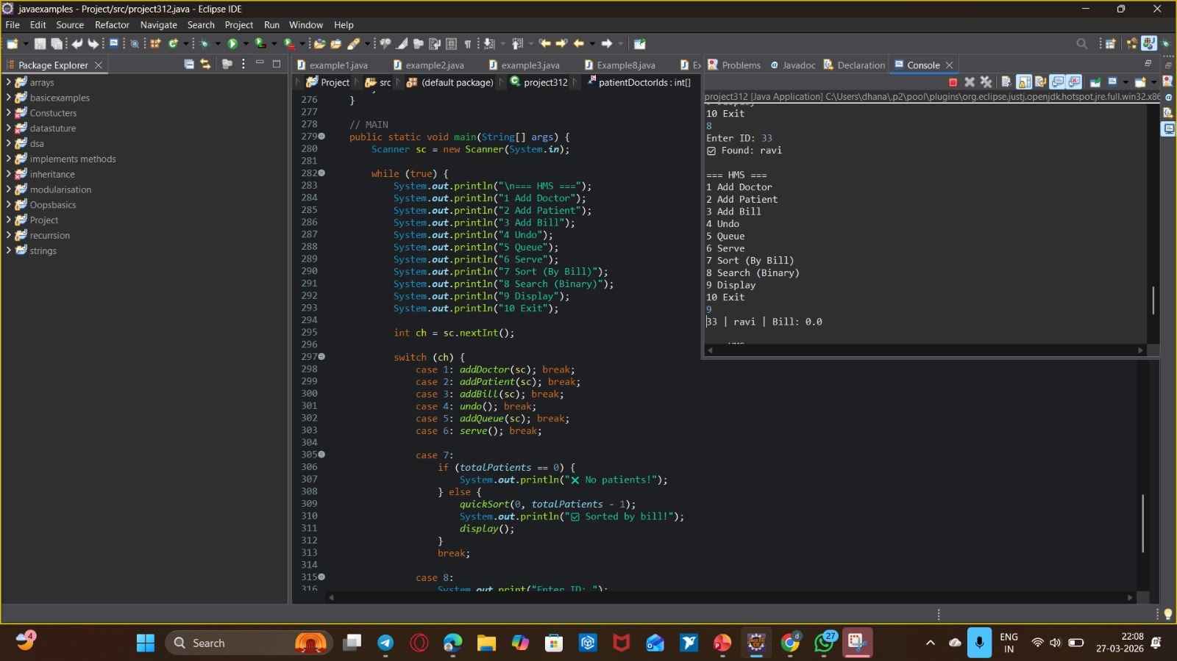
Data Persistence
loadData() — reads patient data from file

Slide 12
Conclusion & Learnings
📚 Applied DSA concepts
💾 File handling for persistence
🔍 Efficient searching
🚀 Handles edge cases
✅ Implemented 10 hospital operations

