Slide 1

Department of Computer Science and Engineering
(Cyber Security)
CS23533– Foundations of Artificial Intelligence
2026-2027
AI-Based Smart Patient Referral and Hospital Selection System
Bharath V -
241901018
Dhanalakshmi C -
241901023
Dr Bhuvana S,
Assistant Professor SG

Slide 2
Problem Statement and Motivation
Referral is two decisions in one: which specialty the patient needs, and which hospital can actually provide it
Nearest is not always right: a close hospital may lack the required specialty or emergency capability
Information is scattered: services, staffing and resources sit in different places, so choices are inconsistent
Time matters: chest pain or stroke symptoms need fast routing, not trial and error
Motivation: a transparent, explainable pipeline from symptoms to a ranked hospital
2 decisions
specialty + hospital
5 factors
match · resources · emergency · specialists · distance
4 roles
patient · caretaker · hospital · admin

Slide 3
Objectives
Collect patient details, address and symptoms through a structured, validated form
Infer the required medical specialty from symptoms using transparent, weighted rules
Locate the patient and estimate distance to each hospital (Haversine)
Rank hospitals on specialty match, resources, emergency facilities and distance
Generate a referral and give the patient a route to the chosen hospital
Support patient, caretaker, hospital and admin workflows with reporting

Slide 4
Abstract
Referral needs more than a specialty label: the receiving hospital must also have the right services, emergency resources, staff and a reasonable distance.
This project is a browser-based prototype that links patient intake, rule-based symptom-to-specialty inference, hospital evaluation, distance estimation and referral generation.
Predefined symptom weights and existing-condition matches rank candidate specialties; the output carries a reason listing the matched symptoms.
Hospitals receive a score out of 100, and the patient gets a route map. Role-based screens and reports complete the workflow.
It is a proof of concept for classical AI, not a clinically validated diagnostic or triage tool.

Slide 5
Literature Survey
S. No. | Author(s) & Year | Paper Title | Methodology / Algorithm | Limitations
1 | Chi, Street & Ward (2008) | Hospital referral expert system (prediction + optimization) | ML classifiers + optimization | Needs labelled data; black-box
2 | Abdel-Hafez et al. (2023) | AI referral triage using Clinical Prioritization Criteria | ML text classification of referral letters by urgency | Moderate accuracy (53.8%); ENT only; not explainable
3 | Määttä et al. (2023) | CDSS for triage in a hospital emergency department | Web form self-entry CDSS vs. physicians | Modest diagnosis accuracy; triage only, not hospital selection

Slide 6
Literature Survey
S. No. | Author(s) & Year | Paper Title | Methodology / Algorithm | Limitations
4 | Omotosho et al. (2016) | Patient-based hospital referral DSS | Multi-attribute provider selection (14 criteria) | No symptom/urgency analysis; no live availability or tracking
5 | Semigran et al. (2015) | Evaluation of online symptom checkers | Audit of 23 symptom checkers, 45 vignettes | Weak diagnosis (34%) and triage (57%); no hospital selection

Slide 7
Research Gap/Existing System
1. What existing studies do
Decision-support reviews and a hospital referral expert system use rules, statistics and optimisation to guide clinical or referral choices [1]–[4].
2. Limitations observed
Rule-based methods depend on matched conditions [3]; benefits vary and clinical effects are small [2]; explanations are debated [5].
3. Research gap
Few simple, explainable systems join symptom-to-specialty inference with hospital ranking, distance and roles in one visible workflow.
4. How our project responds
One pipeline: weighted symptom rules → specialty → hospital score → referral and route, with matched symptoms shown as the reason.

Slide 8
Proposed System
Rule-based AI: 21 tick-box symptoms and 6 existing conditions are scored against 5 specialties
Explainable: the reason lists the exact symptoms that matched
Multi-criteria ranking: 5 sample hospitals scored out of 100
Location aware: Chennai area dictionary, Nominatim fallback, Haversine distance
Human in the loop: a caretaker reviews and generates the referral
Route guidance: OSRM route options plus a Google Maps live-traffic link
Symptoms + conditions
Specialty + reason
Hospital score /100
Referral + route

Slide 9
DFD Diagram
Patient
details
1. Login, Intake & Geocoding
Process
save
D1 Patient Registry
Data store
Caretaker
review
2. Rule-Based Symptom Analysis
External entity
DFD Level 1
Hospital
3. Hospital Evaluation & Ranking
D2 Hospital Records
Admin
facility info
hospital data
reports
4. Referral Generation & Routing
store
D3 Referrals
5. Reports & Dashboard
referral queue

Slide 10
Methodology/Work Flow Diagram
1 Register / Login
2 Patient Intake
3 Geocode
4 AI Analysis
5 Evaluate
6 Refer & Route
Patient registers with phone + password; roles log in with ID
Age, gender, pain hours, emergency level, area, symptoms, conditions
Area looked up locally, else Nominatim; coordinates saved
Weighted symptom rules give specialty, severity and reason
Each hospital scored out of 100 and sorted
Top hospital stored as REF-ID; route map for the patient
Caretaker loop: urgent (Critical / High) unassigned patients appear first; a caretaker clicks Take Patient, runs the analysis and approves the referral; the hospital then sees the patient in its queue with distance in km.

Slide 11
Tools and Technologies
Programming languages, frameworks, software, hardware, and datasets
Languages
HTML5 · CSS3 · JavaScript (ES6)
UI Libraries
Font Awesome 6.5 · Google Fonts (Inter, Manrope) · liquid-glass CSS theme
Maps & Location
Leaflet 1.9.4 · OpenStreetMap tiles · Nominatim geocoding · OSRM routing
Algorithms
Weighted keyword rules · multi-criteria scoring · Haversine distance
Storage
Browser localStorage (patients, referrals, counters); demo only
Hardware & Data
Any modern browser; 5 sample hospitals, 8 caretakers, 12 synthetic patients

Slide 12
List of Modules
1
Patient Data Collection
login, registration, intake, geocoding
2
Rule-Based AI Analysis
symptoms to specialty, severity, reason
3
Hospital Evaluation & Ranking
distance and score out of 100
4
Referral & Route Guidance
referral record and route map
5
Caretaker, Hospital & Admin Portals
patient lists, queues, reports

Slide 13
Module Description (1–3)
Module | What it does | Input → Output
1. Patient Data Collection | Four role logins; patients self-register with a phone number and password. Intake form takes age, gender, hours of pain, emergency level, Chennai area, 21 symptom tick-boxes, free text and 6 existing conditions. The area is geocoded from a built-in Chennai dictionary, else Nominatim. | Credentials, form data, address → saved patient record with coordinates
2. Rule-Based AI Analysis | detectDisease() adds the weights of matched symptoms for each specialty (bonus for heart disease, high BP, asthma) and picks the top one. Falls back to General Medicine when nothing matches. | Symptoms, conditions → condition, specialty, severity, reason
3. Hospital Evaluation & Ranking | Haversine distance to each hospital. Score = specialty (40 match / 10 partial) + 0.25 × resources + emergency (15 / 10 / 4) + max(0, 15 − km), capped at 100. | Specialty, hospital records, location → ranked list

Slide 14
Module Description (4–5)
Module | What it does | Input → Output
4. Referral & Route Guidance | The top-ranked hospital is stored as a referral (REF-0001 style) and linked to the patient. The patient portal shows a Leaflet map with OSRM routes labelled Fastest, Shortest or Alternative, plus a Google Maps live-traffic link. | Best hospital, patient and hospital coordinates → referral record, route options
5. Caretaker, Hospital & Admin Portals | Caretaker sees own and new patients (urgent first) and can take a patient. Hospital sees its referred patients with distance, and its referral queue. Admin sees 8 caretaker and 5 hospital accounts, assignments and reports. | Roles → patient lists, queues, reports

Slide 15
Results & Discussion
Hospital scores for P001 (chest pain, sweating; Anna Nagar; High)
Worked cases from the 12 synthetic seed patients
Patient | Symptoms | Specialty | Top hospital (score)
P001 | chest pain, sweating | Cardiology | Apollo (94)
P002 | persistent cough, wheezing | Pulmonology | Care Plus (73)
P003 | face droop, slurred speech | Neurology | Sri Lakshmi (88)
Reading the result: the cardiac case ranks Apollo first because it matches the specialty, has a 24/7 emergency unit and the highest resources. No clinical accuracy has been measured.
Computed with the app's scoring formula on the synthetic seed patient.

Slide 16
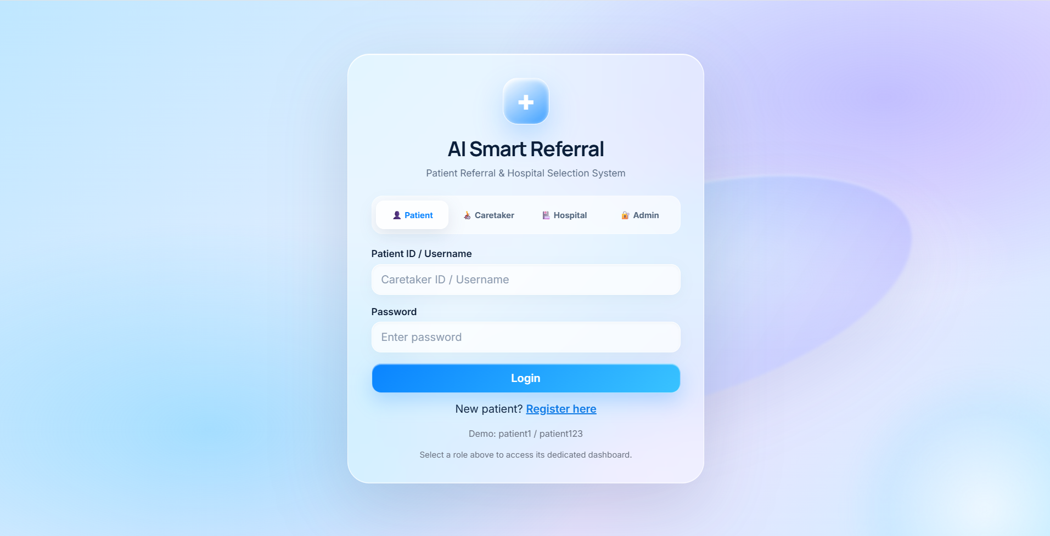
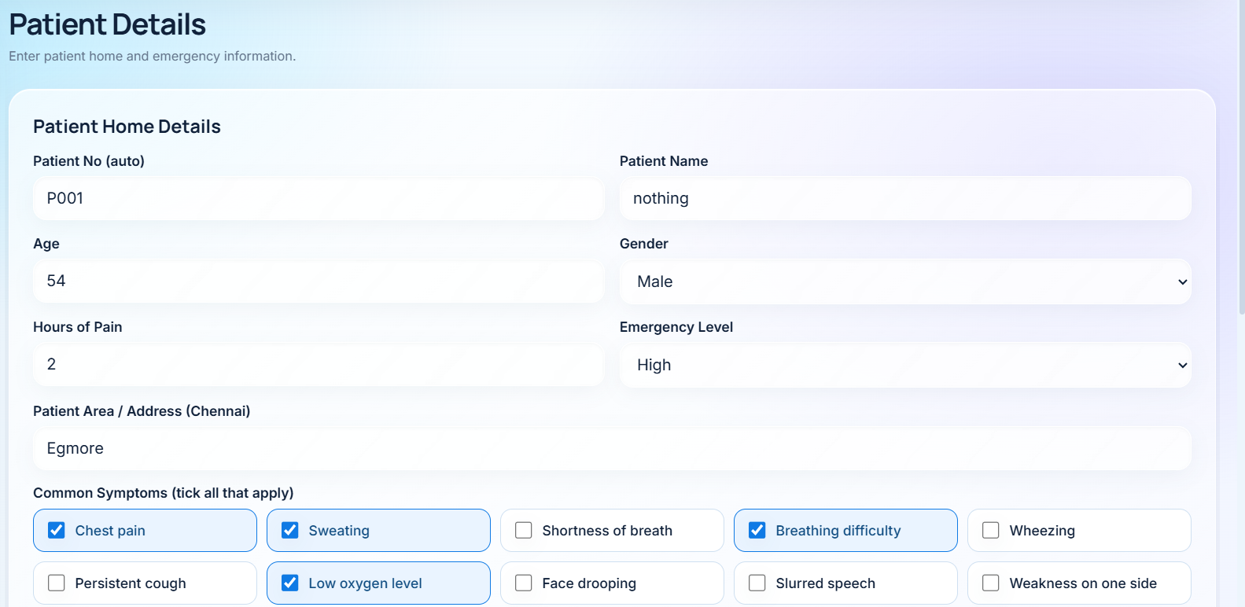
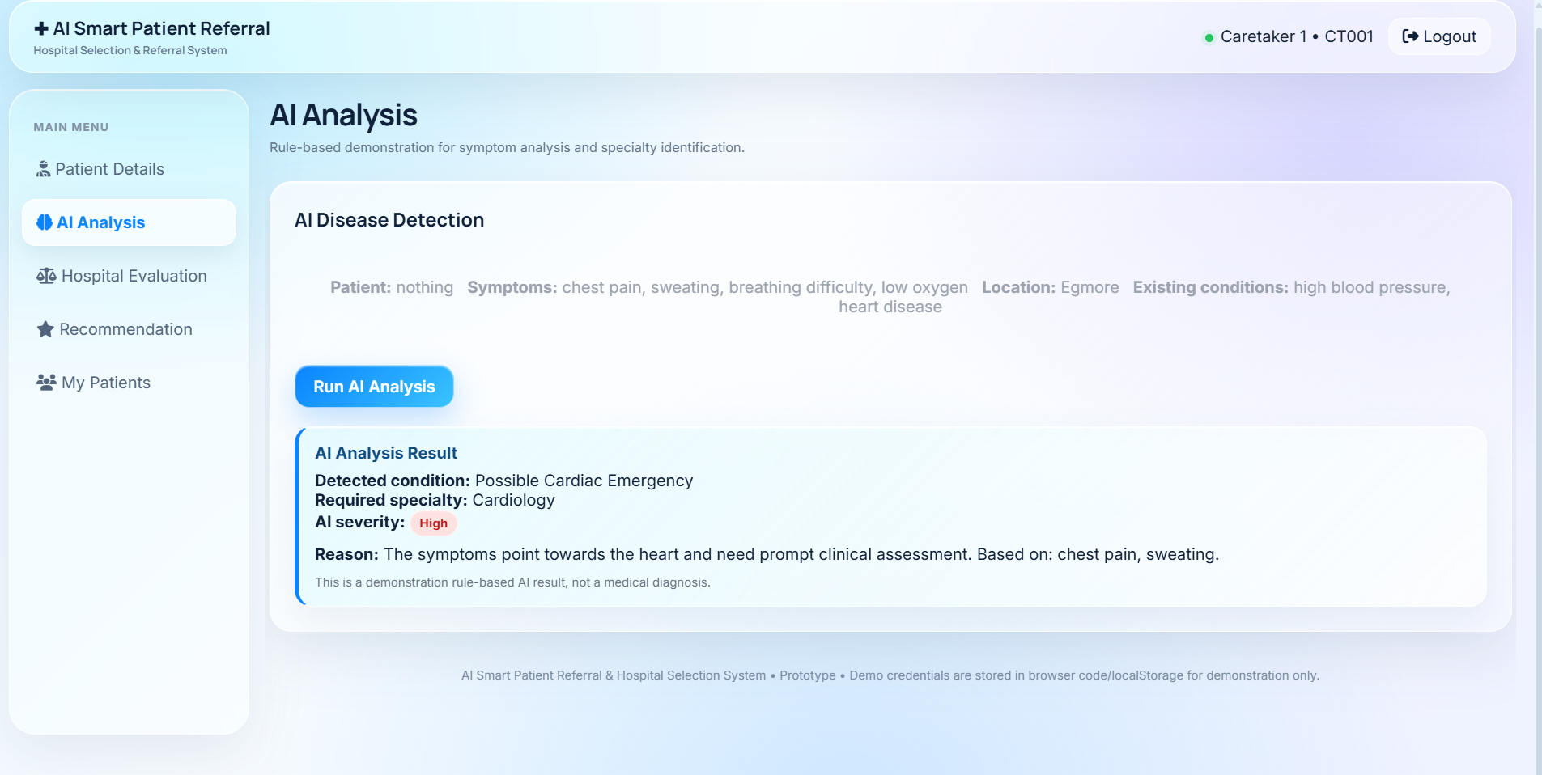
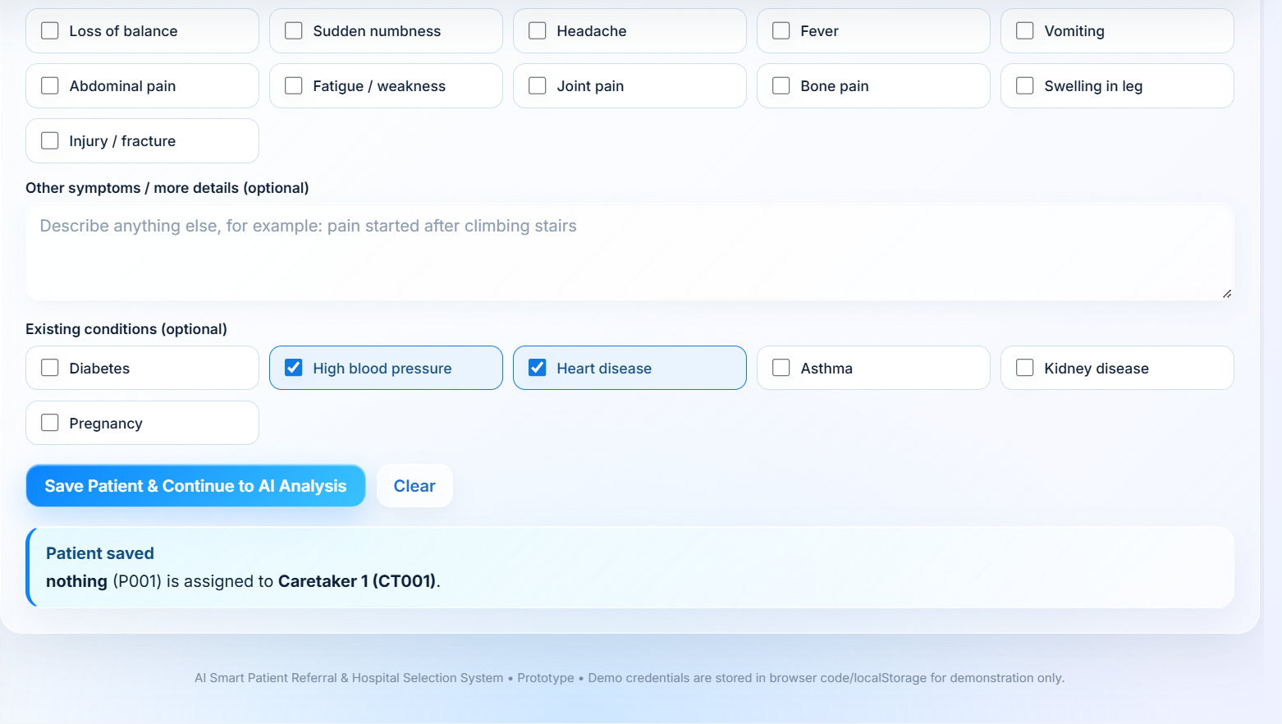
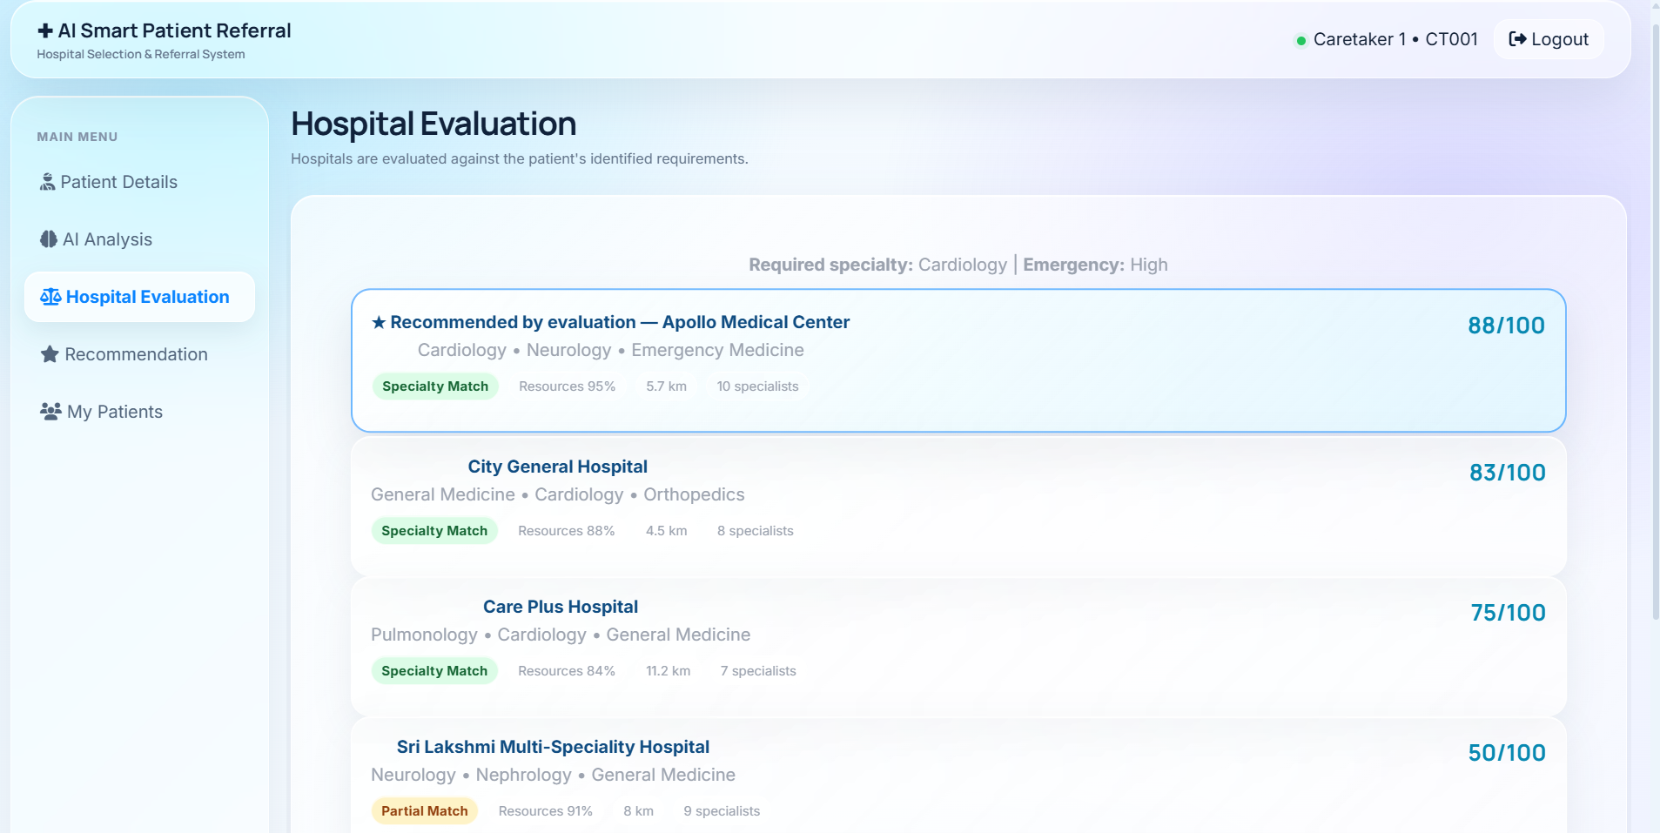
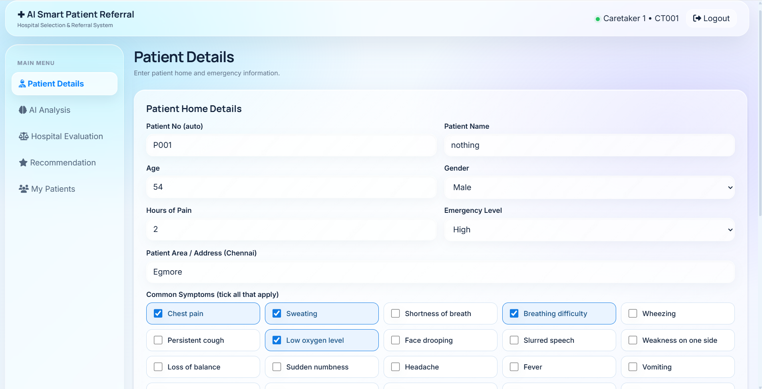
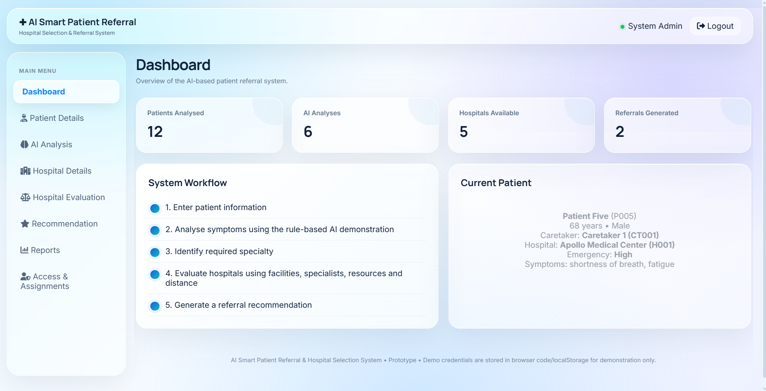
User Interface/ Screenshots
Insert screenshot
Insert screenshot
Insert screenshot
Login with role tabs
Patient details form
AI analysis result
Insert screenshot
Insert screenshot
Insert screenshot
Hospital evaluation ranking
Caretaker dashboad
Admin dashboard

Slide 17
Conclusion
Built a working browser prototype that goes from symptoms to a specialty, a ranked hospital, a referral and a route
Rule-based inference with visible matched symptoms keeps every recommendation inspectable
Hospital scoring combines specialty match, resources, emergency facilities and distance in one score out of 100
Four role-based portals show how patients, caretakers, hospitals and admins share one workflow
It is a proof of concept: no clinical dataset, accuracy figure or outcome benefit is claimed

Slide 18
Future Work
Clinician-reviewed rules, with negation handling (for example, “no chest pain”) and an “insufficient information” state
Hard eligibility constraints so a nearby hospital without the needed service never outranks a suitable one
Live hospital data and a secure backend with server-side authentication, audit logs and a shared database
Road-distance and travel-time ranking instead of straight-line distance
Evaluation against a clinician-labelled reference set, plus usability and safety testing
Compare the rule-based baseline with a validated machine-learning model

Slide 19
References
[1] Chi, C.-L., Street, W. N., & Ward, M. M. (2008). Building a hospital referral expert system with a prediction and optimization-based decision support system algorithm. Journal of Biomedical Informatics, 41(2), 371–386. https://doi.org/10.1016/j.jbi.2007.10.002
[2] Abdel-Hafez, A., Jones, M., Ebrahimabadi, M., Ryan, C., Graham, S., Slee, N., & Whitfield, B. (2023). Artificial intelligence in medical referrals triage based on clinical prioritization criteria. Frontiers in Digital Health, 5, Article 1192975. https://doi.org/10.3389/fdgth.2023.1192975
[3] Määttä, J., Lindell, R., Hayward, N., Martikainen, S., Honkanen, K., Inkala, M., Hirvonen, P., & Martikainen, T. J. (2023). Diagnostic performance, triage safety, and usability of a clinical decision support system within a university hospital emergency department: Algorithm performance and usability study. JMIR Medical Informatics, 11, e46760. https://doi.org/10.2196/46760
[4] Omotosho, A., Adegbola, O., & Adebo, A. (2016). A patient-based hospital referral decision support system. International Journal of Computer Applications, 155(10), 38–43. https://doi.org/10.5120/ijca2016912459
[5] Semigran, H. L., Linder, J. A., Gidengil, C., & Mehrotra, A. (2015). Evaluation of symptom checkers for self diagnosis and triage: Audit study. BMJ, 351, h3480. https://doi.org/10.1136/bmj.h3480

Slide 20
Thank You

