Slide 1

Department of Computer Science and Engineering
(Cyber Security)
CS23533– Foundations of Artificial Intelligence
2026-2027
AI BASED-SMART PATIENT REFERRAL AND HOSPITAL SELECTION SYSTEM — REVIEW 2
Bharath V -
241901018
Dhanalakshmi C -
241901023
Dr Bhuvana S,
Assistant Professor SG

Slide 2
Problem Statement and Motivation
Problem: Difficulty in matching patients with suitable hospitals based on their medical needs and available facilities.
Importance: Delays and incorrect referrals can affect timely treatment, especially during emergencies.
Affected Stakeholders: Patients who need quick and appropriate medical care.
Motivation: To develop a reliable system that recommends suitable hospitals using patient details and current hospital resources.

Slide 3
Objectives
Identify patient specialty and urgency using rule-based reasoning.
Recommend suitable hospitals based on medical needs and available resources.
Provide explainable recommendations and referral tracking.
Validate system functionality using synthetic data and scenario-based testing.
Expected Outcome: A working prototype for hospital recommendations and referral management.
Completion Status: Specify the features implemented and tested so far.

Slide 4
Project Progress Since Review 1
Work Completed After Review 1
Completed Modules 3, 4 and 5.
Integrated AI analysis, hospital ranking and referral workflow.
Created synthetic patient and hospital data.
Passed 9 scenario-based tests.
Measured AI analysis and ranking response times.
Completed core implementation; final documentation and presentation preparation remain.

Slide 5
Literature Survey
S. No. | Author(s) & Year | Paper Title | Methodology / Algorithm | Limitations
1 | Chi, Street & Ward (2008) | Hospital referral expert system (prediction + optimization) | ML classifiers + optimization | Needs labelled data; black-box
2 | Abdel-Hafez et al. (2023) | AI referral triage using Clinical Prioritization Criteria | ML text classification of referral letters by urgency | Moderate accuracy (53.8%); ENT only; not explainable
3 | Määttä et al. (2023) | CDSS for triage in a hospital emergency department | Web form self-entry CDSS vs. physicians | Modest diagnosis accuracy; triage only, not hospital selection

Slide 6
Literature Survey
S. No. | Author(s) & Year | Paper Title | Methodology / Algorithm | Limitations
4 | Omotosho et al. (2016) | Patient-based hospital referral DSS | Multi-attribute provider selection (14 criteria) | No symptom/urgency analysis; no live availability or tracking
5 | Semigran et al. (2015) | Evaluation of online symptom checkers | Audit of 23 symptom checkers, 45 vignettes | Weak diagnosis (34%) and triage (57%); no hospital selection

Slide 7
Research Gap and Project Response
1. Literature findings
Previous studies explored hospital selection, referral triage, and symptom-based decision support.
2. Limitations
Dependence on labelled data, limited transparency, and lack of integrated referral tracking and live availability in the reviewed abstracts.
3. Refined research gap
Need for an explainable system integrating symptom analysis, hospital ranking, availability updates, and referral tracking.
4. Progress toward the solution
Implemented and tested the hospital recommendation system using synthetic data.

Slide 8
System Architecture / Proposed System
Frontend: HTML, CSS, JavaScript — role-based dashboards.
Backend: Node.js, Express — rule-based analysis, hospital ranking, and referral workflow.
Database: SQLite — stores users, hospitals, and referral history.
External Services: OpenStreetMap and OSRM — maps and road routes.
Data Flow: Patient details → Symptom analysis → Hospital ranking → Caretaker confirmation → Hospital response → Referral completion.
Improvements: Explainable recommendations, updated hospital availability, transparent scoring, and complete referral tracking compared with conventional referrals.

Slide 9
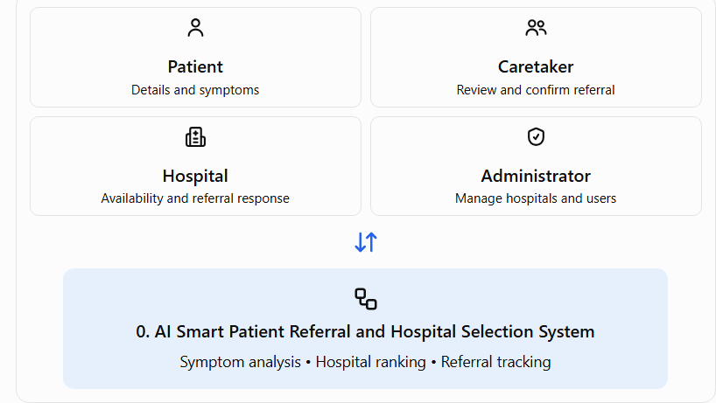
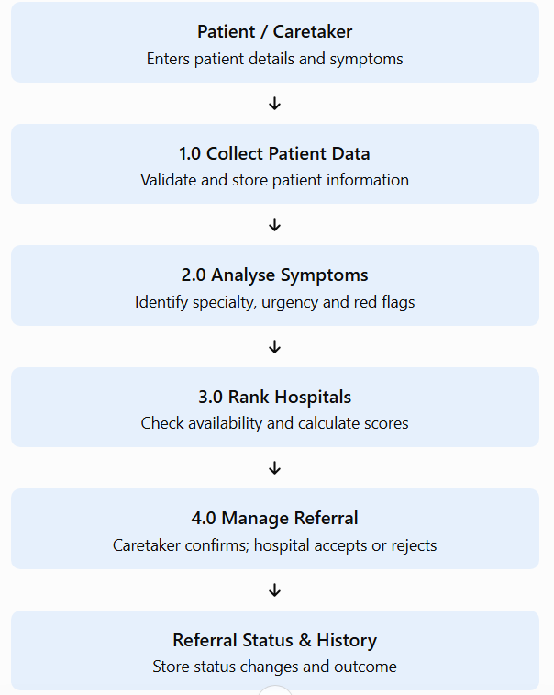
DFD Diagram
LEVEL 0
LEVEL 1

Slide 10
Methodology / Workflow Diagram
Input: Collect patient details, symptoms, and location.
Preprocessing: Validate inputs and normalize symptoms.
Analysis: Apply rule-based reasoning to identify specialty and urgency.
Ranking: Score and rank hospitals based on medical needs and availability.
Implementation: Integrate the web interface, backend, and database.
Testing & Evaluation: Verify functionality using 9 scenario tests and synthetic data.
Output: Explainable hospital recommendations and tracked referrals.

Slide 11
Tools and Technologies
Programming language(s):JavaScript, HTML5, CSS3
Frameworks / libraries:Node.js, Express.js, SQLite, Leaflet
Software:Windows 10/11, npm, Chrome/Edge
Hardware: Dual-core 2 GHz CPU, 4 GB RAM, 500 MB storage
Dataset: Synthetic patient and hospital data
Justification: Lightweight, cost-effective tools support web development, local data storage, hospital ranking, and map visualization.

Slide 12
List of Modules
The system has five modules.
Patient Data Collection — Completed
Patient Requirement Analysis (Rule-Based AI) — Completed
Hospital Evaluation and Ranking — Completed
Referral Recommendation and Explanation — Completed
Hospital Administration and Database Management — Completed

Slide 13
Module Implementation – Part 1
Module 1 – Patient Data: Collect details and register users.
Module 2 – Rule-Based AI: Analyze symptoms and identify specialty and urgency.
Module 3 – Hospital Ranking: Rank hospitals using a weighted score out of 100.
Module 4 – Referral Management: Create referrals and track status.
Module 5 – Administration: Manage hospitals, users and database records.

Slide 14
Module Implementation – Part 2
Module Interaction & Workflow
Flow: Patient Data → AI Analysis → Hospital Ranking → Referral → Administration
Key Logic: Analyze symptoms, calculate hospital scores, validate referrals and update status.
Interaction: Hospital availability updates affect subsequent rankings.
Status: All five modules implemented.
Testing: 9 scenario tests passed using synthetic data.

Slide 15
Preliminary Results and Discussion
Testing: 9/9 scenario tests passed.
AI Analysis: Correct expected specialty in 5 symptom scenarios.
Hospital Ranking: Weighted scoring and availability updates worked as expected.
Referral Workflow: Confirmation, acceptance and rejection tested successfully.
Performance: Analysis and ranking averaged 0.14 ms.
Baseline: Supports dynamic ranking and referral tracking beyond a static directory.
Limitation: Synthetic data; clinical accuracy not validated.

Slide 16
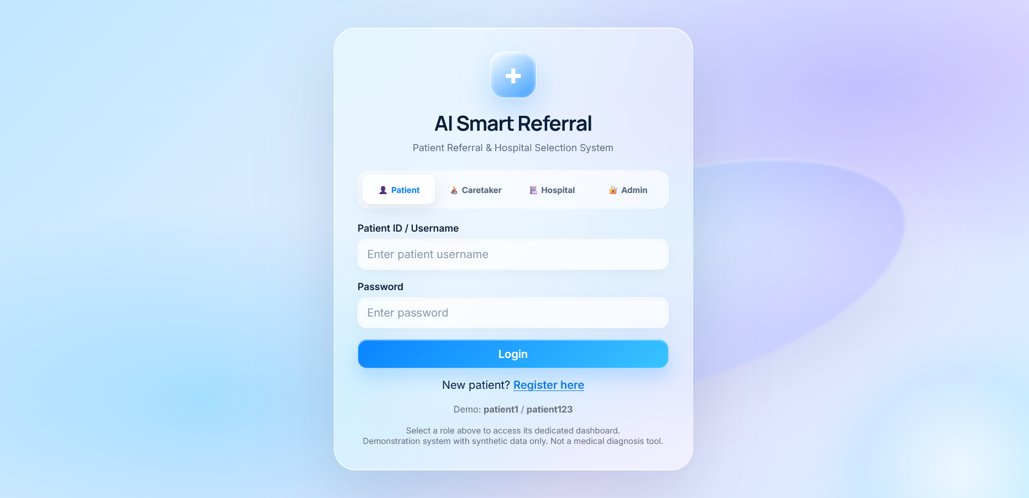
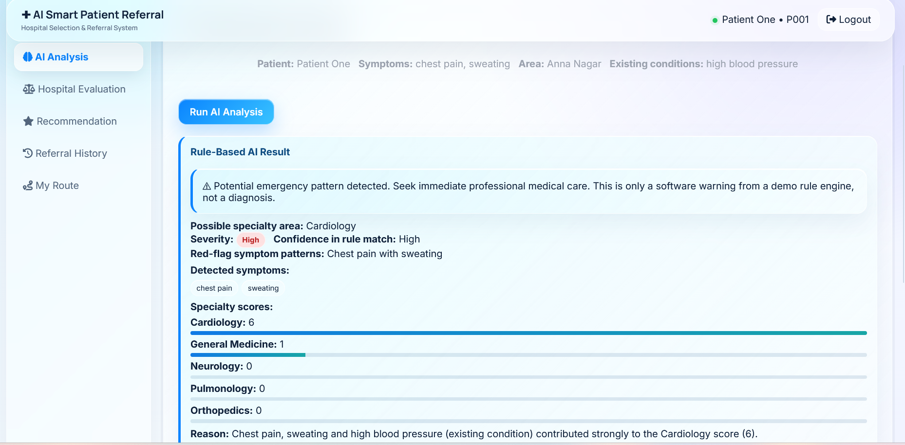
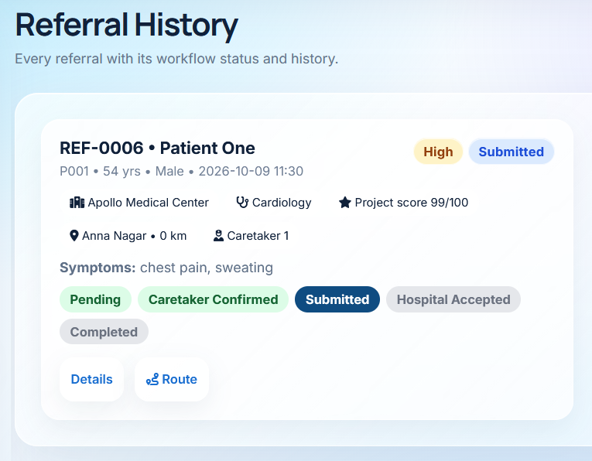
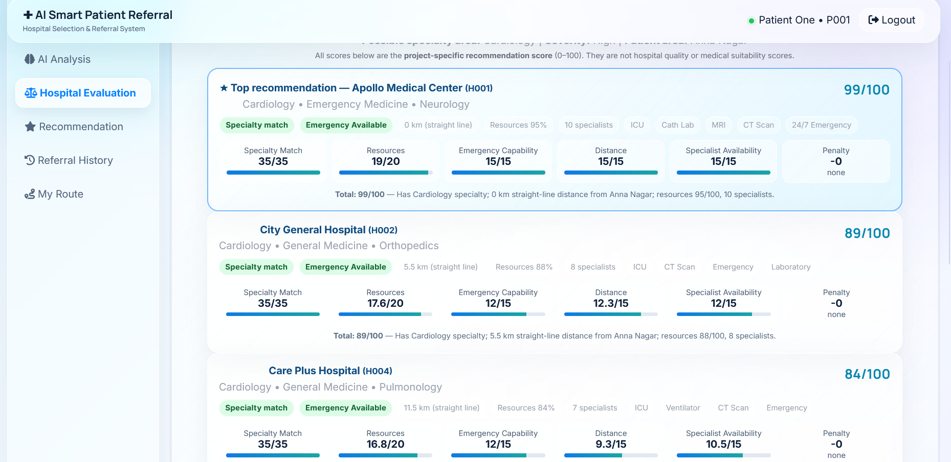
User Interface / Implementation Screenshots
AI Analysis
Referral History
Login Page

Slide 17
Challenges Faced and Solutions
Map Integration: Used OpenStreetMap/OSRM with an offline fallback.
Distance Accuracy: Uses straight-line distance, not road distance or live traffic.
Rule-Based AI: Unrecognized symptoms return “Insufficient information.”
Data & Scalability: Synthetic data; concurrent load and scalability remain untested.
Database: Basic migration support; full schema versioning remains pending.

Slide 18
Work Plan Until Final Review
Milestone 1: Final system testing and bug fixes
Milestone 2: Evaluate results and document limitations
Milestone 3: Complete project report and screenshots
Milestone 4: Prepare slides and rehearse demo
Status: Core implementation and scenario testing completed.

Slide 19
References
References
Chi, Street & Ward — Machine Learning and Hospital Selection.
Abdel-Hafez et al. — Machine Learning for Referral Triage.
Määttä et al. — Emergency Department Decision Support.
Omotosho et al. — Multi-Criteria Healthcare Provider Selection.
Semigran et al. — Evaluation of Online Symptom Checkers.
Node.js, Express.js, SQLite, Leaflet and OpenStreetMap/OSRM documentation.
Citation Style: IEEE

Slide 20
Thank You

