Slide 1

Department of Cyber Security
2026-2027- Odd Semester
III Year /V Sem
CS23533-FOUNDATIONS OF ARTIFICIAL INTELLIGENCE
Zeroth Review – 05.08.2026

Slide 2
AI-Based Smart Patient Referral and Hospital Selection System
Batch Members :
1. Name: Dhanalakshmi C 241901023
2. Name: Bharath V 241901018
Supervisor:
Dr. S.Bhuvana
^{Assistant Professor[SG]}

Slide 3
OUTLINE
Abstract
Objective
Literature Survey
Summary of Literature
Proposed System & Novelty
Block Diagram
Hardware/Software requirements
References

Slide 4
ABSTRACT
Healthcare providers often face challenges in referring patients to the right hospital during emergencies due to differences in medical specialties, treatment facilities, resource availability, and patient conditions. This project proposes an AI-Based Smart Patient Referral and Hospital Selection System that uses classical AI techniques to analyze patient symptoms, identify healthcare requirements, and recommend the most suitable hospital based on specialist availability, medical facilities, resource availability, and travel distance. By applying knowledge-based reasoning, Best-First Search, and Constraint Satisfaction, the system aims to improve referral accuracy, reduce treatment delays, and support efficient and explainable healthcare decision-making.

Slide 5
OBJECTIVE
Develop an AI-based patient referral system.
Analyze patient symptoms and healthcare requirements.
Identify the required medical specialty.
Recommend the most suitable hospital.
Reduce patient referral delays.
Optimize healthcare resource utilization

Slide 6
Literature Survey
TITLE | YEAR | AUTHOR | TECHNIQUE
Building a Hospital Referral Expert System with a Prediction and Optimization-Based Decision Support System Algorithm | 2008 | Chih-Lin Chi, W. Nick Street, Marcia M. Ward | Expert System, Decision Support
Artificial Intelligence in Medical Referrals Triage Based on Clinical Prioritization Criteria | 2023 | Abdel-Hafez et al. | AI-Based Referral Triage
Diagnostic Performance, Triage Safety, and Usability of a Clinical Decision Support System | 2023 | Juhani Määttä et al. | Clinical Decision Support System

Slide 7
EXISTING SYSTEM
Manual patient referral process.
Referral decisions rely on physician experience.
No intelligent hospital recommendation mechanism.
Resource availability is not considered effectively.
Treatment delays during emergency referrals.
Limited evaluation of hospital facilities and specialists.
Lack of transparency in referral decisions

Slide 8
PROPOSED SYSTEM
AI-based patient referral decision support system.
Uses Knowledge-Based Agent with logical reasoning.
Applies Forward & Backward Chaining for inference.
Uses Best-First Search for hospital selection.
Evaluates hospitals using Search Algorithms.
Uses Constraint Satisfaction for optimal selection.
Recommends the most suitable hospital with explainable decisions.

Slide 9
Novelty in Proposed System
Integrates patient triage and hospital selection in a single system.
Uses Knowledge-Based Agent with Forward & Backward Chaining.
Applies Best-First Search for intelligent hospital selection.
Uses Constraint Satisfaction to verify medical and resource constraints.
Provides explainable referral recommendations.
Considers specialist availability, facilities, resources, and travel distance simultaneously.

Slide 10
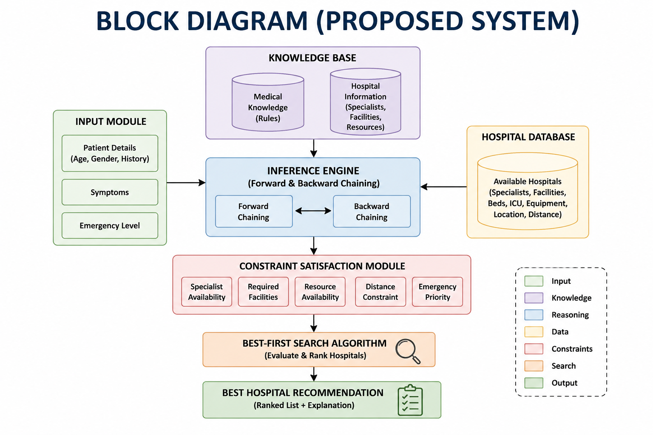

Slide 11
Hardware/Software Requirements
Hardware Requirement
Processor: Intel Core i3 / equivalent or above
RAM: 4 GB minimum
Storage: 500 MB available
Display: Standard monitor
Internet: Stable internet connection (optional, if using online hospital data)
Software Requirement
Operating System: Windows / Linux
Programming Language: Python
Development Environment: Visual Studio Code (VS Code)
Database: MySQL / SQLite
Libraries: Tkinter, Pandas
AI Techniques: Knowledge-Based Agent, Forward Chaining, Backward Chaining, Best-First Search, Constraint Satisfaction

Slide 12
References
[1] Chi, C.-L., Street, W. N., & Ward, M. M. (2008). Building a Hospital Referral Expert System with a Prediction and Optimization-Based Decision Support System Algorithm. Decision Support Systems, 46(3), 727–739. https://doi.org/10.1016/j.dss.2008.10.001
[2] Abdel-Hafez, A., et al. (2023). Artificial Intelligence in Medical Referrals Triage Based on Clinical Prioritization Criteria. Frontiers in Digital Health, 5, Article 1192975. https://doi.org/10.3389/fdgth.2023.1192975
[3] Määttä, J., et al. (2023). Diagnostic Performance, Triage Safety, and Usability of a Clinical Decision Support System. JMIR Medical Informatics, 11, e46760. https://doi.org/10.2196/46760

