Slide 1
Digital Portfolio
STUDENT NAME:DHANALAKSHMI.M
REGISTER NO AND NMID:24132011802522020 AND asanm20124132011802522020
DEPARTMENT:B.SC.COMPUTER SCIENCE
COLLEGE:ARIGNAR ANNA ARTS COLLEGE VILLUPURAM/ANNAMALAI UNIVERSITY

Slide 2
PROJECT TITLE
DIGITAL PORTFOLIO

Slide 3


AGENDA
Problem Statement
Project Overview
End Users
Tools and Technologies
Portfolio design and Layout
Features and Functionality
Results and Screenshots
Conclusion
Github Link
3/21/2024 Annual Review

Slide 4

PROBLEM STATEMENT
Traditional resumes fail to showcase creativity and technical skills effectively. A personal portfolio website is needed to present projects, achievements, and contact details in an interactive and engaging way.

Slide 5

PROJECT OVERVIEW
This project involves creating a digital portfolio website to showcase personal skills, achievements, and projects. It serves as an interactive platform for employers or collaborators to learn more and connect easily.

Slide 6

WHO ARE THE END USERS?
The primary end users of a digital portfolio are potential employers, recruiters, clients, and collaborators who want to evaluate skills and projects. It can also be used by peers, educators, or mentors for review and feedback.

Slide 7
TOOLS AND TECHNIQUES
The digital portfolio is developed using HTML, CSS, and JavaScript for structure, design, and interactivity, along with responsive design techniques for accessibility across devices.

Slide 8
POTFOLIO DESIGN AND LAYOUT
The digital portfolio follows a clean, responsive layout with sections for introduction, skills, projects, and contact. A simple navigation menu and modern design elements ensure easy access and visual appeal.
8

Slide 9
FEATURES AND FUNCTIONALITY
The digital portfolio showcases skills, projects, and achievements with an interactive, responsive design. It includes smooth navigation, project links, and a contact section for easy communication.

Slide 10
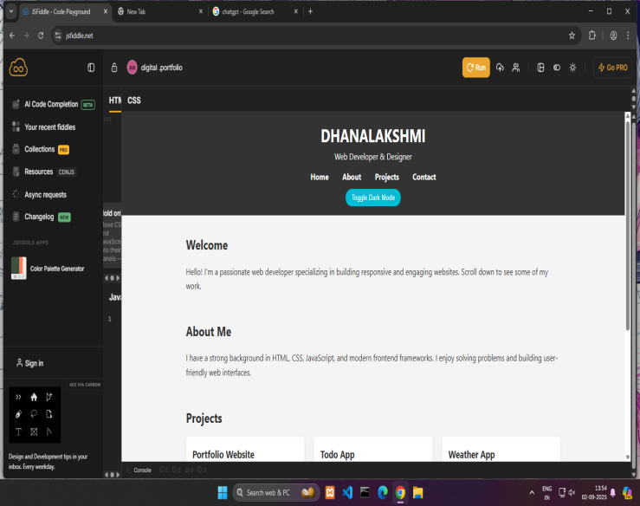
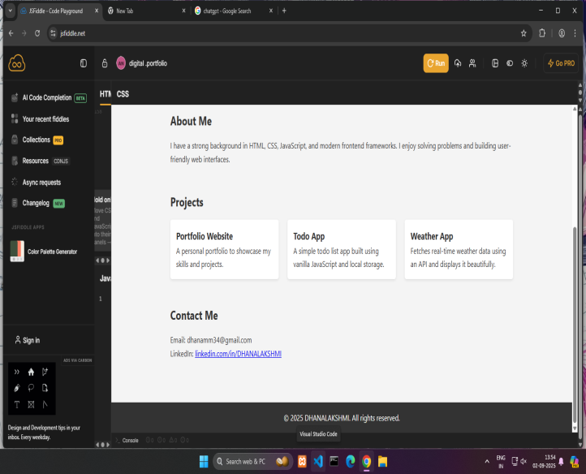
RESULTS AND SCREENSHOTS
he digital portfolio effectively displays personal information, skills, and projects in an interactive format. It provides a responsive and user-friendly interface for easy access across devices.
3/21/2024 Annual Review
10

Slide 11
CONCLUSION
The digital portfolio serves as an effective platform to showcase skills and projects, providing an engaging and professional online presence.
11

