Slide 1
“Soya Enhancer”
A Farmers Participatory Program of Soyabean Research
Dr B. M. Jamadagni¹, Dr B. P. Patil², and Dipak Wangikar³
¹Crop Physiologist and E.C. Member, MACS, Pune.
² Ex Head, Department of Agronomy, Dr BSKKV, Dapoli
³ Progressive farmer, Talasande, Kolhapur
Authors are members of IRDE, PUNE

Slide 2
SOYA ENHANCER DEFINED
Stage Specific Foliar Spray of the Mixture of Following Components :
Water Soluble Mineral Nutrient Fertilizers viz. 19:19:19, 12:61:0, Potassium Schoenite, 13:0:45, Chelated Zinc, Chelated Ferrous and Boron
Plant Growth Regulators viz. IBA, Six BA, Mepiquat Chloride, Triacontenol
Systemic and Contact Insecticides and Fungicides

Slide 3
CRITICAL GROWTH STAGES OF SOYABEAN CROP
EARLY GROWTH STAGE 15 TO 20 DAYS
FLOWERING STAGE 35 TO 45 DAYS
POD SETTING STAGE 55 TO 60 DAYS
POD DEVELOPMENT AND MATYRITY 75 TO 90 DAYS

Slide 4
BASIC REQUIREMENTS
FOR TARGET 20 Q/ACRE (50 Q/H.) SOYABEAN YIELD
Seed treatment with chemical and biological agents
Application of basal dose of fertilizer i.e. 20:30:20 N,P,K/acre
Sowing on B.B.F. or Ridges and Furrows
Adequate soil moisture
Four foliar sprays of Soya Enhancer at critical growth stages

Slide 5
FARMERS, PLACES, SEASON AND CLIMATE
A mission mode program was organized in monsoon 2024-2025 season.
For this, 300 farmers in 17 different places of Western Maharashtra and Marathwada were contacted through pre-season training programs.
Among them 195 conducted the demonstrations. Others could not undertake it due to continuous rains throughout the growing season, specifically year 2025.
There was a wide diversity of soil, crop varieties, climate, planting methods, sowing time, availability of fertilizers and other critical inputs.

Slide 6
Heavy Rainfall and Flood situation
Heavy incessant rainfall from June to October 2024-2025 prevented to undertake some or the other critical operations.
In many fields water logging occurred for 2 to 3 weeks.
In some places crop remained submerged for 5 to 7 days due to river flood.

Slide 7
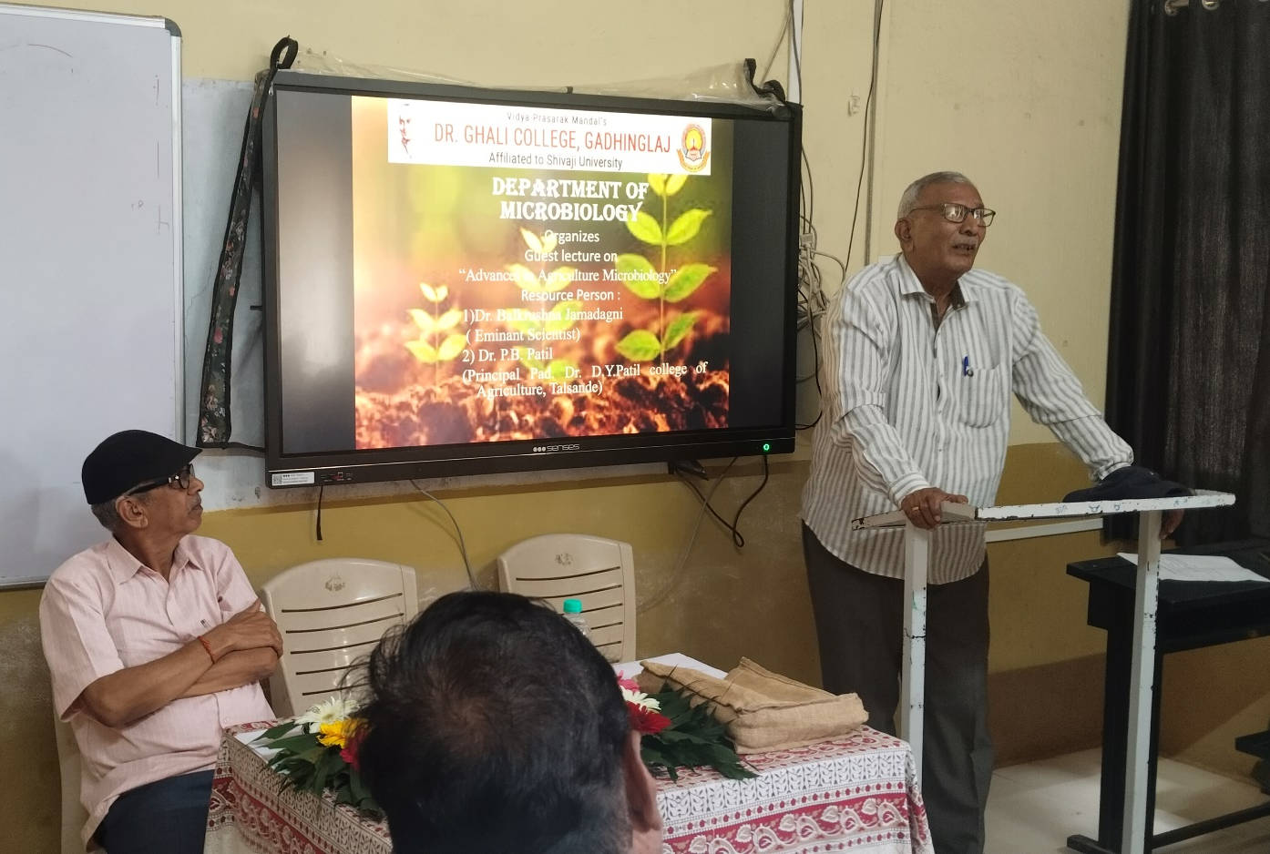
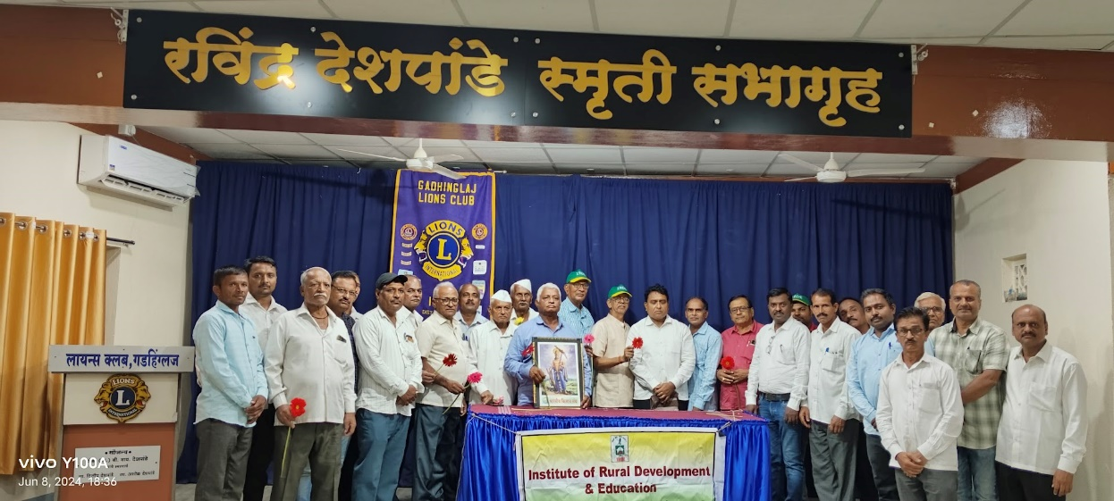
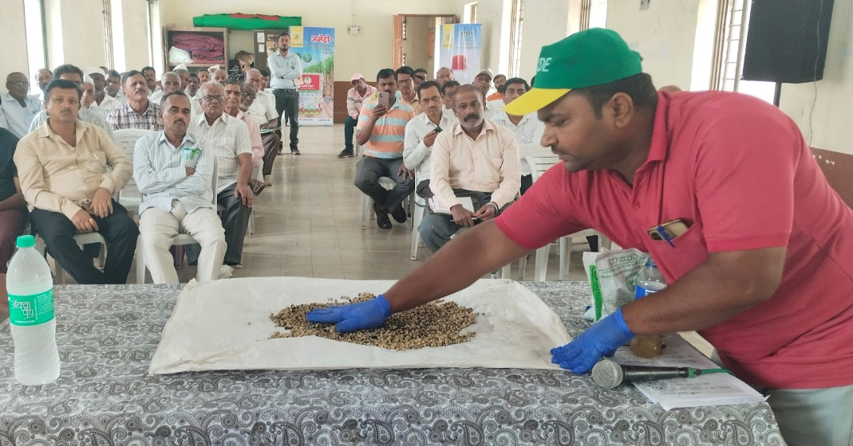
Pre-season orientation at Gadhinglaj

Slide 8
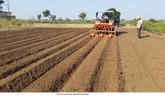
Broad Bed Furrows

Slide 9
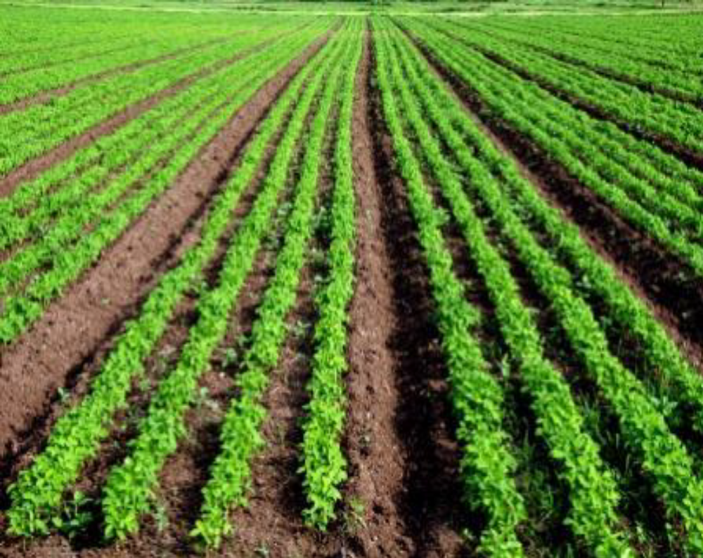
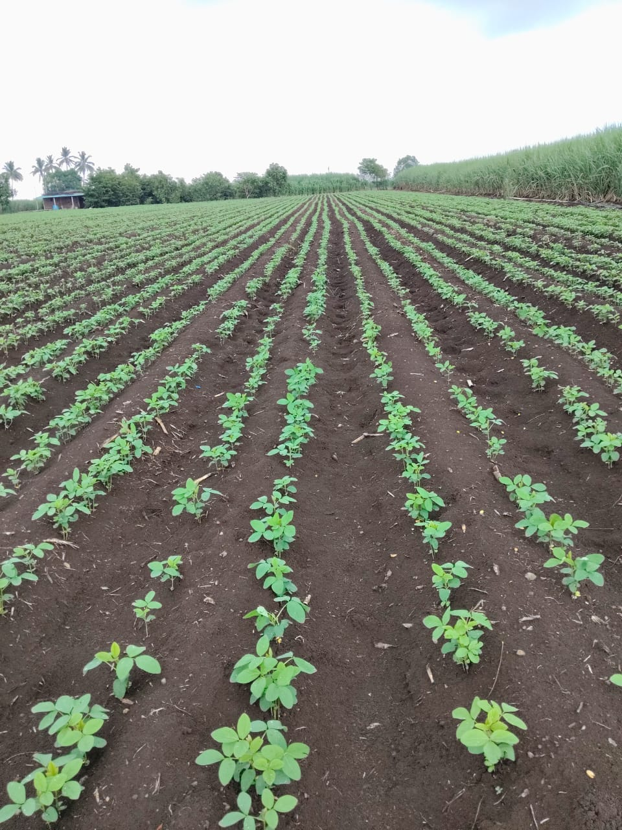
Sowing of Soyabean on
Broad Bed Furrows (BBF) or Ridge and Furrows

Slide 10
Soya Enhancer on Farmers Fields 2024
Farmer Group I, II, III and IV
Treatment | Parameters for Yield q/acre | GROUP 1 Agharkar Res.Ins Pune | GROUP 2 Kisan Bharati, Gadhinglaj | GROUP 3 IRDE, Surya Sanstha | GROUP 4 Prayag Group
 | Number of farmers | 09 | 16 | 8 | 8
With SOYA ENHANCER | Highest yield | 17.0 | 17.75 | 18.0 | 17.50
 | Average | 13.37 | 13.38 | 14.26 | 14.59
 | Variance | 3.81 | 6.96 | 10.20
 | SD | 1.95 | 2.63 | 3.19 | 1.67
 | CV | 14.60 | 19.73 | 22.38 | 11.43
Without SOYA ENHANCER | Average | 08 | 7.24 | 7.06 | 7.75
 | Variance | 2.59 | 4.29 | 6.31 | 1.5
 | SD | 1.60 | 2.07 | 2.51 | 1.22
 | CV | 19.98 | 28.60 | 35 59 | 15.81
 | Yield Enhancement | 72.12 % | 84.8 % | 101.9 % | 88.25 %

Slide 11
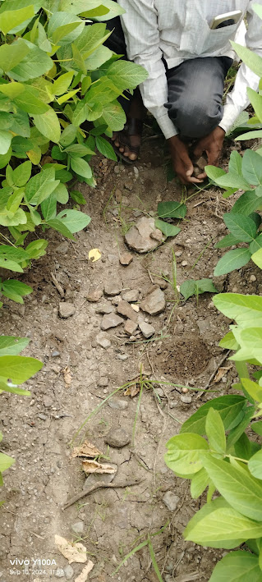
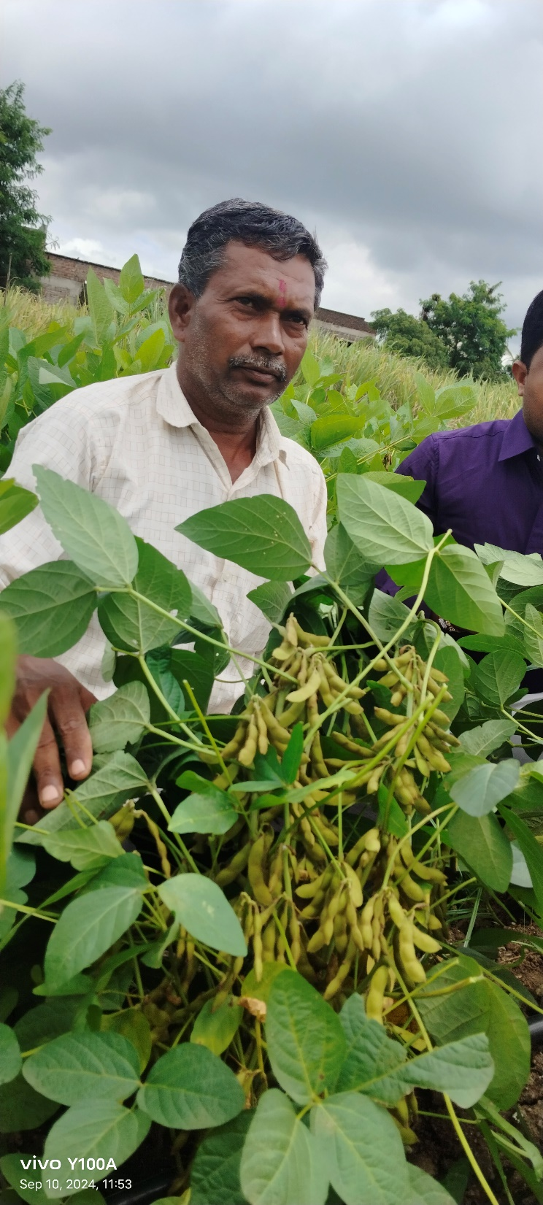
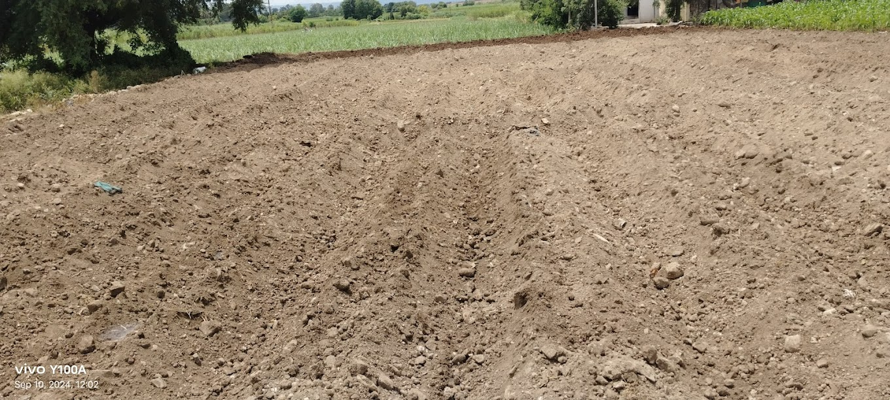
Profuse pod bearing even on very light soil by foliar sprays of Soya Enhancer

Slide 12
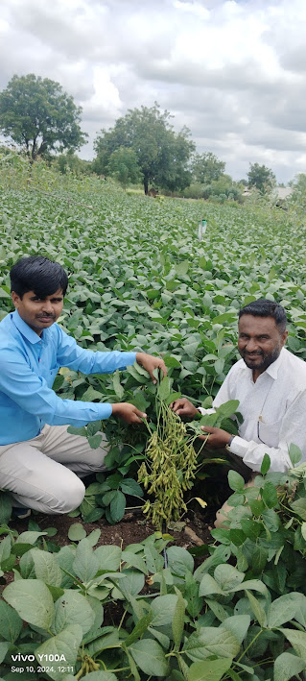
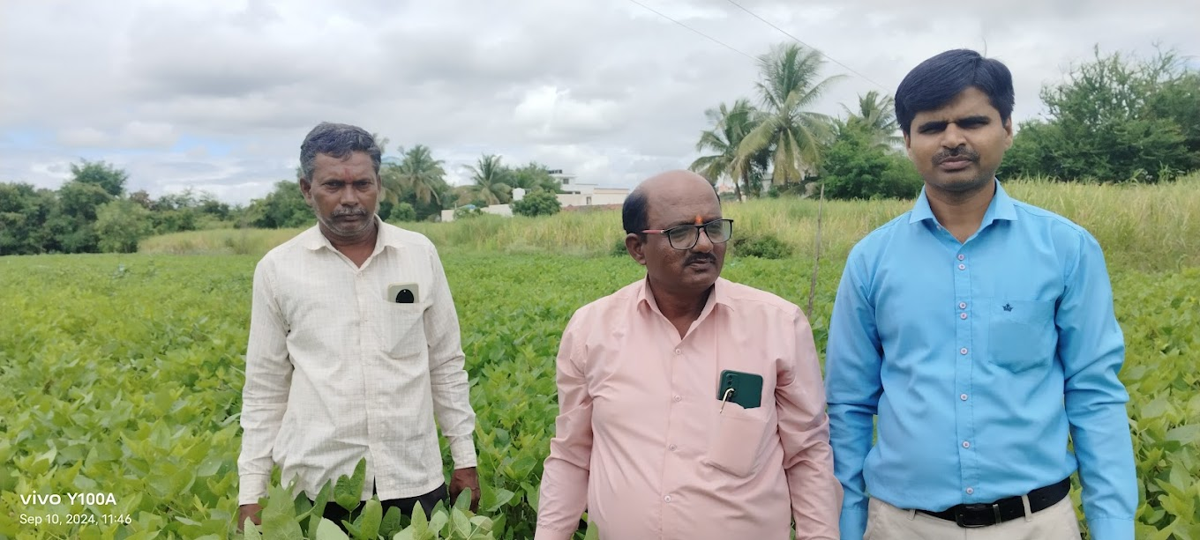
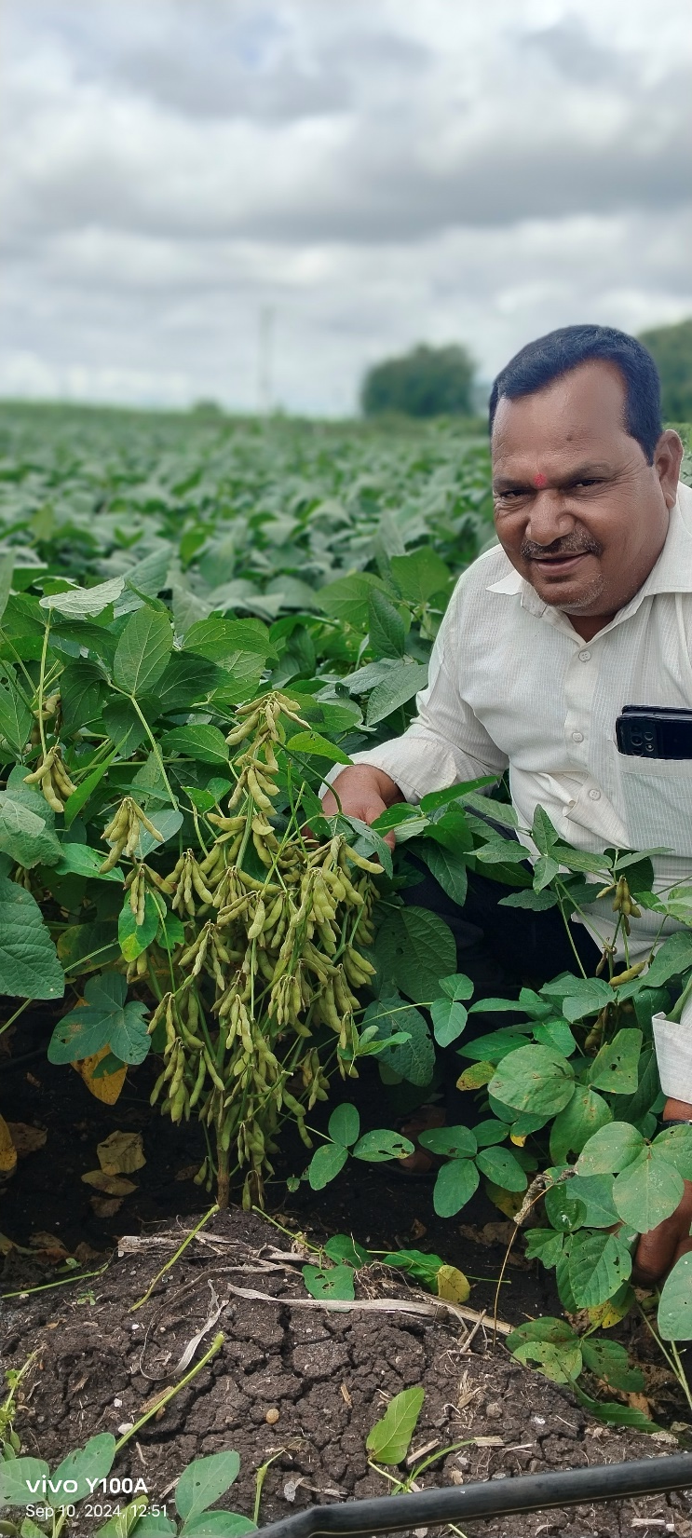
Soya Enhancer demonstration on Farmers field at village Hol Th. Baramati

Slide 13
Soya Enhancer on Farmers Fields
Group V , VI, VII, and VIII
Treatment | Parameters Yield q/acre | Group V Dnyan Hira Chavare | Group VI Sangali Ashta | Group VII Shirol, Narsobawadi | Group VIII Vasagade-Sangali
 | No. of farmers | 5 | 11 | 9 | 10
With SOYA ENHANCER PLUS | Highest yield | 15 | 22 | 19.5 | 19
 | Average | 12.15 | 16.58 | 14.85 | 15.35
 | Variance | 4.86 | 7.06 | 8.94 | 4.78
 | SD | 2.27 | 2.65 | 2.99 | 2.18
 | CV | 18.16 | 16.03 | 20.15 | 14.24
Without SOYA ENHANCER | Average | 5.68 | 8.08 | 6.34 | 10.2
 | Variance | 1.82 | 1.16 | 0.802 | 3.51
 | SD | 1.34 | 1.08 | 0.89 | 1.87
 | CV | 23.76 | 13.36 | 14.12 | 18.37
 | Yield Enhancement | 113.90% | 86.70 % | 113.4% | 49.90 %

Slide 14
Soya Enhancer on Farmers Field
Farmer Group IX,X
Treatment | Parameters Yield q/acre | Group IX Rahimatpur | Group X Jinti
 | Number of farmers | 9 | 22
With SOYA ENHANCER PLUS | Highest yield | 16 | 15
 | Average | 14.11 | 11.68
 | Variance | 1.61 | 2.70
 | SD | 1.26 | 1.64
 | CV | 9.0 | 14.08
Without SOYA ENHANCER | Average | 6.88 | 6.55
 | Variance | 1.61 | 1.50
 | SD | 1,26 | 1.22
 | CV | 18.43 | 18.54
 | Yield Enhancement | 85.61 % | 82.46 %

Slide 15
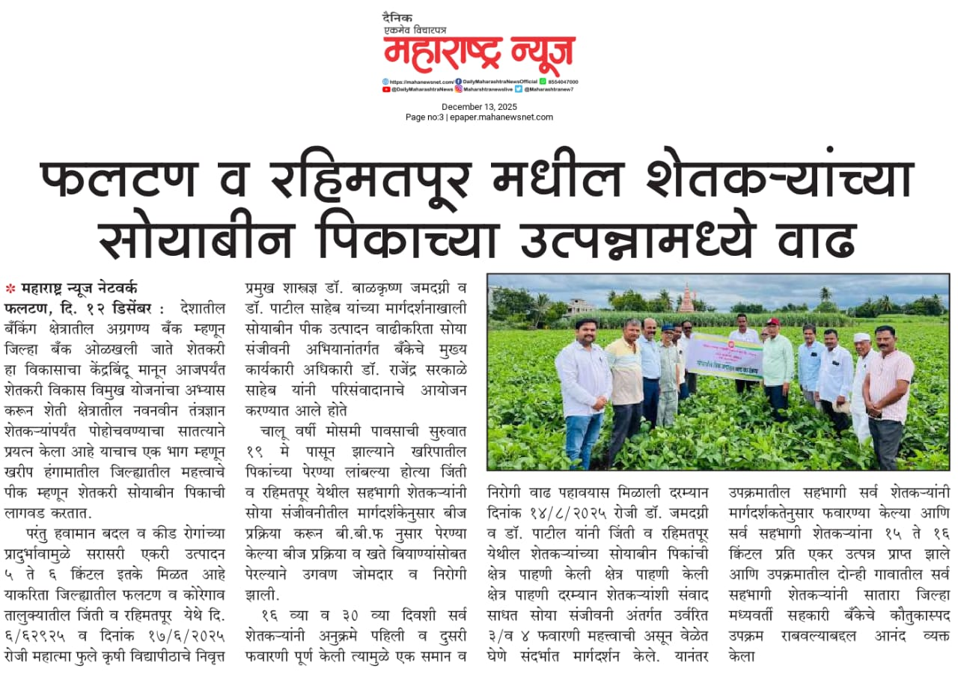
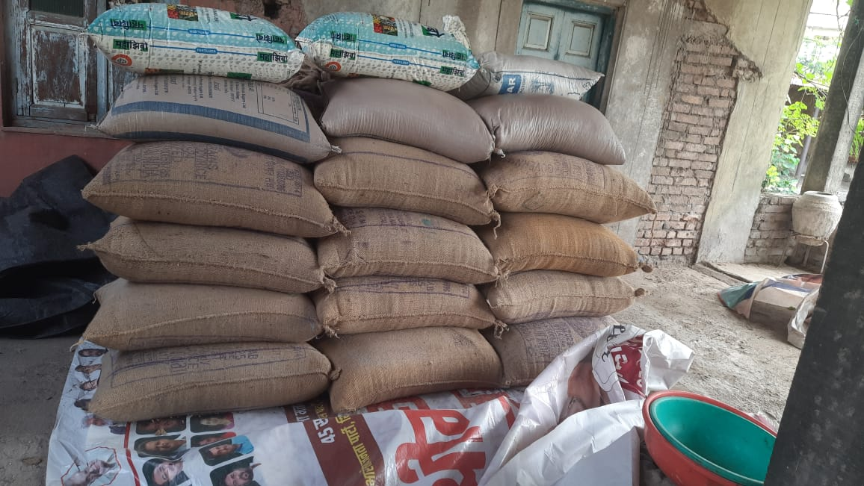
Bumper Yield of Soyabean in Jinti village Dst Satara
Sponsorer: Satara District Central Co-Op Bank

Slide 16
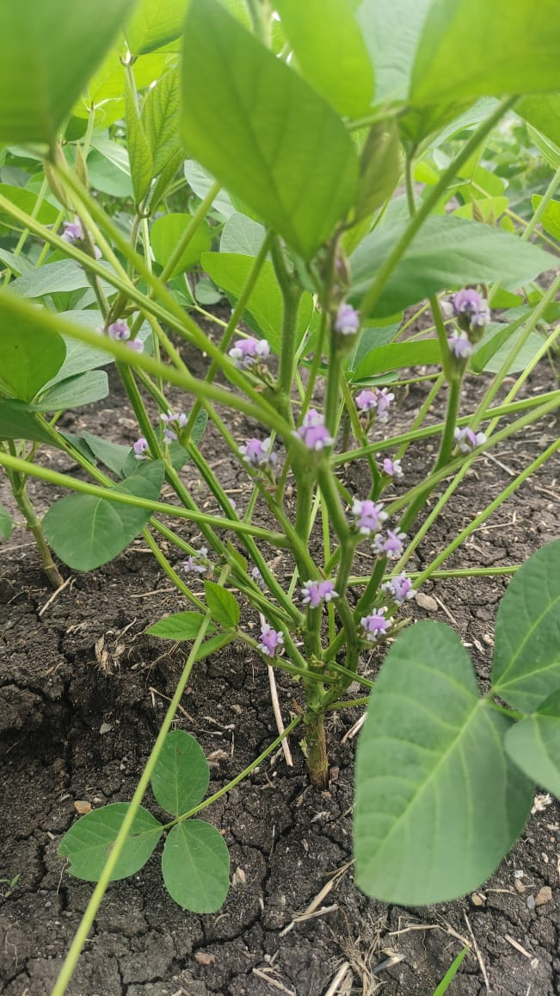
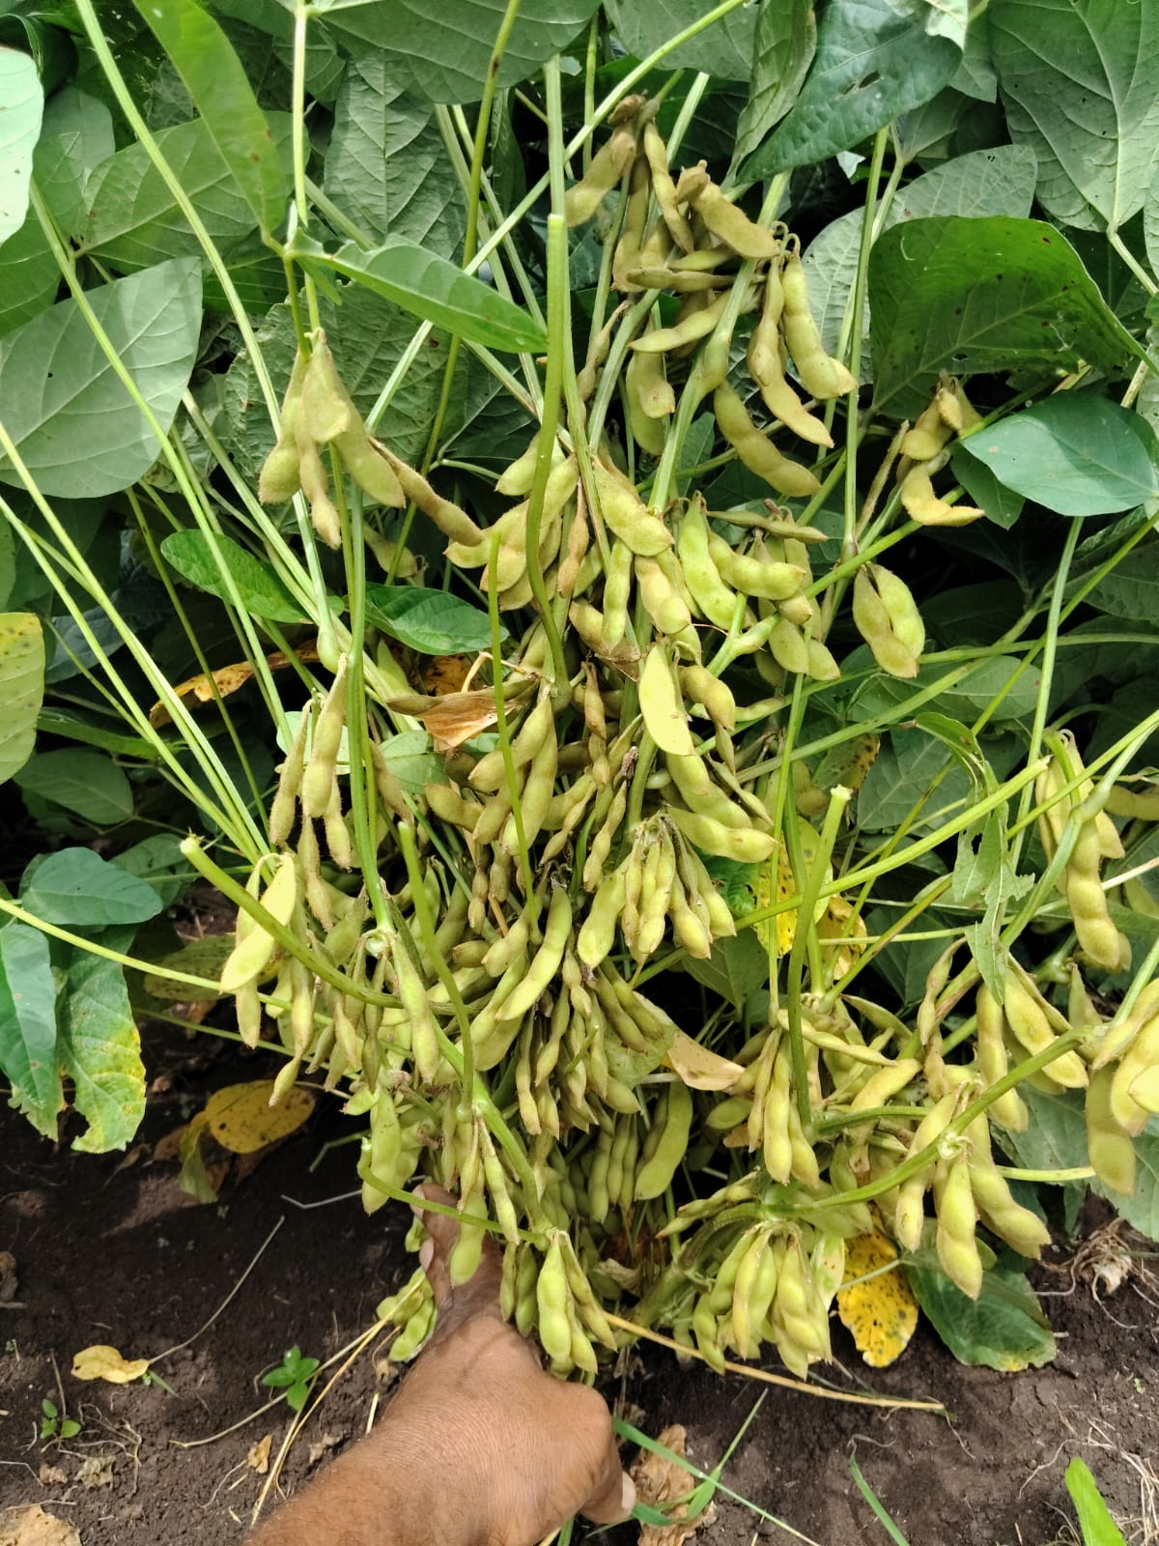
SOYA ENHANCER INDUCED
PROFUSE BRANCHES, FLOWERS AND PODS

Slide 17
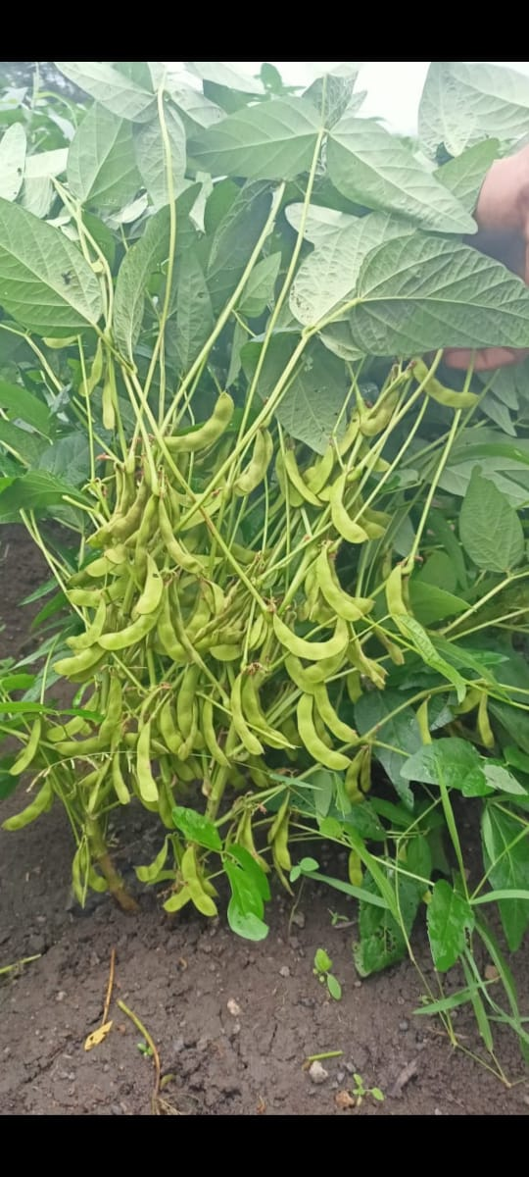
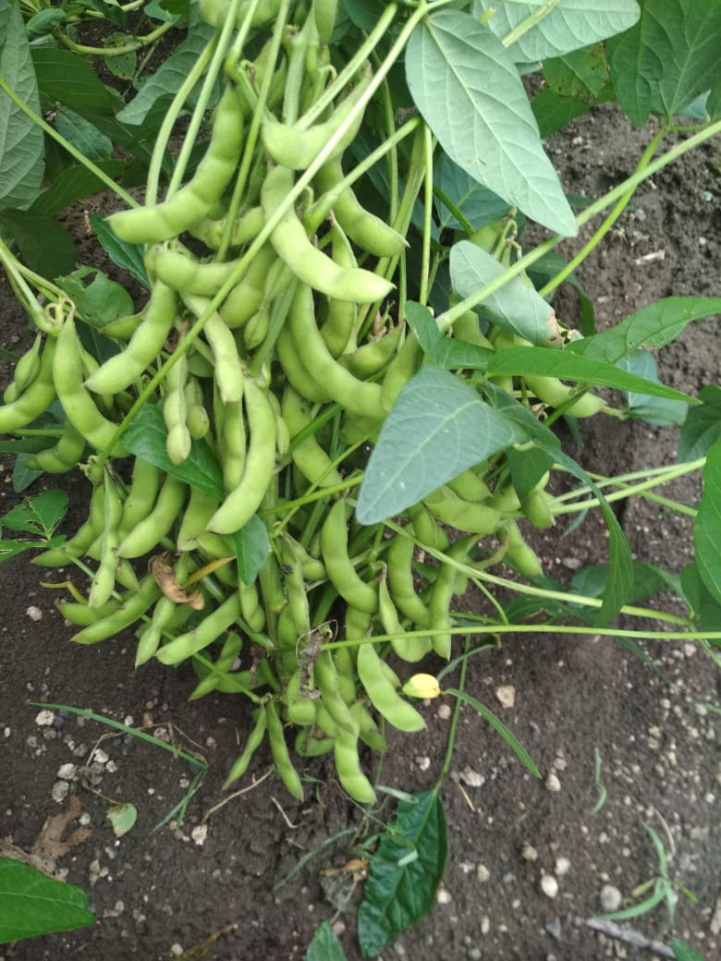
Profuse pod bearing by Soya Enhancer

Slide 18
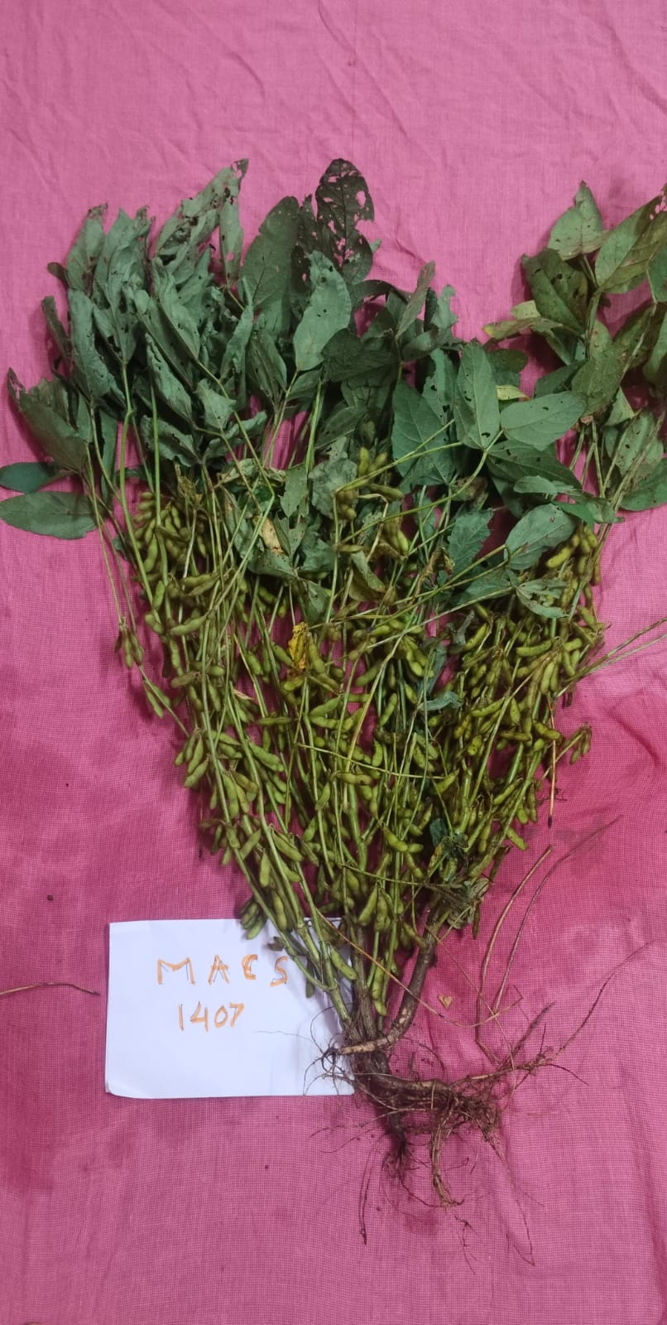
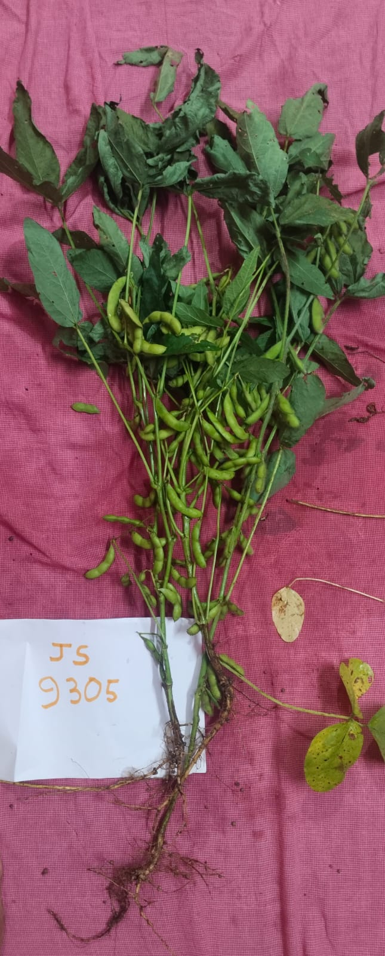
Soya Enhancer vs no Soya Enhancer

Slide 19
Soya Enhancer on Farmers Field
Farmers Group :Marathwada
Treatment | Parameters Yield q/acre | Group XI MarathwadaI | GroupXII Marathwada ii | GroupXIII Marathwadaiii
 | Number of farmers | 10 | 10 | 12
With SOYA ENHANCER PLUS | Highest yield | 18.20 | 18 | 18
 | Average | 15.11 | 14.68 | 12.25
 | Variance | 4.67 | 2.44 | 14.75
 | SD | 2.16 | 1.56 | 3.84
 | CV | 14.31 | 10.66 | 31.35
Without SOYA ENHANCER | Average | 9.54 | 10.62 | 6.67
 | Variance | 1.97 | 9.98 | 2.42
 | SD | 1.40 | 3.16 | 1.55
 | CV | 14.71 | 29.75 | 23.35
 | Yield Enhancement | 58.38% | 38.22% | 85.45%

Slide 20
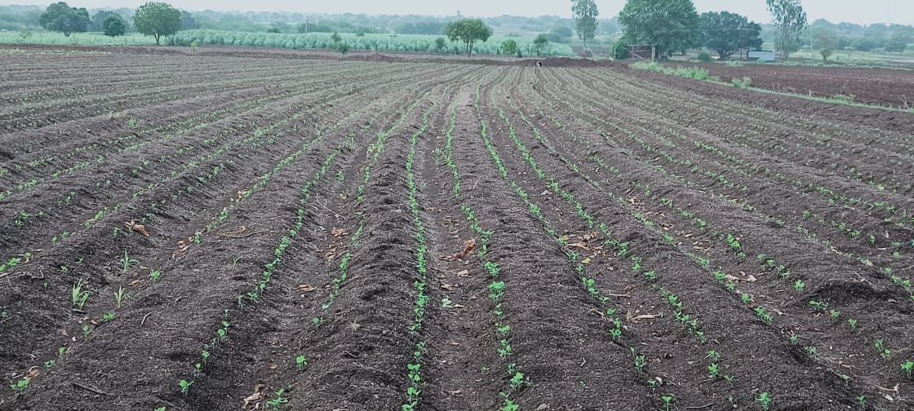
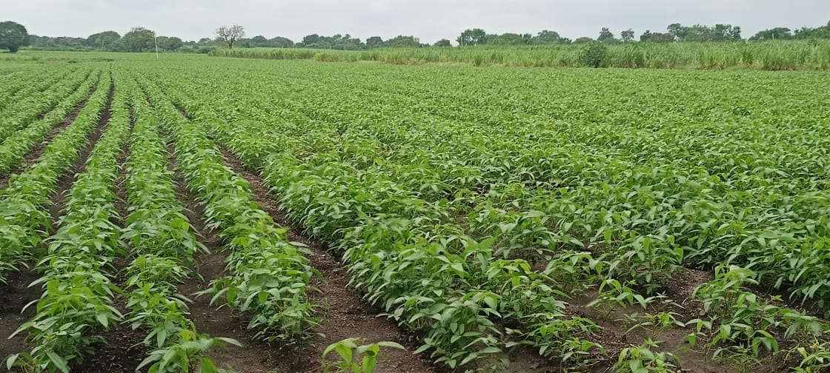
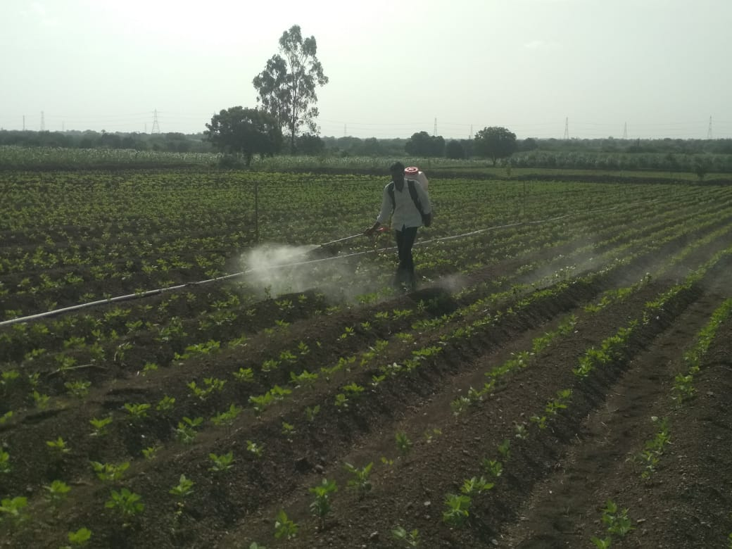
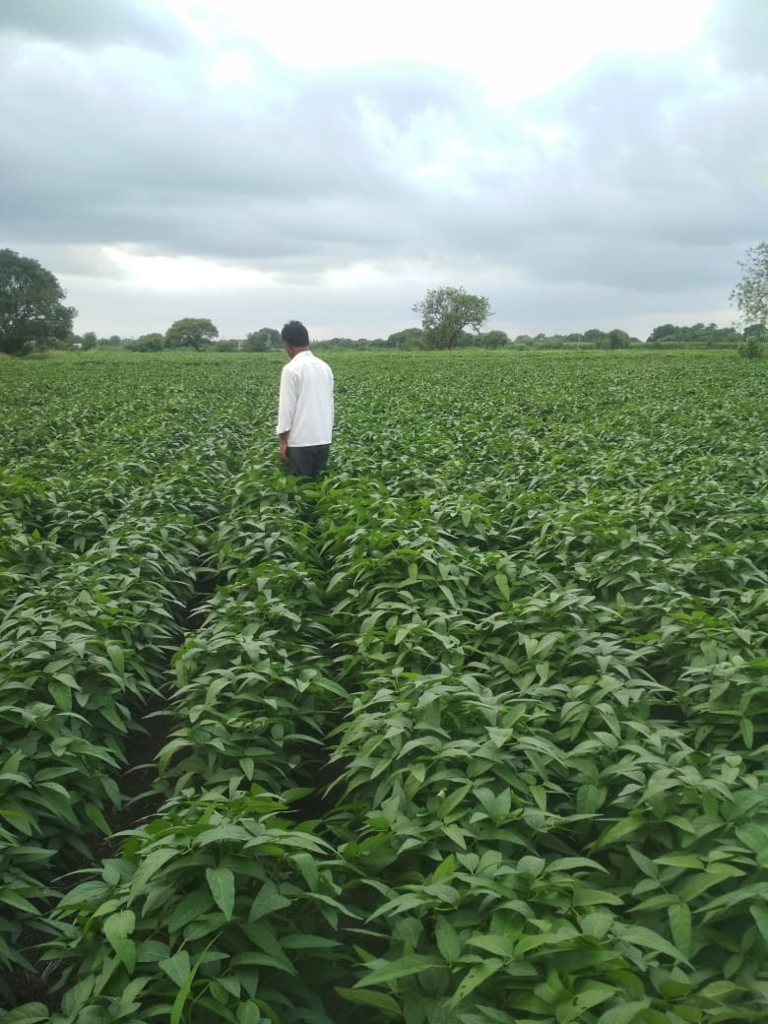
Mr. MUKUND KADAM, KAMEGAV DIST. LATUR 21 q /acre

Slide 21
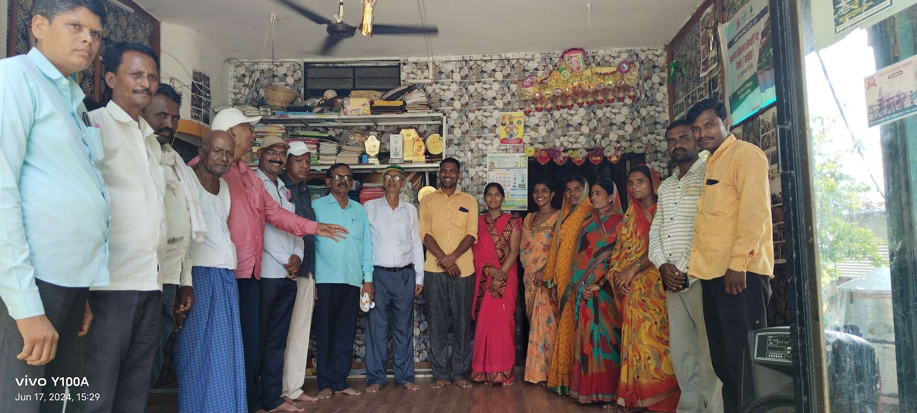
Marathwada Farmers At Deola Th. Ambejogai

Slide 22
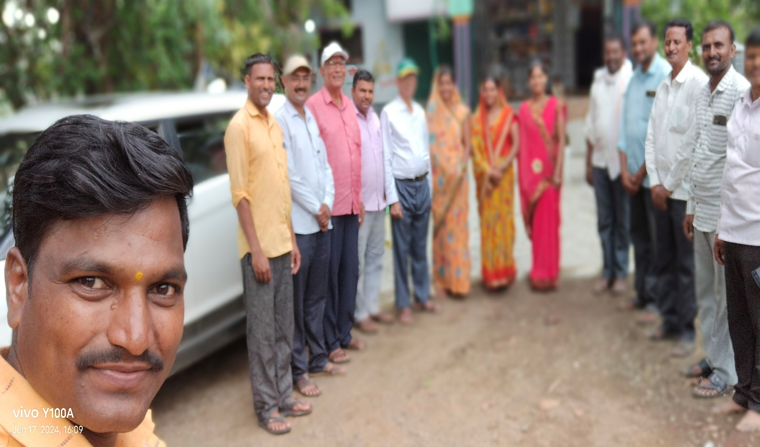
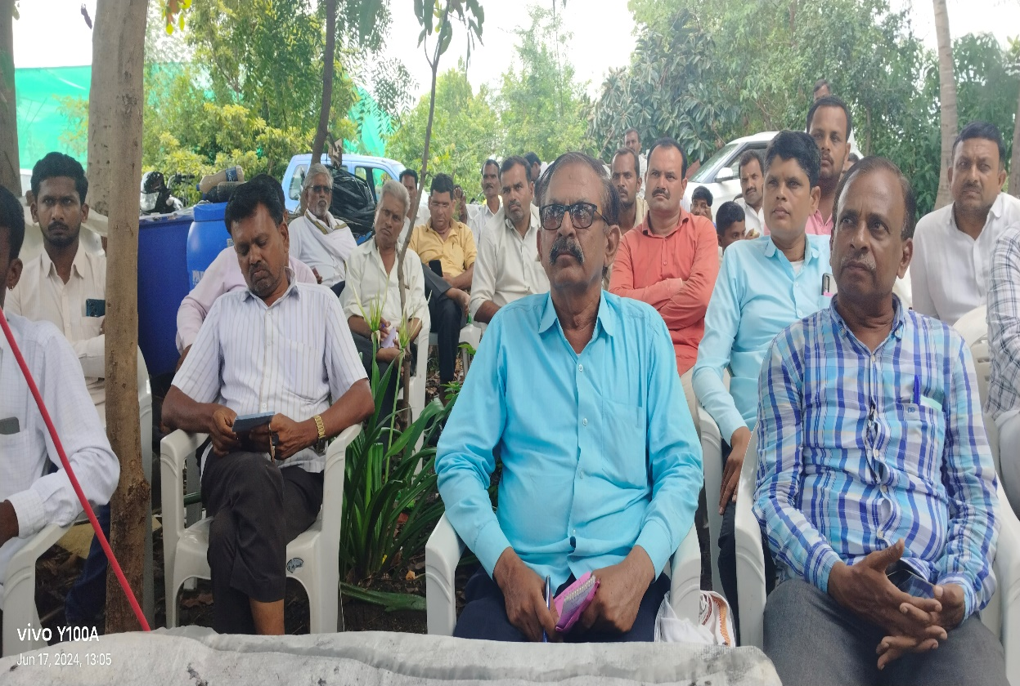
MARATHWADA FARMERS GROUP

Slide 23
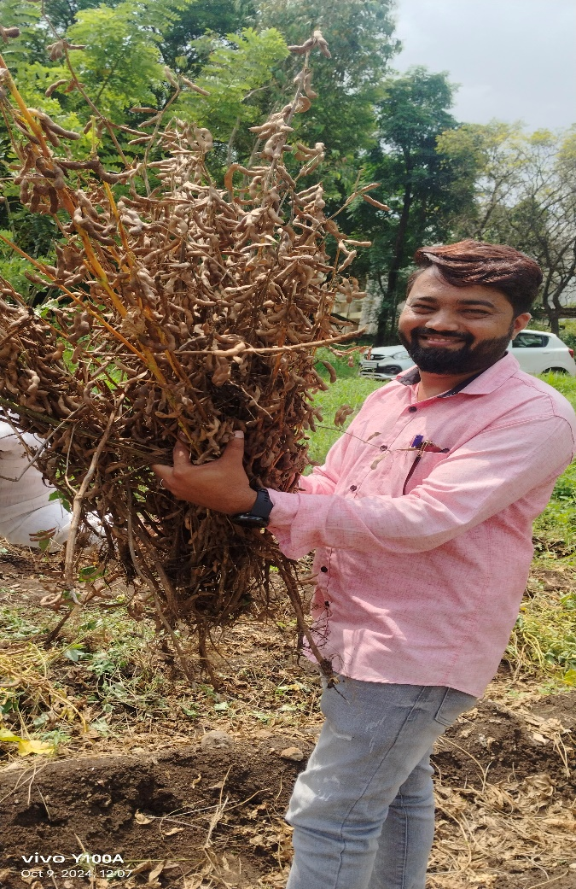
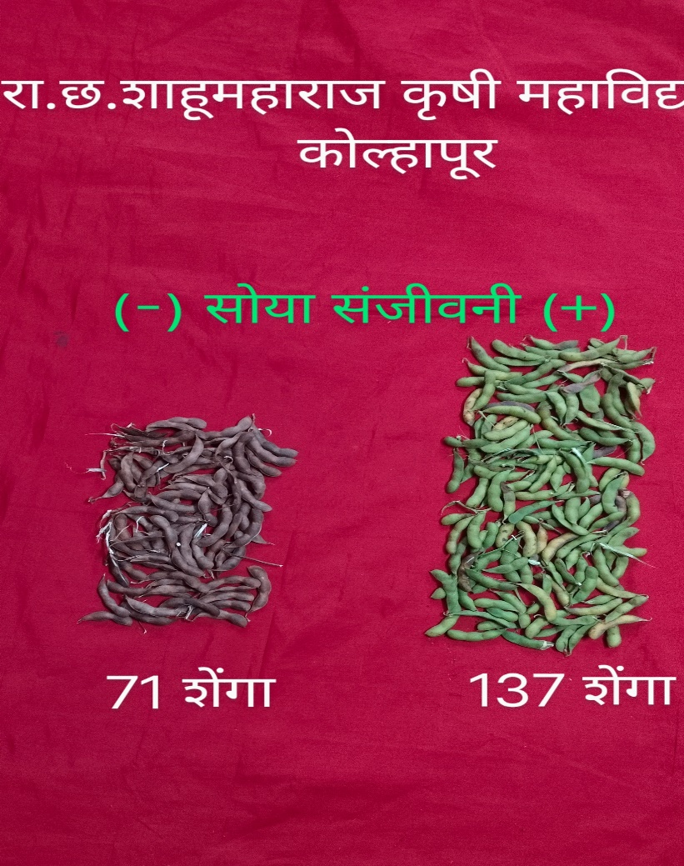
DEMONSTRATION AT R.C.S. COLLEGE OF AGRICULTURE, KOLHAPUR

Slide 24
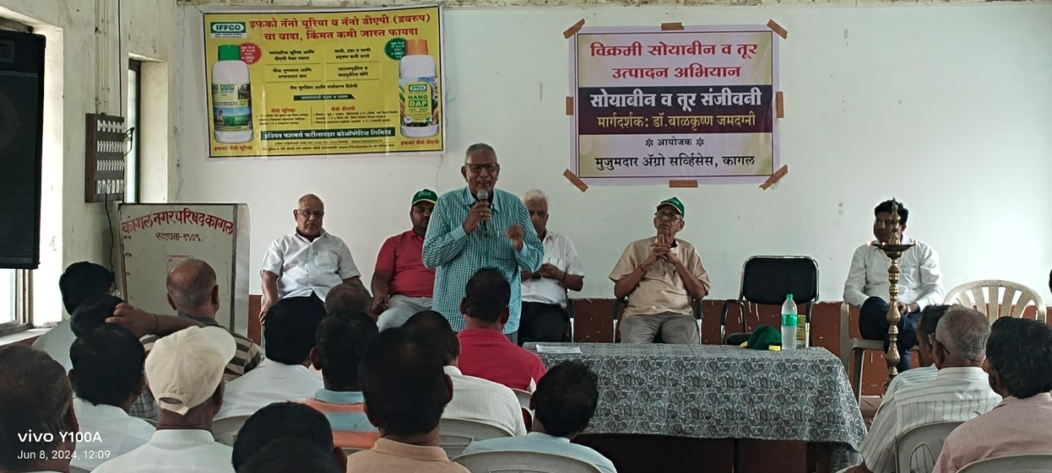
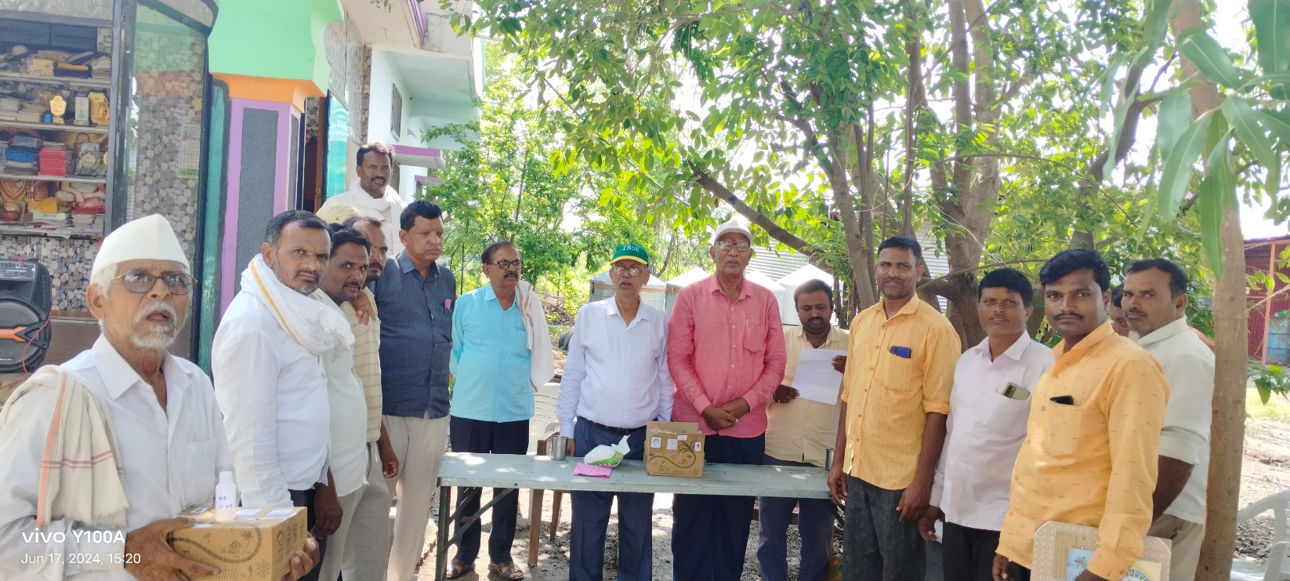
PRAYAG GROUP, KAGAL

Slide 25
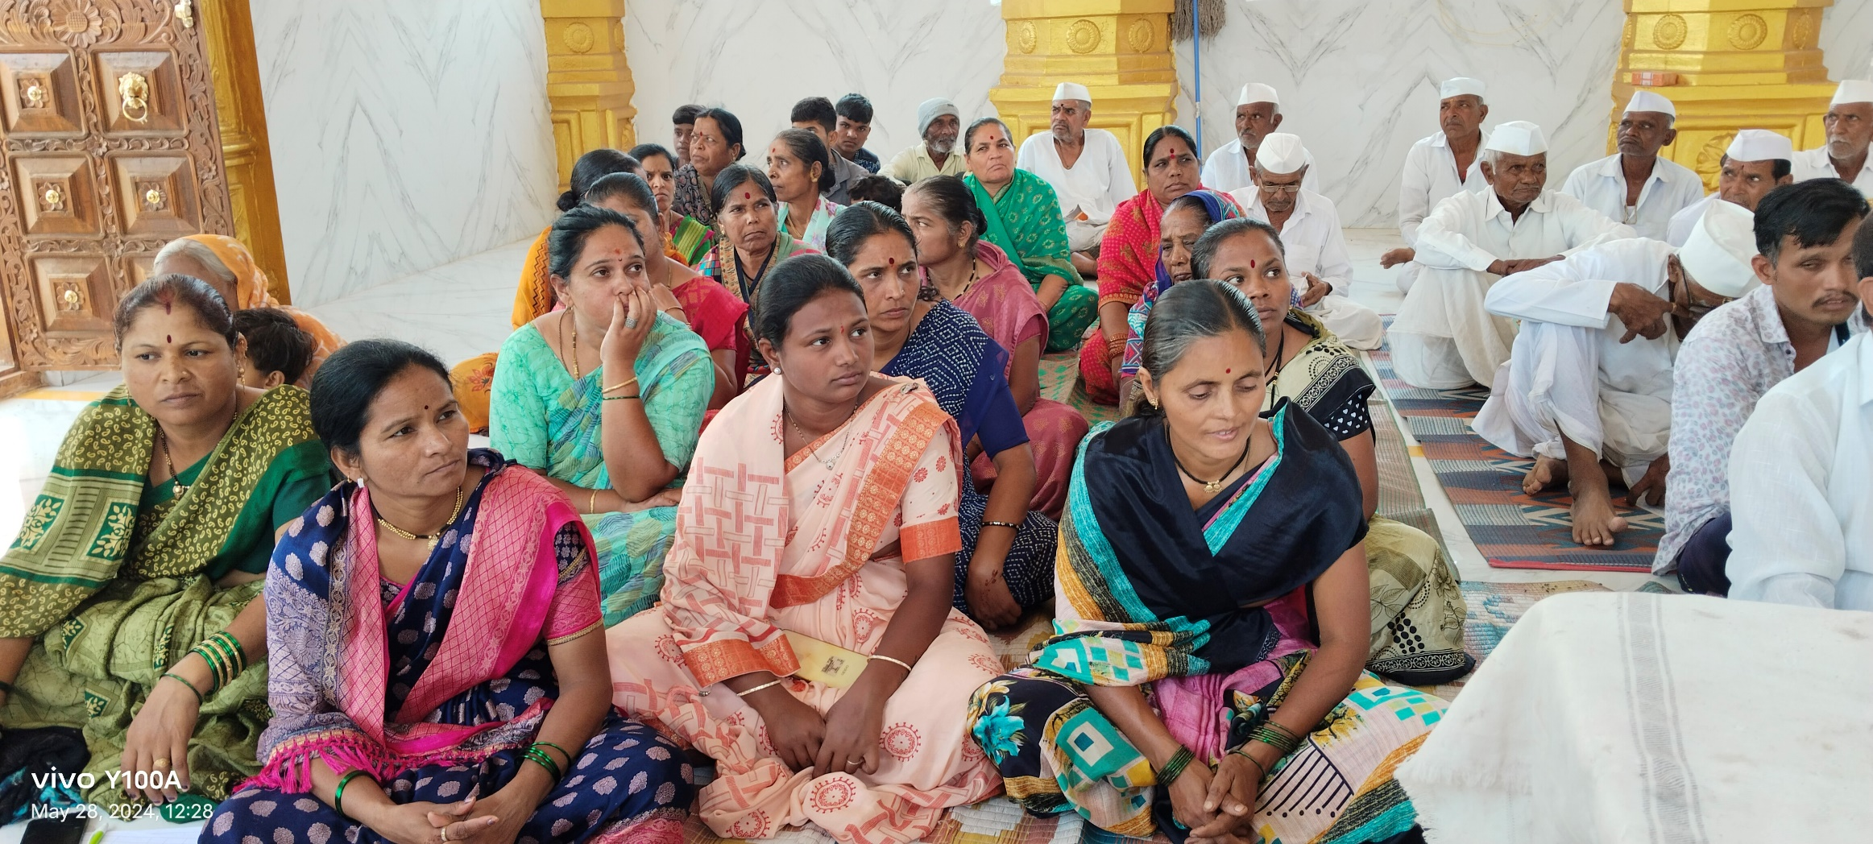
PARTICIPATION OF WOMEN FARMERS

Slide 26
K.V.K. BARAMATI
EXPERIENCE
KVK Bramati Dst. Pune, conducted 150 demonstrations of which 50 were in Baramati Tahasil and 100 in BHOR Tahasil. Bhor is known for assured rainfall, whereas, Baramati encompasses scanty rainfall region.
In year 2025 the rains commenced from last week of May and continued till October. Heavy rains caused flood situation in many fields.
This situation prevented to undertake basic operations like preparatory tillage, inter-culturing, formation of BBF or Ridges and Furrows, basal dose application, spacing, sowing time and harvesting the crop.
However, the farmers conducted the trials as and when the situation permitted. The result on effect of no.of sprays are noteworthy.

Slide 27
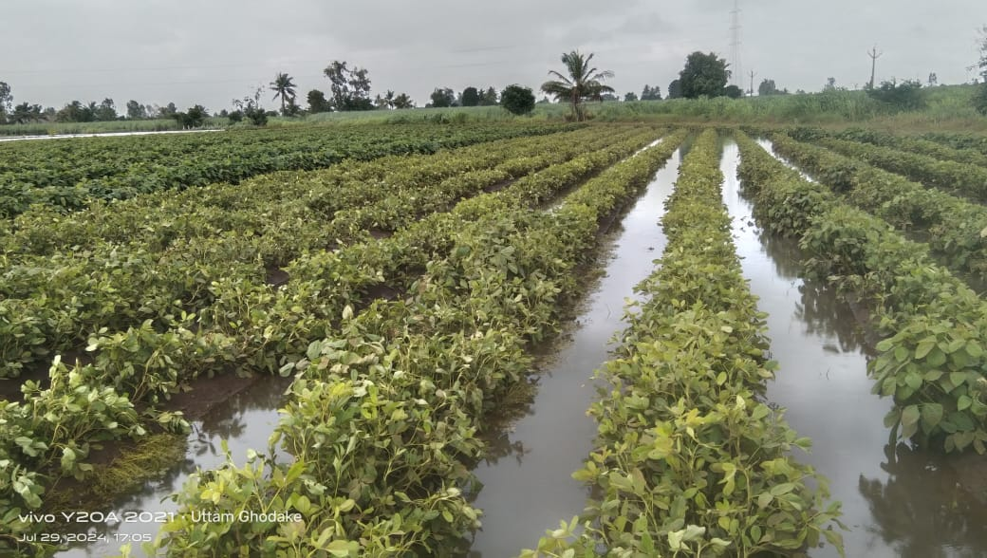
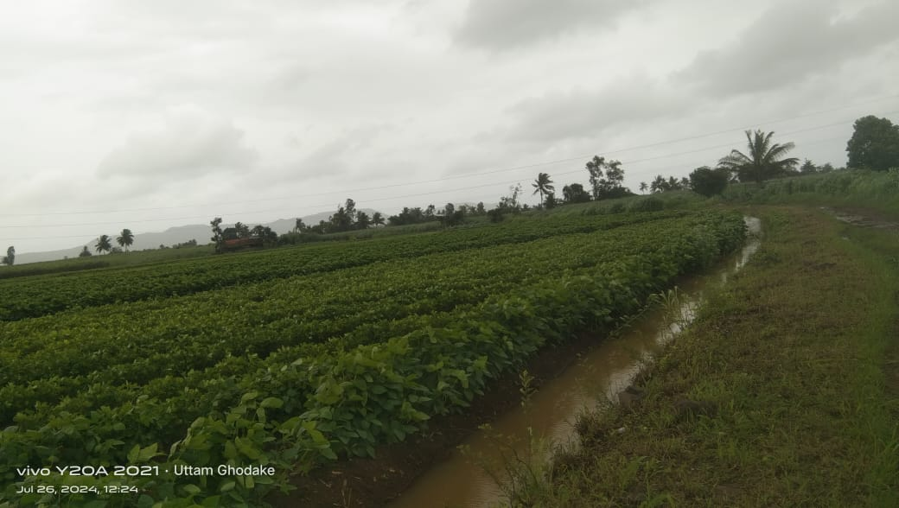
Water Stagnation in Field

Slide 28
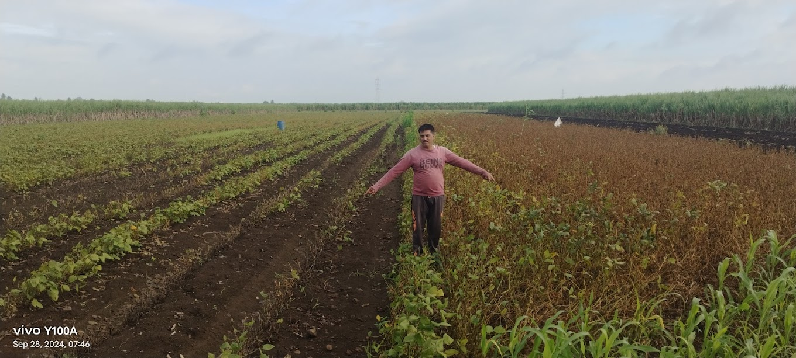
SOYA ENHANCER INDUCED TOLERANCE TO WATER STAGNATION

Slide 29
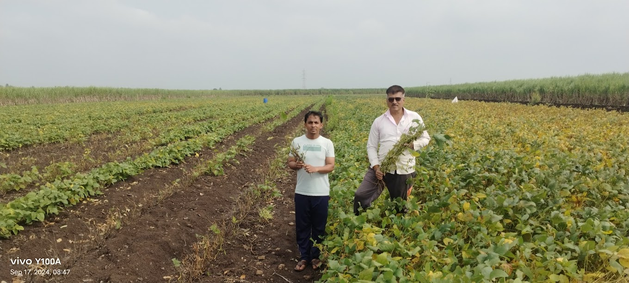
Poor crop growth due to water stagnation
Soya Enhancer could alleviate it

Slide 30
Soya Enhancer on Farmers Fields
Farmers Group: KVK, Baramati
Treatment | Parameters Yield q/acre | One Spray of SOYA ENHANCER | Two Sprays of SOYA ENHANCER | Three Sprays of SOYA ENHANCER | Four Sprays of SOYA ENHANCER
 | Number of farmers | 15 | 15 | 15 | 12
With SOYA ENHANCER PLUS | Highest yield | 10 | 10.5 | 13 | 17
 | Average | 8.5 | 9.53 | 11.33 | 15.08
 | Variance | 1.07 | 1.34 | 2.80 | 2.26
 | SD | 1.035 | 1.15 | 1.67 | 1.50
 | CV | 12.18 | 12.13 | 14.79 | 9.98
Without SOYA ENHANCER | Average | 5.96 | 6.47 | 7.35 | 7.12
 | Variance | 0.76 | 0.76 | 1.15 | 3.097
 | SD | 0.88 | 0.87 | 1.076 | 1.75
 | CV | 14.67 | 13.47 | 14.62 | 24.70
 | Yield Enhancement | 42.61% | 42.29 % | 53.94 % | 111.8 %

Slide 31
KVK BARAMATI : EFFECT OF NUMBER OF SOYA ENHANCER SPRAYS ON YIELD OF SOYABEAN
Effect of 1 and 2 sprays was similar which showed 42.6 and42.29 per cent yield enhancement (10 and 10.5 q /acre) over untreated fields (6 to 6.4 q /acre)
With 3 successive foliar sprays of the Enhancer, there was 53.94 per cent yield enhancement giving 13 q /acre highest yield as against 7.35 /acre in untreated crop
Four successive foliar sprays of SOYA ENHANCER at critical growth stages showed spectacular yield enhancement (111.94 per cent) with maximum yield of 17 q /acre as against 7.12 q in untreated crop.
CONCLUSION : Foliar sprays of Soya Enhancer at critical growth stages counteracts the adverse conditions and results in spectacular yield enhancement in Soyabean. The effect is progressive with number of successive sprays.

Slide 32
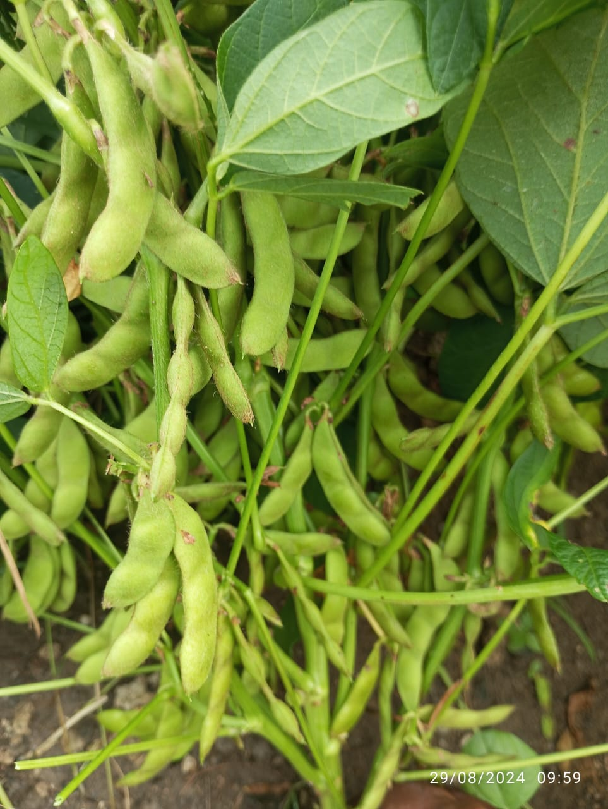
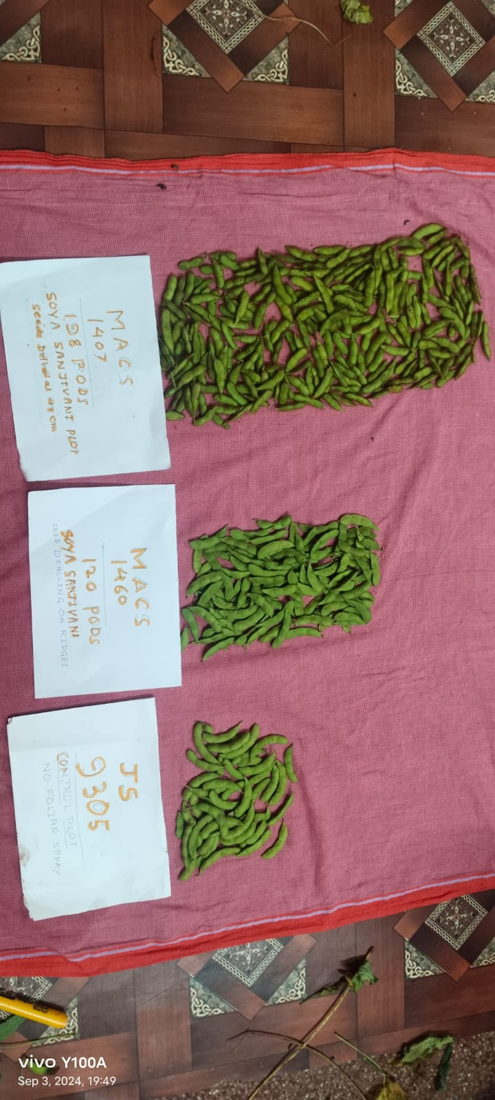
RESPONSE OF MACS 1407 TO SOYA ENHANCER
04 sprays
02 sprays
No sprays

Slide 33
RESULTS
Out of 195 farmers in the program, 4 produced yield between 20 to 22 q/acre (50 to 55 q/ ha.). They had followed the full package of Soya Enhancer management technology.
37 farmers produced yield of 16 to19 q /acre (40 to 47 q /ha) They could not achieve a target of 20 q/acre due to heavy rains.
47 farmers reached a yield level between 14 to 16 q /acre (35 to 40 q/ha). Many of them did line sowing by tractor drawn seed drill, partial or no application of basal dose of fertilizers, missed 1 or 2 Soya Enhancer sprays.

Slide 34
RESULTS continued
40 farmers had yield level between 12 to 14 q/acre (30 to 35 q/ha). These farmers had done line sowing with high seed rate, without fertilizers and incomplete spray schedule. Impotantantly even the few sprays could compensate fertilizer dose.
67 farmers did only 1 or 2 sprays, no other expected package of Soya Enhancer and got 8 to10 q/acre (20 to25 q/ha.)

Slide 35
SUMMARY
This is a Farmers Participatory Program of Soyabean Research
It was undertaken over the area of about 500 acres, belonging to 300 farmers, in 17 different places, with varying climatic conditions and different soils, irrespective of variety used.
The target set was 20 q /acre (50 q /ha).
Five farmers achieved the target;37 farmers produced 16 to 19 q /acre; 47 farmers were in the range of14 to 16 q/acre.
Continuous heavy rainfall prevented to undertake critical operations, and was the main reason for not reaching the target.
The Soya Enhancer induced tolerance to submergence and promoted yield by 40 to 113 per cent even under adverse condition.
PGR is the extra component of Soya Enhancer in addition to regular critical inputs; it’s market cost is around Rs. 1000 for one acre area kit.

Slide 36
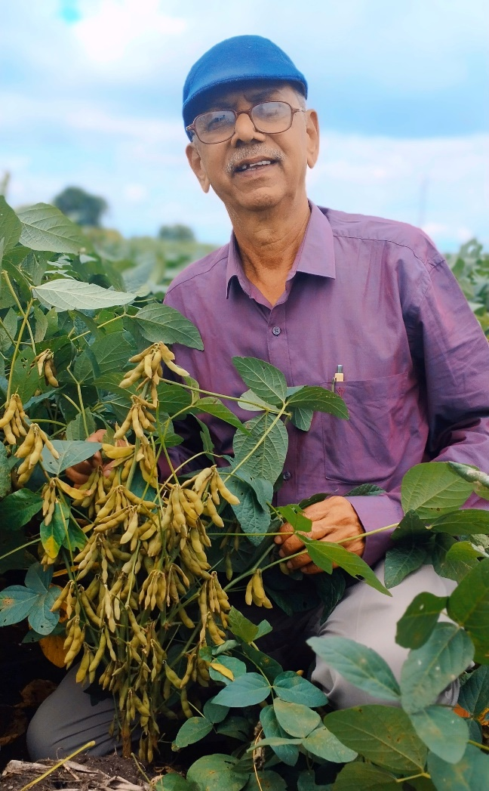
Thank You Very Much!

