Slide 1
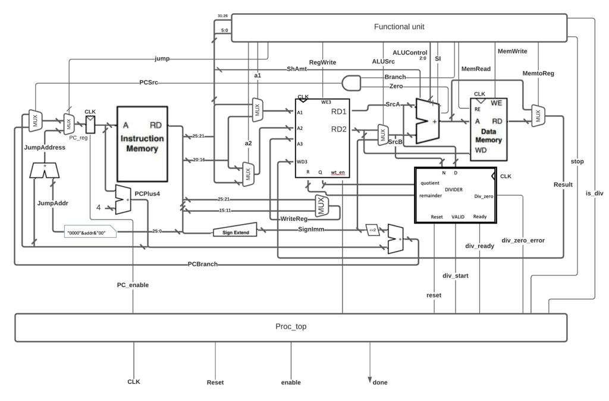
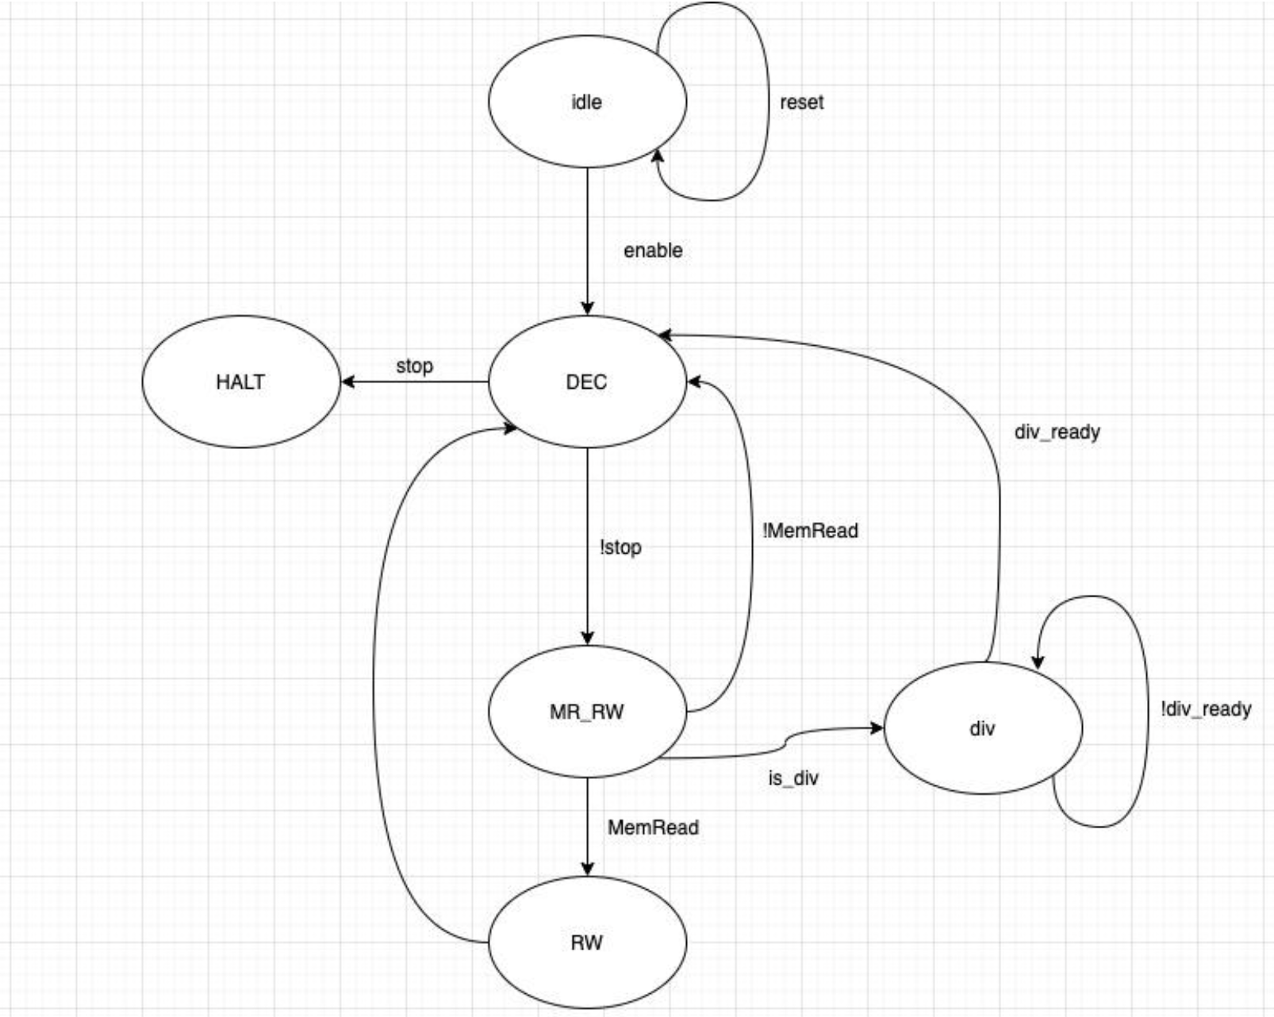
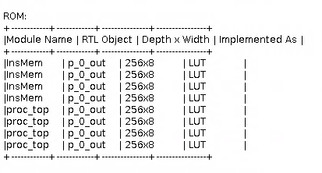
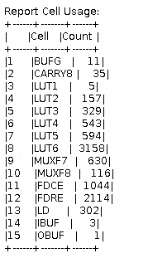
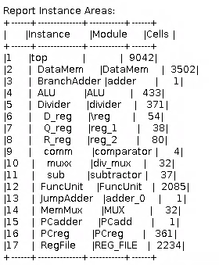
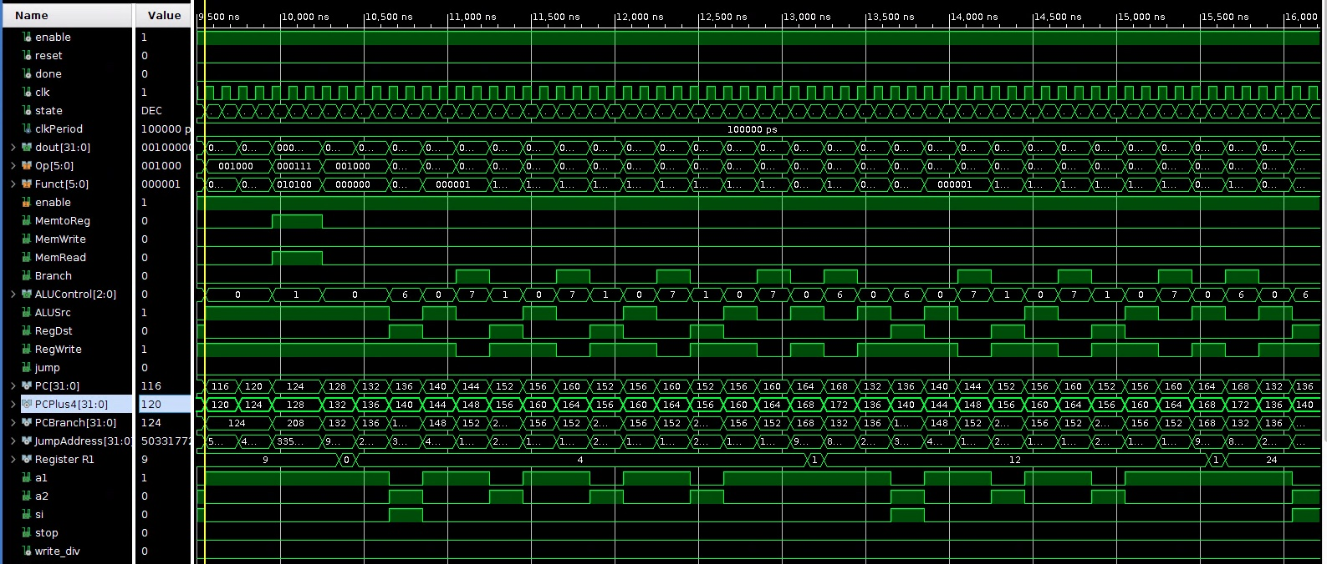
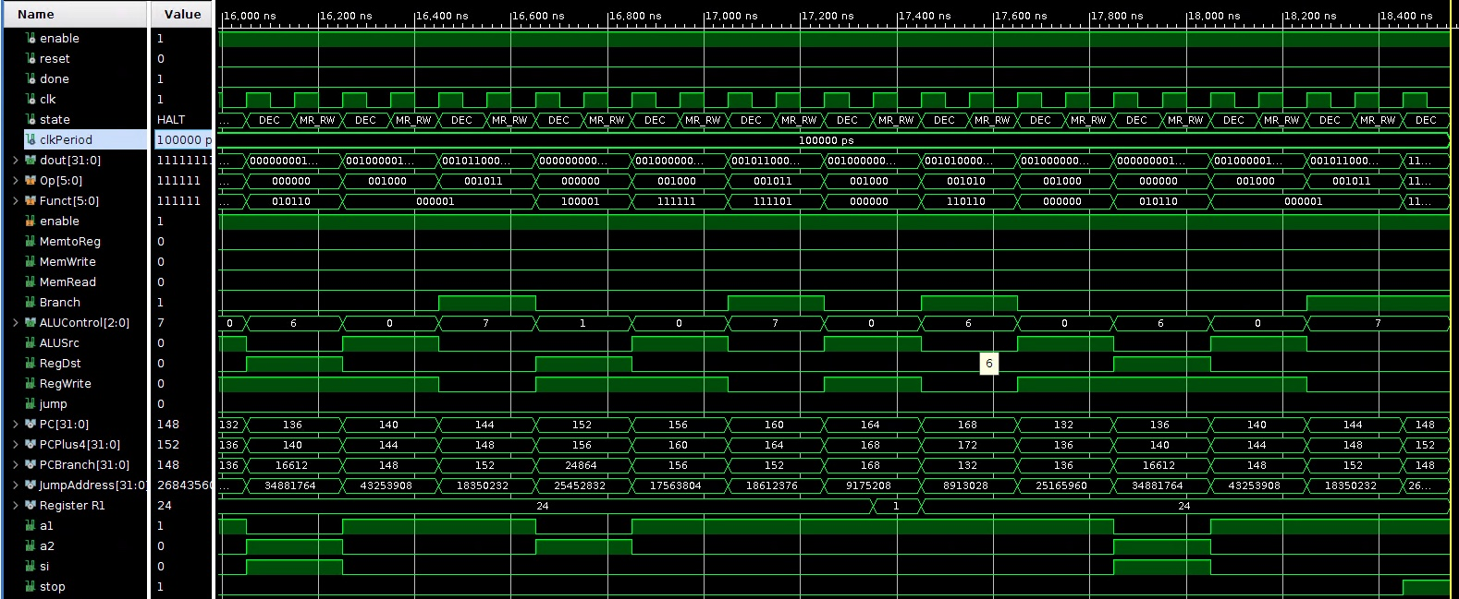

NYU-6463 Processor
Dhananjai Sharma¹, Puneet Rehal¹
¹Department of Electrical and Computer Engineering, Mentors: Prof. Ramesh Karri, Prof. Michail Maniatakos
ADEMIC RESEARCH POSTER TEMPLATE
Subtitle for Academic Research Poster (48x36 inches)
Your names and the names of the people who contributed to this presentation
Modified Diagram of Processor
Finite State Machine Diagram
Maximum Area Utilization
Data Memory
FuncUnit
RegFile
Figure A: neque dignissim, and in aliquet nisl et umis.
Factorial Calculation Simulation
Key Features
Executes R, I, J type and special instructions like XRLR
Uses rising edge of the clock for executing instructions
Uses Euclidean Algorithm for unsigned division
Implements a complex program to calculate the factorial
Uses LUTs instead of RAM for memory
Future Scope
Statistics
Use intermediate buffers for pipelining to increase throughput
Use long division method to reduce clock cycles
Trigger data memory and register file at different clock edges to execute instruction in one cycle
I–type instructions like LOAD takes 3 cycles for execution
J-type instructions take 2 cycles for execution
LOAD and DIVU instructions dominate the latency
Department of Geography
buffalo.edu

