Slide 1
Retail Store Analysis
Batch - AW2
Name- Dhananjay Kumar

Slide 2
Top 5 Stores
StoreName | Amount
Adyar Chennai | 12241430.060000004
Perinthalmanna | 7722680.270000001
Trichy Store | 7240638.87
Hilite Mall | 6627877.99
RS Puram | 6258223.889999999

Slide 3
Which store is performing better in compared to the previous year.
StoreName | Amount | 2021_amount | percent
Kottakkal Store | 551631.07 | 174086.94 | 68.44
Focus Mall | 1030016.4 | 391643 | 61.98
Hilite Mall | 1106186.25 | 451249.48 | 59.21
Marina Mall | 416452 | 183466.96 | 55.95
Adyar Chennai | 977452.45 | 517049.38 | 47.1
Perinthalmanna | 975881.25 | 628229.91 | 35.62
Trichy Store | 447385.01 | 486273.15 | -8.69
RS Puram | 429411.88 | 576307.95 | -34.21
Central Storage Area | 0 | 1898

Slide 4
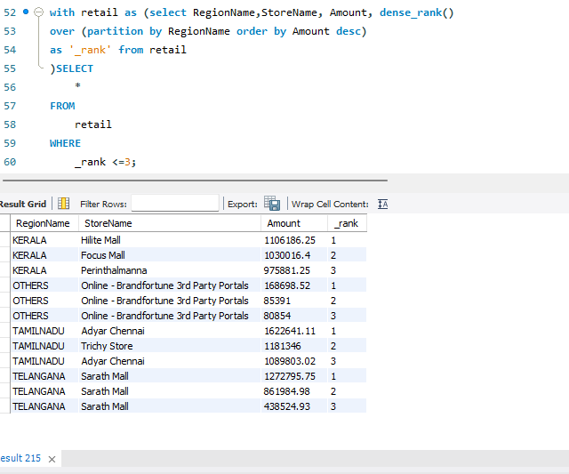
Display the top 3 sales that happened in each region

Slide 5
Give the contribution of sales by region.
RegionName | Amount
TAMILNADU | 37802305.82
KERALA | 25417318.60000001
TELANGANA | 2573305.66
OTHERS | 645828.8999999999

Slide 6
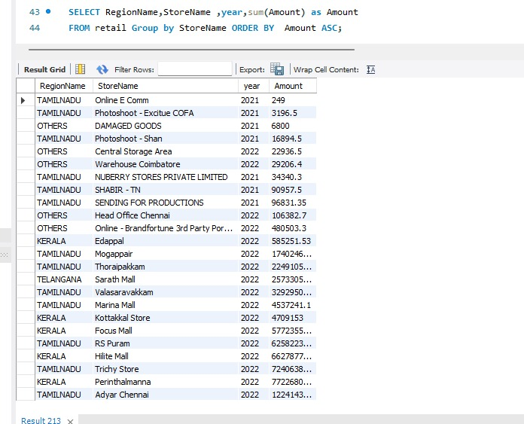
Display low-performing stores by region.

