Slide 1
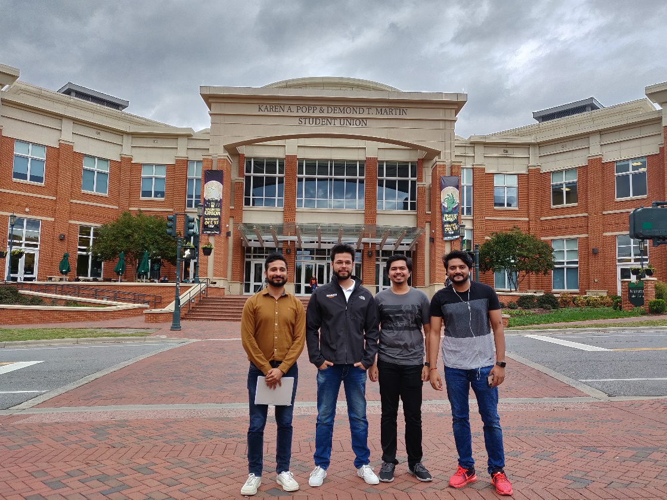
Deliverable 4
Group #7 MAVERICKS
Name | Niner ID | UNCC ID
Dhananjay Arora | 801077164 | darora2
Akshay Babu | 801134117 | ababu1
Sumit Kawale | 801135233 | skawale1
Prashant Madaan | 801081768 | pmadaan

Slide 2
Introduction
NinerEats is a “campus-wide” food delivery service. The application lets people explore restaurant menus, order and get the food delivered at designated locations like dorms, student union, etc. across the campus. It is similar to Uber Eats and DoorDash but the scope of delivery is limited to the university campus area to ensure additional security precautions. Also, only people related to the University as students, faculty, etc. can use the application. We have identified three main actors in the use case:
1. Customer: Explores the menu and places the order.
2. Driver: Picks the food from the restaurant and delivers the order to the designated location.
3. Admin: Maintains and monitors the database.

Slide 3
Scope
The scope of this project is divided into three main categories which are:
database
backend
UI.
The database is an extensive and complete MySQL database with high-level views, stored procs, and triggers. The backend is to act as a broker between the UI and the database with minimal business logic. The UI will be web-based providing the basic CRUD operations.

Slide 4
Business Rules
A Person can be a Student, Faculty, and Staff. They can play individual or multiple roles.
Each person is identified by a key called Person_ID. The person can order zero to many orders.
Faculty_ID will be the local primary key for the Faculty table and referential constraint to Person table using Person_ID.
Staff_ID will be the local primary key for the Staff table and referential constraint to Person
table using Staff_ID. The admin attribute value can take only “Y/N” where Y means staff is an admin and N means staff is not an admin.
Student_ID will be the local primary key for the Student table and referential constraint to Person table using Student_ID. Type attribute will have only graduate or undergraduate values only.
All the delivery persons are students only.
There is a flat fee of $5 for each delivery.
A person can order many times, but an individual delivery is tied to one and only one person for the order. An order can be placed for only one restaurant.
There is a unique identifier (ID) that ties to the id for the order at the individual restaurant.
The restaurant must be approved in order to be included in the restaurant table.

Slide 5
Examples
The food will be delivered by the authorized student who has the authorized driving license.
The final charge for the delivery will contain the total charge from the restaurant and a fixed delivery charge.
Person who orders from the food delivery service will be able to rate the delivery.
The food can be ordered from the approved restaurants only.
Orders are delivered to predetermined locations on UNCC campus.

Slide 6
Assumption
University vehicles are used, and they will be assigned to a particular driver or no driver.
The actual items on the order come from the restaurant database.
Food providers or restaurants have to be approved in order to be included in the database.
NinerEats will start with 8 pre-approved delivery person. They have been cleared as a delivery person.
In the restaurant table only approved restaurants will be added as a record.
Multiple orders can be delivered by a single driver. The driver can use only one vehicle from the university pool of vehicles.

Slide 7
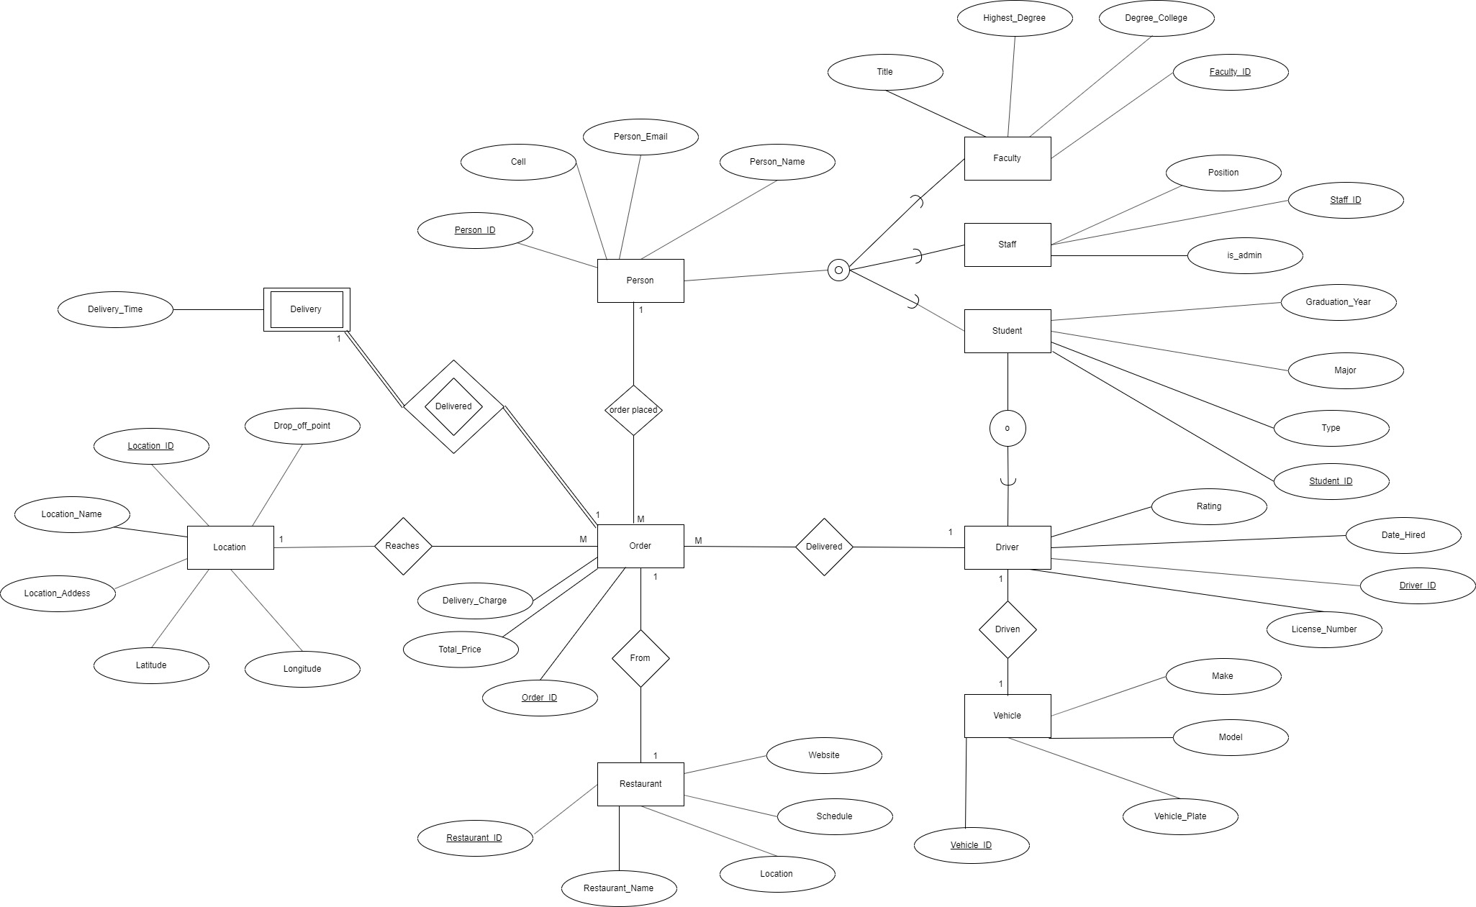
Enhanced Entity Relationship Diagram

Slide 8
Data Dictionary
Entity/Table | Attributes | Primary Key | Foreign Key | Data Type | Field Size | Data Format/Constraints | Null/Not Null | Description
person | person_id | pk |  | int | 11 |  | Not Null | Identification number used to uniquely identify person
 | person_name |  |  | varchar | 300 |  | Null | Name of a person
 | person_email |  |  | varchar | 150 |  | Null | E-mail ID of a person
 | cell |  |  | bigint | 15 | xxxxxxxxxx | Null | Cell/Contact number of a person
faculty | faculty_id | pk |  | int | 11 |  | Not Null | Identification number used to uniquely identify Faculty
 | person_id |  | fk | int | 11 |  | Not Null | Identification number used to uniquely identify person
 | title |  |  | varchar | 75 |  | Null | Title of the faculty
 | degree_college |  |  | varchar | 75 |  | Null | The college where the faculty went to earn the degree
 | highest_degree |  |  | varchar | 75 |  | Null | Highest degree earned by the faculty
staff | staff_id | pk |  | int | 11 |  | Not Null | Identification number used to uniquely identify staff
 | person_id |  | fk | int | 11 |  | Null | Identification number used to uniquely identify person
 | position |  |  | varchar | 75 |  | Null | Position of the staff
 | is_admin |  |  | varchar | 1 | y/n | Null | To check if staff is admin or not

Slide 9
Entity/Table | Attributes | Primary Key | Foreign Key | Data Type | Field Size | Data Format/Constraints | Null/Not Null | Description
student | student_id | pk |  | int | 11 |  | Not Null | Identification number used to uniquely identify student
 | person_id |  | fk | int | 11 |  | Not Null | Identification number used to uniquely identify person
 | graduation_year |  |  | int | 4 |  | Null | Graduation year of the student
 | major |  |  | varchar | 75 |  | Null | Major of the student
 | type |  |  | varchar | 75 |  | Null | To check if the student is graduate or undergraduate student
location | location_id | pk |  | int | 11 |  | Not Null | Identification number used to uniquely identify Location
 | location_name |  |  | varchar | 75 |  | Null | Name of the location
 | location_address |  |  | varchar | 75 |  | Null | Address of the location
 | latitude |  |  | varchar | 75 |  | Null | Latitude point of the location
 | longitude |  |  | varchar | 75 |  | Null | Longitude point of the location
 | drop_off_point |  |  | varchar | 75 |  | Null | Drop off point of order
vehicle | vehicle_id | pk |  | int | 11 |  | Not Null | Identification number used to uniquely identify Vehicle
 | vehicle_plate |  |  | varchar | 75 |  | Null | Vehicle license plate number
 | model |  |  | varchar | 75 |  | Null | Vehicle model name
 | make |  |  | varchar | 75 |  | Null | Vehicle make
driver | driver_id | pk |  | int | 11 |  | Not Null | Identification number used to uniquely identify Driver
 | student_id |  | fk | int | 11 |  | Not Null | Identification number used to uniquely identify student
 | license_number |  |  | varchar | 75 |  | Null | License number of the driver
 | date_hired |  |  | date |  | YYYY-MM-DD | Null | Date when the driver was hired
 | rating |  |  | float | 4 |  | Null | Rating of the river

Slide 10
Entity/Table | Attributes | Primary Key | Foreign Key | Data Type | Field Size | Data Format/Constraints | Null/Not Null | Description
restaurant | restaurant_id | pk |  | int | 11 |  | Not Null | Identification number used to uniquely identify Restaurant
 | location |  |  | varchar | 75 |  | Null | Location of the restaurant
 | restaurant_name |  |  | varchar | 75 |  | Null | Name of the restaurant
 | schedule |  |  | varchar | 75 |  | Null | Opening and closing time of the restaurant
 | website |  |  | varchar | 75 |  | Null | Website link of the restaurant
delivery | delivery_id | pk |  | int | 11 |  | Not Null | Identification number used to uniquely identify Delivery
 | driver_id |  | fk | int | 11 |  | Not Null | Identification number used to uniquely identify Driver
 | vehicle_id |  | fk | int | 11 |  | Not Null | Identification number used to uniquely identify Vehicle
 | delivery_time |  |  | datetime |  | YYYY-MM-DD HH:MI:SS | Null | Time of delivery
order | order_id |  |  | int | 11 |  | Not Null | Identification number used to uniquely identify Order
 | person_id |  | fk | int | 11 |  | Not Null | Identification number used to uniquely identify person
 | delivery_id |  | fk | int | 11 |  | Not Null | Identification number used to uniquely identify Delivery
 | location_id |  | fk | int | 11 |  | Not Null | Identification number used to uniquely identify Location
 | driver_id |  | fk | int | 11 |  | Not Null | Identification number used to uniquely identify Driver
 | restaurant_id |  | fk | int | 11 |  | Not Null | Identification number used to uniquely identify Restaurant
 | total_price |  |  | float | 11 |  | Null | Total price of the order from the restaurant
 | delivery_charge |  |  | float | 11 |  | Null | Delivery charge of the order

Slide 11
ADVANCED SQL STATEMENTS

Slide 12
Stored Procedure
Below stored procedure will insert values in person table, depending on person_type values will be inserted in student/ faculty/ staff tables.
CREATE DEFINER=`root`@`localhost` PROCEDURE `add_person`(in person_name varchar(300), in email varchar(150), cellno bigint (15), person_type varchar(10))
BEGIN
insert into person (person_name, person_email, cell) values(person_name, email, cellno);
if(person_type = 'student') then
insert into student (person_id, graduation_year, major, type) values
((select person_id from person where cell = cellno), 2019, 'Computer Science', 'Graduate');
elseif(person_type = 'faculty') then
insert into faculty (person_id, title, degree_college, highest_degree) values
((select person_id from person where cell = cellno), 'Assistant Professor', 'UCLA', 'PhD');
elseif(person_type = 'staff') then
insert into student (person_id, position, is_admin) values
((select person_id from person where cell = cellno), 'Bus Driver', 'N');
end if;
END
To Call Procedure:
CALL `niner_eats`.`add_person`('Akshay Babu', 'ababu1@uncc.edu’,9802820911,'faculty');

Slide 13
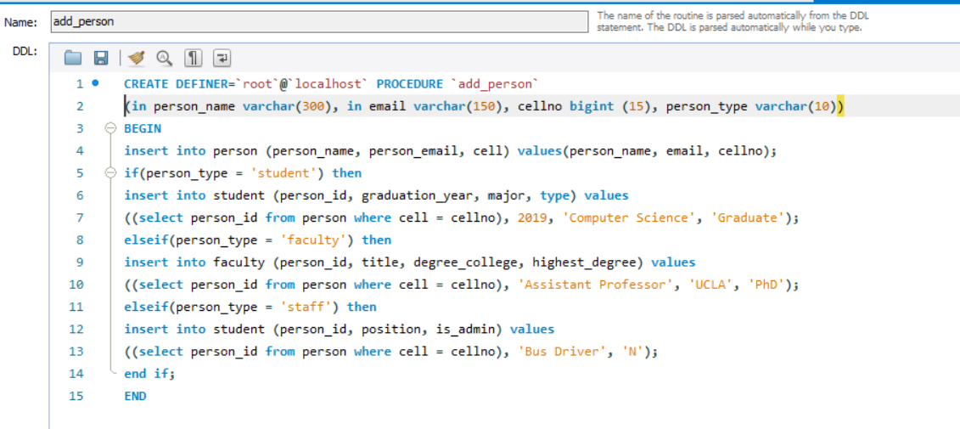

Slide 14
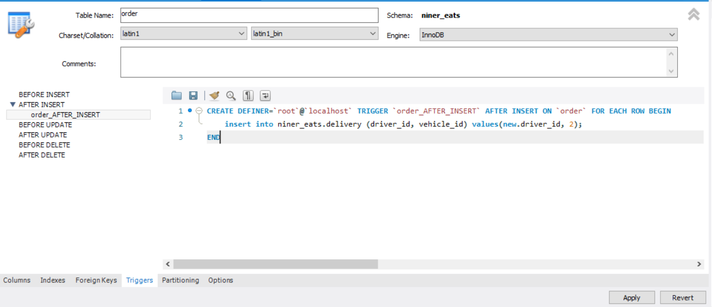
Trigger
The below trigger populates value in delivery table as soon as a new record is created in order table.
CREATE DEFINER=`root`@`localhost` TRIGGER `order_AFTER_INSERT` AFTER INSERT ON `order` FOR EACH ROW BEGIN
insert into niner_eats.delivery (driver_id, vehicle_id) values(new.driver_id, 2);
END

Slide 15
View #1
The below view person_join will contain names of students and their details whose major is Computer Science.
CREATE
ALGORITHM = UNDEFINED
DEFINER = `root`@`localhost`
SQL SECURITY DEFINER
VIEW `niner_eats`.`person_join` AS
SELECT
`niner_eats`.`person`.`person_id` AS `person_id`,
`niner_eats`.`person`.`person_name` AS `person_name`,
`niner_eats`.`person`.`person_email` AS `person_email`,
`niner_eats`.`student`.`student_id` AS `student_id`,
`niner_eats`.`student`.`graduation_year` AS `graduation_year`
FROM
(`niner_eats`.`person`
JOIN `niner_eats`.`student` ON ((`niner_eats`.`student`.`person_id` = `niner_eats`.`person`.`person_id`)))
WHERE
(`niner_eats`.`student`.`major` = 'Computer Science')

Slide 16
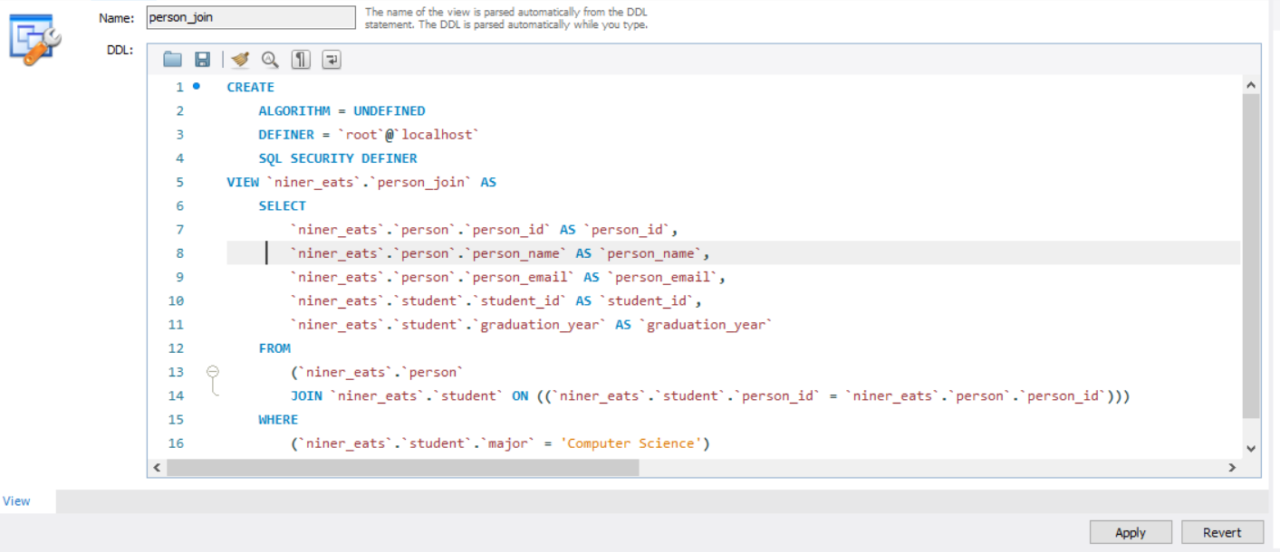
View #1

Slide 17
View #2
The below view person_student will contain the details of students who have graduated in 2019.
CREATE
ALGORITHM = UNDEFINED
DEFINER = `root`@`localhost`
SQL SECURITY DEFINER
VIEW `niner_eats`.`person_student` AS
SELECT
`a`.`person_id` AS `person_id`,
`a`.`person_name` AS `person_name`,
`a`.`person_email` AS `person_email`,
`a`.`cell` AS `cell`
FROM
`niner_eats`.`person` `a`
WHERE
`a`.`person_id` IN (SELECT
`niner_eats`.`student`.`person_id`
FROM
`niner_eats`.`student`
WHERE
(`niner_eats`.`student`.`graduation_year` = 2019))

Slide 18
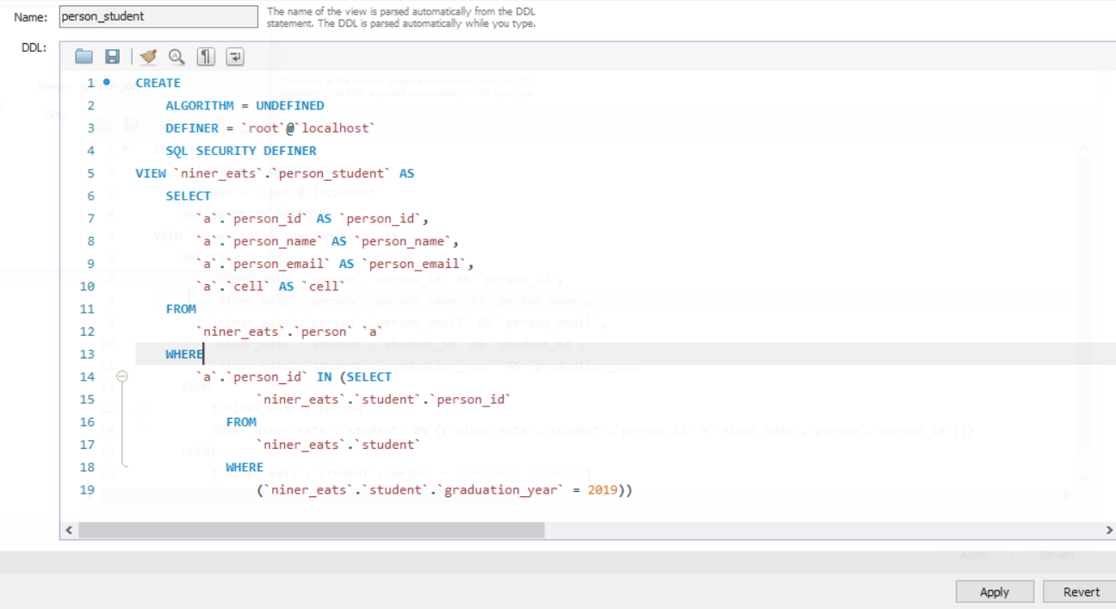
View #2

Slide 19
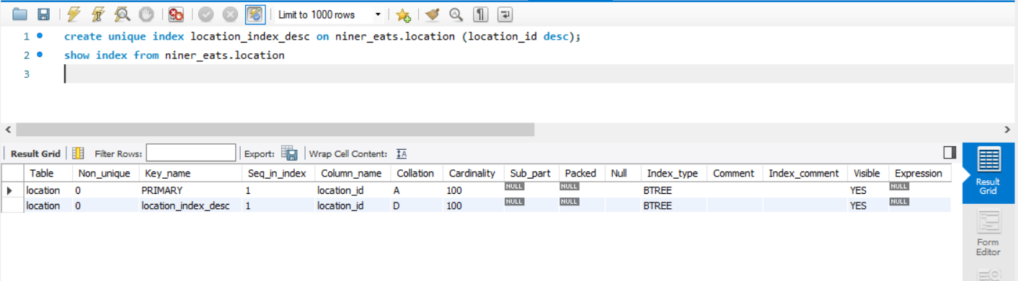
Index
On location table we created an unique index for optimizing query on location_id in descending order.
create unique index location_index_desc on niner_eats.location (location_id desc);
show index from niner_eats.location

Slide 20
User Interface

