Slide 1
















































Machine Learning Basic Concepts
Feature 2
Feature 2
Feature 1
Feature 1
Decision boundary

Slide 2
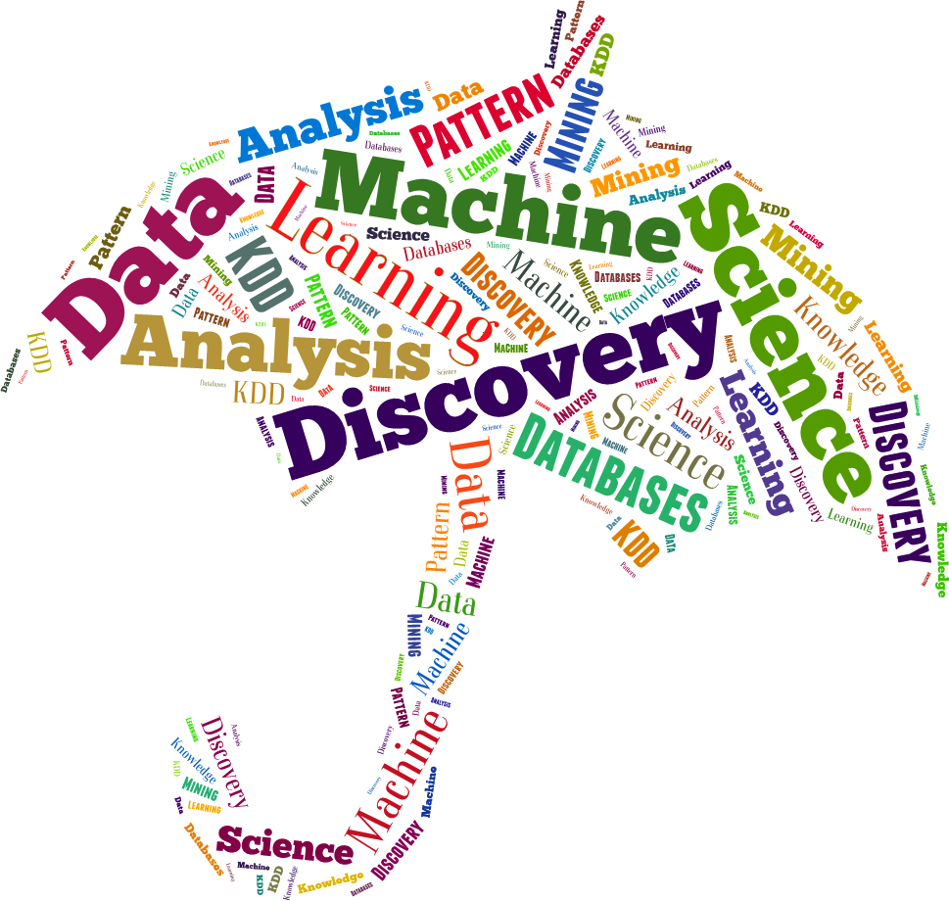
Terminology
Machine Learning, Data Science, Data Mining, Data Analysis, Sta- tistical Learning, Knowledge Discovery in Databases, Pattern Dis- covery.

Slide 3
Data everywhere!
Google: processes 24 peta bytes of data per day.
Facebook: 10 million photos uploaded every hour.
Youtube: 1 hour of video uploaded every second.
Twitter: 400 million tweets per day.
Astronomy: Satellite data is in hundreds of PB.
6. . . .
7. “By 2020 the zettabytes...”
digital universe will reach 44
The Digital Universe of Opportunities: Rich Data and the Increasing Value of the Internet of Things, April 2014.
That’s 44 trillion gigabytes!

Slide 4
Data types
Data comes in different sizes and also flavors (types):
☒ Texts
☒ Numbers
☒ Clickstreams
☒ Graphs
☒ Tables
☒ Images
☒ Transactions
☒ Videos
☒ Some or all of the above!

Slide 5
Smile, we are ’DATAFIED’ !
Wherever we go, we are “datafied”.
Smartphones are tracking our locations.
We leave a data trail in our web browsing.
Interaction in social networks.
Privacy is an important issue in Data Science.

Slide 6

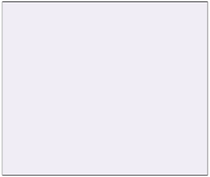
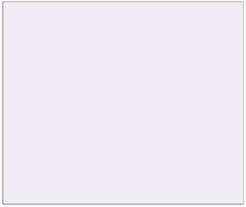






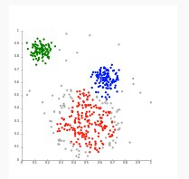

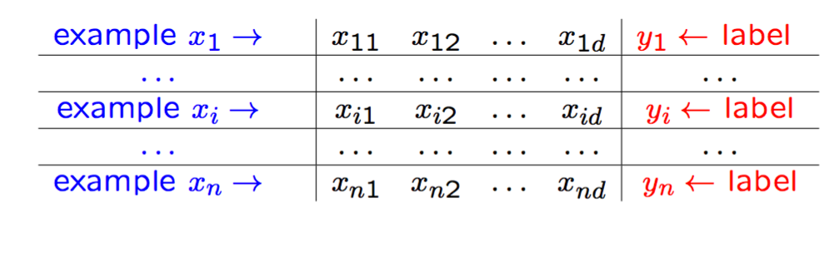

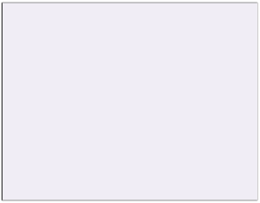
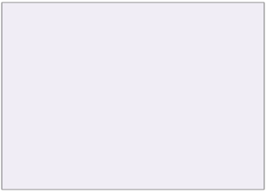
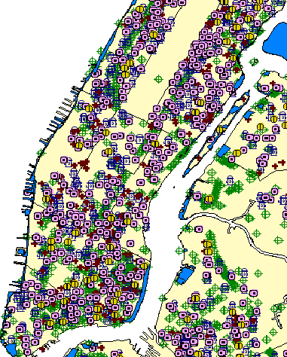
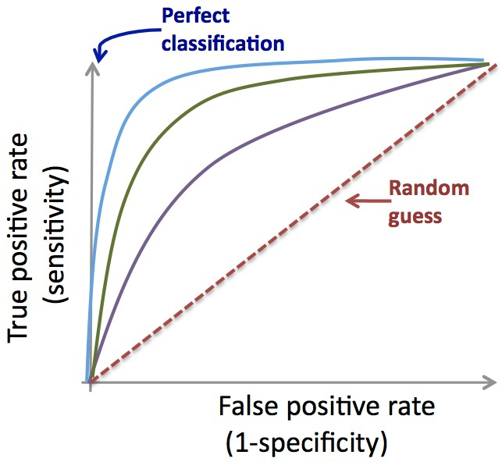





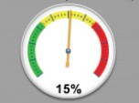

The Data Science process
1
DATA COLLECTION
2
DATA PREPARATION
3
EDA
 |  | Static Data.
A and B  C
Data cleaning
Descriptive statistics, Clustering Research questions?
DB
Static
Data.
Feature/variable engineering
Domain expertise
Time
5
Visualization
4 MACHINE LEARNING
Application deployment
Classification, scoring, predictive models, clustering, density estimation, etc.
+
+
-
+
+
-
-
+
+
-
-
+
+
-
Data-driven decisions
Model (f)
-
Predicted class/risk
Yes / 90%
Dashboard

Slide 7

Applications of ML
We all use it on a daily basis. Examples:

Slide 8
Machine Learning
Spam filtering
Credit card fraud detection
Digit recognition on checks, zip codes
Detecting faces in images
MRI image analysis
Recommendation system
Search engines
Handwriting recognition
Scene classification
etc...

Slide 9








Interdisciplinary field
Statistics
Biology
Visualization
ML
Signal
Engineering
Economics
processing
Databases

Slide 10
ML versus Statistics
Statistics: Machine Learning:
Hypothesis testing
Experimental design
Anova
Linear regression
Logistic regression
GLM
PCA
Decision trees
Rule induction
Neural Networks
SVMs
Clustering method
Association rules
Feature selection
Visualization
Graphical models
Genetic algorithm
http://statweb.stanford.edu/~jhf/ftp/dm-stat.pdf

Slide 11
Machine Learning definition
“How do we create computer programs that improve with experi- ence?”
Tom Mitchell
http://videolectures.net/mlas06_mitchell_itm/

Slide 12
Machine Learning definition
“How do we create computer programs that improve with experi- ence?”
Tom Mitchell
http://videolectures.net/mlas06_mitchell_itm/
“A computer program is said to learn from experience E with respect to some class of tasks T and performance measure P , if its performance at tasks in T , as measured by P , improves with experience E. ”
Tom Mitchell. Machine Learning 1997.

Slide 13
Supervised vs. Unsupervised
Given: Training data: (x₁, y₁), . . . , (xn, yn) / x_{i} ∈ R^{d} and y_{i} is the
label.
example x₁ → | ^{x}11 | ^{x}12 | . . . | ^{x}1d | y₁ ← label
. . . | . . . | . . . | . . . | . . . | . . .
example x_{i} → | ^{x}i1 | ^{x}i2 | . . . | ^{x}id | y_{i} ← label
. . . | . . . | . . . | . . . | . . . | . . .
example xn → | ^{x}n1 | ^{x}n2 | . . . | ^{x}nd | yn ← label

Slide 14
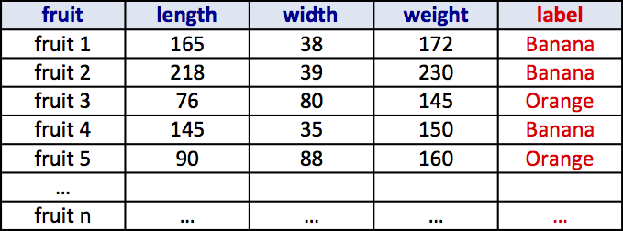
Supervised vs. Unsupervised
Given: Training data: (x₁, y₁), . . . , (xn, yn) / x_{i} ∈ R^{d} and y_{i} is the
label.
example x₁ → | ^{x}11 | ^{x}12 | . . . | ^{x}1d | y₁ ← label
. . . | . . . | . . . | . . . | . . . | . . .
example x_{i} → | ^{x}i1 | ^{x}i2 | . . . | ^{x}id | y_{i} ← label
. . . | . . . | . . . | . . . | . . . | . . .
example xn → | ^{x}n1 | ^{x}n2 | . . . | ^{x}nd | yn ← label

Slide 15
Supervised vs. Unsupervised
Unsupervised learning:
Learning a model from unlabeled data.
Supervised learning:
Learning a model from labeled data.

Slide 16
Unsupervised Learning
Training data:“examples” x.
x₁, . . . , xn, x_{i} ∈ X ⊂ R^{n}
Clustering/segmentation:
f : R^{d} −→ {C₁, . . . C_{k}} (set of clusters).
Example: Find clusters in the population, fruits, species.

Slide 17


































Unsupervised learning
Feature 2
Feature 1

Slide 18













Unsupervised learning
Feature 2
Feature 1

Slide 19
Unsupervised learning
Feature 2
Feature 1
hierarchical
Methods: K-means, gaussian spectral clustering, etc.
mixtures,
clustering,

Slide 20
Supervised learning
Training data:“examples” x with “labels” y.
(x₁, y₁), . . . , (xn, yn) / x_{i} ∈ R^{d}
Classification: y is discrete. To simplify, y ∈ {−1, +1}
f : R^{d} −→ {−1, +1} f is called a binary classifier.
Example: Approve credit yes/no, spam/ham, banana/orange.

Slide 21




































Supervised learning
Feature 2
Feature 1

Slide 22


Supervised learning
Feature 2
Feature 1
Decision Boundary

Slide 23
Supervised learning
Feature 2
Feature 1
Decision Boundary
Support Vector Machines, neural networks, decision
Methods:
trees, K-nearest neighbors, naive Bayes, etc.

Slide 24































































































































































































































Supervised learning
Classification:
Feature 2
Feature 2
Feature 1
Feature 1
Feature 2
Feature 2
Feature 2
Feature 1
Feature 1
Feature 1

Slide 25
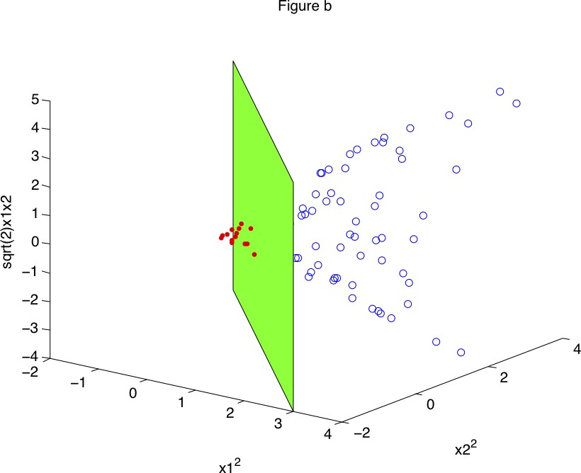
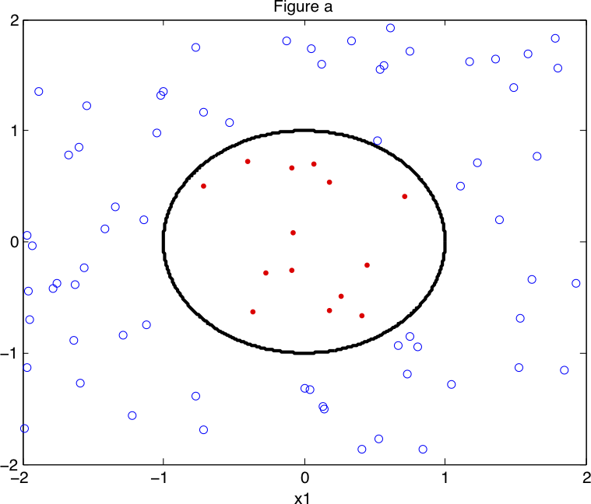
Supervised learning
Non linear classification

Slide 26
Supervised learning
Training data:“examples” x with “labels” y.
(x₁, y₁), . . . , (xn, yn) / x_{i} ∈ R^{d}
Regression: y is a real value, y ∈ R
f : R^{d} −→ R f is called a regressor.
Example: amount of credit, weight of fruit.

Slide 27

















Supervised learning
Regression:
y
Feature 1
Example: Income in function of age, weight of the fruit in function of its length.

Slide 28

Supervised learning
Regression:
y
Feature 1

Slide 29

Supervised learning
Regression:
y
Feature 1

Slide 30


Supervised learning
Regression:
y
Feature 1

Slide 31


Training and Testing
Training Set
ML Algorithm
Model (f)

Slide 32


Training and Testing
Training Set
ML Algorithm
Income ,
Gender,
Age,
Family Status ,
Zipcode
Credit Amount $
Credit Yes/No
Model (f)

Slide 33
K-nearest neighbors
Not every ML method builds a model!
Our first ML method: KNN.
Main idea: Uses the similarity between examples.
Assumption: Two similar examples should have same labels.
Assumes all examples (instances) are points in the d dimen- sional space R^{d}.

Slide 34
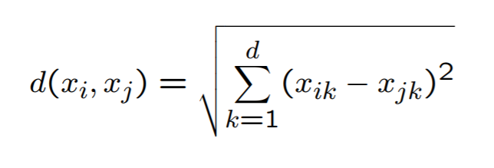
K-nearest neighbors
KNN uses the standard Euclidian distance to define nearest neighbors.
Given two examples x_{i} and x_{j}:
_{d}

Slide 35
K-nearest neighbors
Training algorithm:
Add each training example (x, y) to the dataset D.
x ∈ R^{d}, y ∈ {+1, −1}.

Slide 36
K-nearest neighbors
Training algorithm:
Add each training example (x, y) to the dataset D.
x ∈ R^{d}, y ∈ {+1, −1}.
Classification algorithm:
Given an example xq to be classified. Suppose N_{k}(xq) is the set of the K-nearest neighbors of xq.
Σ
yˆq = sign( y_{i})
x_{i}∈N_{k}(xq)

Slide 37
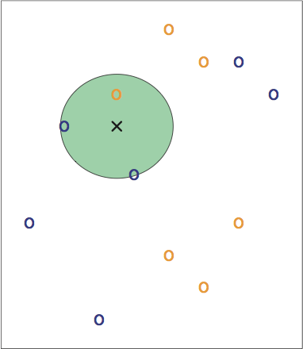
K-nearest neighbors
3-NN. Credit: Introduction to Statistical Learning.

Slide 38
K-nearest neighbors
3-NN. Credit: Introduction to Statistical Learning.
Question: Draw an approximate decision boundary for K = 3?

Slide 39
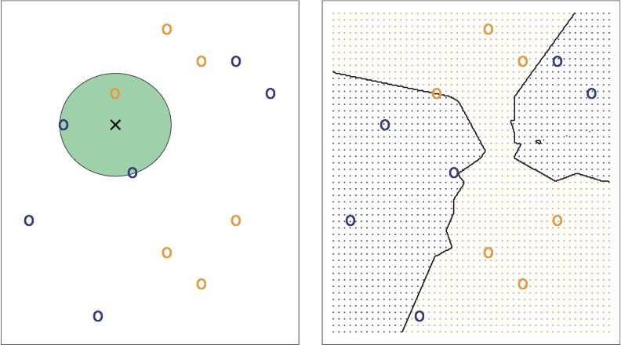
K-nearest neighbors
Credit: Introduction to Statistical Learning.

Slide 40
K-nearest neighbors
Question: What are the pros and cons of K-NN?

Slide 41
K-nearest neighbors
Question: What are the pros and cons of K-NN?
Pros:
+ Simple to implement.
+ Works well in practice.
+ Does not require to build a model, make assumptions, tune parameters.
+ Can be extended easily with news examples.

Slide 42
K-nearest neighbors
Question: What are the pros and cons of K-NN?
Pros:
+ Simple to implement.
+ Works well in practice.
+ Does not require to build a model, make assumptions, tune parameters.
+ Can be extended easily with news examples.
Cons:
Requires large space to store the entire training dataset.
Slow! Given n examples and d features. The method takes
O(n × d) to run.
Suffers from the curse of dimensionality.

Slide 43
Applications of K-NN
Information retrieval.
Handwritten character classification using nearest neighbor in large databases.
Recommender systems (user like you may like similar movies).
Breast cancer diagnosis.
Medical data mining (similar patient symptoms).
Pattern recognition in general.

Slide 44
Training and Testing
Training Set
ML Algorithm
Income ,
Gender,
Age,
Family Status ,
Zipcode
Credit Amount $
Credit Yes/No
Model (f)
Question: How can we be confident about f ?

Slide 45
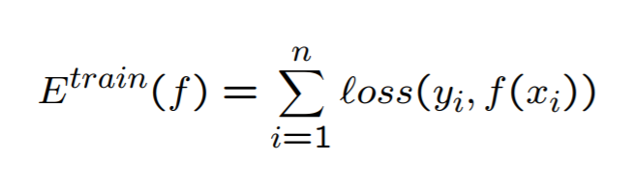
Training and Testing
We calculate E^{train} the in-sample error (training error or em- pirical error/risk).

Slide 46
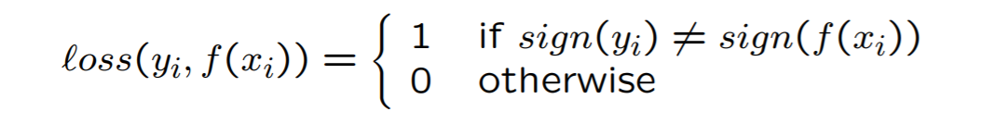
Training and Testing
We calculate E^{train} the in-sample error (training error or em- pirical error/risk).
Examples of loss functions:
– Classification error:
.

Slide 47

Training and Testing
We calculate E^{train} the in-sample error (training error or em- pirical error/risk).
Examples of loss functions:
– Classification error:
.
– Least square loss:

Slide 48
Training and Testing
We calculate E^{train} the in-sample error (training error or em- pirical error/risk).
We aim to have E^{train}(f ) small, i.e., minimize E^{train}(f )

Slide 49
Training and Testing
We calculate E^{train} the in-sample error (training error or em- pirical error/risk).
We aim to have E^{train}(f ) small, i.e., minimize E^{train}(f )
We hope that E^{test}(f ), the out-sample error (test/true error), will be small too.

Slide 50

Overfitting/underfitting
An intuitive example

Slide 51

Structural Risk Minimization
High Bias Low Variance
Low Bias High Variance
Prediction Error
Test error
Training error
UnderﬁAng
Good models OverﬁAng
Complexity of the model
Low
High

Slide 52











Training and Testing
Income
Income
Age
Age
Income
Age

Slide 53
Training and Testing
Income
Income
Age
Age
High bias (underfitting)
Income
Age

Slide 54
Training and Testing
Income
Income
Age
Age
High bias (underfitting)
Income
Age
High variance (overfitting)

Slide 55
Training and Testing
Income
Income
Age
Age
High bias (underfitting)
Just right!
Income
Age
High variance (overfitting)

Slide 56
Avoid overfitting
In general, use simple models!
Reduce the number of features manually or do feature selec- tion.
Do a model selection (ML course).
Use regularization (keep the features but reduce their impor- tance by setting small parameter values) (ML course).
Do a cross-validation to estimate the test error.

Slide 57
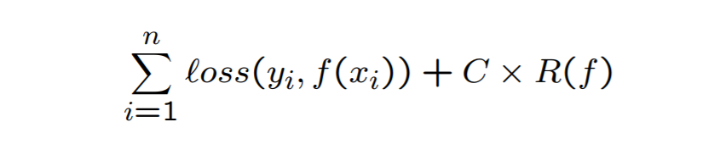
Regularization: Intuition
We want to minimize:
Classification term + C × Regularization term

Slide 58
Regularization: Intuition
Income
Income
Income
Age
Age
Age
f (x) = λ₀ + λ₁x ... (1)
f (x) = λ₀ + λ₁x + λ₂x² ... (2)
f (x) = λ₀ + λ₁x + λ₂x² + λ₃x³ + λ₄x⁴ ... (3)
Hint: Avoid high-degree polynomials.

Slide 59
Train, Validation and Test
TRAIN | VALIDATION | TEST
Example: Split the data randomly into 60% for training, 20% for validation and 20% for testing.

Slide 60
Train, Validation and Test
TRAIN | VALIDATION | TEST
1. Training set is a set of examples used for learning a model (e.g., a classification model).

Slide 61
Train, Validation and Test
TRAIN | VALIDATION | TEST
Training set is a set of examples used for learning a model (e.g., a classification model).
Validation set is a set of examples that cannot be used for learning the model but can help tune model parameters (e.g., selecting K in K-NN). Validation helps control overfitting.

Slide 62
Train, Validation and Test
TRAIN | VALIDATION | TEST
Training set is a set of examples used for learning a model (e.g., a classification model).
Validation set is a set of examples that cannot be used for learning the model but can help tune model parameters (e.g., selecting K in K-NN). Validation helps control overfitting.
Test set is used to assess the performance of the final model and provide an estimation of the test error.

Slide 63
Train, Validation and Test
TRAIN | VALIDATION | TEST
Training set is a set of examples used for learning a model (e.g., a classification model).
Validation set is a set of examples that cannot be used for learning the model but can help tune model parameters (e.g., selecting K in K-NN). Validation helps control overfitting.
Test set is used to assess the performance of the final model and provide an estimation of the test error.
Note: Never use the test set in any way to further tune the parameters or revise the model.

Slide 64

K-fold Cross Validation
A method for estimating test error using training data.
Algorithm:
Given a learning algorithm A and a dataset D
Step 1: Randomly partition D into k equal-size subsets D₁, . . . , D_{k}
Step 2:
For j = 1 to k
Train A on all D_{i}, i ∈ 1, . . . k and i ƒ= j, and get f_{j}. Apply f_{j} to D_{j} and compute E^{Dj}
Step 3: Average error over all folds.

Slide 65
Confusion matrix
 |  | Actual Label
 |  | Positive | Negative
Predicted Label | Positive | True Positive (TP) | False Positive (FP)
 | Negative | False Negative (FN) | True Negative (TN)

Slide 66
Evaluation metrics
 |  | Actual Label
 |  | Positive | Negative
Predicted Label | Positive | True Positive (TP) | False Positive (FP)
 | Negative | False Negative (FN) | True Negative (TN)
Accuracy | (TP+TN) / (TP+TN+FP+FN) | The percentage of predictions that are correct
Precision | TP / (TP+FP) | The percentage of positive predictions that are correct
Sensitivity (Recall) | TP / (TP+FN) | The percentage of positive cases that were predicted as positive
Specificity | TN / (TN+FP) | The percentage of negative cases that were predicted as negative

Slide 67
Terminology review
Review the concepts and terminology:
Instance, example, feature, label, supervised learning, unsu- pervised learning, classification, regression, clustering, pre- diction, training set, validation set, test set, K-fold cross val- idation, classification error, loss function, overfitting, under- fitting, regularization.

Slide 68
Machine Learning Books
Tom Mitchell, Machine Learning.
Abu-Mostafa, Yaser S. and Magdon-Ismail, Malik and Lin, Hsuan-Tien, Learning From Data, AMLBook.
The elements of statistical learning. Data mining, inference, and prediction T. Hastie, R. Tibshirani, J. Friedman.
Christopher Bishop. Pattern Recognition and Machine Learn- ing.
Richard O. Duda, Peter E. Hart, David G. Stork. Pattern Classification. Wiley.

Slide 69
Machine Learning Resources
Major journals/conferences: ICML, NIPS, UAI, ECML/PKDD, JMLR, MLJ, etc.
Machine learning video lectures:
http://videolectures.net/Top/Computer_Science/Machine_Learning/
Machine Learning (Theory):
http://hunch.net/
LinkedIn ML groups: “Big Data” Scientist, etc.
Women in Machine Learning:
https://groups.google.com/forum/#!forum/women-in-machine-learning
KDD nuggets http://www.kdnuggets.com/

Slide 70
Credit
The elements of statistical learning. Data mining, inference, and prediction. 10th Edition 2009. T. Hastie, R. Tibshirani,
J. Friedman.
Machine Learning 1997. Tom Mitchell.

