Slide 1

Notes:
Module – Welcome to Agile Boot Camp (Day1)

Slide 2
What is Machine Learning?
Notes:
Module 1 –What is Agile?

Slide 3
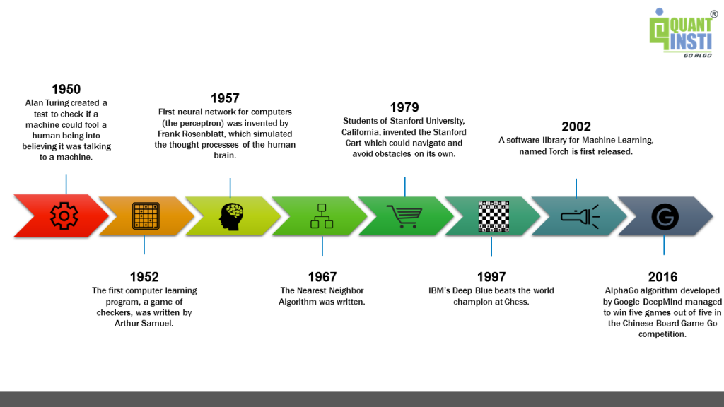
History of Machine learning
Notes:
Module 1 –What is Agile?

Slide 4
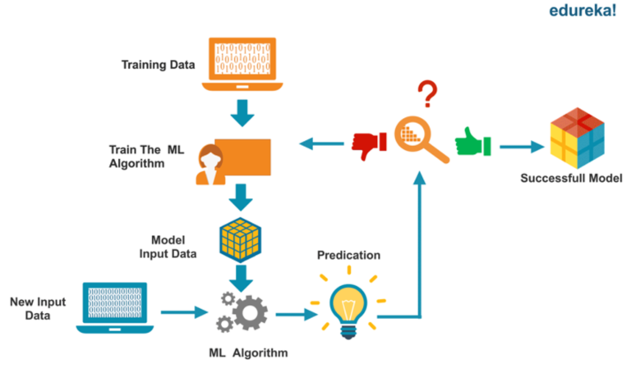
Overview of Machine Learning
Machine learning is a subset of Data Science which provides machines the ability to learn automatically and improve from experience without being explicitly programmed.
Notes:
Module 1 –What is Agile?

Slide 5
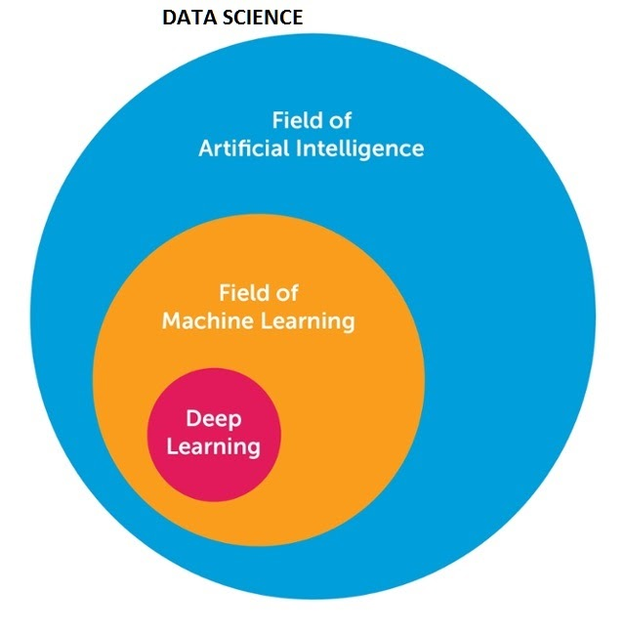
Data Science vs AI vs ML vs Deep Learning
Artificial Intelligence
A technique which enables machines to mimic human behavior.
Machine Learning
Subset of AI techniques which use statistical methods to enable machines to improve with experience
Deep Learning
Subset of ML which make the computation of multi-layer neural network feasible
Notes:
Module 1 –What is Agile?

Slide 6
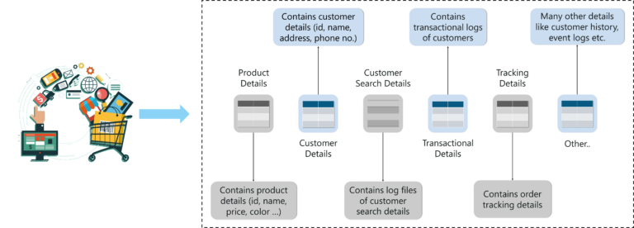
Use Case – Recommendation System
Notes:
Module 1 –What is Agile?

Slide 7
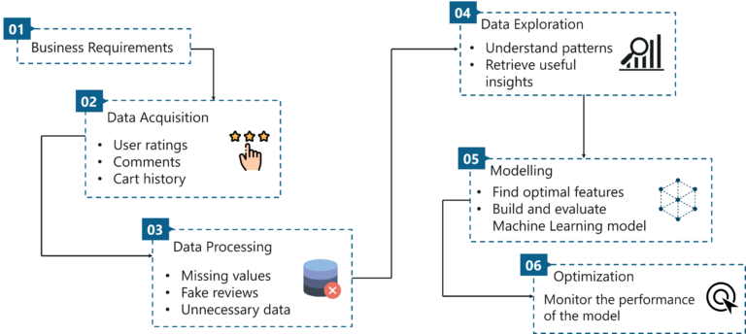
Data Science Lifecyle
Notes:
Module 1 –What is Agile?

Slide 8
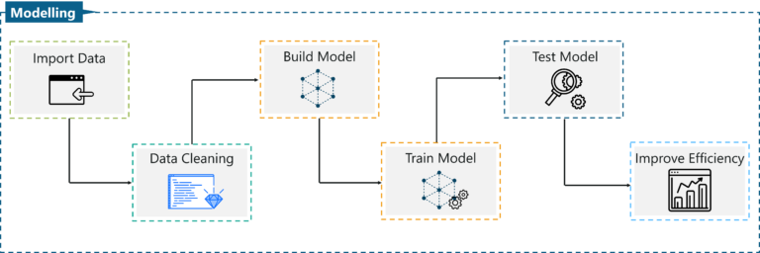
Where does Machine Learning fit in?
Notes:
Module 1 –What is Agile?

Slide 9
When do we use ML?
When should we not use ML?
Classification: Machine learning is a great tool when you need to divide objects into two or more pre-defined groups.
Clustering: ML discovers patterns in chaos
Regression: Future prediction
Dimensionality Reduction: ML can choose which data are the most significant
Not Enough Data
Noisy Data
No Time and Money
Simple Problem to Solve
Notes:
Module 1 –What is Agile?

Slide 10
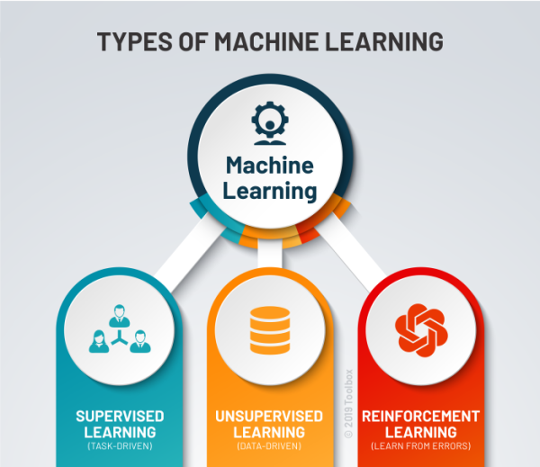
Notes:
Module 1 –What is Agile?

Slide 11
Supervised Learning
Notes:
Module 1 –What is Agile?

Slide 12
Supervised Learning
Supervised learning algorithms are trained using labeled examples, such as an input where the desired output is known.
It is commonly used in applications where historical data predicts/classify likely future events.
For example, a segment of text could have a category label, such as:
Spam vs. Legitimate Email
Positive vs. Negative Movie Review

Slide 13
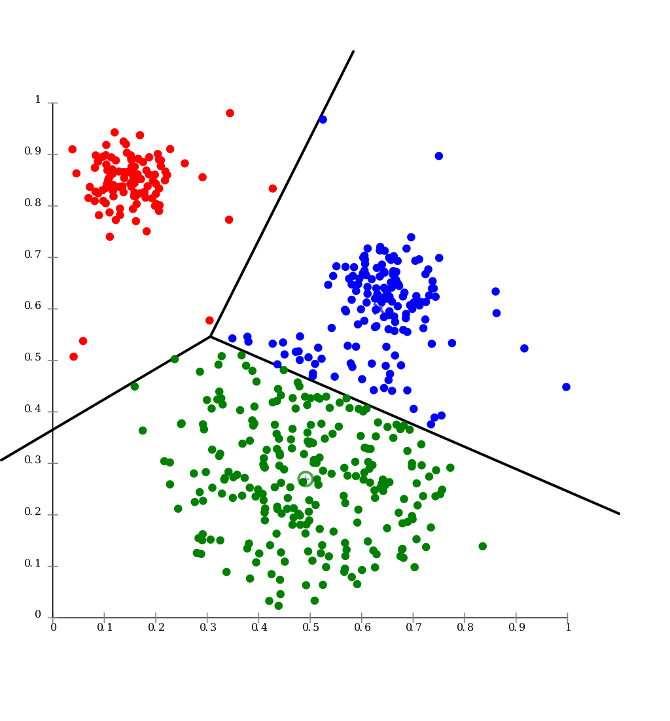
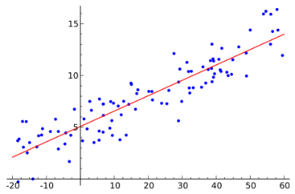
Types of Supervised Learning Problems
Classification
Regression
Predict whether a given input belongs to one of multiple classes
Output is discrete
Given the input, predict a continuous output
Output is continuous
Notes:
Two main types of supervised learning problems

Slide 14
Supervised Learning Algorithms
Classification
Regression
Logistic Regression
Naïve Bayes
K-Nearest Neighbors
Decision Tree
Random Forest
Support Vector Machine
Linear Regression
Polynomial Regression
Decision Tree
Random Forest
Naïve Bayes
Support Vector Machine
Notes:
Two main types of supervised learning problems

Slide 15

Linear Regression
Regression Analysis is one of the most widely used method for prediction.
A linear regression is a linear approximation of a causal relationship between two or more variables.
Central to simple linear regression is the formula for a straight line that is most commonly represented as y = mx + c or y = a + bx . Statisticians however generally prefer to use the following form involving betas:

Slide 16
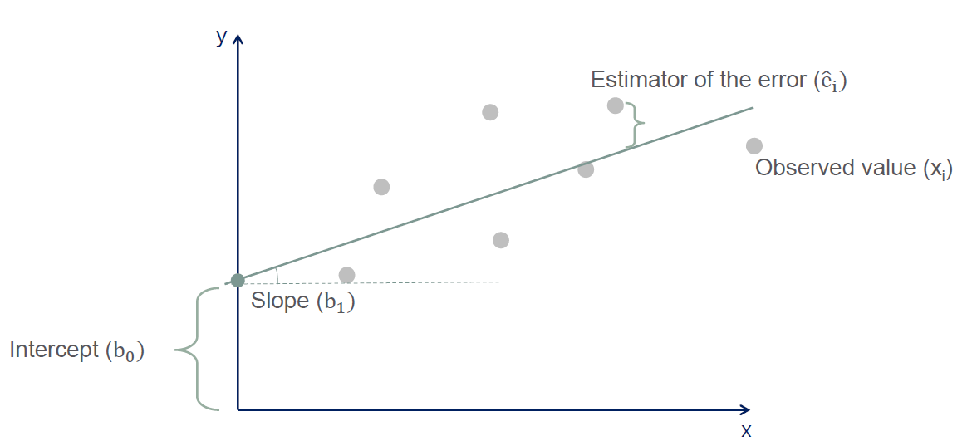
Linear Regression (Continued…)
x = independent (or predictor or explanatory) variable
y = dependent (or response) variable

Slide 17
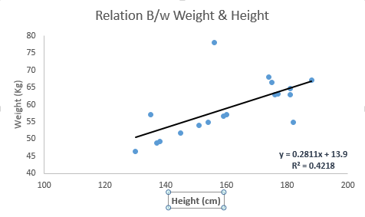
Linear Regression (Continued…)
Examples of Linear Regression
Weight and Height
Advertising and Sales
Forecasting Revenues and expenses
Height | Weight | Outcome from LR
130 | 46 | 50.4
135 | 57.5 | 51.8
137 | 48 | 52.4
138 | 48.5 | 52.7
145 | 52.5 | 54.7

Slide 18
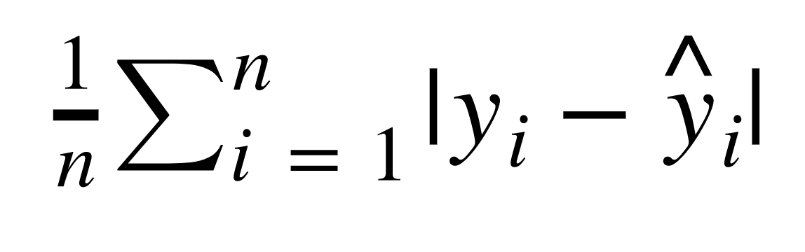
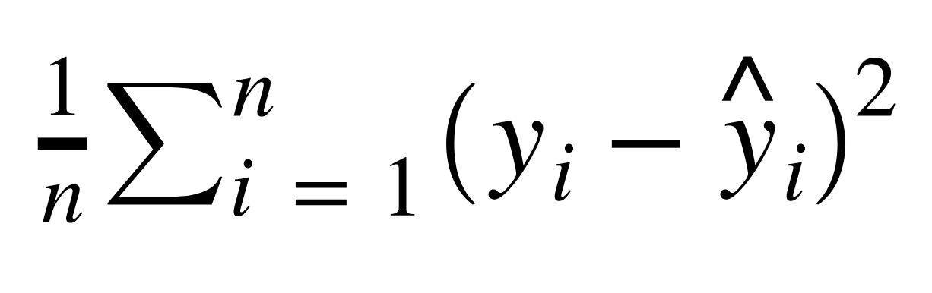
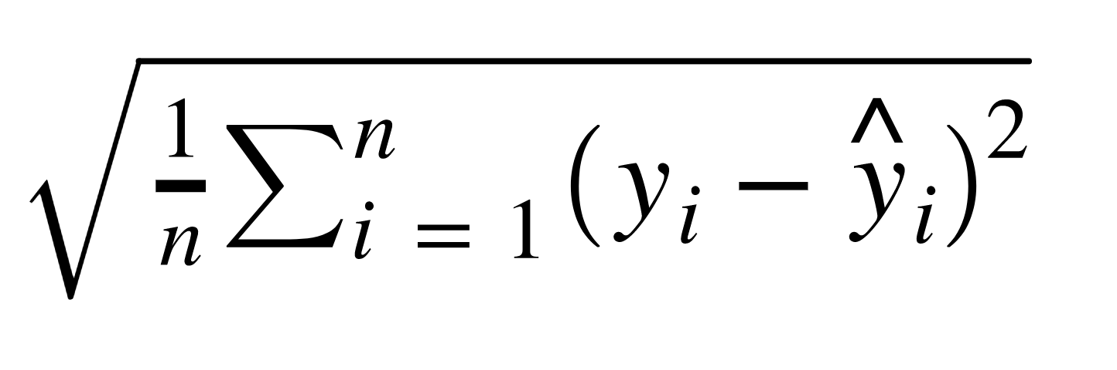
Evaluating Performance
Mean Absolute Error (MAE) = 4.14
Mean Squared Error (MSE) = 35.66
Root Mean Square Error (RMSE) = 5.97

Slide 19
Unsupervised Learning
Notes:
Module 1 –What is Agile?

Slide 20
Unsupervised Learning
Unsupervised learning is used where the data is not labeled and requires segregation based on a hidden feature.
It is commonly used in applications where machine tries to identify patterns and accordingly determine a response.
For example, based on the historical data, unsupervised learning can help with:
Recommending movies based on viewing patterns.
Likelihood of a product being sold along with some other product.

Slide 21
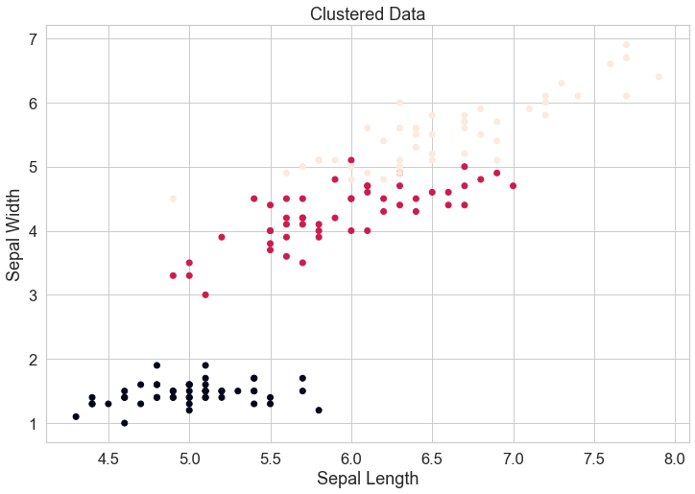
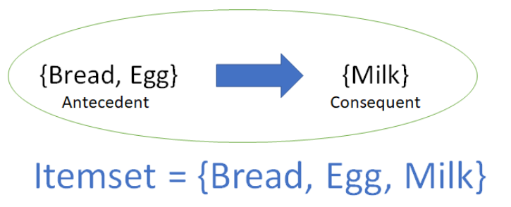
Types of Unsupervised Learning Problems
Classification
Association
Group the data points based on similarities.
Identify relationships amongst data objects in data set.
Notes:
Two main types of supervised learning problems

Slide 22
Unsupervised Learning Algorithms
Classification
Association
K-Means
K-Medians
Hierarchical Clustering
Expectation Maximization Algorithms
Apriori Algorithm
Eclat Algorithm
Notes:
Two main types of supervised learning problems

Slide 23
K-Means Clustering
Assume the number of clusters(k-value) and define k initial centroids.
Assign each instance in data set to the cluster centroid closest to it.
Move each of the k centroids to the average of all the instances that were assigned to that cluster centroid
Repeat until centroids stop changing.

Slide 24
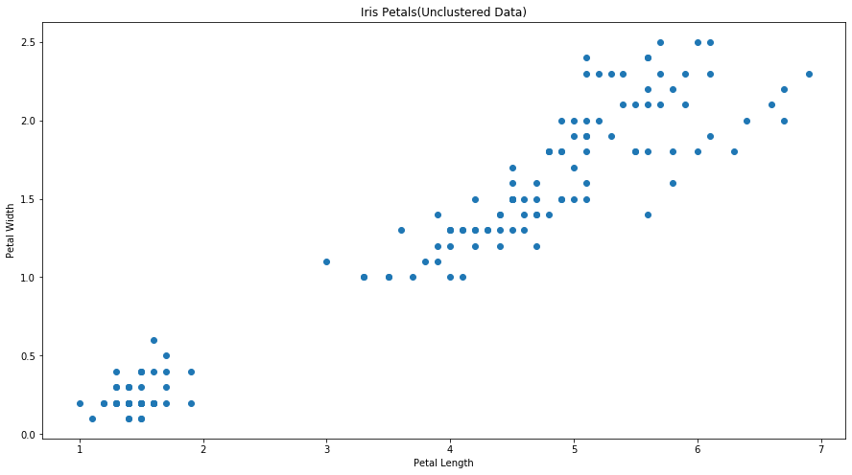

K-Means Clustering(Example)
In this example we would be identifying the IRIS flower based on the features namely petal length and petal width.

Slide 25
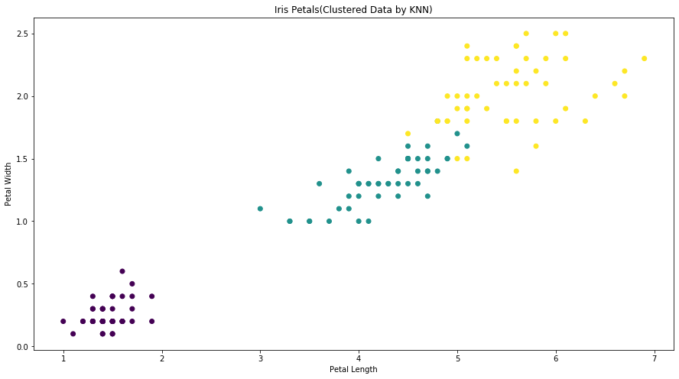
K-Means Clustering(Example)
At first iteration we are able to segregate different types based on the petal length and petal width, however, there is an overlap between 2 clusters

Slide 26
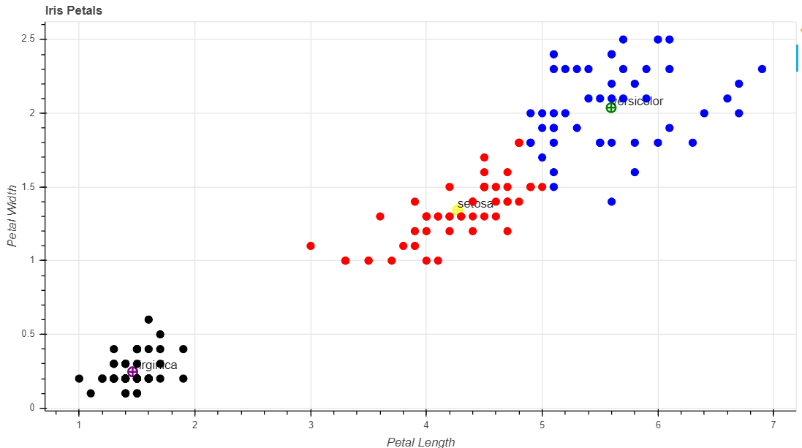
K-Means Clustering(Example)
After multiple iterations(once the centroids stop changing), the data is classified accurately into 3 different type of IRIS flower.

Slide 27
Underfitting and Overfitting
Notes:
Module 1 –What is Agile?

Slide 28
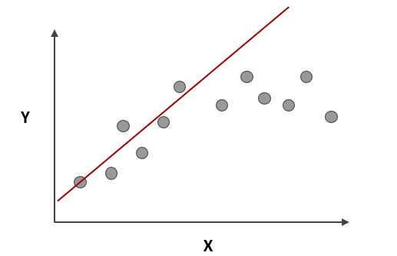
Underfitting
Model does not capture the underlying trend of the data and does not fit the data well enough.
Low variance but high bias.
It is often a result of an excessively simple model.

Slide 29
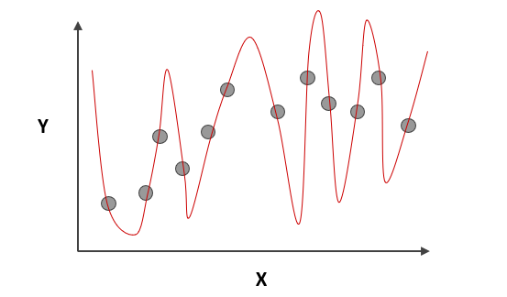
Overfitting
The model fits too much to the noise from the data Low variance but high bias.
This often results in low error on training sets but high error on test/validation sets.

Slide 30
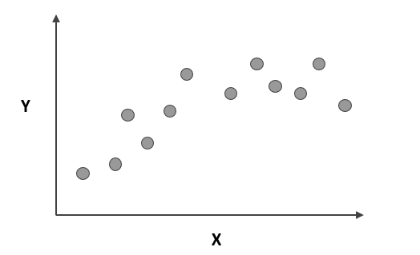
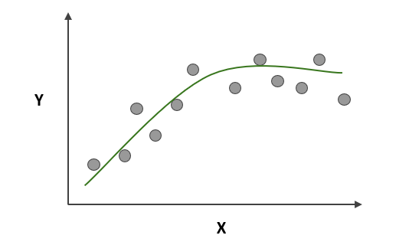
Good Model
Captures the underlying logic of the dataset
Low Bias and Low Variance

