Slide 1
Road Damage Detection using Image Processing
ICT2403 – Graphics and Image Processing
University: Rajarata University of Sri Lanka
Group: 13
Member Name | Registration Number | Index Number
Mr.H.M.T.D.M.Amarasingha | ICT/2023/058 | 6046
Mr.H.M.N.R.B.Herath | ICT/2023/059 | 6047
Mr.D.M.R.V.Dissanayaka | ICT/2023/060 | 6048
Mr.D.S.M.D.B.Subasingha | ICT/2023/083 | 6065

Slide 2
Introduction
Road damage detection is important for maintenance and safety
Manual inspection is slow and inefficient
This project uses image processing techniques to detect road damages
Focus on:
Cracks
Potholes
Road markings

Slide 3
Objective
Detect different types of road degradation
Segment damaged regions from video frames
Mark and visualize detected damages
Evaluate performance of segmentation

Slide 4
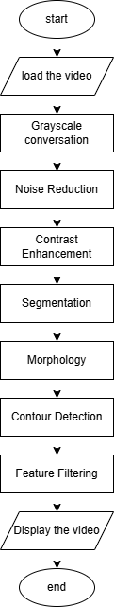
System Pipeline

Slide 5
Image Enhancement
Convert to grayscale
Histogram equalization → improves contrast
Gaussian blur → reduces noise
Output: Clearer frames for segmentation

Slide 6
Segmentation
Thresholding:
Bright regions → road markings
Dark regions → potholes
Canny edge detection → cracks
Combined mask created
Output: Binary segmented image

Slide 7
Morphology
Morphological closing → removes noise
Contour detection → finds objects
Area filtering:
Small → ignore
Medium → cracks
Large → potholes

Slide 8
Final Output
Bounding boxes drawn
Labels added:
Cracks
Potholes
Lines
Output video generated
Shows real-time detection

Slide 9
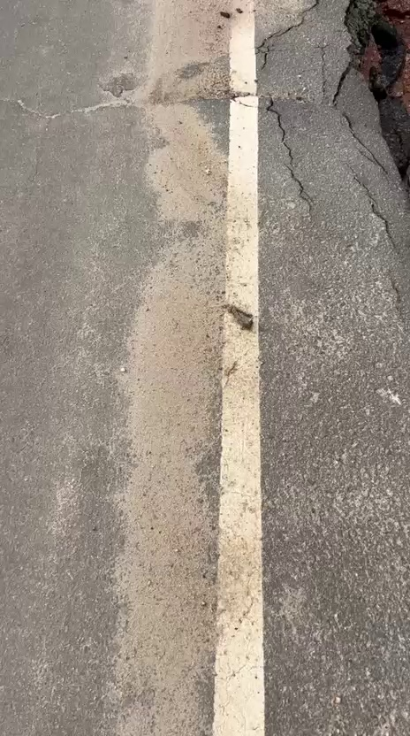
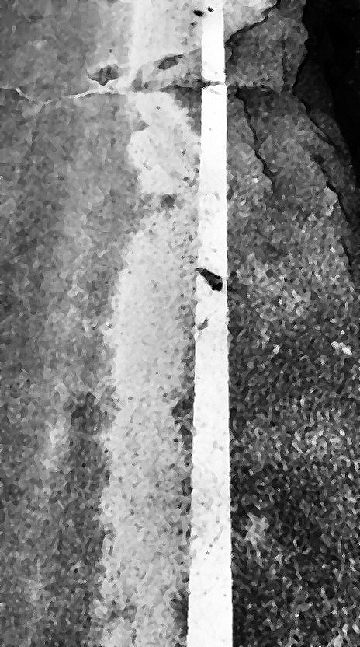

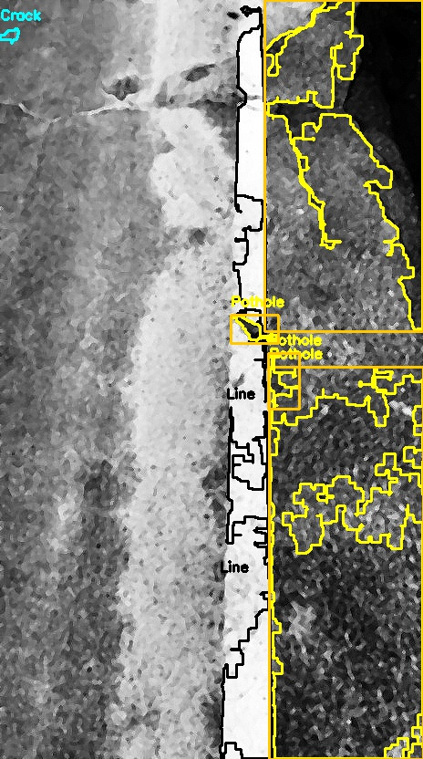
Results
Original enhanced segmented mask final output

Slide 10
Challenges
Shadows detected as potholes
Low contrast cracks difficult to detect
Motion blur reduces edge detection
Similar textures cause false detection

Slide 11
Future Improvements
Use adaptive thresholding
Improve crack detection
Use machine learning / deep learning
Better dataset with ground truth

Slide 12
Thank You!

