Slide 1
ADMISSION CELL CHAT BOT (USING PYTHON)
PROVIDING INTELLIGENT DYPCET ASSISTANT
DYPCET intelligent ChatBot especially designed for admission cell to provide the user ease and comfort during a hectic process of admission of their loved one in our institute

Slide 2
Problem Statement
The traditional user service methods like phone calls, emails, and social media messages can take a lot of time to address user concerns.
Often face challenges in providing timely and efficient solutions.
Project 01

Slide 3
Provided Solution
Develop an intelligent chatbot that can understand the user’s queries and provide immediate and accurate responses.
Also provide an engaging interface to solve issues.
DYPCET Admission Cell
ChatBot

Slide 4




Objectives
Improving customer service
2) Streamlining communication
3) Increasing engagement
4) Automating tasks
5) Improve accessibility
6) Providing reliable services
Existing Systems

Slide 5
Features
-Handle range of enquiries
-NLP based accurate reply
-Provide seamless experience to user

Slide 6
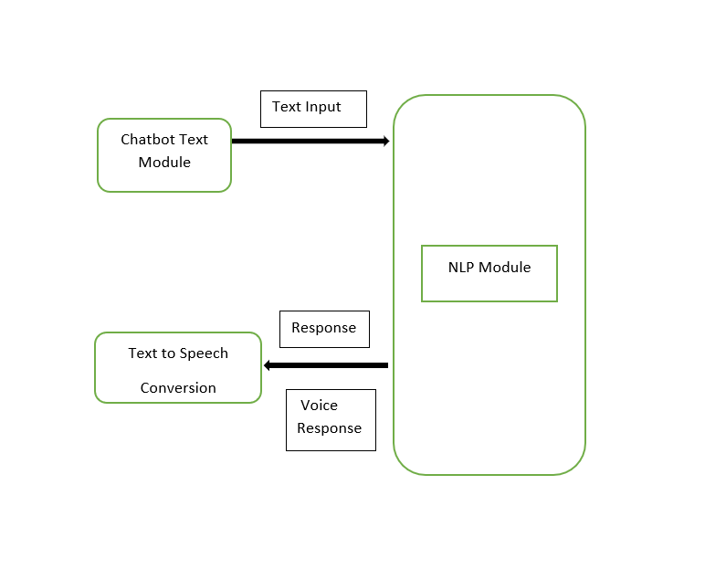
System Architecture

Slide 7
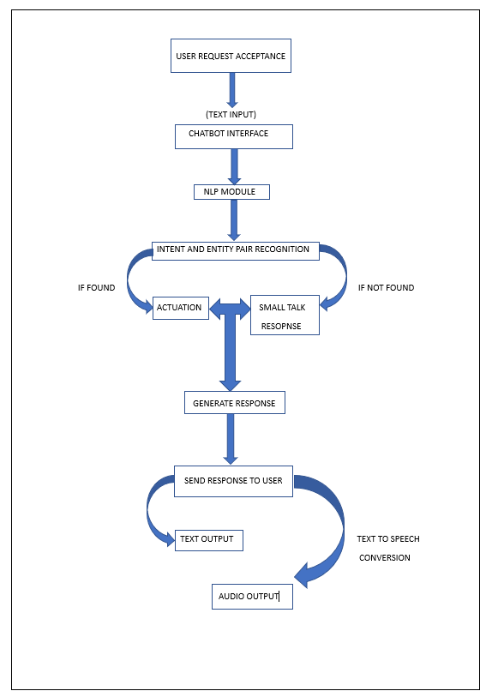
System Architecture

Slide 8
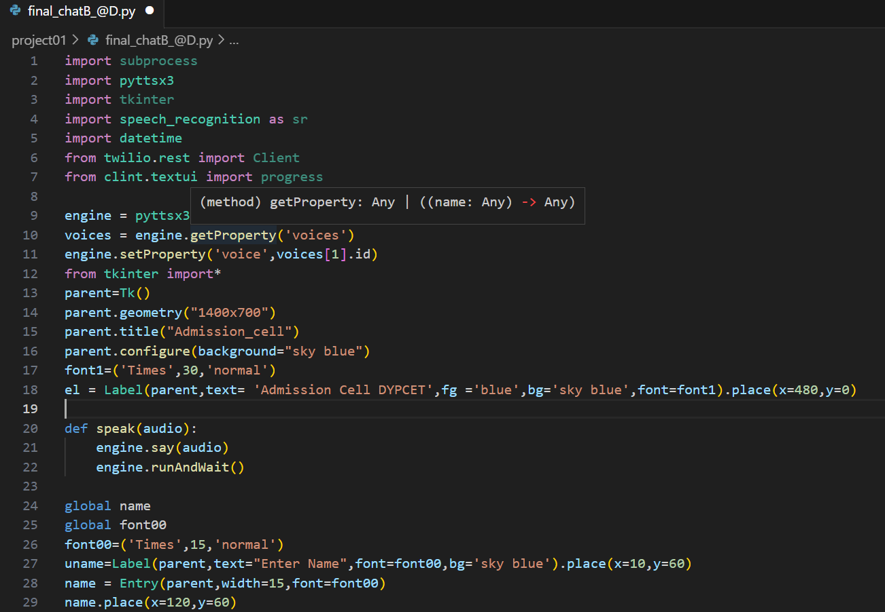
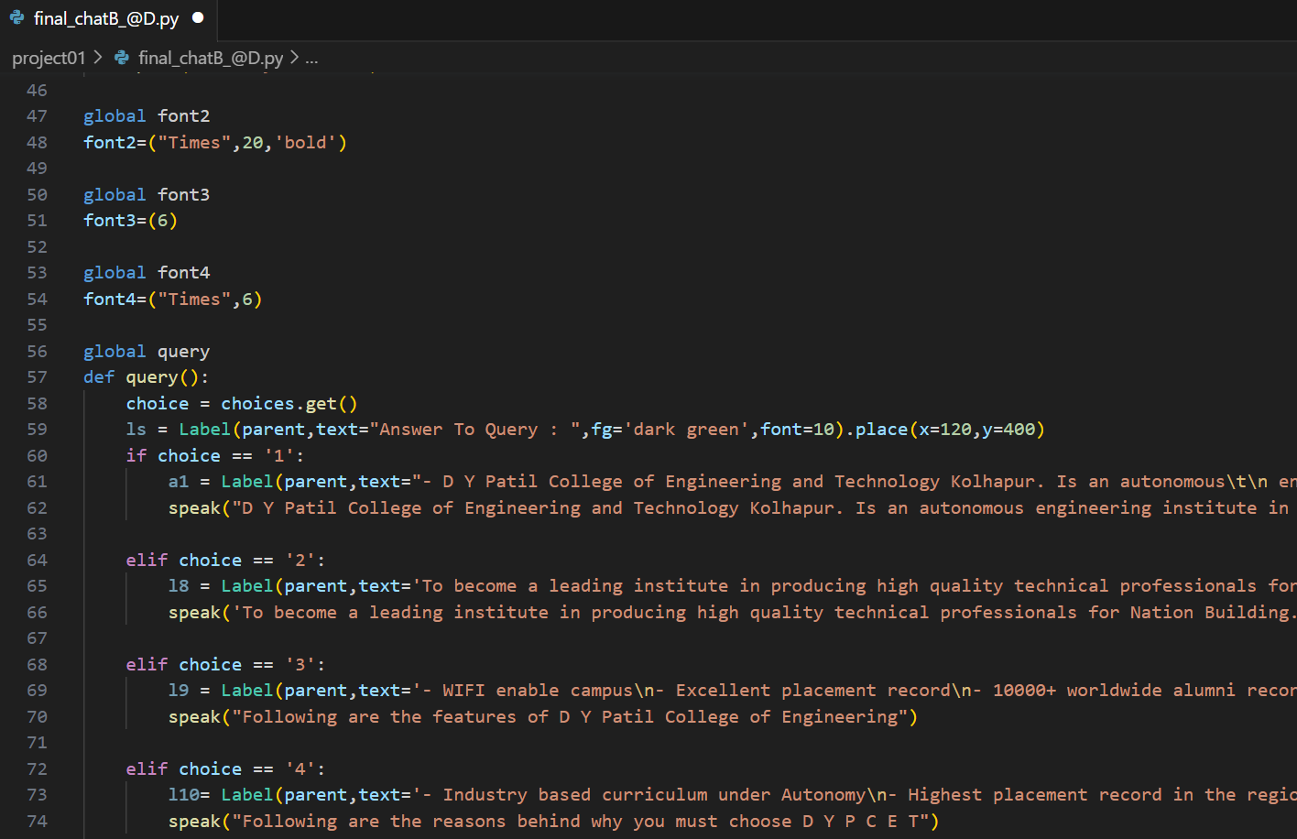
Code

Slide 9
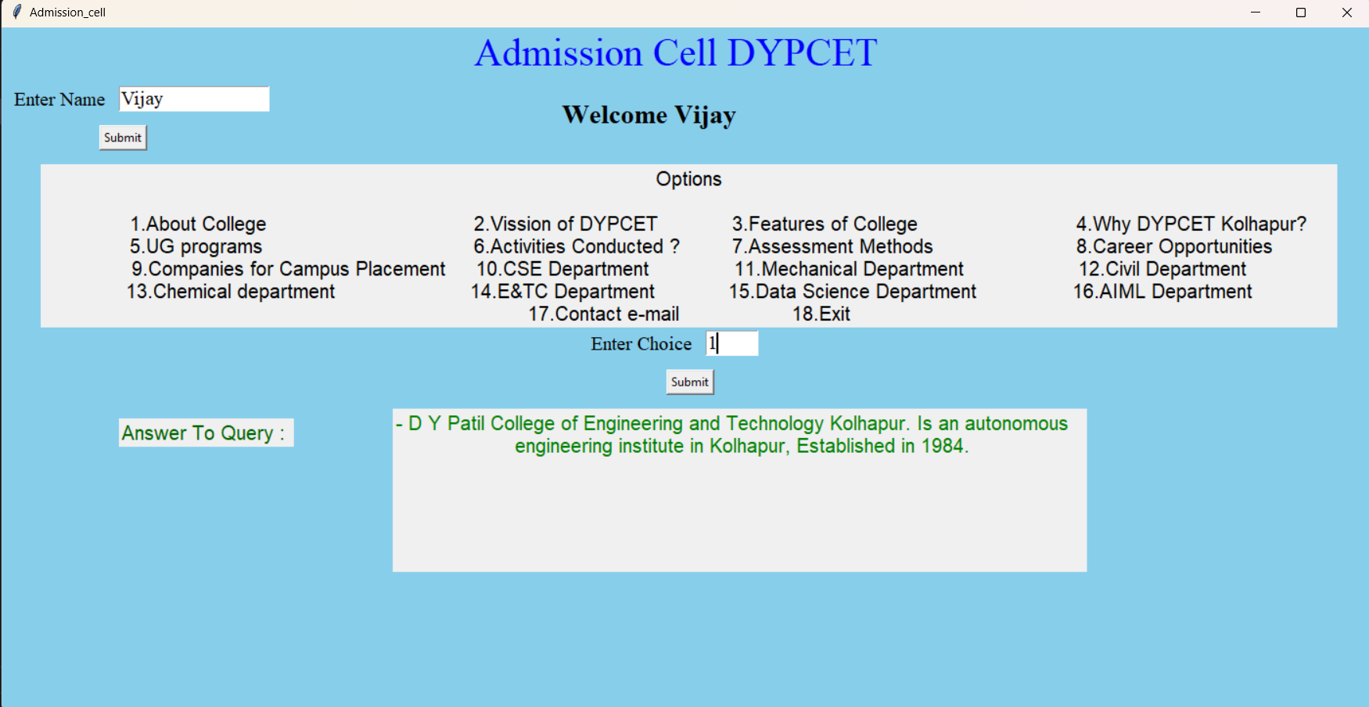
Graphical User Interface

Slide 10
Conclusion and References
Conclusion
Admission Cell chatbot is an innovative and useful tool for institutions in order to increase efficiency that can streamline the admission process and provide quick and appropriate assistance to prospective students. It results in higher satisfaction of students!
References
https://www.researchgate.net/Chatbot_and_Voice_Assistant https://www.academia.edu/38409853/CHATBOT_IN_PYTHON https://www.coursehero.com/file/

Slide 11

Thank You…!
“
”
10 – Aryan S. Tapase
13 – Dhananjay R. Ambatwar
14 – Afif S. Sayyad

