Slide 1
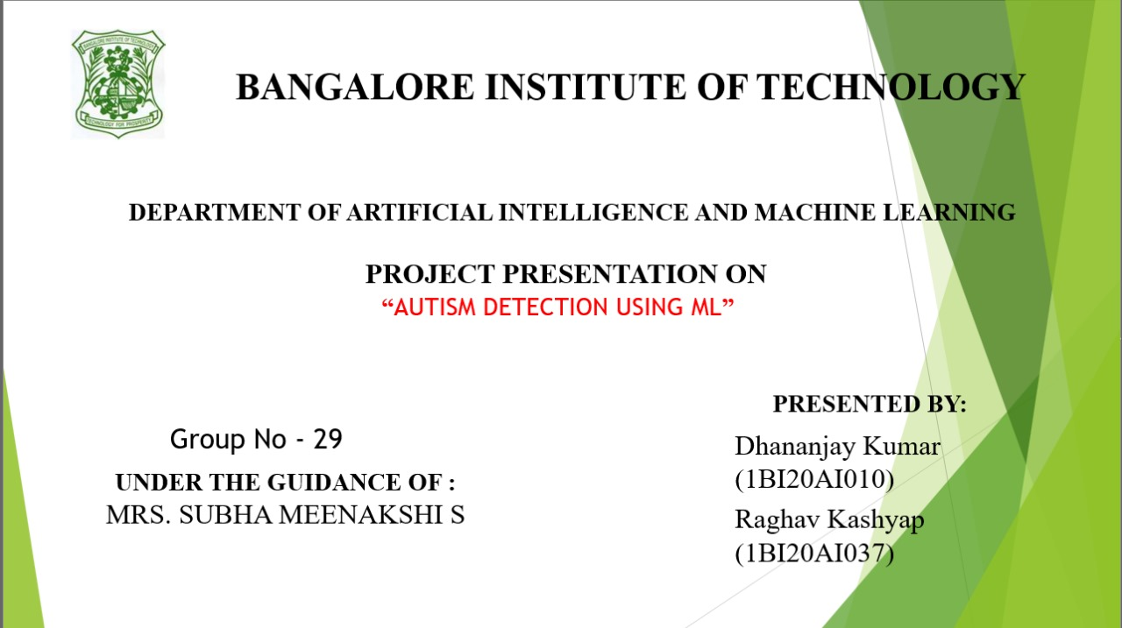

Slide 2

Introduction
The usage of machine learning has increased to a great extent ever since the internet has evolved. Autism Spectrum Disorder (ASD) poses complex challenges in social interaction, communication, and repetitive behaviors, necessitating early diagnosis for improved outcomes. Recent advancements at the intersection of healthcare and technology have ushered in innovative approaches to autism prediction, with machine learning emerging as a promising tool. Involving the development of algorithms, machine learning utilizes diverse datasets, including behavioral observations, genetics, and brain imaging, to identify patterns indicative of autism risk. The objective is to create accurate models capable of early ASD detection, potentially revolutionizing research and clinical practice. This proactive approach, exploring the synergy of machine learning and autism prediction, addresses benefits, challenges, and ethical considerations. Collaborative efforts at this interdisciplinary crossroads hold the potential to enhance our understanding of autism and significantly improve the lives of those affected.

Slide 3
Abstract
This application of machine learning is used to predict Autism Spectrum Disorder (ASD). ASD, a neurodevelopmental condition marked by challenges in social interaction, communication, and repetitive behaviors, benefits significantly from early diagnosis and intervention. The intersection of advanced healthcare and machine learning technologies has given rise to innovative approaches in ASD prediction. Machine learning algorithms, trained on diverse datasets encompassing behavioral observations, genetic information, and brain imaging data, aim to identify patterns indicative of autism risk. The primary goal is to develop accurate and efficient models for early ASD detection, surpassing traditional diagnostic methods. This proactive approach holds the potential to revolutionize autism research and clinical practices, paving the way for timely interventions that can enhance long-term outcomes for individuals on the spectrum. The abstract explores the exciting prospects, challenges, and ethical considerations associated with leveraging machine learning in the quest for early identification and intervention in autism spectrum disorders.

Slide 4
Literature Survey
S.NO | Paper title, Name of Journal | Abstract or Objective | Techinque used | Limitation
1 | “Applied behavior analysis in autism spectrum disorders: recent developments, strengths, and pitfalls” Research Gate | research on autism trends includes early intervention, functional assessment, challenging behaviors, and increased parental involvement; implications are discussed. | Random forest classifer | Research gaps persist, with sporadic focus on functional assessment; future exploration should include behavioral momentum, parent-mediated interventions, and self-management.
2 | “Autism spectrum disorder” Research Gate | Drosophila courtship dominance induced by male cuticular hydrocarbons during a critical period; social experience modulates effects. | Support Vector Machine | Study's timeframe limitations suggest either a critical period or a need for extended social experience for observed effects.
3 | Detection of autism spectrum disorder (ASD) in children and adults using machine learning Scientific Reports | Autism's early diagnosis crucial; conventional methods time-consuming. Machine learning offers quick, accurate ASD risk assessment, aiding prompt therapies. | LSTM (Long Short Term Memory) | dataset bias, lack of interpretability, ethical concerns, and potential overreliance on technology in ASD detection using ML.

Slide 5
4 | Machine learning for autism spectrum disorder diagnosis using structural magnetic resonance imaging frontiers | CNN,ANN,RNN | Limited sample size challenges ML/DL models; comprehensive datasets and rigorous methods are essential for generalizability.
5 | Prediction and Analysis of Autism Spectrum Disorder Using Machine Learning Techniques | SVM , Naive Bayes | imbalance datasets.smoting techniques shouldused for balance dataset
6 | Automatic autism spectrum disorder detection using artificial intelligence methods with MRI neuroimaging frontiers | CNN,Random forest classifier | image dataset are used it reqire large amount of time and space to predict.

Slide 6
Proposed System
The suggested method is to develop an application that would allow users to enter ‘ID’s’,‘Class/ASD' they have enter through manually or other correspondence to ascertain . The ‘ID’s’,‘Class/ASD' is classified using a machine learning classification model built with the Random Forest Classifier algorithm. To extract features for the purpose of training the classification model, a data set is collected and put through pre-processing and data mining techniques, Standard Scaler is use for fix the value in given range.

Slide 7
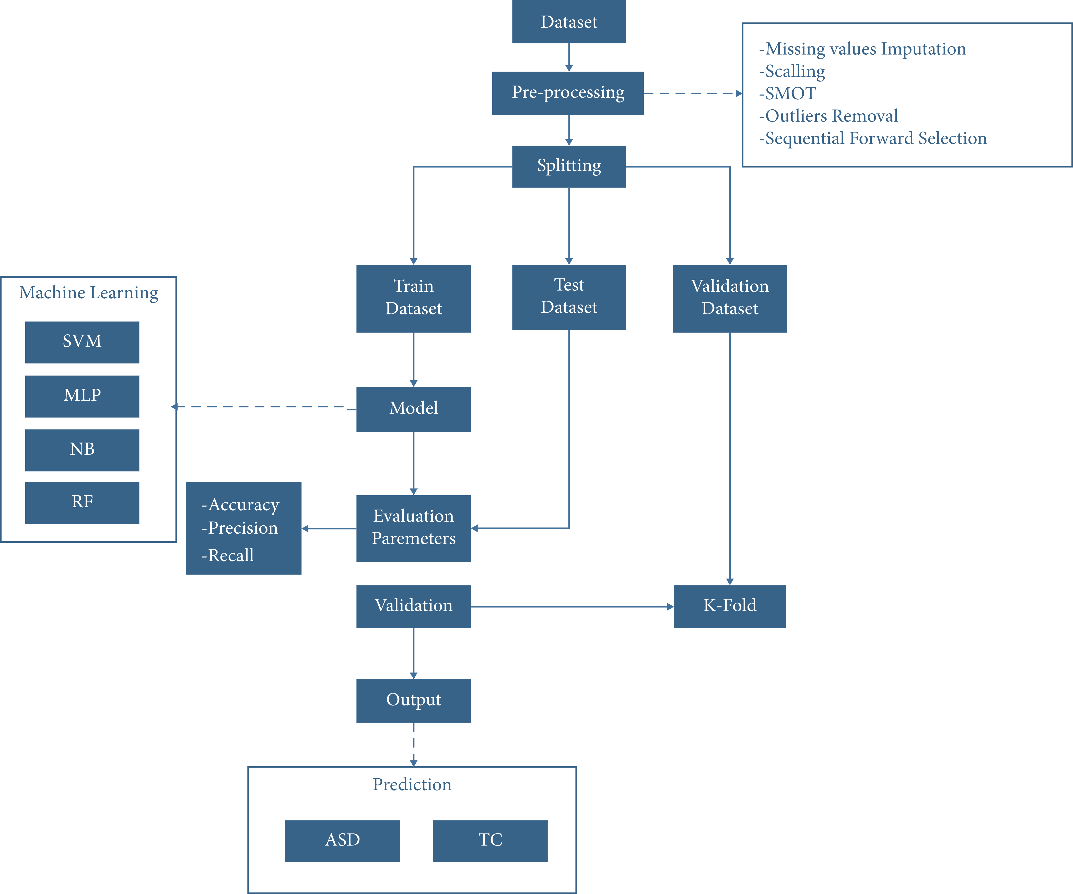
Block Diagram

Slide 8
Multilayer Perceptron (MLP): MLP is a feedforward neural network algorithm, comprising multiple layers of nodes. It learns complex patterns, making it effective for various tasks, such as classification and regression, by adjusting weights during training through backpropagation. Support Vector Machine (SVM): SVM is a powerful supervised learning algorithm for classification and regression tasks. It constructs hyperplanes to separate data into classes, maximizing the margin between them. SVM is effective in high-dimensional spaces, making it suitable for diverse applications. Naive Bayes: Naive Bayes is a probabilistic classification algorithm based on Bayes' theorem. It assumes feature independence, simplifying calculations. It's efficient and works well with large datasets. Naive Bayes is often used for text classification, spam filtering, and sentiment analysis. Random Forest Classifier: Random Forest is an ensemble learning method that builds multiple decision trees during training. It combines their outputs for more robust and accurate predictions. Random Forest handles overfitting, works well with diverse data, and is widely used in classification and regression tasks.

Slide 9
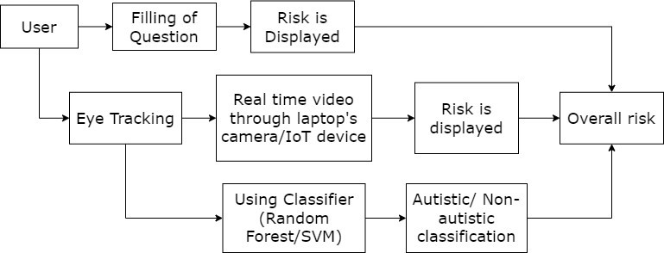
System Architecture

Slide 10
System Requirements
Hardware Requirements:
-CPU : Processor i5 or more
-RAM : 8GB
-Operating System
Software Requirements:
-Jupyter Notebook
-Anaconda Navig
-Python 3.8
Non Functional Requirements
Reliability:
The software should be able to detect the URL tуре accurately,irrespectivec of nо of attempts.
It should be able to give the faster response as output. Scalability:
The software should be able to differentiate the class of all the URLs ands should be user friendly for yielding better results.

Slide 11
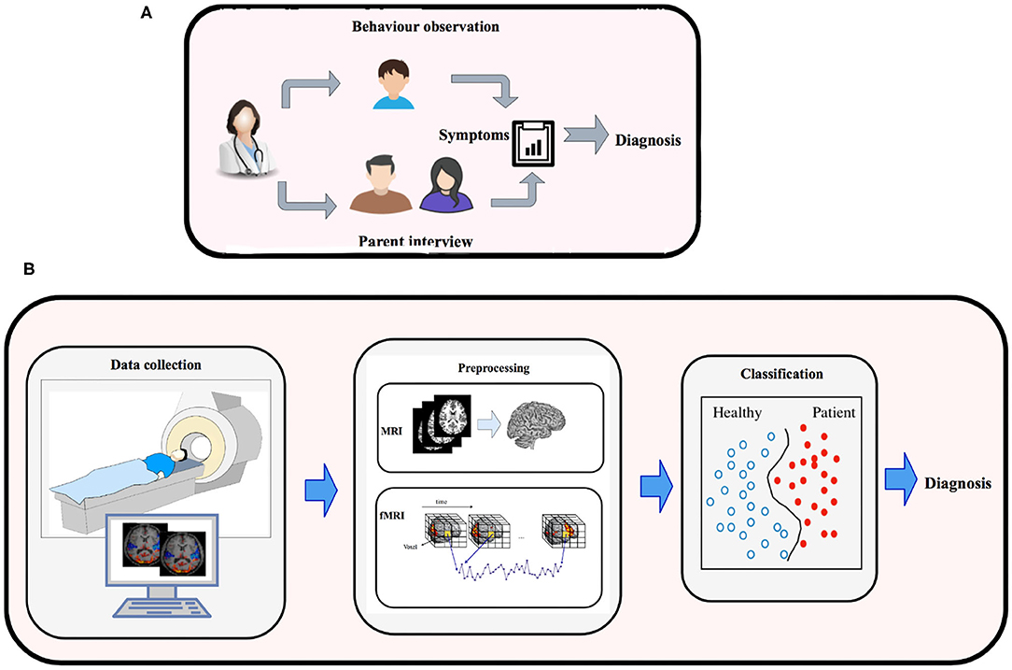
Module Design:

Slide 12
Behavioral Interview:A behavioral interview assesses an individual's actions, responses, and social interactions, crucial in autism prediction. It helps identify behavioral patterns and challenges, providing insights into potential signs of autism spectrum disorder (ASD).
Parent Interview : Parent interviews in autism prediction involve discussing a child's behavior and development with parents. Parents provide valuable information about early signs, communication skills, and social interactions, aiding in diagnosis and intervention planning.
Symptoms : Autism symptoms include challenges in social communication, repetitive behaviors, and restricted interests. These can manifest in various ways, impacting daily functioning. Early recognition of symptoms is essential for effective intervention.
Diagnosis : Autism diagnosis involves comprehensive evaluations by healthcare professionals. Criteria from diagnostic manuals, like DSM-5, guide assessments. Multidisciplinary approaches, including behavioral observations and standardized tests, ensure accurate and timely diagnosis for appropriate intervention strategies.

Slide 13
Data Collection: Data collection in machine learning for autism prediction involves gathering relevant information about individuals, often through neuroimaging techniques, behavioral observations, or surveys. In the context of autism, this data may include structural magnetic resonance imaging (sMRI) scans, functional MRI (fMRI) data, behavioral assessments, and demographic details. Large and diverse datasets are crucial to train accurate models, capturing the complexity of autism spectrum disorder (ASD).
Preprocessing: Preprocessing is essential to refine raw data before feeding it into machine learning models. For autism prediction, preprocessing may include cleaning and handling missing data, normalizing or standardizing numerical features, and encoding categorical variables. In neuroimaging, preprocessing involves tasks like skull stripping, registration, and normalization. Feature extraction techniques are applied to derive relevant information from raw data, such as extracting morphometric features from MRI scans.
Classification: Classification in autism prediction involves training machine learning models to categorize individuals into classes, typically ASD and non-ASD. Common classification algorithms include Support Vector Machines (SVM), Random Forests, and Neural Networks. These models learn patterns and relationships from the preprocessed data during the training phase. The trained model is then evaluated on new, unseen data to assess its predictive accuracy. The classification output aids in identifying individuals at risk of or with ASD based on learned features from the input data.

Slide 14
Thank You

