Slide 1
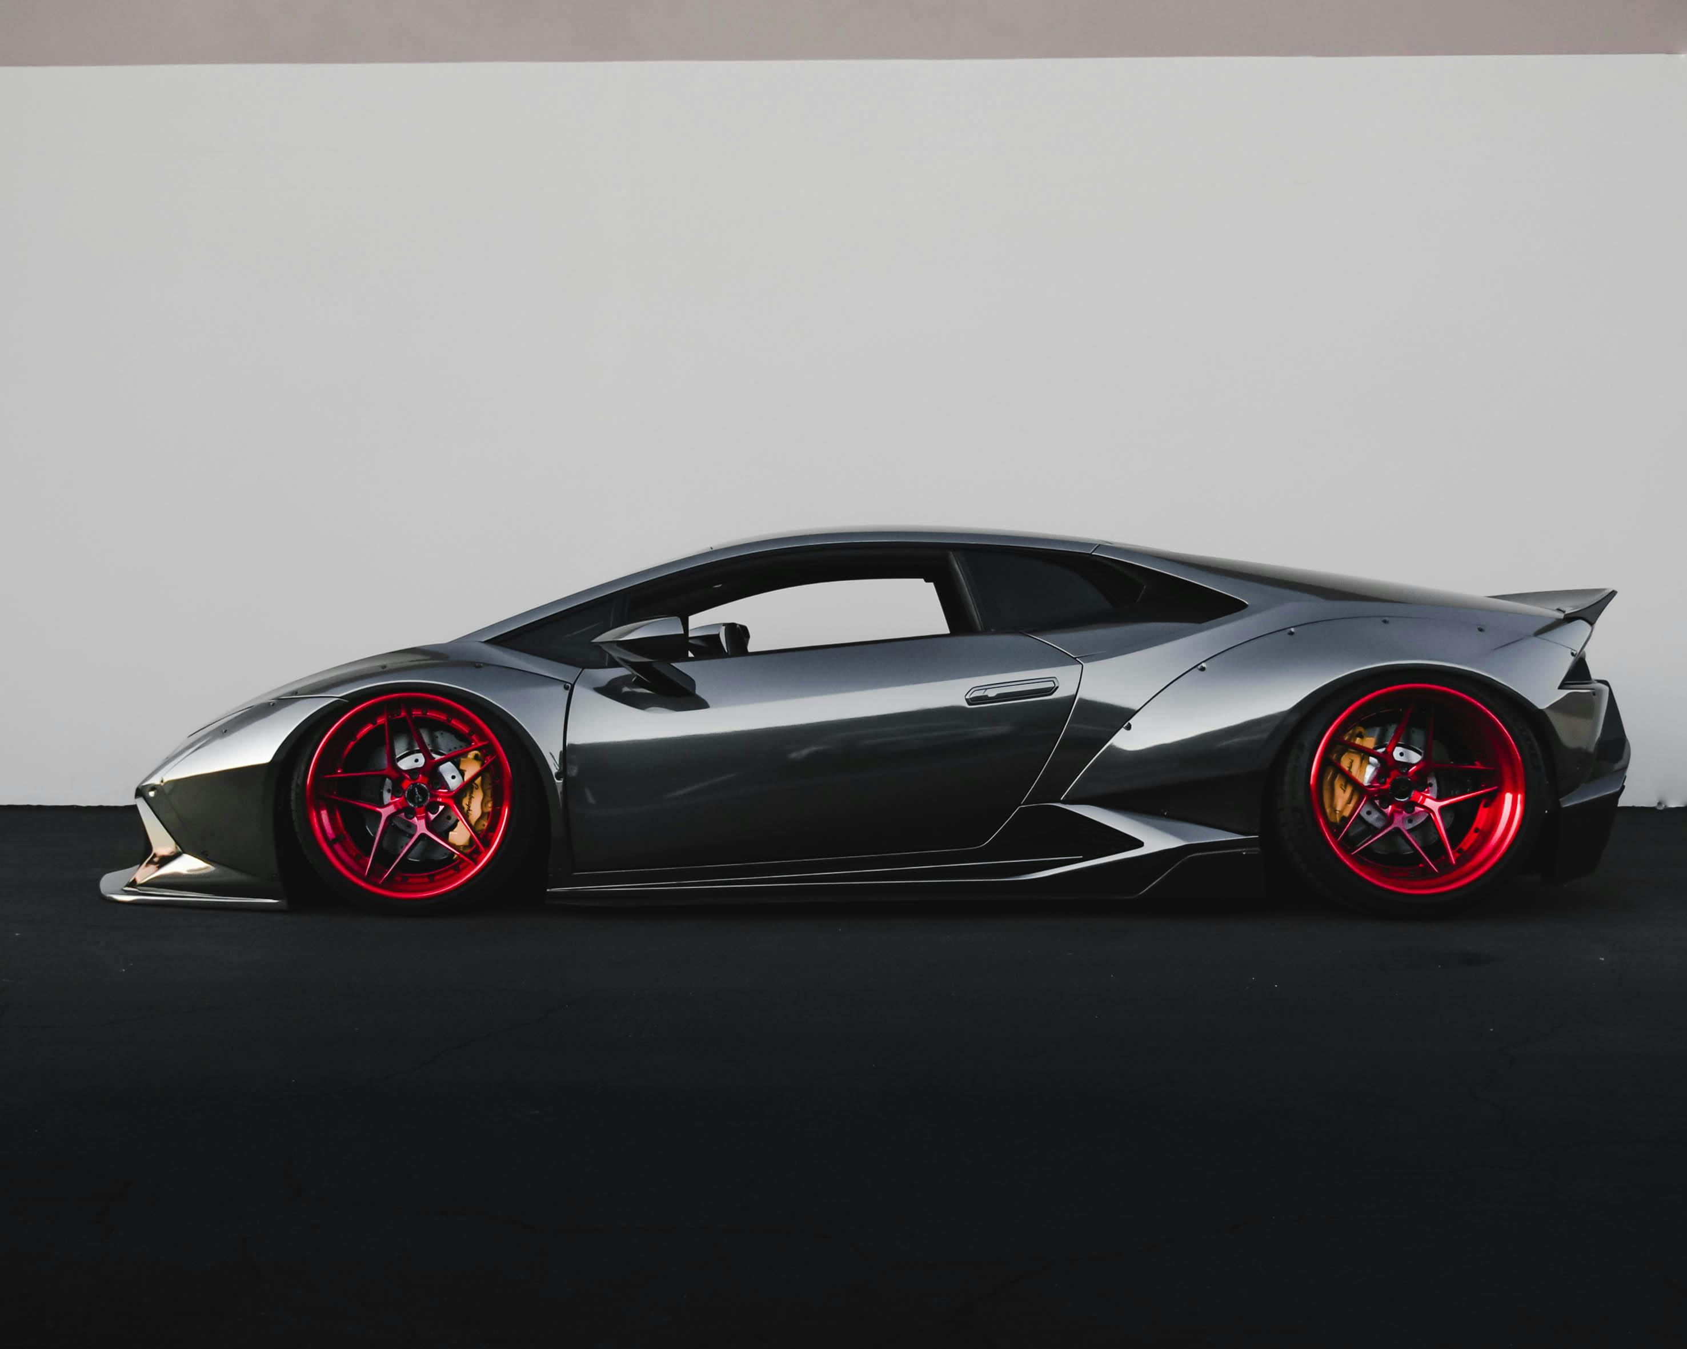
Resources
Evaluation only.
Created with Aspose.Slides for Python via .NET 25.3.
Copyright 2004-2025Aspose Pty Ltd.
A
B
C
D
E
F
Consumer electronics stores
ACME Corp can invest in in-store displays and demonstrations to showcase the features and benefits of their products
Office supply
stores
ACME Corp can create targeted marketing materials and offer package deals to encourage small businesses to purchase their products
Small business
supply stores
ACME Corp can partner with these stores to offer joint promotions and discounts
Direct sales through ACME Corp's website
ACME Corp can invest in search engine optimization (SEO) and pay-per-click (PPC) advertising to drive traffic to their website
Online
marketplaces
ACME Corp can optimize their product listings and offer competitive pricing to stand out from competitors on these marketplaces
Social media promotions
ACME Corp can create targeted advertising campaigns on social media to reach their desired audience

Slide 2
Assessing the potential of Zentrionix
Title | Real-time monitoring | 3D Facial recognition | Remote Access | AI Engine | Unlimited Cloud Storage | Established market presence | Integration with other devices
AcmeDefender
Bell
PadLock Pro
Evaluation only.
Created with Aspose.Slides for Python via .NET 25.3.
Copyright 2004-2025Aspose Pty Ltd.
AcmeDefender
Bell
PadLock Pro
New entrant in the space targeting high-end market
Advanced security system with unique features and offerings
Established market presence in smart door locks space
Relatively lower cost
Limited monitoring capability
Established market presence
High compatibility with other smart devices
Limited AI capabilities in current offering

Slide 3
Approach: Maintaining sales in existing accounts
Focus on maintaining existing accounts while exploring curated new opportunities
Key Insights
Maintain historical sales in all target accounts. Ensure minimal churn and prioritize HCP-Rep relationship for territory allocations
Evaluation only.
Created with Aspose.Slides for Python via .NET 25.3.
Copyright 2004-2025Aspose Pty Ltd.
Projected growth
50% projected growth QoQ: Expand in existing accounts and explore land opportunities in new accounts.
Optimize spend and maximize ROI by equipping reps with curated resources

