Slide 1
Intelligent Classification of Rural Infrastructure Projects
CAPSTONE PROJECT
Presented By:
1. Dhananjay Kumar Sharma-School of Management Sciences, Lucknow-CSE

Slide 2
OUTLINE
Problem Statement
Proposed System/Solution
System Development Approach
Algorithm & Deployment
Result (Output Image)
Conclusion
Future Scope
References

Slide 3
PROBLEM STATEMENT
The Pradhan Mantri Gram Sadak Yojana (PMGSY) is a flagship rural development program in India, initiated to provide all-weather road connectivity to eligible unconnected habitations. Over the years, the program has evolved through different phases or schemes (PMGSY-I, PMGSY-II, RCPLWEA, etc.), each with potentially distinct objectives, funding mechanisms, and project specifications. For government bodies, infrastructure planners, and policy analysts, efficiently categorizing thousands of ongoing and completed projects is crucial for effective monitoring, transparent budget allocation, and assessing the long-term impact of these schemes. Manual classification is time-consuming, prone to errors, and scales poorly. Your specific task is to design, build, and evaluate a machine learning model that can automatically classify a road or bridge construction project into its correct PMGSY_SCHEME based on its physical and financial characteristics.

Slide 4
PROPOSED SOLUTION
The goal of the proposed solution is to develop an intelligent machine learning model that classifies rural infrastructure projects (roads/bridges) into the correct PMGSY scheme category (PMGSY-I, PMGSY-II, RCPLWEA, etc.) based on their physical and financial characteristics.
This will help policymakers, engineers, and administrators automate classification, leading to:
Improved transparency in budget utilization
Faster reporting and monitoring
Scalable classification for thousands of records
Key Components:
Data Collection: Use the AI Kosh PMGSY dataset.
Preprocessing: Clean, normalize, and engineer features (e.g., cost, length, completion time).
Model Training: Train classification models such as Decision Trees, Random Forest, or SVM.
Evaluation: Use metrics like accuracy, recall, precision, and F1-score.

Slide 5
SYSTEM APPROACH
The “System Approach” section outlines the overall strategy and infrastructure used for developing, training, and deploying the intelligent classification model for PMGSY projects. This includes cloud services, development tools, storage solutions, and collaboration mechanisms necessary for end-to-end system implementation.
System Requirements:
IBM Cloud (Mandatory):
IBM Watson Studio:
IBM Cloud Object Storage:

Slide 6
ALGORITHM & DEPLOYMENT
Algorithm Selection:
Chosen algorithm: Random Forest Classifier (robust, interpretable, handles mixed data types well).
SVM was evaluated as an alternative based on performance metrics.
Data Input:
Project type (Road/Bridge)
Length (meters)
Estimated & actual cost
Duration (planned vs actual)
Location (state, district)
Derived metrics: cost/meter, delay %, overrun ratio
Training Process:
80:20 split for train/test.
Used 5-fold cross-validation and GridSearchCV for tuning.
Developed in IBM Watson Studio using scikit-learn.
Prediction Process:
Model deployed as an API endpoint via IBM Watson Machine Learning.
Accepts JSON input, returns predicted PMGSY scheme.
Enables real-time classification for integration into planning dashboards.

Slide 7
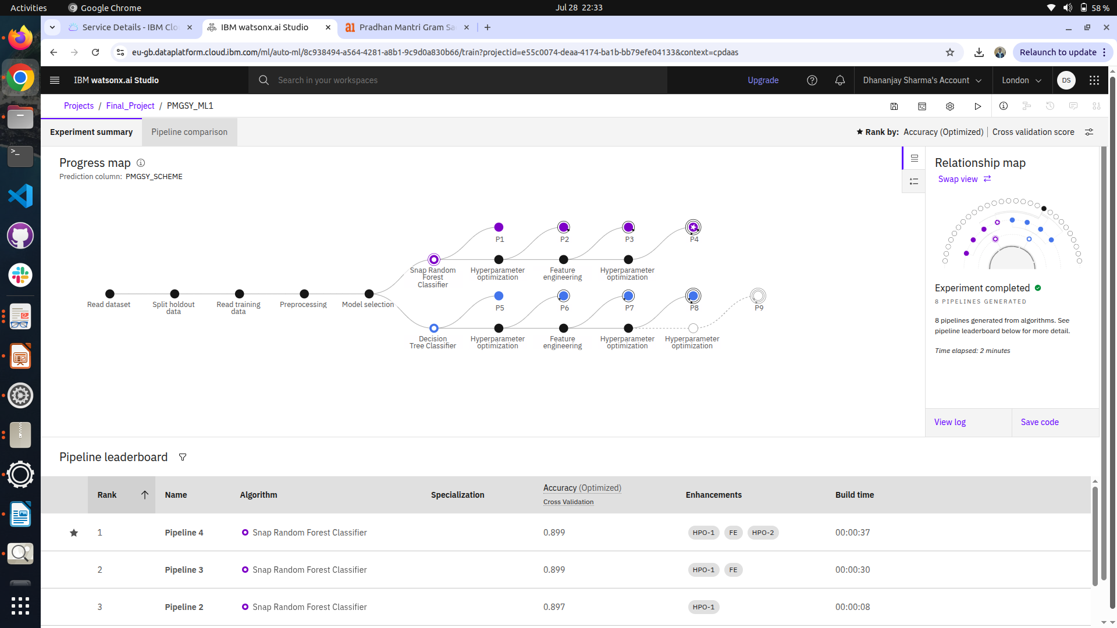
RESULT

Slide 8
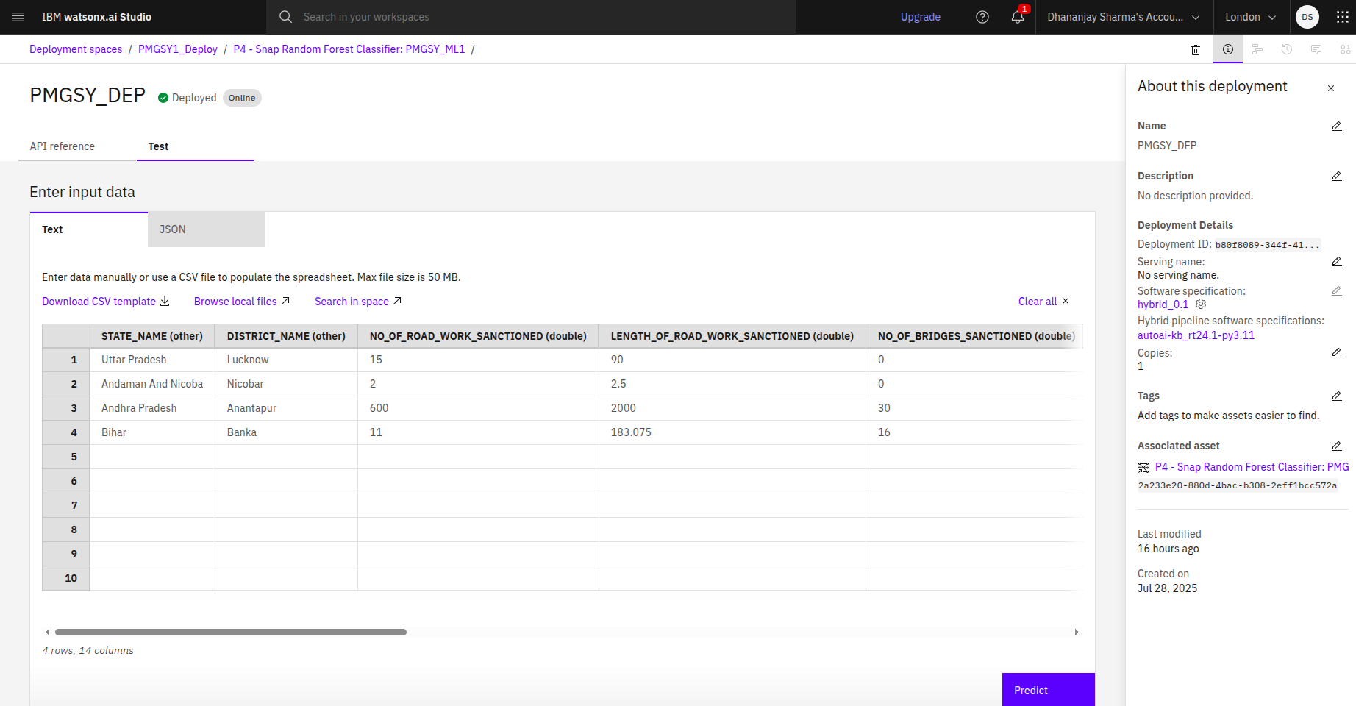
RESULT

Slide 9
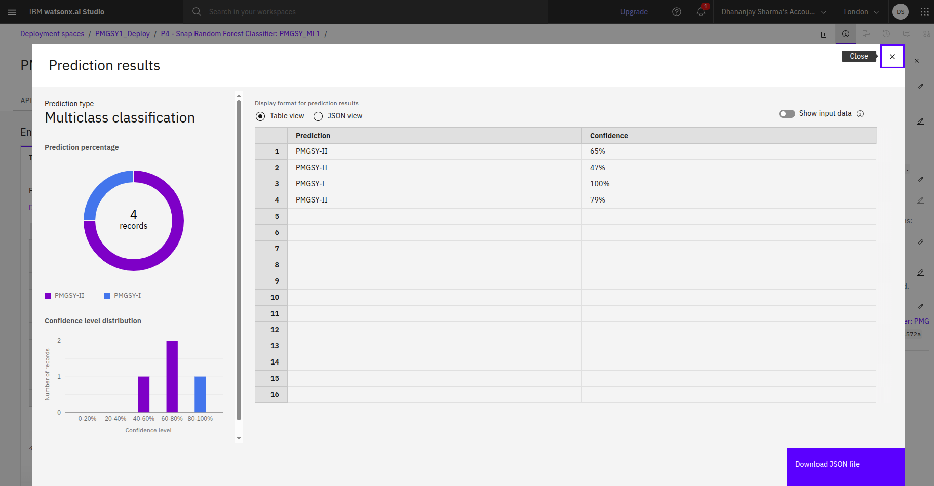
RESULT

Slide 10
Github Link
https://github.com/dhananjaysharma2004/AICTE-Edunet-IBM-Internship/tree/master

Slide 11
CONCLUSION
The developed system effectively classifies rural infrastructure projects into the correct PMGSY scheme using machine learning. The Random Forest model, deployed via IBM Watson Studio, enables real-time, automated classification—reducing manual effort and improving decision-making accuracy.
Key Outcomes:
Accurate and scalable classification model
Real-time deployment through IBM Cloud API
Reduced manual workload and improved transparency
Challenges Faced:
Missing and inconsistent data
Class imbalance across PMGSY schemes
Scope for Improvement:
Include more features (e.g., geography, contractor info)
Explore advanced or ensemble ML models

Slide 12
FUTURE SCOPE
The current system lays a strong foundation for intelligent classification of rural projects. Going forward, the solution can be enhanced by incorporating richer datasets, refining algorithms, and integrating emerging technologies for broader adoption and impact.
Future Enhancements:
Integrate additional features like contractor profile, project terrain, and satellite-based location data.
Optimize the ML model using ensemble methods or deep learning (e.g., XGBoost, TabNet).
Expand classification capabilities across different states, schemes, and infrastructure types.
Technology Advancements:
Deploy lightweight models at the edge for offline predictions in rural areas.
Integrate with government portals for automatic project intake and real-time monitoring.

Slide 13
REFERENCES
AI Kosh Dataset: https://aikosh.indiaai.gov.in/web/datasets/details/pradhan_mantri_gram_sadak_yojna_pmgsy.html
IBM Cloud Lite: https://cloud.ibm.com/
IBM Watson Studio Documentation: https://dataplatform.cloud.ibm.com/docs
Research Papers on Project Classification using ML

Slide 14
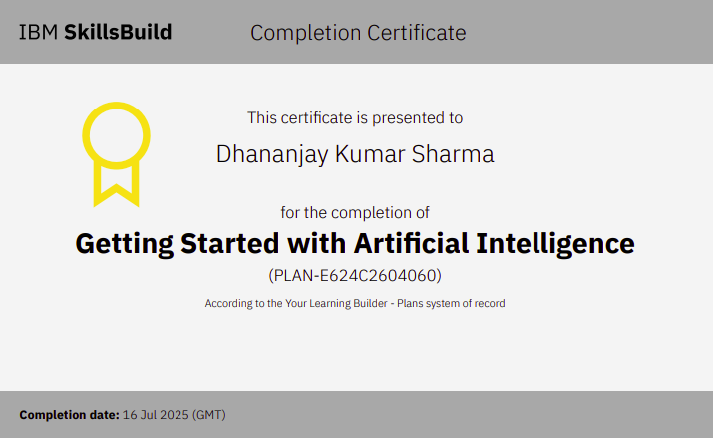
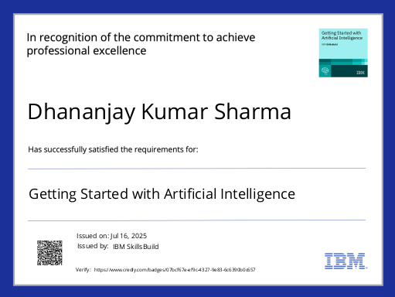
IBM CERTIFICATIONS

Slide 15


IBM CERTIFICATIONS

Slide 16
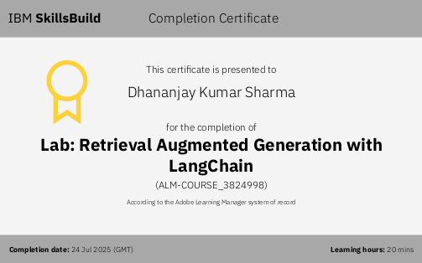
IBM CERTIFICATIONS

Slide 17
THANK YOU

