Slide 1
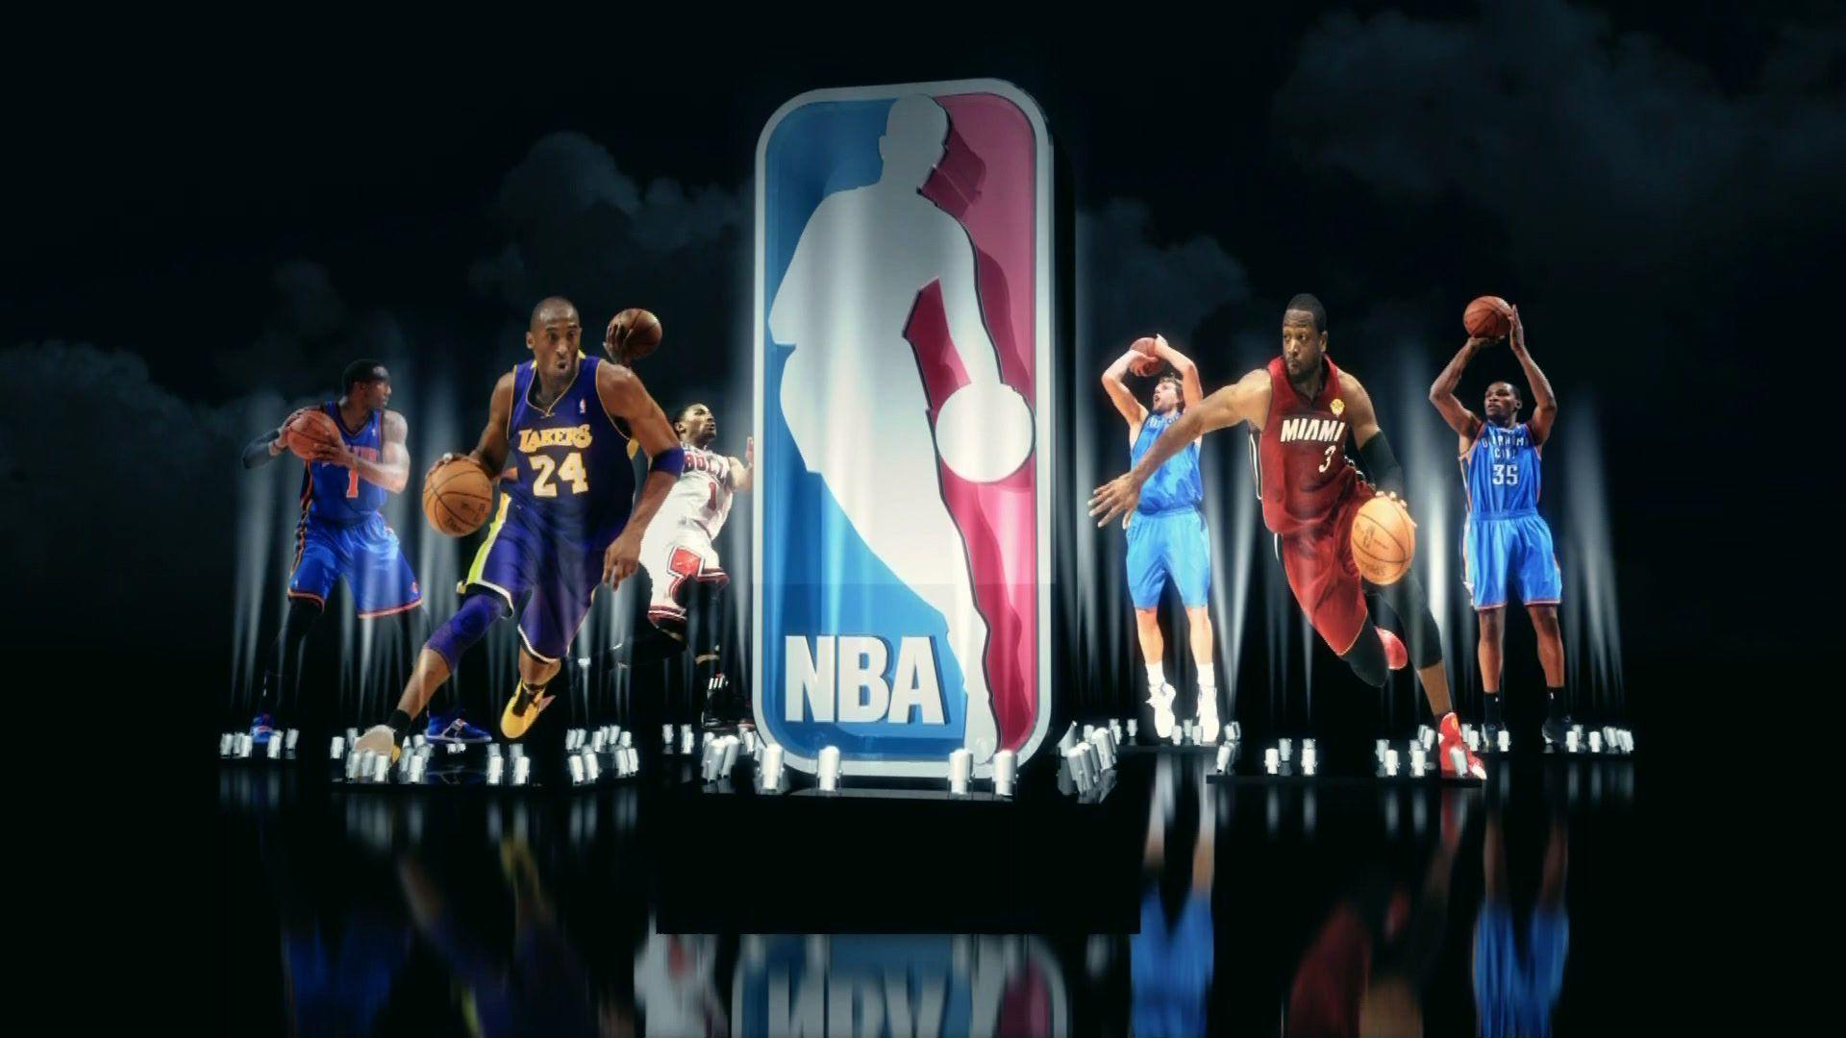
Project Name – NBA Player Analytics
Group Name – D&A Champs
Project Members –
Dhana, Rajesh, Dave & Asit

Slide 2
Data discovery, Analysis & Conceptualization
Datasets contain NBA player stats for last four seasons
2016-2017 (NBA Players Stats 201617.csv)
2017-2018 (NBA Players Stats 201718.csv)
2018-2019 (NBA Players Stats 201819.csv)
2019-2020 (NBA STATs19-20.csv – need cleanup)
Also the datasets contain NBA player’s salary for last four seasons:
2016-2017 (nba_stats_salaries_16-19.csv)
2017-2018 (nba_stats_salaries_16-19.csv)
2018-2019 (nba_stats_salaries_16-19.csv)
2019-2020 (NBA_salaries_2019_present.csv)
Dataset discovery by – Dave & Dhana
Data Analysis and data clean up step derivation done by - Dhana
Role Played - Circle
Conceptualization by – All project members
GitHub URL-
https://github.com/asitkumar26/nba-player-analytics/tree/main/Resources
https://github.com/asitkumar26/nba-player-analytics/blob/main/Presentation/ETLSteps.xlsx

Slide 3
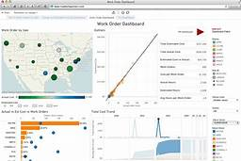




Solution Architecture & Tools/Technologies to be used
Solution Architecture done/prepared by – Rajesh
Role played - X
Finalized by – All project members
Supervised
& Un-supervised
Tableau
Visualization
M/C learning
PG
Databases
Postgres
ETL/Pre-processing
Python Scripts

Slide 4
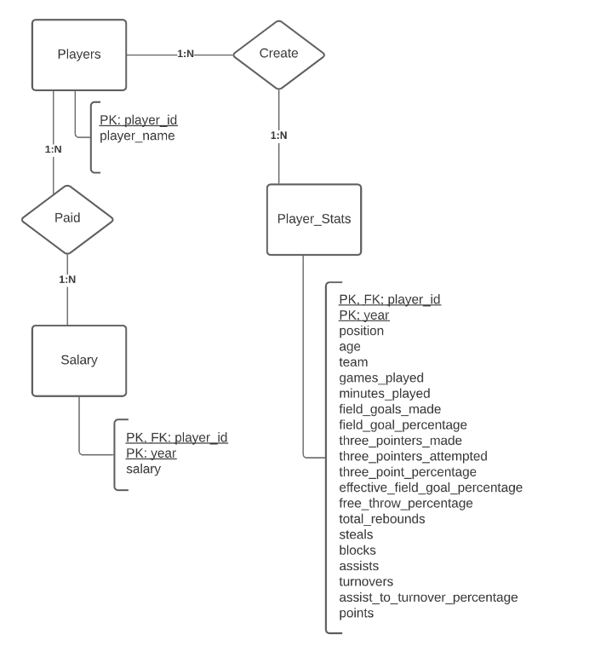
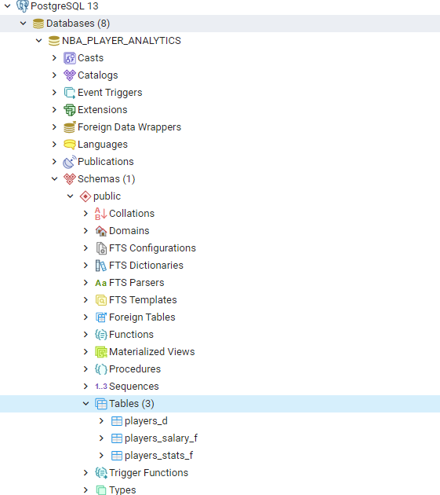
DB logical/physical design
DB design done by – Dave
Role played - Circle
GitHub URL-
XXXXX

Slide 5
Analysis through M/C learning
Requirement | Types of M/C learning | Algorithm
There is a new club that wants to build a team and they want to sign up contract with different players. They have a budget of 110 million USD. They want to build a well-balanced team choosing players of different tiers. They want to see players of different tiers so that they can sign up with them. | Un-supervised learning | KMeans
A relatively new players want to predict whether his salary is going to increase, decrease or remains similar in next subsequent seasons based on his performance statistics in NBA. | Supervised learning | Logistic regression
ML Blueprint done by – Asit
(done only for requirement of Un-supervised learning) Role played - Triangle
GitHub URL-
https://github.com/asitkumar26/nba-player-analytics/blob/main/ML-Models/player-clustering.ipynb

Slide 6
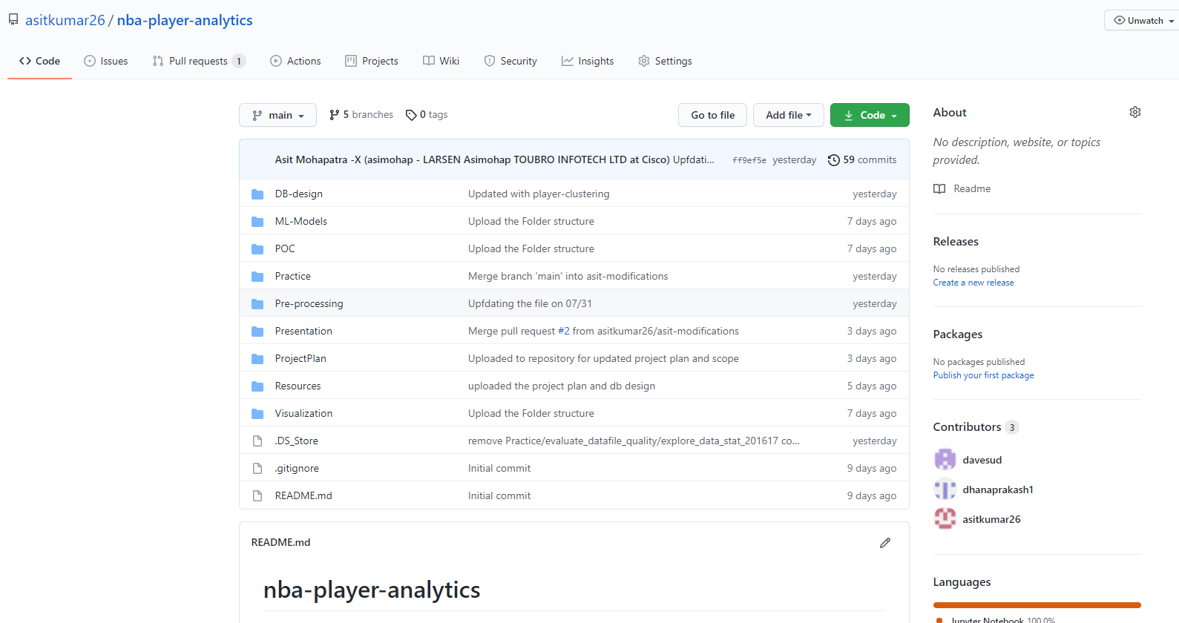
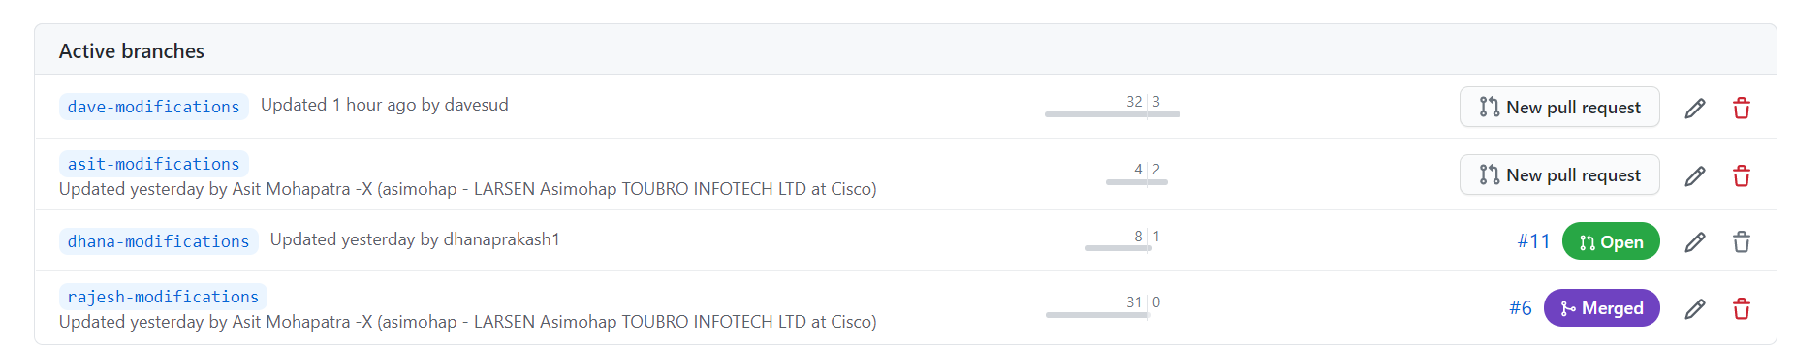
Configuration Management – GitHub Repository creation
GitHub Repository done by – Asit
Role played - Square
GitHub URL-
https://github.com/asitkumar26/nba-player-analytics

