Slide 1
PSCS_245 Travel and Toursim
CSE7101- Capstone Project
Review-1
Batch Number: ISE_9
Under the Supervision of,
Mrs.Josephine John
School of Computer Science and Engineering
Presidency University
Roll Number | Student Name
20221ISE0054 | MANOJ R
20221ISE0027 | DARSHAN D
20221ISE0079 | DHANARAJ
Name of the Program: B.Tech
Name of the HoD: Dr.Zafar Ali Khan
Name of the Program Project Coordinator: Ms Suma N G
Name of the School Project Coordinators: Dr. Sampath A K , Dr. Geetha A

Slide 2
Content
Problem Statement
Objectives
Background and Related work for title Selection
Analysis of Problem Statement
Innovation or Novel Contributions
Git-hub Link
Timeline of the Project
References

Slide 3
Problem Statement :
Organization: Travel and Tourism
Category : Software
Problem Description:
Travelers often face difficulties due to fragmented booking systems. Currently, users must switch between multiple applications for flights, trains, buses, hotels, rental cabs, and travel accessories.
This creates:
Inconvenience – Multiple apps/websites for different bookings.
High Costs – Lack of consolidated discounts or bundled offers.
Time-Consuming – Comparing prices across platforms takes extra effort.

Slide 4
Problem Statement :
No Unified Support – Customer queries and cancellations are scattered across different providers
Limited Personalization – Current apps focus on general travelers, with no customization for student, family, or group travel needs.
Thus, there is a need for a single integrated travel app that simplifies bookings, saves costs, and provides a seamless travel experience.

Slide 5
Objectives :
Develop a one-stop travel application integrating all bookings – flights, trains, buses, hotels, rental vehicles, and accessories.
Provide a cost-effective solution with exclusive discounts, combo offers, and seasonal deals.
Create a user-friendly interface for fast and hassle-free booking.
Enable group and family bookings with cost-sharing features.
Integrate AI-based personalization (budget packages, recommendations, safe travel tips).
Include 24/7 unified support for cancellations, rescheduling, and refunds.
Support secure digital payments and loyalty rewards.

Slide 6
Background and Related work for title Selection:
Existing Travel Platforms:
MakeMyTrip / Goibibo Provide flights, trains, buses, and hotel bookings. Offer packages but no exclusive student discounts.
Booking.com Strong global hotel and accommodation database. But no budget-friendly packages for students.
Amazon / Flipkart (Travel Accessories) Sell travel items (bags, power banks, etc.) But not integrated with travel booking systems.
Limitations of Existing Work:
High Costs – Most platforms target general customers, not students with budget constraints.
Scattered Services – Tickets, hotels, and accessories are on different platforms, requiring multiple apps/websites.
Lack of Personalization – No features for student groups, ID-based discounts, or community travel forums.
Focus on Luxury – Many existing platforms emphasize premium/luxury travel, not budget-friendly student travel.

Slide 7
Analysis of Problem Statement
High Travel Costs: Students often cannot afford expensive flight, train, and hotel bookings.
Scattered Services: Current platforms require switching between apps for
tickets, hotels, and travel accessories.
Personalization: Current sites provide generic recommendations, not tailored to student budgets
and needs.
Opportunity: Build a one-stop, student-friendly platform integrating bookings, discounts, accessories, and travel planning

Slide 8
Analysis of Problem Statement (contd...)
1 Frontend
HTML5
CSS3
JavaScript
2 Backend
PHP + MySQL
Node.js
Flask (Python)
3 Development Tools:
IDE/Text Editor: Tools like VS Code, PyCharm
Testing and Debugging: Web Browser ( Chrome, Firefox, Edge )

Slide 9
Analysis of Problem Statement (contd...)
Recommended(HARDWARE) Requirements
Processor: Intel i5 / Ryzen 5 or higher
RAM: 8 GB or more (for smoother development with Node.js / React)
Storage: 500 GB SSD
Graphics: Integrated graphics sufficient (no need for dedicated GPU)
Operating System: Windows 11 / Ubuntu 22.04 / macOS Monterey+
Network: High-speed internet (for deployment, GitHub, and API integration)

Slide 10
Innovation or Novel Contributions
How Our Website Outsmarts Other Platforms
Student Discounts & ID Verification
Unlike MakeMyTrip/Goibibo, we provide exclusive verified student discounts.
Integrated Travel Accessories Store
Other sites only book tickets/hotels, but we add luggage, backpacks, travel kits in one place.
Budget-Friendly Packages
Curated low-cost trips designed for student budgets (vs costly holiday packages elsewhere).
Community Travel Forum
Students can share tips, reviews, and group travel plans (not present in Booking.com or MakeMyTrip).
Travel Gifting Feature
Parents/friends can sponsor trips directly through the site.
Gamified Rewards System
Students earn points for bookings → discounts on future trips (unlike plain cashbacks on other sites).

Slide 11
Github Link
Github Link
https://github.com/dhanaraj99/ISE-9-capstone-project

Slide 12
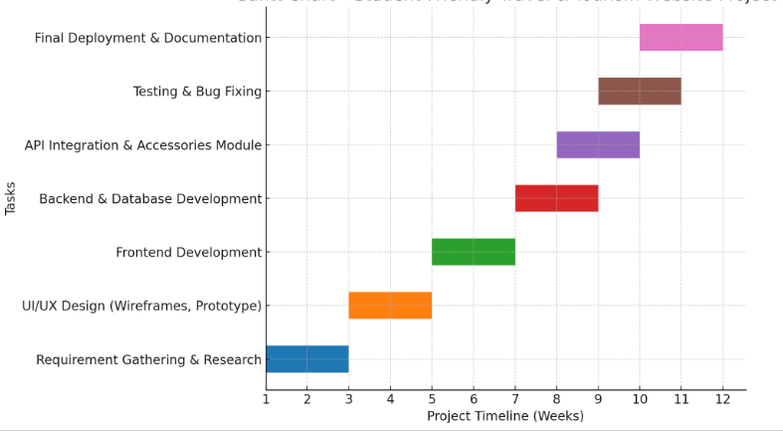
Timeline of the Project (Gantt Chart)

Slide 13
References (IEEE Paper format)
[1] MakeMyTrip, “Online travel booking platform,” MakeMyTrip.com, 2024. [Online]. Available: https://www.makemytrip.com/. [Accessed: Aug. 16, 2025].
[2] Goibibo, “Flights, hotels, bus booking services,” Goibibo.com, 2024. [Online]. Available: https://www.goibibo.com/. [Accessed: Aug. 16, 2025].
[3] Booking.com, “Global travel and accommodation platform,” Booking.com, 2024. [Online]. Available: https://www.booking.com/. [Accessed: Aug. 16, 2025].
[4] A. Sharma and R. Gupta, “E-tourism: The role of ICT in tourism industry,” International Journal of Innovative Research in Computer and Communication Engineering (IJIRCCE), vol. 5, no. 6, pp. 1234–1240, Jun. 2017.
[5] Google, “Google Maps Platform – APIs for location and travel,” Google Developers, 2024. [Online]. Available: https://developers.google.com/maps. [Accessed: Aug. 16, 2025].

Slide 14


