Slide 1
CSE7302- University Project Review-5
SIH25048 - Gamified Learning Platform
for Rural Education
Batch Number: ISE 40
Roll Number 20221ISE0051
20221ISE0079
20221ISE0029
Student Name
Shivateja
Dhanaraj
Darshan
Under the Supervision of,
Ms. Priyanki Dutta
Assistant Professor
School of Computer Science and Engineering Presidency University
Name of the Program: B.Tech
Name of the HoD: Dr. Gopal Shyam
Name of the School Project Coordinators: Ms. Sumita Guddin

Slide 2
Content
Problem Statement
Objectives
Analysis of Problem Statement(Software Requirements)
Analysis of Problem Statement(Hardware Requirements)
Innovation or Novel Contributions
Flow Diagram
System Testing and Result
Performance Analysis
Future enhancement

Slide 3
Problem Statement :
Organization: Smart Automation
Category : Software
Problem Description: The rapid growth of digital education platforms has transformed the learning environment, but many existing e-learning systems still suffer from several major limitations. Most traditional platforms mainly focus on delivering static educational content and fail to provide interactive, engaging, and motivating learning experiences for students.
Current learning systems lack:
Real-time interaction between students and teachers
Competitive and collaborative learning environments
Gamification elements such as rewards, badges, and leaderboards
Student engagement and motivation tracking
Therefore, there is a need for a scalable, secure, and interactive gamified learning platform that combines:
Real-time communication
Gamification techniques
Competitive learning
Performance analytics
Multi-user role management

Slide 4
Objectives :
Develop a Gamified Learning Platform Design and develop a complete interactive learning platform that improves student engagement using gamification concepts and competitive learning techniques.
Implement Multi-Role User Management Provide separate functionalities and dashboards for students, teachers, and administrators through role-based access control mechanisms.
Integrate Interactive Quiz and Tournament System Develop quiz modules, real-time duels, tournaments, and challenge-based activities to create an engaging learning experience.
Enable Real-Time Communication and Interaction Implement live notifications, quiz duels, real-time score updates, and instant communication using Socket.io technology.

Slide 5
Objectives :
Incorporate Gamification Features Integrate badges, leaderboards, achievements, rewards, and ranking systems to motivate students and encourage active participation.
Ensure Secure Authentication and Data Management Implement JWT-based authentication and secure database management for safe access and protected communication.
Track Student Performance and Analytics Provide performance monitoring, progress tracking, leaderboard analysis, and activity evaluation for effective learning assessment.
Develop a Scalable Cross-Platform System Build a responsive and scalable application accessible through both web and mobile platforms using modern full-stack technologies.

Slide 6
Analysis of Problem Statement ( Software Requirements )
1 Frontend
React.js
React Native
HTML
CSS
JavaScript
2 Backend
Express.js
Node.js
3 Real-Time Communication
Socket.io
4 Database
MongoDB
5 Authentication
JWT Autentication
6 Development Tools
Tools like VS Code, Git
7 Testing and Debugging: Web Browser ( Chrome, Firefox, Edge )

Slide 7
Analysis of Problem Statement ( Hardware Requirements )
1 Development Machine
Processor: A modern multi-core processor(64-bit Processor (Intel i5/i7 or AMD Ryzen 5/7))
RAM: At least 8 GB
Storage: 30GB recommended
2 Network:
Internet Connection: Stable and standard speed internet connection for development and deployement
3 Additional Hardware (Optional for Deployment)
Microphone for voice data ingestion
External Storage (HDD/SSD) for large offline datasets
High-resolution Scanner for document digitization

Slide 8
Innovation or Novel Contributions
Gamified Interactive Learning Platform: Unlike traditional e-learning systems that mainly focus on static content delivery, this project provides a complete gamified learning environment using badges, leaderboards, tournaments, rewards, and achievements to improve student engagement and motivation.
Real-Time Quiz Duel and Communication System: The platform integrates Socket.io–based real-time communication to support live quiz duels, instant notifications, real-time score updates, and interactive learning experiences.
Multi-Role Educational Management System: The system provides dedicated dashboards and functionalities for students, teachers, and administrators, ensuring efficient content management, monitoring, and user interaction.
Cross-Platform Learning Accessibility: The application supports both web and mobile platforms using React.js and React Native technologies, allowing users to access educational resources anytime and anywhere.

Slide 9
Innovation or Novel Contributions
Performance Tracking and Analytics System: The platform continuously tracks student performance, rankings, achievements, quiz scores, and participation levels to provide detailed educational analytics.
Secure and Scalable Full-Stack Architecture: The project integrates JWT authentication, MongoDB database management, and modular backend architecture to ensure secure communication, scalability, and efficient system performance.
Interactive Competitive Learning Environment: Students can participate in quizzes, tournaments, missions, and leaderboard competitions, creating an engaging and collaborative educational ecosystem.
Extensible and Future-Ready System Design: The architecture is designed to support future integration of AI-based recommendations, adaptive learning systems, AR/VR educational features, and advanced analytics modules.

Slide 10
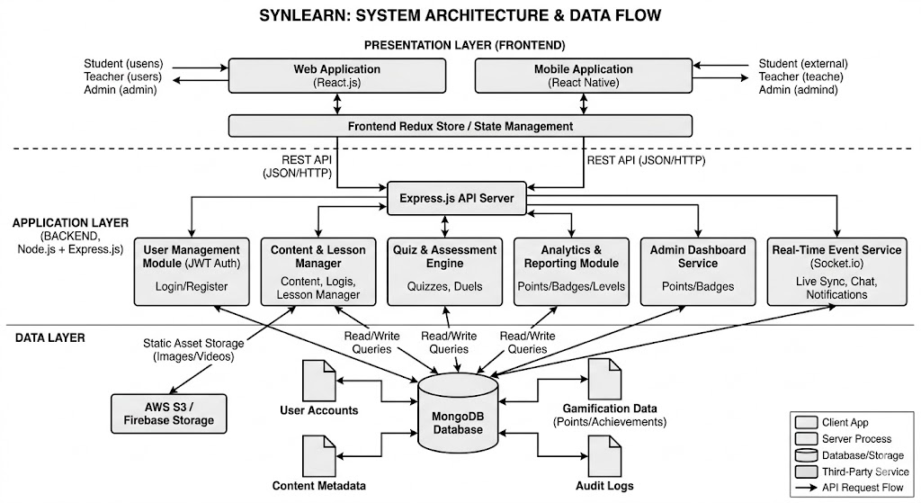
Flow Diagram

Slide 11
System Testing and Results
Authentication Testing
JWT-based login and registration functionalities were tested successfully for students, teachers, and administrators.
Quiz and Tournament Testing
Quiz modules, tournaments, missions, and duel systems were tested for score generation, ranking updates, and performance evaluation.
Real-Time Communication Testing
Socket.io implementation was tested successfully for instant notifications, leaderboard synchronization, and live quiz duels.
Database and API Testing
MongoDB database integration and backend APIs were tested for efficient data storage, retrieval, and system scalability.
Overall Result
The platform successfully delivered an interactive, scalable, and real-time gamified learning environment with secure authentication and efficient performance.

Slide 12
Performance Analysis
System Performance
The platform efficiently handled multiple concurrent users with low response time and stable real-time synchronization.
User Engagement Improvement
Gamification elements such as badges, tournaments, achievements, and leaderboards increased student participation and interaction.
Real-Time Communication Efficiency
Socket.io enabled fast notification delivery, instant score updates, and live duel synchronization with minimal latency.
Database Performance
MongoDB provided flexible and scalable storage for quizzes, lessons, achievements, analytics, and educational resources.
Cross-Platform Accessibility
The system successfully supported both web and mobile environments using React.js and React Native technologies.

Slide 13
Future Enhancements
Future Enhancements
Artificial Intelligence–Based Learning Recommendations Implementation of AI-driven personalized learning suggestions and adaptive quiz generation systems.
AR/VR Educational Environment Integration of immersive AR/VR-based learning experiences for interactive education.
Voice Assistant and Chatbot Integration Development of voice-enabled assistants and chatbot systems for better communication and accessibility.
Advanced Analytics Dashboard Implementation of advanced performance visualization and predictive analytics modules.
Offline Learning Support Support for offline educational content access and synchronization mechanisms.
Cloud-Based Scalability Enhancements Deployment optimization for handling large-scale concurrent educational environments.

Slide 14
Github Link
https://github.com/dhanaraj99/SyncLearn_Gamified_learning_platform.git

Slide 15


